Slide 1

Design of Asalaus
Building
An-Najah National University
Faculty of Engineering
Civil Engineering Department
Prepared by:
1. Maher Barii.
2. Mustafa Rabay’a.
3. Motasem Allan
4.Yousef Ibraheem
Supervised by: Dr. Monther Dyab

Slide 2
Outline:
CH.1:Introduction.
CH.2:Preliminary Design.
CH.3:Static Design.

Slide 3
Chapter 1 :
Introduction

Slide 4
Introduction:
  Asalaus building is located in Muta street in Nablus, near Al-RAWDA college, it consists of one basement floor, one ground floor, and 6 repeated floors with an area 178 m² for every apartment.
  The basement story is used as parking, the second story is used as chamber and the above 6 stories used as residential apartments (two apartments per floor) .
  soil bearing capacity = 300kN/m²

Slide 5
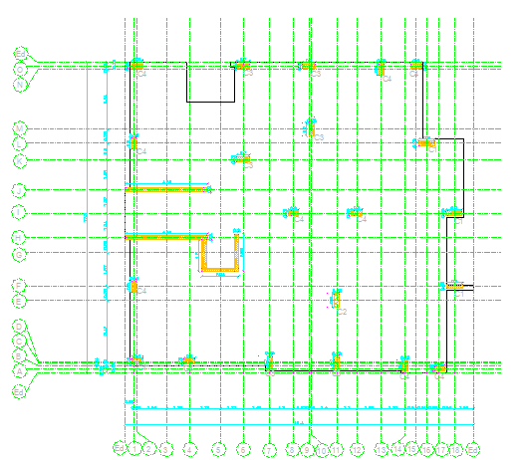
Previous Columns Centers Plan :

Slide 6
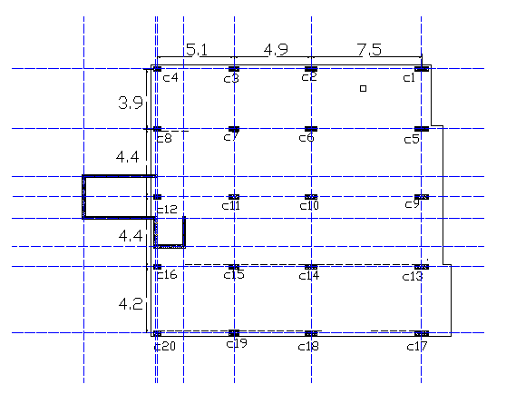
Columns Centers Plan in
Graduation project 1

Slide 7
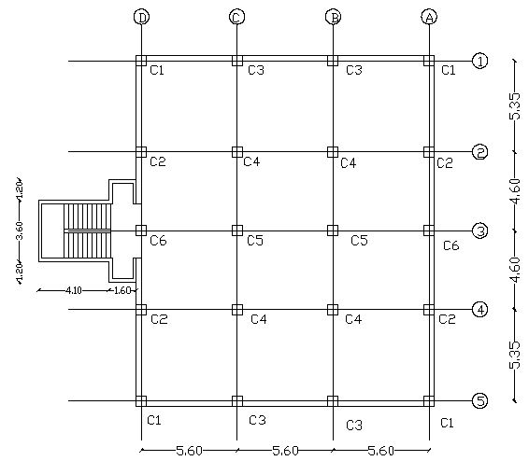
Columns Centers Plan in
Graduation project 2

Slide 8
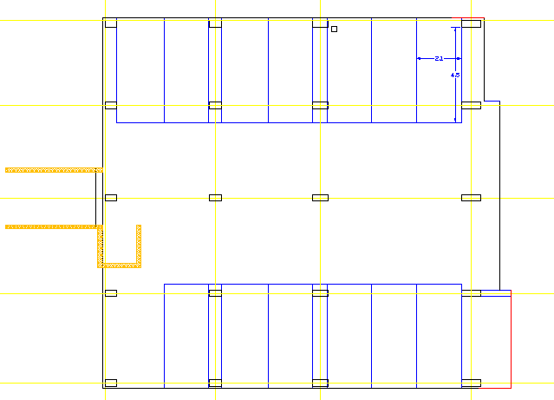
Parking distribution:

Slide 9
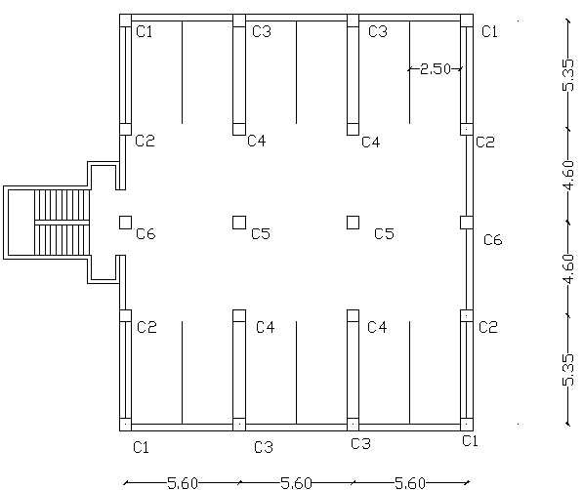
Parking distribution:

Slide 10
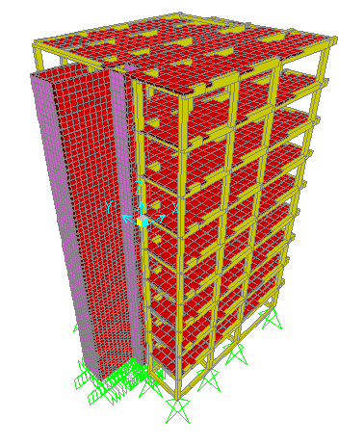
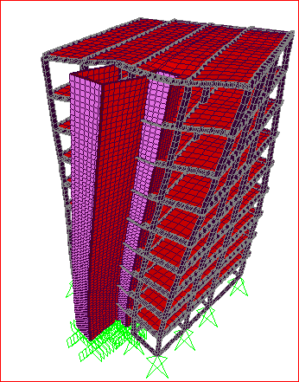
3D model from graduation project 1

Slide 11
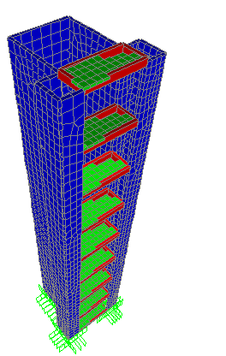
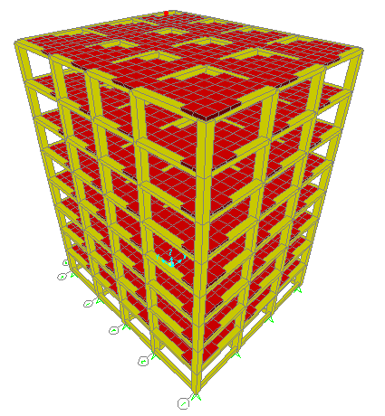
3D model graduation project 2

Slide 12
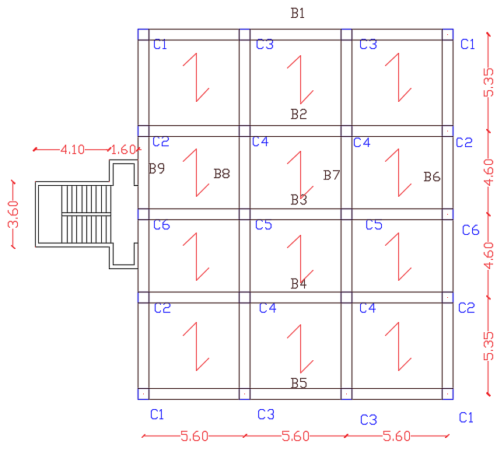
Structural Systems :
One way solid slab in y-direction:

Slide 13
Materials:
Concrete :
f’c= 280 kg/cm²( 28 MPa.)
Concrete unit weight = 25 (kN/m³).
Reinforcing Steel: The yield strength of steel is equal to 4200 Kg/cm² (420 MPa).
Others :
Material | Unit weight (kN/m³)
Reinforced concrete | 25
Plain concrete | 23
Sand | 18
Aggregate | 17
Blocks | 12
Masonry stone | 27
Tile | 27

Slide 14
Design loads :
Dead loads in addition to slab own weight
Superimposed dead load = 3.5 kN/m²
Live load = 3 kN/m² (for residential stories).

Slide 15
Design codes and load combinations:
The following are the design codes used :
ACI 318-08 : American Concrete Institute provisions for reinforced
concrete structural design.
IBC-2009: International Building Code.

Slide 16
:Load Combination
Wu=1.4 D
Wu=1.2 D +1.6 L
Wu=1.2D.L +1.0L.L ±1.0E
Wu=0.9 D ±1.0 E

Slide 17
Chapter 2 :
Preliminary Design

Slide 18
Preliminary design
story height = 3.25m.
One way solid slab:
- depth = 22cm (based on deflection criteria) .
- Slab Own weight:
γconcrete= 24.525 kN/m³
Own weight = (0.22*1*1) X 24.525=5.395kn/m².
Own weight=5.4kN/m²
Ultimate gravity load =15.48 kN/m².

Slide 19
Preliminary Design
beam dimension:
All beams : 35 cm depth x 60 cm width.
Tie beams :60 cm depth x30cm width.
column dimension:
All columns are (60x60)cm.

Slide 20
Preliminary design and checks
Footing :
(Service load / bearing capacity) ≤ 60% area of the building .
we choose single footings.

Slide 21
Chapter 3 :
Design Process

Slide 22
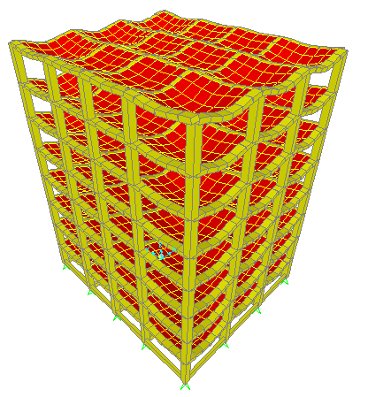
Verification Of SAP model:
We perform the verification for SAP models( one and eight stories and it was OK) the following is verification for eight stories :
1. Compatibility satisfied :

Slide 23
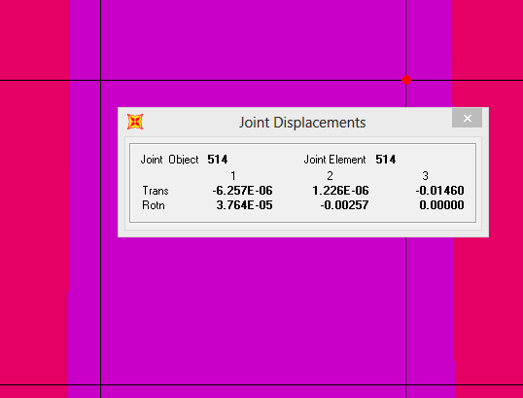
-2.Deflection check:
Allowable deflection=L/240=5350/240=22.3mm>14.6mm >> ok

Slide 24
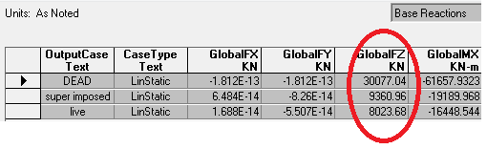
-3.Equilibrium Satisfied :

Slide 25
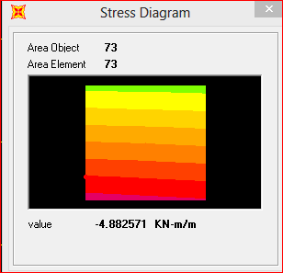
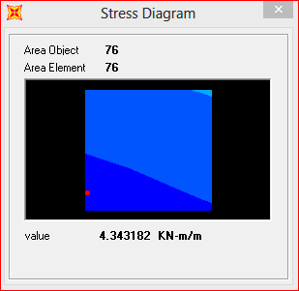
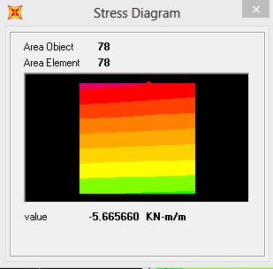
4.Stress -Strain relationship satisfied
From live load:
Mu=wl²/8=3*5.35^{^2}/8=10.73kn.m.
(5.66+4.88)/2+4.34=9.61kn.m.
%different =10.73-9.61/10.61=10% ok.

Slide 26
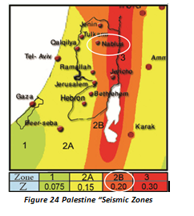
Zone 2 ➔Z= 0.2 (the building is in Nablus region) ➔Framing type: sway intermediate.

Slide 27
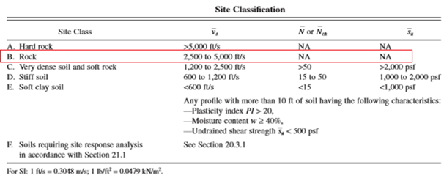
Site Classification:

Slide 28
Site coefficient
Ss: The mapped spectral accelerations for short periods
S1: The mapped spectral accelerations for 1-second periods
Ss=2.5*Z=2.5*0.2=0.5
S1=1.25*0.2=0.25
Fa :Site coefficient for Ss Fa=1
Fv: Site coefficient S1 Fv=1

Slide 29
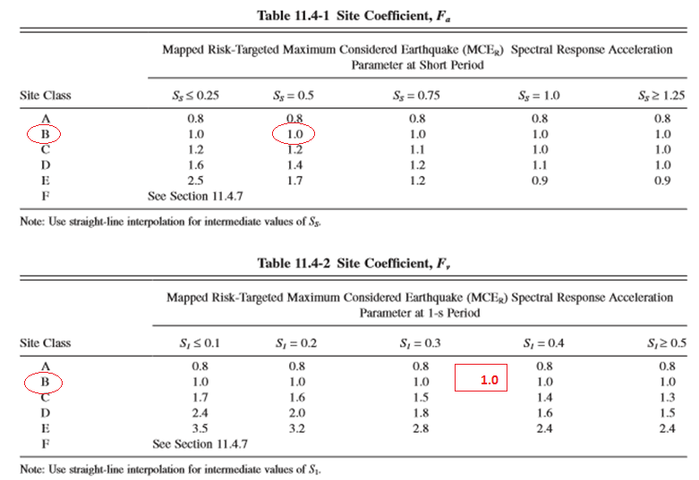
Site coefficient

Slide 30
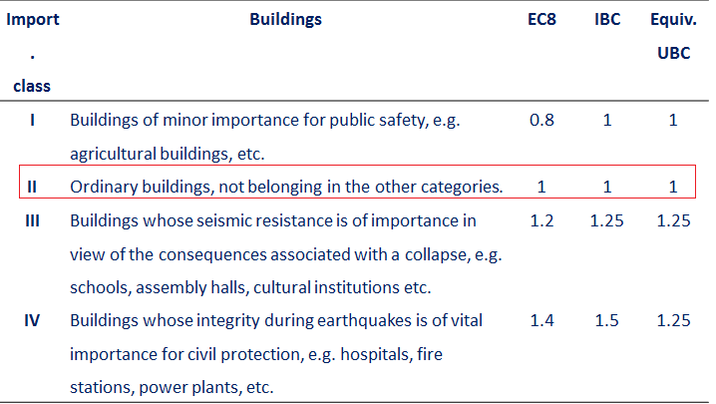
Importance classes and importance factors
I = 1 (Non-essential building).

Slide 31
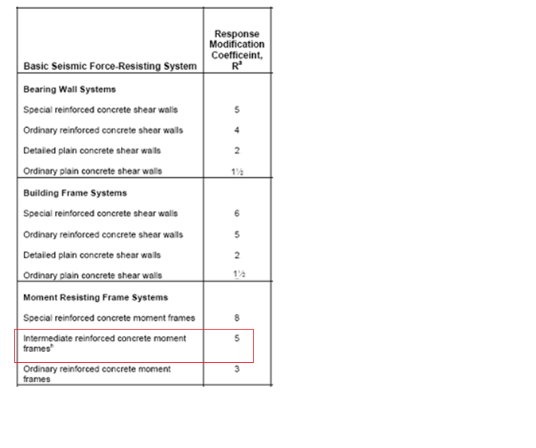
● Response acceleration calculation :
S_{MS}=F_{a*}S_{S}=1*0.5=0.5
S_{M1}=F_{v*}S₁=1*0.25=0.25
Response Modification Factor:
R = 5

Slide 32
    Period: for eight storeys
Manually
The value of T shall be determined from one of the following methods:
Method A:
T_{a}=C_{t}h_{n}^{x} h_{n=3.25*8=26}
_{Ta=.047*(26)}^{.9}
T_{a}=0.9 second
C_{t} =0.047 for moment resisting frame systems of reinforced concrete

Slide 33
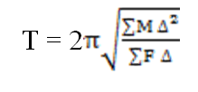
Period calculation
Method B:
Rayleigh’s formula is used to find the value of the period:
Where:
M = Mass of each storey.
F= Force at each storey.
∆= Horizontal displacement for each storey.

Slide 34
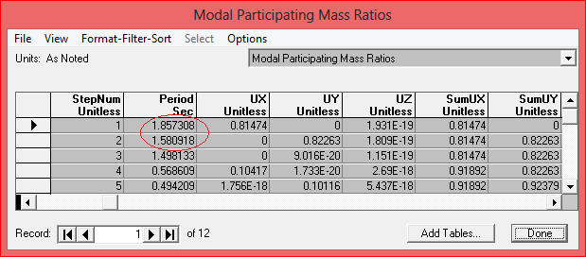
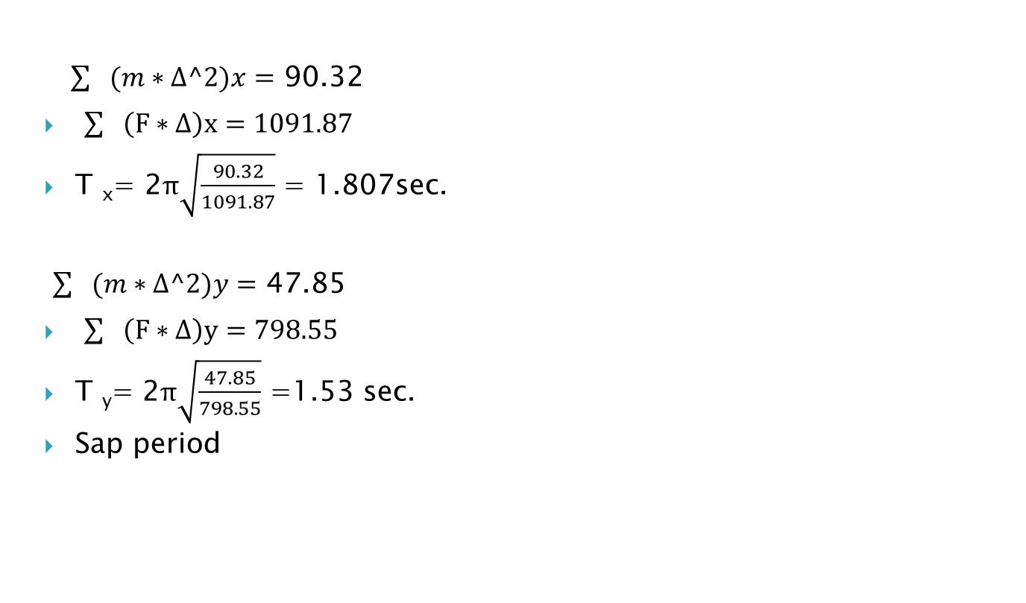
Period calculation
$\sum{(m∗∆^2})x=$ 90.32
$\sum{\left(F∗∆\right)x=1091.87}$
T _{x}= 2$π\sqrt{\frac{90.32}{1091.87}}$ = 1.807sec.
$\sum{(m∗∆^2})y=$ 47.85
$\sum{\left(F∗∆\right)y=798.55}$
T _{y}= 2$π\sqrt{\frac{47.85}{798.55}}$ =1.53 sec.
Sap period

Slide 35
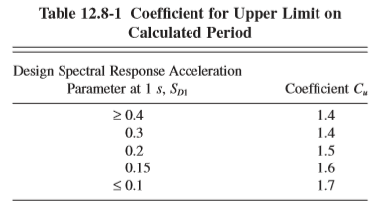
S_{D1}=S_{M1}=0.25 so C_{u}=1.45
T_{a}=0.9
T_{computed in} x=1.807> T_{a}* C_{u}=0.9*1.45=1.305 sec
T_{computed in} y=1.53> T_{a}* C_{u}=0.9*1.45=1.305 sec
So we use T_{a}* C_{u}=1.305
0.01< C_{s} = 0.044S_{DS}I ≤ S_{D1}I/TR ≤ S_{DS}I/R
In x and ydirection C_{s}:
0.01< C_{s} = 0.044*0.5*1≤ 0.25*1/1.305*5≤ 0.5*1/5
0.022≤0.0383≤0.1 so C_{s}= 0.0383
Base Shear, V_{x}=V_{y} = C_{s}W=0.0383*42790.54kn=1639.5 kn

Slide 36
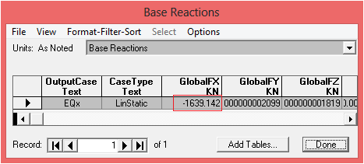
to ensure that work true we define earthquqke IBC in x direction and read base reaction from sap

Slide 37
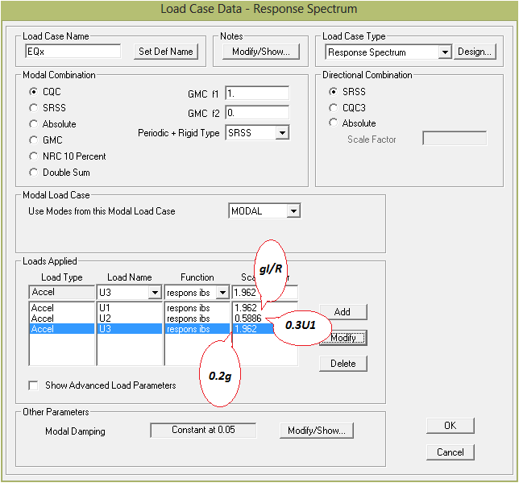
Response spectrum in X-direction.

Slide 38
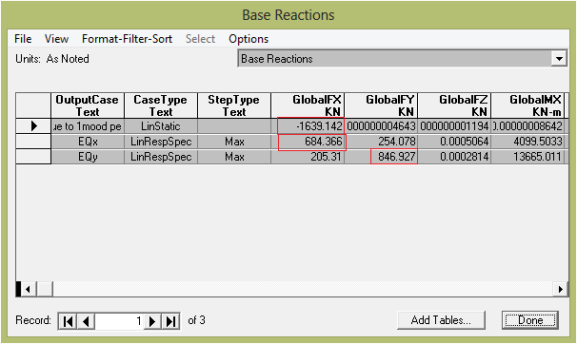
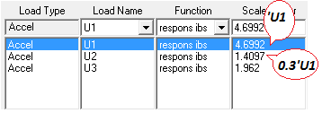
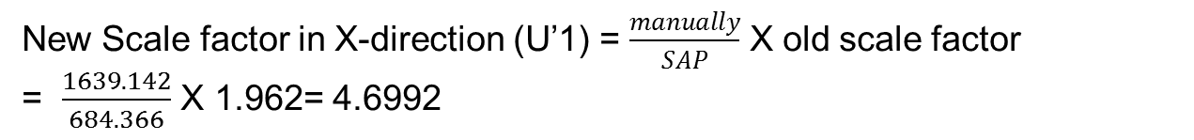
Modified scale factor in X-direction.
New Scale factor in X-direction (U’1) = $\frac{manually}{SAP}$ X old scale factor
= $\frac{1639.142}{684.366}$ X 1.962= 4.6992

Slide 39
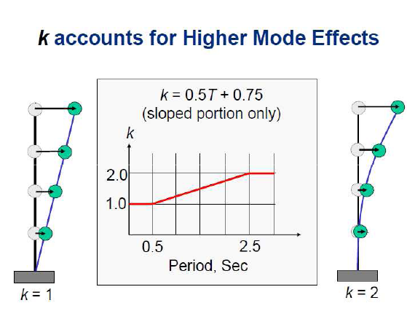
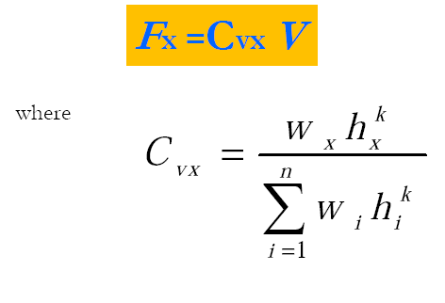
Vertical distribution of seismic loads
The seismic force at any level is a portion of
the total base shear

Slide 40
Chapter Four:
Design Result

Slide 41
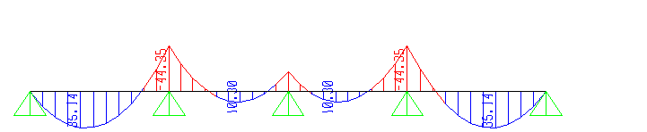
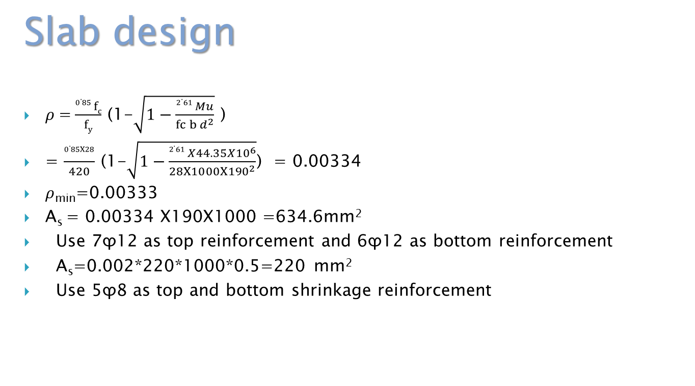
Slab design
$ρ$=$\frac{0.85 fc}{fy}$ (1-$\sqrt{1−\frac{2.61 Mu}{fc b d^{2}}}$ )
= $\frac{0.85X28}{420}$ (1-$\sqrt{1−\frac{2.61 X44.35X{10}^{6}}{28X1000X{190}^{2}}}$) = 0.00334
$ρ$_{min}=0.00333
A_{s} = 0.00334 X190X1000 =634.6mm²
Use 7ϕ12 as top reinforcement and 6ϕ12 as bottom reinforcement
A_{s}=0.002*220*1000*0.5=220 mm²
Use 5ϕ8 as top and bottom shrinkage reinforcement
Moment diagram in slab

Slide 42
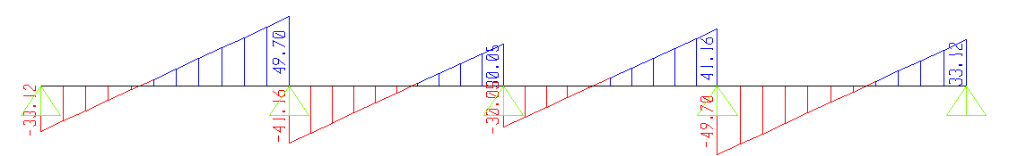

Slab design
Shear Check:
b_{w}= 1 m
d=0.19m
h=0.0.22m
$Ø$ V_{c} =$\frac{1}{6}Ø\sqrt{fc} b d= \frac{1}{6}∗0.75∗\sqrt{28 }∗1000∗\frac{190}{1000}=$191KN
V_{u}=3*50=150kN< $Ø$ V_{c}
>>>>OK
shear diagram in slab

Slide 43
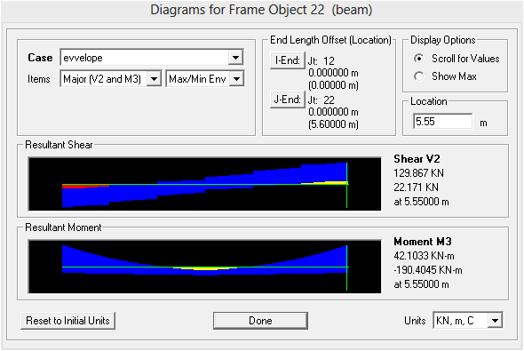

Design Of Beams :
Beam design (take B5 as a sample):
$ρ$=$\frac{0.85 fc}{fy}$ (1-$\sqrt{1−\frac{2.61 Mu}{fc b d^{2}}}$ )
= $\frac{0.85X28}{420}$ (1-$\sqrt{1−\frac{2.61 X190X{10}^{6}}{28X600X{350}^{2}}}$)
= 0.007297
$ρ$_{min}=0.00333
A_{s} = 0.007297 X320X600
=1401mm².
>>>> Use 7ϕ14

Slide 44
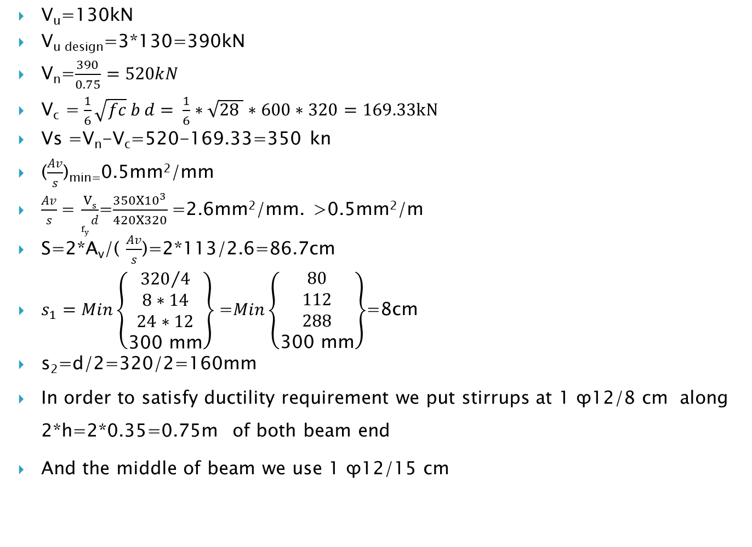
Design Of Beams:
V_{u}=130kN
V_{u design}=3*130=390kN
V_{n}=$\frac{390}{0.75}=520kN$
V_{c} =$\frac{1}{6}\sqrt{fc} b d= \frac{1}{6}∗\sqrt{28 }∗600∗320=169.33kN$
Vs =V_{n}-V_{c}=520-169.33=350 kn
($\frac{Av}{s}$)_{min=}0.5mm²/mm
$\frac{Av}{s}$= $\frac{Vs}{f_{y }d}$=$\frac{350{X10}^{3}}{420X320}$=2.6mm²/mm. >0.5mm²/m
S=2*A_{v}/( $\frac{Av}{s}$)=2*113/2.6=86.7cm
$s_{1}=Min\left\{\begin{aligned}{320}/4 \\ 8∗14 \\ 24∗12 \\ \text{300 }\text{mm}\end{aligned}\right\}$=$Min\left\{\begin{aligned}80 \\ 112 \\ 288 \\ \text{300 }\text{mm}\end{aligned}\right\}$=8cm
s₂=d/2=320/2=160mm
In order to satisfy ductility requirement we put stirrups at 1 ϕ12/8 cm along 2*h=2*0.35=0.75m of both beam end
And the middle of beam we use 1 ϕ12/15 cm

Slide 45
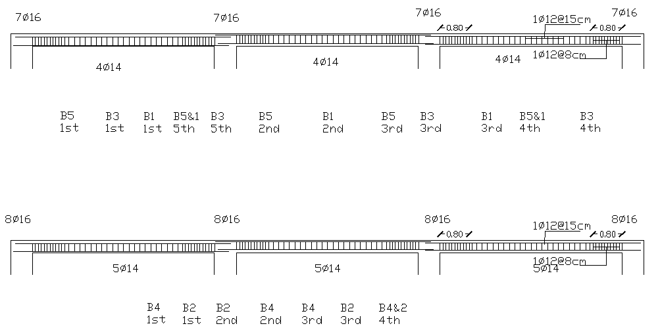
Design Of Beams:
Reinforcement for beams :

Slide 46
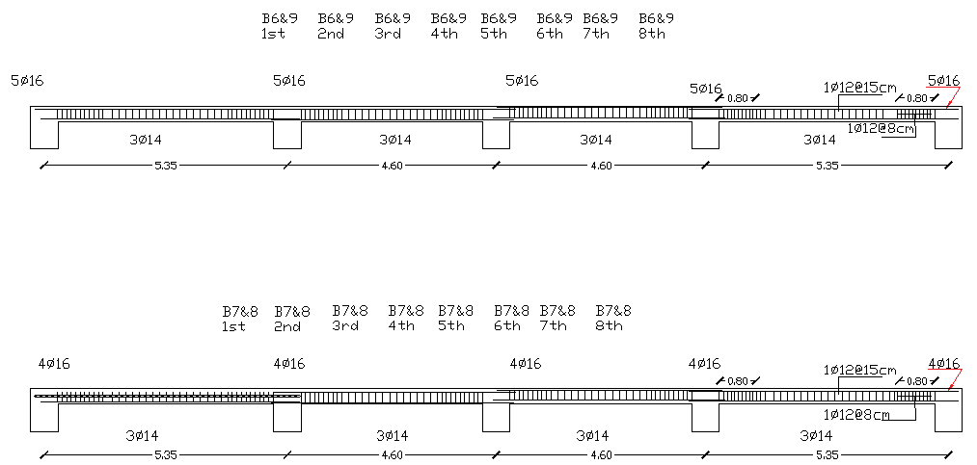
Design Of Beams:
Reinforcement for beams :

Slide 47
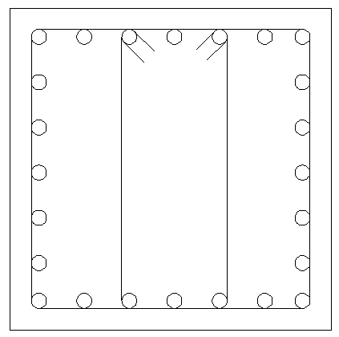
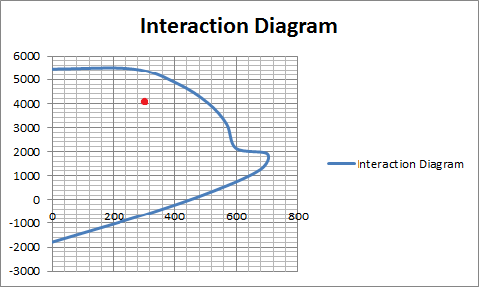
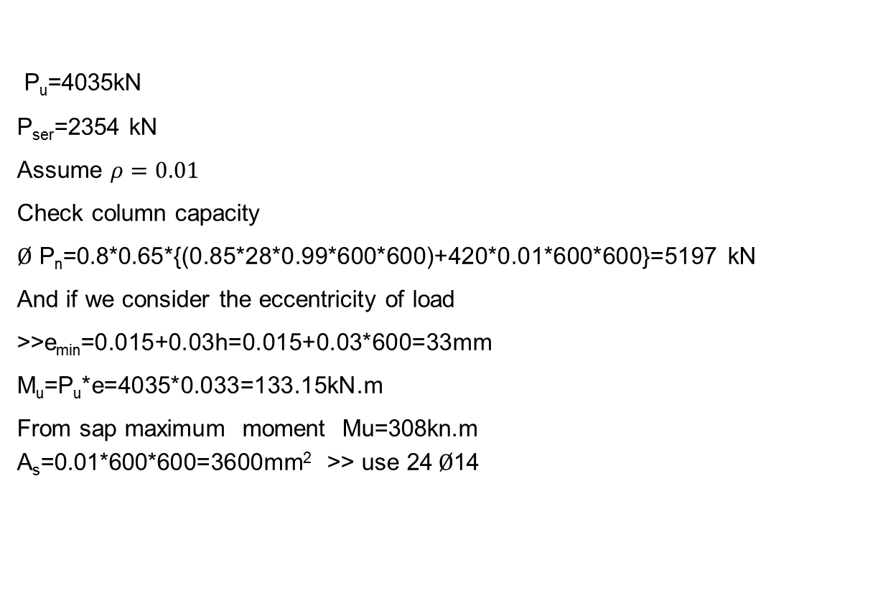
Design of columns:
Manual design(C4)
P_{u}=4035kN
P_{ser}=2354 kN
Assume $ρ=0.01$
Check column capacity
$Ø$ P_{n}=0.8*0.65*{(0.85*28*0.99*600*600)+420*0.01*600*600}=5197 kN
And if we consider the eccentricity of load
>>e_{min}=0.015+0.03h=0.015+0.03*600=33mm
M_{u}=P_{u}*e=4035*0.033=133.15kN.m
From sap maximum moment Mu=308kn.m
A_{s}=0.01*600*600=3600mm² >> use 24$Ø$14
column interaction diagram

Slide 48
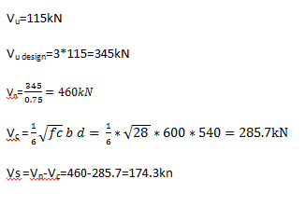
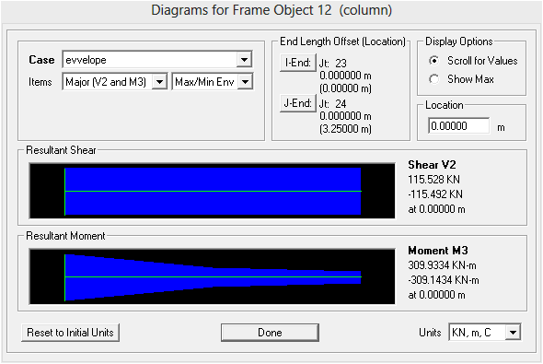
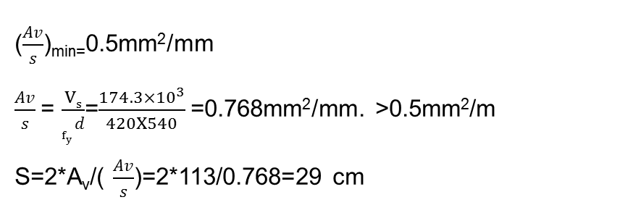
Column shear design
Design of columns:
($\frac{Av}{s}$)_{min=}0.5mm²/mm
$\frac{Av}{s}$= $\frac{Vs}{f_{y }d}$=$\frac{174.3×{10}^{3}}{420X540}$=0.768mm²/mm. >0.5mm²/m
S=2*A_{v}/( $\frac{Av}{s}$)=2*113/0.768=29 cm
maximum shear in column

Slide 49
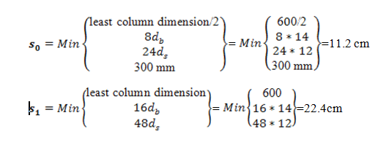
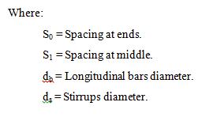
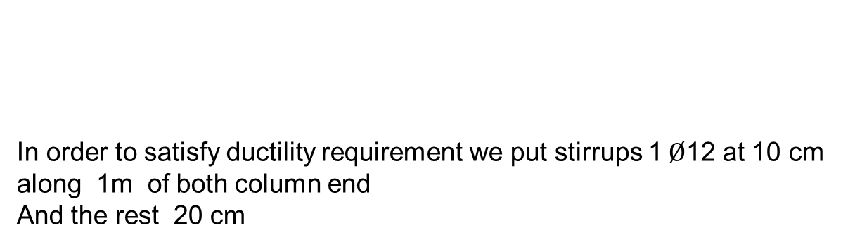
Design of columns:
Max spacing (According to intermediate frame requirements):
In order to satisfy ductility requirement we put stirrups 1$Ø$12 at 10 cm along 1m of both column end
And the rest 20 cm

Slide 50

Design of columns:
Longitudinal section in column

Slide 51

Design of columns:

Slide 52
Footing design
Single Footing :
Bearing capacity of the soil=300 kN/m².
thickness of single footing:
thickness of mat will be determined based on punching shear and wide beam shear.

Slide 53



Footing design
P_{u}=4035 kN
P_{ser}=2354kN
A_{f}=$\frac{2354}{300}$=7.840m²
B=L=$\sqrt{7.846}$=2.8m
q_{u}=4035/7.840=514.66
q_{u}=515kn/m²
Wide beam shear check
b_{w}=2.8m
d=0.6m
h=0.65m
$Ø$ V_{c} =$\frac{1}{6}Ø\sqrt{fc} b d= \frac{1}{6}∗0.75∗\sqrt{28 }∗2800∗\frac{600}{1000}$
$Ø \text{V}\text{c}=$1111.2 KN
V_{u}=515*((2.8-0.6)/2-0.6)*2.8=721kN
>>>>OK
Footing Sample design (F4 as a sample):

Slide 54

Footing design
punching shear check
b₀=4*(0.6+d)=4*( 0.6+0.6)=4.8m
$Ø$ V_{c} =$\frac{1}{3}Ø\sqrt{fc} b d= \frac{1}{3}∗0.75∗\sqrt{28 }∗4800∗600/1000=$3809.9KN
V_{u}=4035-(0.6+d)*(0.6+d)*515=4035-(0.6+0.6)*(0.6+0.6)*515=3293.4
>>>>OK
Flexural design
M_{u}=WL²/2= 515*((2.8-0.6)/2)²/2=311.575kN.m/m
$ρ$=$\frac{0.85fc}{fy}$ (1-$\sqrt{1−\frac{2.61 Mu}{fc b d^{2}}}$ )= $\frac{0.85X28}{420}$ (1-$\sqrt{1−\frac{ 2.61X311.575X{10}^{6}}{28X1000X{600}^{2}}}$) = 0.00234 < $ρ$_{min}=0.00333
>>>> use $ρ$_{min}
A_{s} = 0.0033 X1000X600 =1980mm². >>>>>Use 10ϕ16/m
Top steel reinforcement
A_{shr.}=0.0018*650*1000=1170mm²
0.5*1170=585mm² >>>> Use 4ϕ14

Slide 55
Footing Design:
Col. # | Service load of column(kN) | Area of footing(m²) | Dimension chosen for footing [(B=L)/m] | Footing thickness (mm) | Steel ratio |  | Area of steel (mm²) | Botom Reinforcement #Φ16/m | Top steel Reinforcement #Φ14/m
1 | 1410 | 4.84 | 2.2 | 400 |  | 0.0033 | 1155 | 6 | 3
2 | 1868 | 6.25 | 2.5 | 500 |  | 0.0033 | 1485 | 8 | 3
3 | 1960 | 6.76 | 2.6 | 550 |  | 0.0033 | 1650 | 9 | 4
4 | 2354 | 7.84 | 2.8 | 650 |  | 0.0033 | 1980 | 10 | 4
5 | 2144 | 7.29 | 2.7 | 600 |  | 0.0033 | 1815 | 10 | 4
6 | 1721 | 5.76 | 2.4 | 500 |  | 0.0033 | 1485 | 8 | 3

Slide 56

Shear wall Design:

Slide 57
Thanks for your attention

