Slide 1

An-Najah National University
Civil Engineering Department
Graduation Project
3-D Dynamic Structural Design For “Mecca Commercial” Building
Prepared By:
Samir Mizyed
Muhammad Jarrar
Osama Massarweh
Osama Qashou
Supervised by:
Dr. Abd Al-Razaq Touqan

Slide 2
Table of contents:
Chapter One: Abstract and Introduction
Chapter Two: Preliminary Design
Chapter Three: Static Design
Chapter Four: Dynamic Analysis
Chapter Five: Soil Structure Interaction

Slide 3
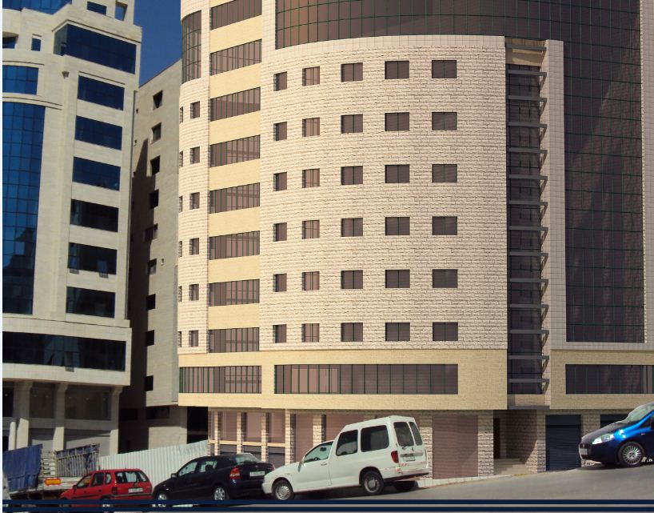

Slide 4
Chapter One:
Abstract and Introduction
a) The “Mecca Commercial Building” is located in Nablus city, consists of nine floors and will be used primarily as offices and commercial stores.
b) The project will include a detailed design of all structural elements in the building such as slabs, beams and columns.
c) It will include a 3D-designed model for the whole building.

Slide 5
Methodology and Design Codes
A 3D static model will be used for analysis and design considering dead and live loads.
Moreover, hand calculations will be used for some elements for verification of the model.
In order to determine required loads and structural elements dimensions according to loads we will use these codes:
a) ACI 318-08 Code for design.
b) IBC-2009 for loads.
c) ASCE 7-05, 2006 for minimum loads.

Slide 6
Materials
Concrete:
For beams and slabs: compressive strength (f’c) = 28MPa
For columns: f’c = 35MPa
Unit weight of reinforced concrete = 24.5 KN/ m³.
Steel:
Yielding strength (Fy) = 420 MPa
Modulus of elasticity (E) = 200GPa
Non structural elements:
Unit weight(KN/m³) | Material
23 | Plain concrete
17 | Filler material
12 | Blocks
27 | Masonry stone
27 | Tiles

Slide 7
Loads and Computer Programs:
Super-imposed Dead Load = 4KN/m²
Live Load = 3KN/m²
Load combinations in ACI Code are:
U1=1.4D
U2=1.2D+1.6L
Computer Programs:
For analysis and design processes we will use SAP 2000(version 14.2.4).

Slide 8
Chapter Two:
Preliminary Design
In this chapter we will design structural elements of the building as a preliminary design. This design is based on determinants such as shear and bending.
In this project, the slab system to be used is a one way ribbed slab with hidden beams.

Slide 9
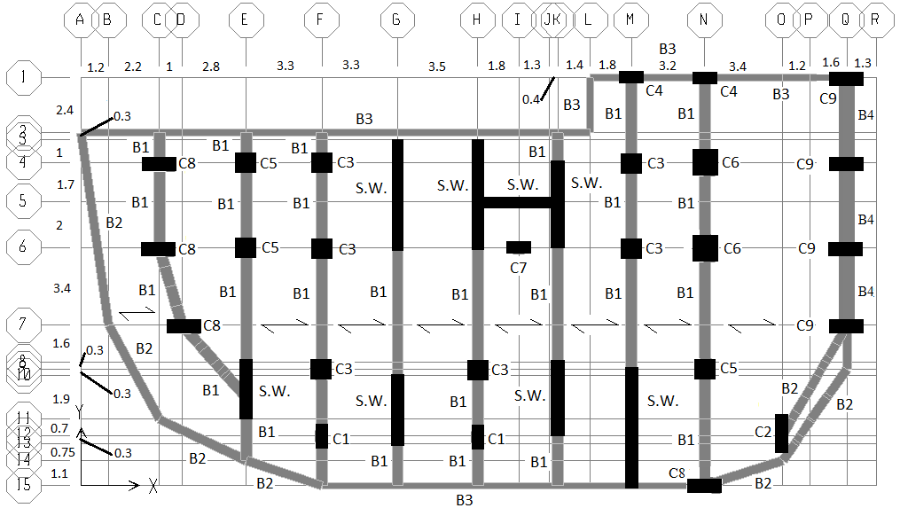
The figure below shows the distribution of beams, columns and shear wall (note: all shear walls are 0.3m thick):

Slide 10
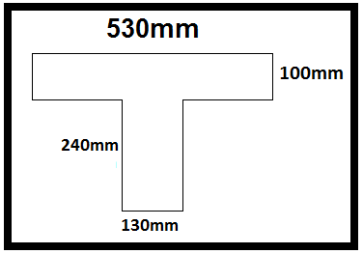
Preliminary Design of Slab
The thickness of the slab based on the most critical span and using the ACI code (table 9.5(a)) was found to be 0.34m.
The figure below shows the dimensions of the rib:

Slide 11
Preliminary Design of Slab
Rib own weight=3.25KN\m.rib (6.14KN\m² )
W_{D} =O.W.+S.I.=6.14+4=10.14KN\ m²
W_{L} =3KN\ m²
W_{U} =1.2D+1.6L=17KN\ m²
W_{U} =9KN/m.rib

Slide 12
The column dimensions are as follows:
Column | Section Name (On SAP) | No. of columns | Depth (m) | Width (m)
C1 | col 0.3*0.6 | 2 | 0.3 | 0.6
C2 | col 0.3*1.5 | 1 | 0.3 | 1.5
C3 | col 0.5*0.5 | 6 | 0.5 | 0.5
C4 | col 0.6*0.3 | 2 | 0.6 | 0.3
C5 | col 0.6*0.6 | 3 | 0.6 | 0.6
C6 | col 0.7*0.7 | 2 | 0.7 | 0.7
C7 | col 0.8*0.3 | 1 | 0.8 | 0.3
C8 | col 1.5*0.3 | 4 | 1.5 | 0.3
C9 | col 1.65*0.3 | 4 | 1.65 | 0.3

Slide 13
The beams dimensions are as follows:
Beam | Section Name (On SAP) | Depth (m) | Width (m)
B1 | Beam0.5*0.34 | 0.34 | 0.5
B2 | Beam0.4*0.34 | 0.34 | 0.4
B3 | Beam0.3*0.34 | 0.34 | 0.3
B4 | Beam0.8*0.34 | 0.34 | 0.8

Slide 14
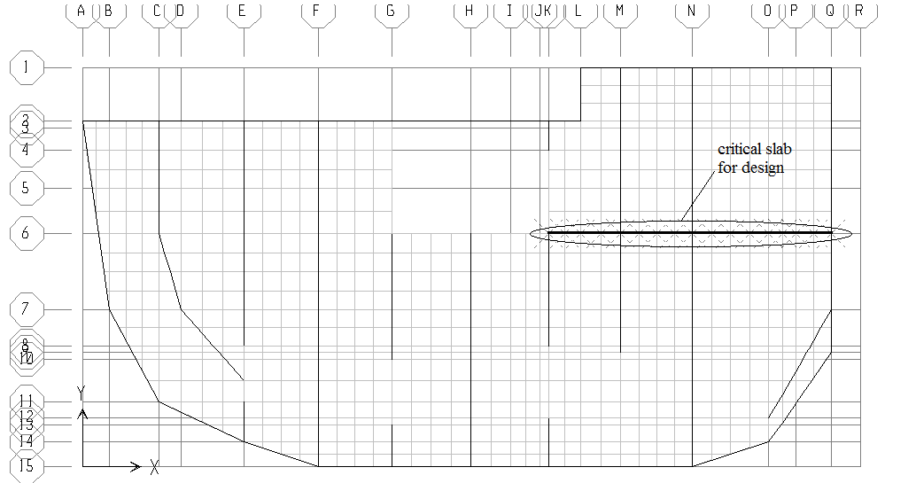
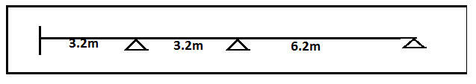
Critical Strip for Slab
The location of the critical strip is as shown below:

Slide 15
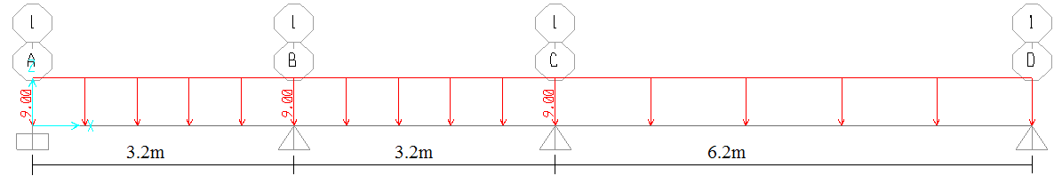
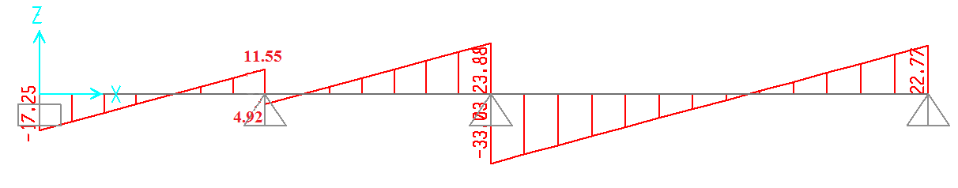
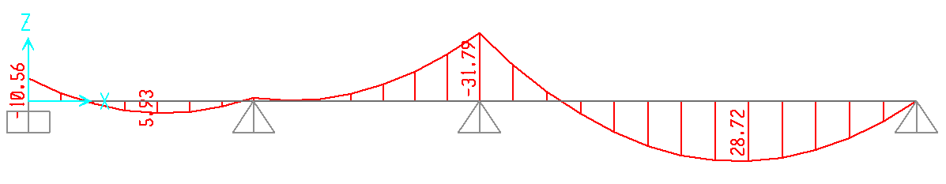
1D Analysis of Critical Strip Using SAP
The load distribution, shear and moment diagrams for the critical strip are as shown below:

Slide 16
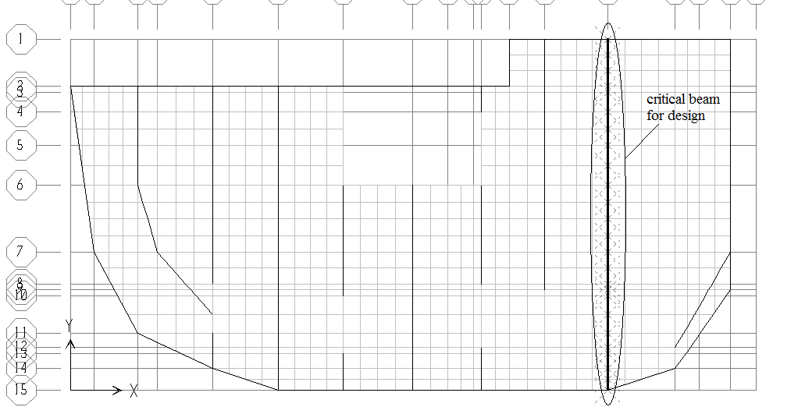
Critical Beam
The location of the critical beam is as shown below:

Slide 17
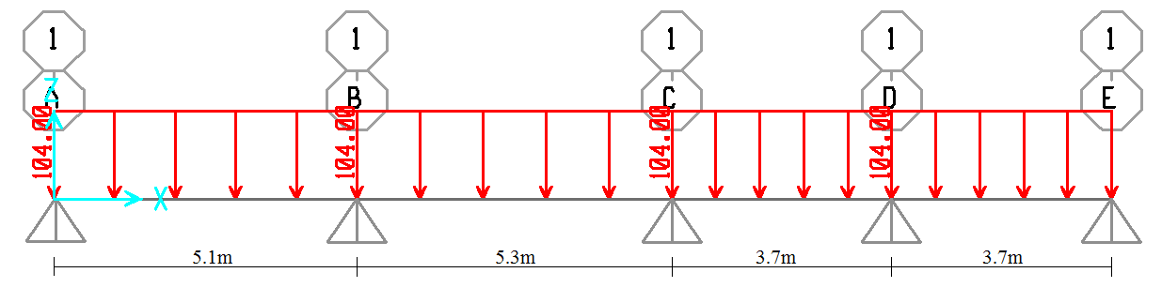
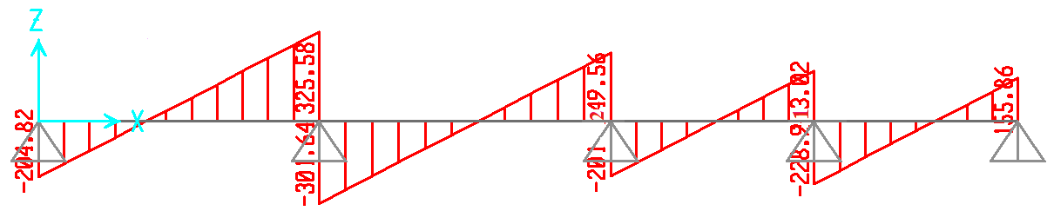
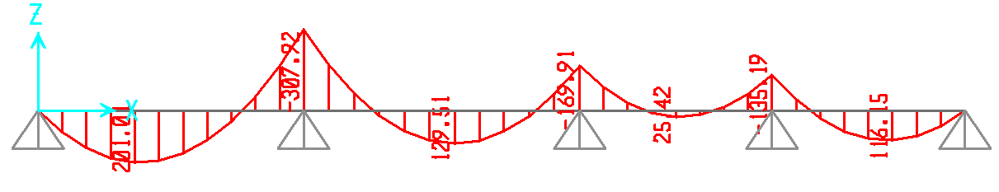
1D Analysis of Critical Beam Using SAP
The load distribution, shear and moment diagrams for the critical strip are as shown below:

Slide 18
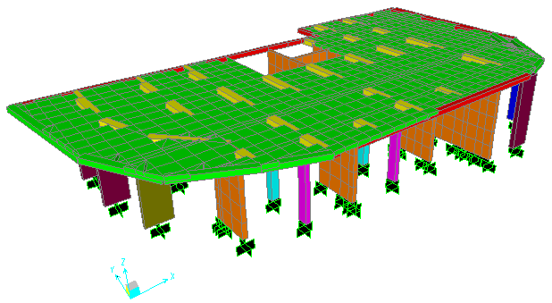
SAP 3D Analysis
Below is the 3d model of the structure:

Slide 19
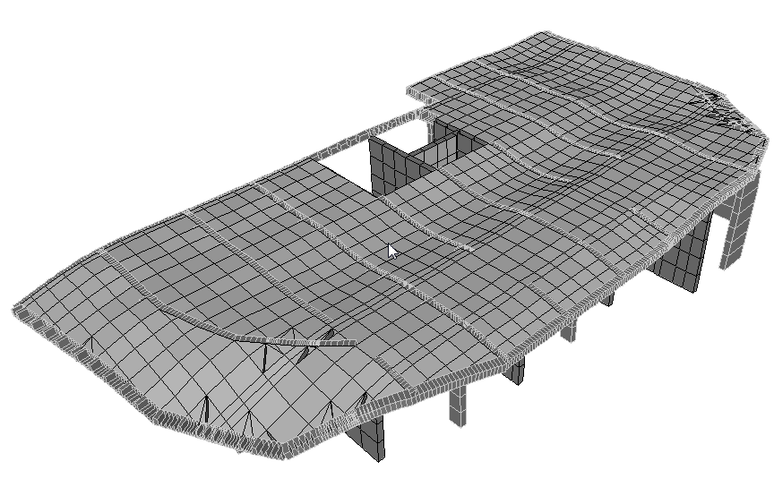
Preliminary Checks
Compatibility:
As shown below, the structure moves together:

Slide 20
Preliminary Checks
Equilibrium:
Area of Slab = 462 m²
Total live load from slab = 3 * 462 = 1386KN
Total superimposed dead load from slab = 4 * 462 = 1848KN
Total volume of structure = 210.725m³
Total dead load = total volume* unit weight of concrete =210.725*25=5268KN
From the table from SAP we see that we are okay.
OutputCase | CaseType | GlobalFX | GlobalFY | GlobalFZ
 |  | KN | KN | KN
DEAD | LinStatic | -2.988E-12 | -6.025E-12 | 5078.649
Si | LinStatic | -2.261E-12 | -3.741E-12 | 1847.662
live | LinStatic | -1.69E-12 | -2.734E-12 | 1385.747
ult 1 | Combination | -9.114E-12 | -1.619E-11 | 10528.769

Slide 21
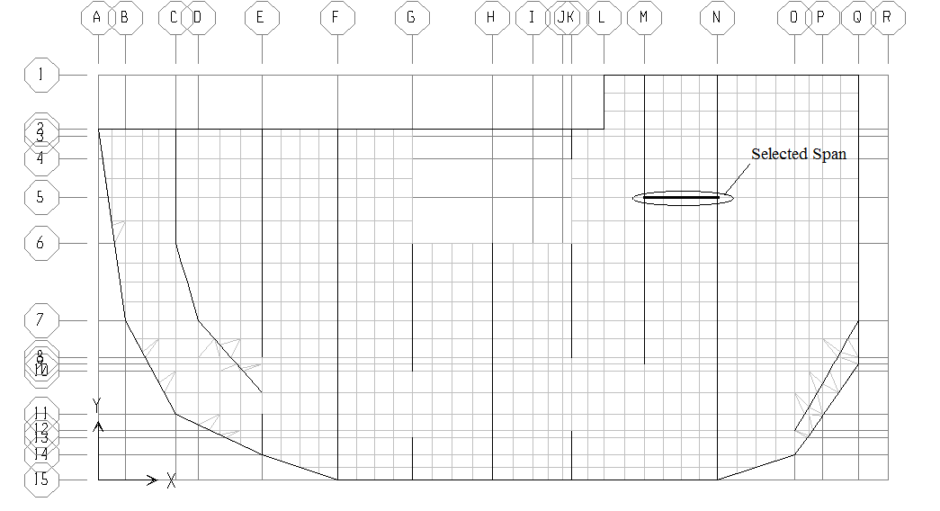
Preliminary Checks
Stress strain relationships:
We take the middle span of our selected slab:

Slide 22
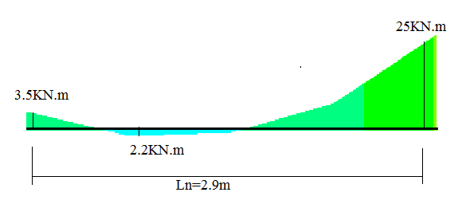
Preliminary Checks
Based on the moment on the span as shown:
From our 1d analysis (width of both beams on the edges is 0.5m):
W_{u}L_{n}²/8 = 17 * (3.2-0.5)²/8 = 15.5KN.m
From 3d analysis:
(3.5+25)/2 + 2.2 = 16.45KN.m
%error = (16.45-15.5)/16.45 = 5.8% < 10%, this means we are okay.

Slide 23
Comparing 1D with 3D
From the SAP 3d model we found that the results for shear and moment for both the selected beam and slab varied significantly.
This tells us there are problems in the assumption made for 1-d analysis (for example, we assumed that the flexural strength of the beams is very high, which is not the case, especially considering that these are hidden beams).
Since our 3-d model is much closer to reality then 1-d we use the values we got from 3-d analysis for the design of slabs, beams and columns.

Slide 24
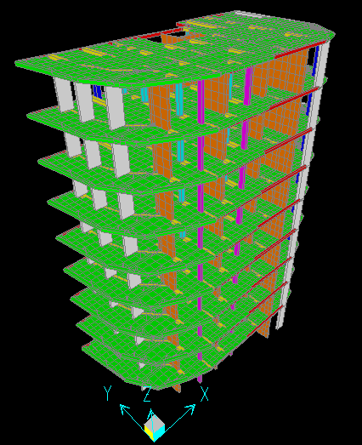
Chapter Three:
Before designing for reinforcement we checked all the floors of the structure to make sure all the beams and columns were safe

Slide 25
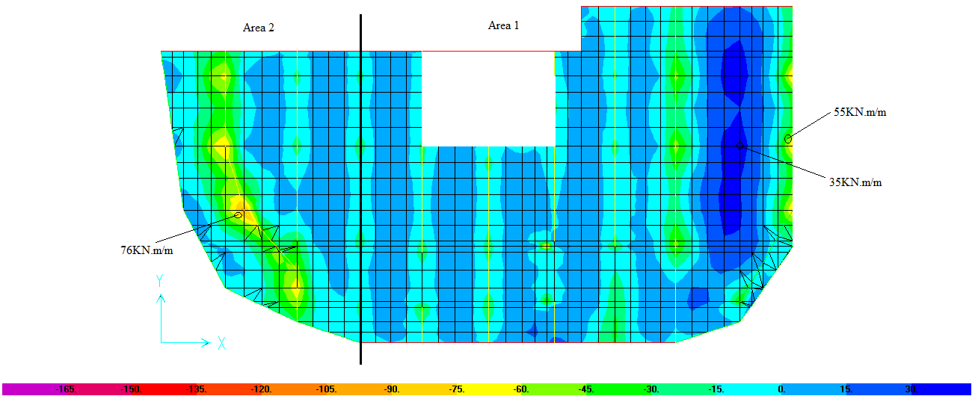
Slab Design
Below is the distribution of the moment on the slab:

Slide 26
Slab Design
We divided the slab into two different areas of reinforcement:
Area 1:
a) Negative Moment:
d = 310mm, b_{f} = 530mm, b_{w} = 130mm
M_{u}⁻ = 55Kn.m/m (from SAP)
M_{u}⁻ = 55 * 0.53 = 29.2KN.m (moment per rib)
From these values we find that As = 264mm²/rib, which is greater than
A_{smin} = 133mm²/rib, so we take it.
Use 2Ф14mm/rib.
b) Positive Moment:
Applying the same laws we get A_{s} = 160mm²/rib, so we use 2Ф12mm/rib
Area 2:
a) Negative Moment:
A_{s} = 374mm²/rib
Use 2Ф16mm/rib
b) Positive Moment:
Use 2Ф12mm/rib

Slide 27
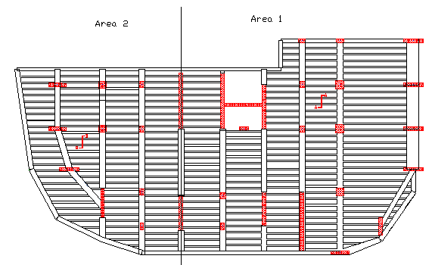
Slab Design
The figure below shows the distribution of ribs on the slab:

Slide 28
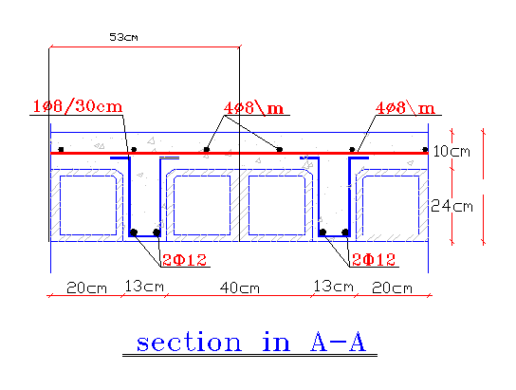
Slab Design
Below is the reinforcements for sections A-A from the previous figure:

Slide 29
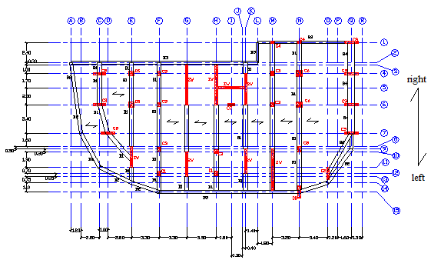
Beam Design
The figure below shows all the beams we are going to design for:

Slide 30
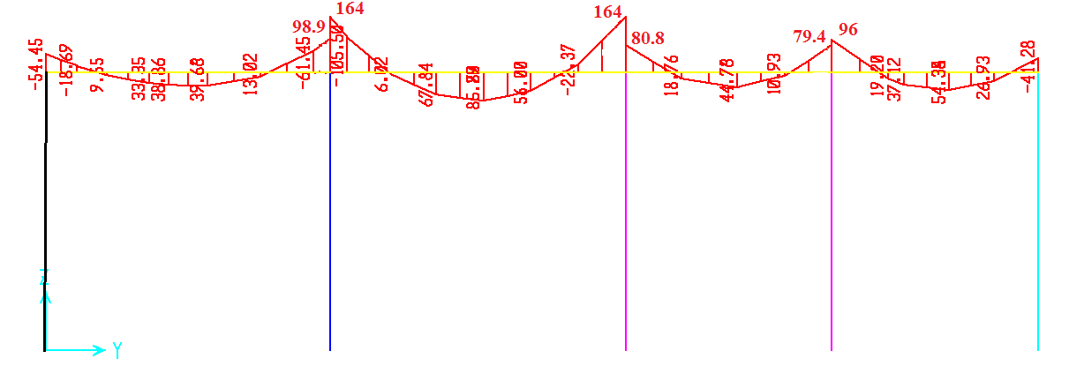
Beam Design
We will take the beams on grid line N (the critical beams) as sample calculations.
Below are the moment values for the beams:

Slide 31
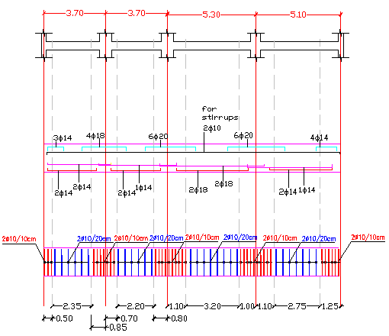
Beam Design
The figure below shows the reinforcement for the selected beams:

Slide 32
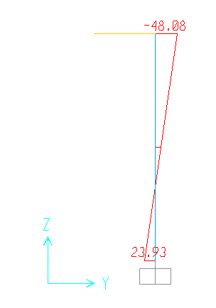
Column Design
First off we take the most critical column to check for slenderness. This is col 0.3*0.6 (the one with the smallest dimensions) located on grid line N. The figure below displays the moment distribution on the column:
We found that K*L_{u}/r > 34 – 12(M₂/M₁), so we have a long column.
From calculations: ρ = 0.01, meaning the area of steel required is 1% of area gross
This is the same for all other columns in the building, whether long or short.

Slide 33
Column Design
The table below shows reinforcement for various columns:
Column Name | Column Name (SAP) | Width (mm) | Depth (mm) | Area (mm^2) | Area of steel (mm^2) | Longitudinal Reinforcement | Stirrup Reinforcement
C1 | col 0.3*0.6 | 300 | 600 | 180000 | 1800 | 6φ20 | 1φ10\200mm
C2 | col 0.3*1.5 | 300 | 1500 | 450000 | 4500 | 18φ18 | 5φ10\200mm
C3 | col 0.5*0.5 | 500 | 500 | 250000 | 2500 | 8φ20 | 2φ10\200mm
C4 | col 0.6*0.3 | 600 | 300 | 180000 | 1800 | 6φ20 | 1φ10\200mm
C5 | col 0.6*0.6 | 600 | 600 | 360000 | 3600 | 12φ20 | 3φ10\200mm
C6 | col 0.7*0.7 | 700 | 700 | 490000 | 4900 | 18φ18 | 5φ10\200mm
C7 | col 0.8*0.3 | 800 | 300 | 240000 | 2400 | 8φ20 | 2φ10\200mm
C8 | col 1.5*0.3 | 1500 | 300 | 450000 | 4500 | 18φ18 | 5φ10\200mm
C9 | col 1.65*0.3 | 1650 | 300 | 495000 | 4950 | 18φ18 | 5φ10\200mm

Slide 34
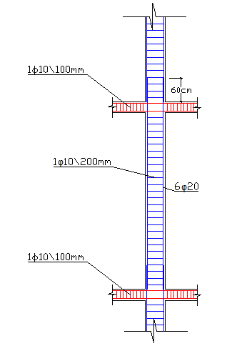
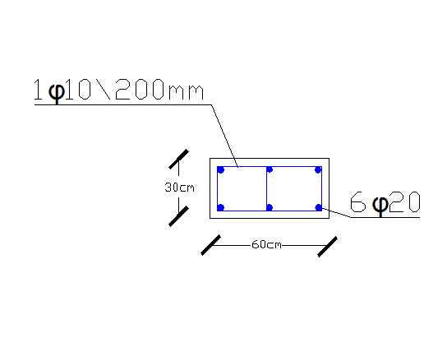
Column Design
Below is a sample of column reinforcement for column of dimensions 0.3*0.6:

Slide 35
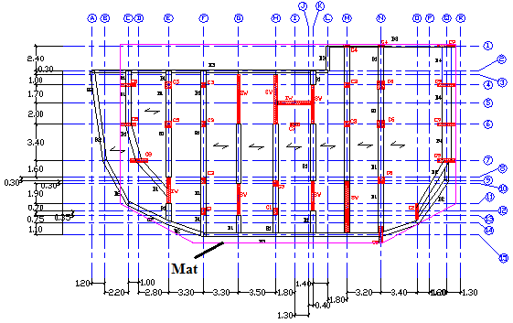
Foundation Design
The figure below displays our proposed mat:

Slide 36
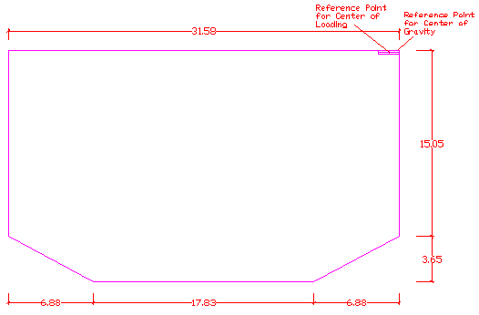
Foundation Design
Below are the dimensions of the mat and the reference points:

Slide 37
Foundation Design
To calculate the required depth we took the critical ultimate load from corner, edge and internal columns as well as shear walls (all of which are internal) as shown below:
We will take the depth as 900mm and the thickness of the mat as 1m.
We will then replace the fixed supports on SAP with a slab and springs to represent the mat and soil. This changed the loads on the columns slightly, but not enough to change the depth.
Type | Service Load (KN) | Ult. Load (KN) | Depth (mm)
Corner | 1257 | 1572 | 792.97
Edge | 2724 | 3470 | 883.60
Internal | 3114 | 4009 | 633.17
SW | 5528 | 6980 | 835.46

Slide 38
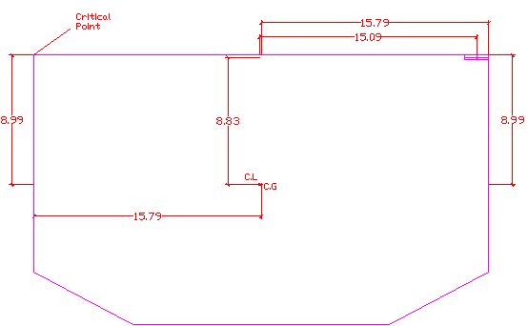
Foundation Design
We found the center of gravity (by dividing the area into rectangles and triangles) and the center of loading (by taking the load from each column on the mat) to be as follows:

Slide 39
Foundation Design
The table below shows the stress on the critical point which is less than the allowable stress (200KN/m²), so we are okay.
Xp (m) | 15.09
Xg (m) | 14.96
Yp (m) | 8.83
Yg (m) | 8.84
ex (m) | 0.01
ey (m) | -0.13
P total (KN) | 74695.00
A total (m²) | 565.36
Mx (KN.m) | 845.63
My (KN.m) | -9357.66
Ix (m^4) | 15454.05
Iy (m^4)) | 44419.40
Cx (m) | 8.99
Cy (m) | -15.79
Mx*Cx/Ix (KN/m²) | 0.49
My*Cy/Iy (KN/m²) | 3.33
(P/A) total (KN/m²) | 132.12
Stress (KN/m²) | 135.94
𝛔
KNm²

Slide 40
Foundation Design
Next we check for punching shear for all the critical columns:
Taking the corner column as a sample:
ϕV_{c} = 2313.5KN > P_{u} = 1472KN
As we can see all the loads are less than the allowable, which means we are okay.
The depth required is 856mm but we keep it 900mm.
Type | Ult. Load (KN) | Depth (mm) | Width (m) | Length (m) | Punch. Shear width (m) | Punch. Shear length (m) | Allowable load (KN)
Corner | 1472 | 767.33 | 0.3 | 1.65 | 0.75 | 2.1 | 2313.53
Edge | 3264 | 856.97 | 0.3 | 1.5 | 1.2 | 1.95 | 4250.40
internal | 4027 | 634.59 | 0.7 | 0.7 | 1.6 | 1.6 | 7619.76
SW | 6893 | 830.24 | 0.3 | 4.95 | 1.2 | 5.85 | 9411.06

Slide 41
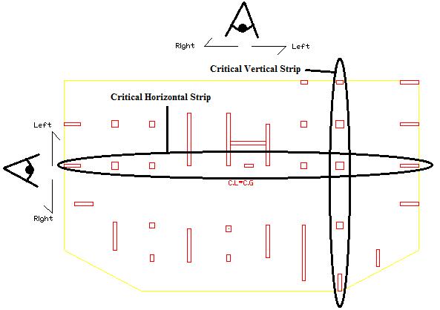
Foundation Design
For reinforcement we will take a critical vertical and horizontal strip. We found that in most locations a minimum reinforcement of 6φ20/m was enough.

Slide 42
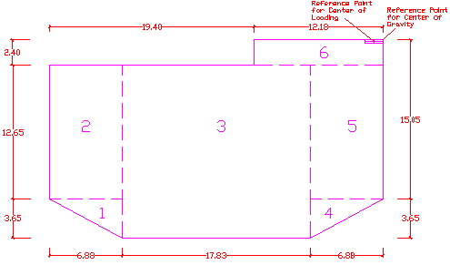
Foundation Design
The figures on this slide and the following show other options:
1) Removing the area below the driveway. This will save us concrete.
Max stress = 187.95KN/m², so we are okay

Slide 43
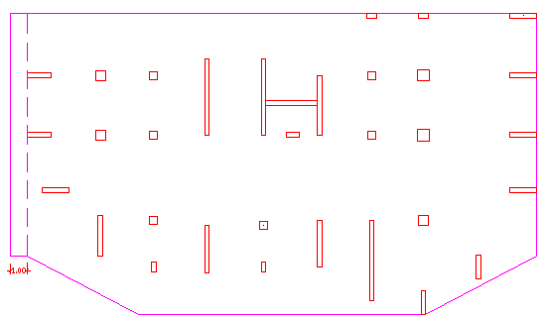
Foundation Design
2) Extending the mat to the left. Since the critical column was found to be an edge column we can extend the mat a 1m distance on that side, so that the column becomes an internal column. This will reduce the required depth for the entire mat

Slide 44
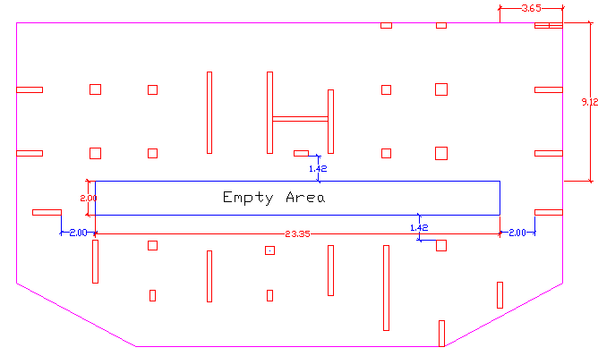
Foundation Design
3) Removing a portion of the mat in the center. This is similair to option 1, but here the shape will be more symmetrical giving us less eccentricity and thereby reducing to stress, which will be 149KN/m²

Slide 45
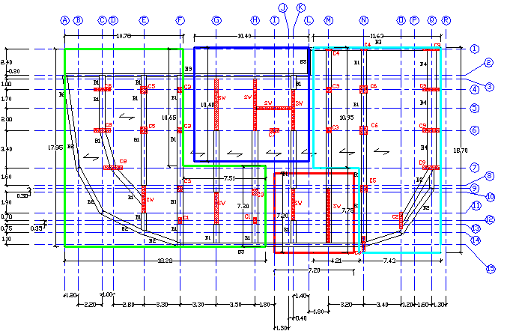
Foundation Design
4) Four mat plan. So that one column won’t decide the entire depth, we will divide the foundation into four mats, each with a different depth (stress at critical point for all of them was found to be okay).

Slide 46
Foundation Design
Options 3 and 4 were found to be the best. Option 4 saved us the most concrete but option 3 is easier to implement in reality.
It all depends on the desires of the owner, whether he wants to save cost or save time and effort.
It should be noted that the reason we have only been looking at how much each option saves concrete is because in all cases we mostly use minimum steel reinforcement, meaning the amount of steel does not vary significantly between the different options.

Slide 47
Chapter Four:
So far, we’ve only designed for static loads, but buildings can also be subjected to dynamic loads in the form of earthquakes.
In this chapter we will perform dynamic analysis for the structure using response spectrum function on SAP 14, while doing some hand calculation to make sure SAP is working properly.
We will check the design of the structure to see if it is safe against earthquakes, adjusting the design if necessary.

Slide 48
SAP Verification
We must make sure SAP is working properly. First we find how many modes needed to achieve a Modal Load Participation ratio of more than 90% in all 3-directions to ensure reliability in the accuracy of the structure modal.
This is achieved after 525 modes as shown in the table below:
OutputCase | Item | Dynamic
Text | Text | Percent
MODAL | UX | 99.1527
MODAL | UY | 97.7255
MODAL | UZ | 90.0665

Slide 49
SAP Verification
Next, we will calculate the period in the x-direction and then compare it to what we get from SAP.
We will assume that the building is completely rigid. Therefore, on SAP we will make temporary changes in the building so that it can behave as rigid structure, because then we can take the slabs as lump masses.
These assumptions include increasing slab thickness to 2m (while adjusting the weight modifier so that the weight remains the same), making the beams very stiff and preventing torsion in columns and shear walls.

Slide 50
SAP Verification
In our hand calculations we will take the building as a 1D structure where the slabs masses are concentrated in one point and all the columns and shear walls for each floor are represented by one column with stiffness equal to the summation of the stiffness of all of them.
Stiffness = 3EI_{y}/L³
We find the total stiffness in the x-direction (Kx) to be 3128600KN/m
Note: for columns and shear walls that have a large width in the x-direction we will also have to add shear stiffness as well (AG/(1.2L))

Slide 51
SAP Verification
Next we will use the Kx calculated previously to find the deflection for each floor and the total period Tx of the structure as shown in the table below:
Floor No. | Force F (KN) |  | Mass M (t) | Deflection δ (m) | Total Deflection ∆ (m) | ∆^2 (m^2) | m*(∆^2) | F*∆
1 | 1053.6 |  | 536.46 | 0.00296 | 0.00296 | 0.0000087 | 0.0047 | 3.115
2 | 1053.6 |  | 536.46 | 0.00262 | 0.00558 | 0.0000311 | 0.0167 | 5.875
3 | 1053.6 |  | 536.46 | 0.00228 | 0.00786 | 0.0000618 | 0.0331 | 8.281
4 | 1053.6 |  | 536.46 | 0.00195 | 0.00981 | 0.0000962 | 0.0516 | 10.331
5 | 1053.6 |  | 536.46 | 0.00161 | 0.01142 | 0.0001303 | 0.0699 | 12.027
6 | 1053.6 |  | 536.46 | 0.00127 | 0.01269 | 0.000161 | 0.0864 | 13.368
7 | 1053.6 |  | 536.46 | 0.00094 | 0.01362 | 0.0001856 | 0.0996 | 14.354
8 | 1053.6 |  | 536.46 | 0.00060 | 0.01422 | 0.0002023 | 0.1085 | 14.985
9 | 821.1 |  | 418.5 | 0.00026 | 0.01449 | 0.0002098 | 0.0878 | 11.894
 |  |  |  |  |  | Sum | 0.5583 | 94.231

Slide 52
SAP Verification
Notes:
1)Force = ma. We take a as 0.2g.
2)For the first eight floors the weight will equal the slab plus half the weight of the columns and shear walls above and below it, while the for the top floor the weight will equal the slab plus half the weight of the columns below it. Therefore for the first eight floors we have F₁ = 1053.6KN and for the last floor we have F₂ = 821.1KN
Taking the second floor as a sample calculation:
∆₁ = (8F₁+F₂)/Kx = (8*1053.6 + 821.1)/ 3128601.4 = 0.00296m
δ₂ = (7F₁+F₂)/Kx = 0.00262m
∆₂ = ∆₁ + δ₂ = 0.00296 + 0.00262 = 0.00558m

Slide 53

SAP Verification
From SAP we found that mode 1 is primarily in the x-direction (Ux = 78%) and the period is 0.6seconds. This means we have an error of 20%.
However, since this mode is not completely in the x-direction we will for practical reasons accept an error of 25%.
We then removed the rigid assumptions on SAP and tried to calculate the actual Tx. Unfortunately we could not find any mode where the period is mainly in the x-direction.

Slide 54
Response Spectrum
Now that we can are certain of SAP, we can enter the response spectrum and perform a start/check design of structure.
Given the type and location of the building we will take S1 = 0.2seconds, Ss = 0.5seconds from seismic graphs of the middle east, the important factor I = 1 from IBC code and the response modification factor R = 3 (sway ordinary) fro ASCE code.
Scale Factor = I*g/R = 1 * 9.81/3 = 3.27
We also enter the following load combinations:
Ultimate 3 = 1.2*(Dead + si) + 1.4*(Equ-respX) + 1*Live
Ultimate 4 = 1.2*(Dead + si) + 1.4*(Equ-respY) + 1*Live

Slide 55
Response Spectrum
From the base reactions table in SAP, we find that the total force resulted from the earthquake in the x-direction is 953KN and from the y-direction is 1060KN, which is approximately 1.27% and 1.4% respectively of the total service static load from the building (75000KN) in the gravity direction.
We can prove from hand calculations:
%earthquake load (both directions) = SD₁/(R*T₁)*100%
%earthquake load = 0.1333/(3*2.3788)*100% = 1.86%
This is around the value we got from SAP in both cases, which means we are okay.

Slide 56
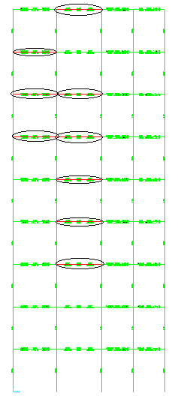
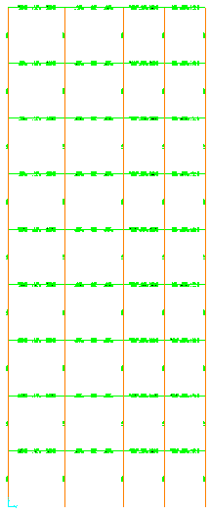

Check of Structural Design
After performing a start/check design of structure we find that there are several beams, all on grid line N, that failed, so we increase their widths to 0.8m instead on 0.5m. We then find that we are okay:

Slide 57
Check of Structural Design
Notes:
The reason why all of these beams highlighted in red are unsafe is because the shear stress due to shear force and torsion together exceeds the maximum allowed value.
We expect the cause as to why this happened is because the loads on these beams are quite large compared to other beams, as these are critical beams.
No failure occurred on the two beams on the right because these beams have much shorter spans and therefore take less load and moment.

Slide 58
Check of Structural Design
Next we check the slabs, columns and beams comparing the previous ultimate moment values we got when we only had dead and live loads (Ult1 = 1.4DL + 1.6LL) to the values we got when we had dead, live and earthquake loads (we have Ultimate 3 = 1.2DL + 1.4EL_{x} + 1LL and Ultimate 4 =1.2DL + 1.4EL_{y} + 1LL ).

Slide 59
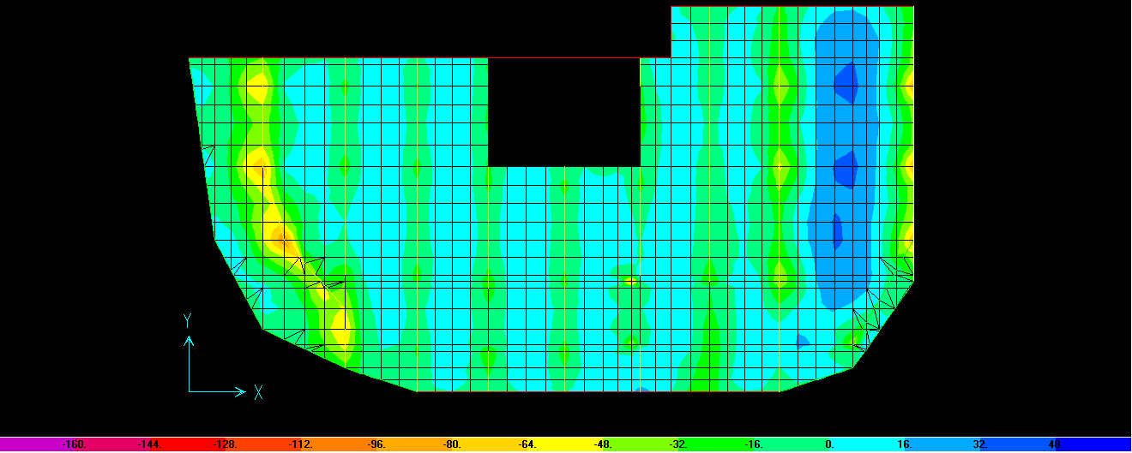
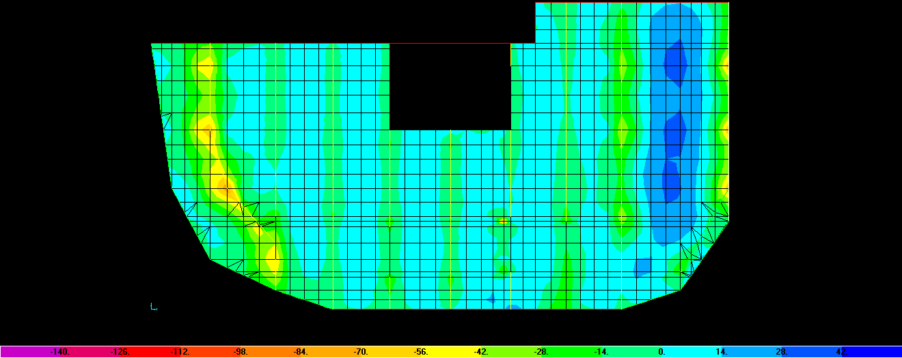

Check of Structural Design
First we take the slabs. For the bottom slab we see that the moment in general actually decreases slightly when there is an earthquake load:
Static Load: Earthquake X:
Earthquake Y:

Slide 60
Check of Structural Design
Checking for other slabs and columns, we see that it is the same case for all of them.
The reason for that is because for load combinations, we reduced the factor for the live load from 1.6 to 1 when there was an earthquake load, which was unable to make up for the difference.
When there is no earthquake load: UL= 1.2DL + 1.6LL
When there is an earthquake load: UL = 1.2DL + 1.4EL + 1LL
(we got these equations from the AC1 code)
This shows that a safe design against static loads can also result is a safe design against earthquakes.
For beams, on the higher up floors we needed additional reinforcement on the edge beams, due to the high deflection in the columns increasing the moment of these beams. The rest of the beams remained the same.

Slide 61
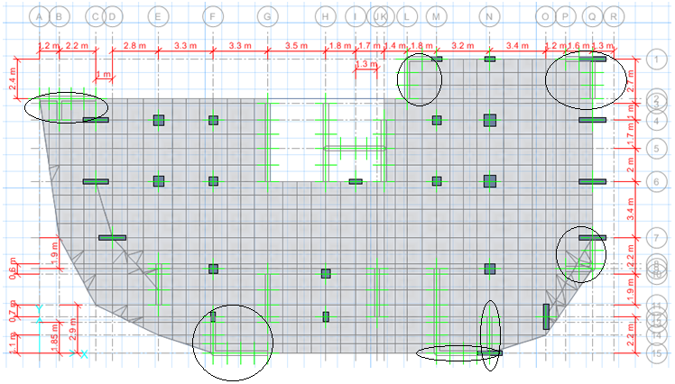
New Design for Structure
A problem in our previous design was for mode 1 it was mainly under torsion, which we are uncertain of. To remove torsion we suggested to add shear walls in the corners as shown below:

Slide 62
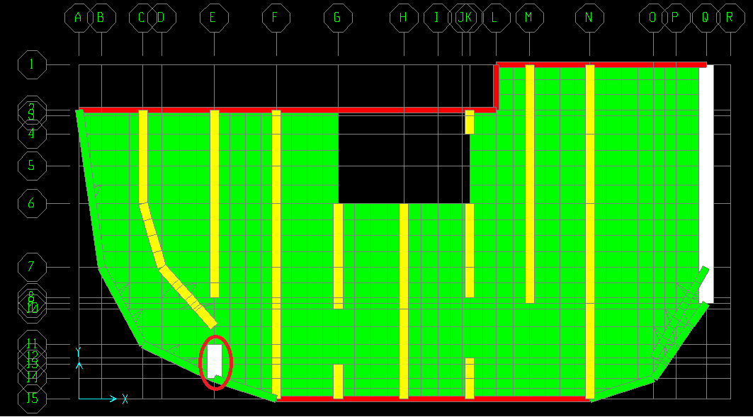
New Design for Structure
This meant that for the fundamental mode, the torsion was reduced significantly, meaning we are more certain of the structural safety. We found though that a cantilever beam on floors 4-roof was unsafe so we increased the width to 0.8 meters:

Slide 63
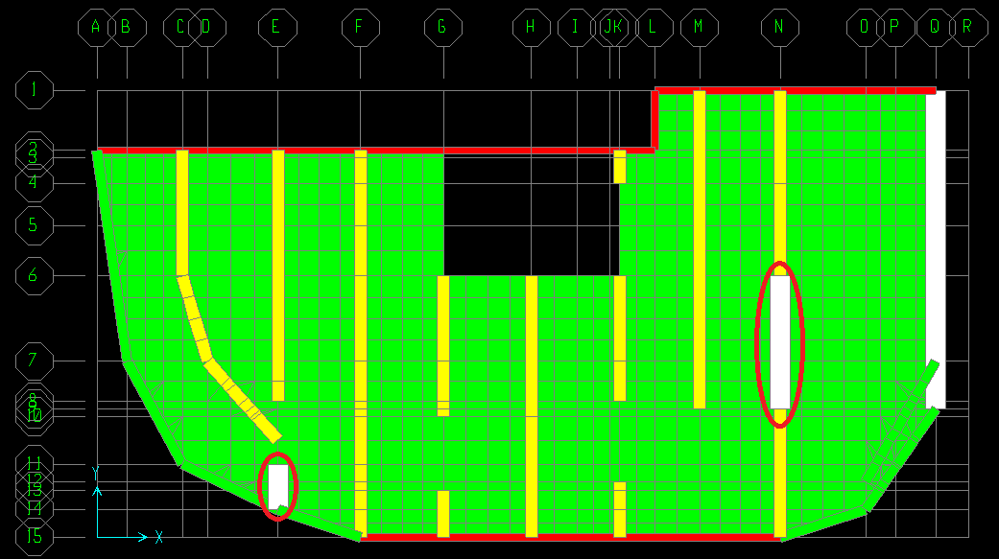
New Design for Structure
Another beam on floor 9 also needed an increase in width (to 0.8m). This is expected as it is a critical beam:
The reason why the beam below it didn’t need adjustment, despite also being a critical beam of similar length is because it is now being carried on a shear wall.

Slide 64
Chapter Five:Soil Structure Interaction
It is a traditional approach to assume infinite rigidity for supports when analyzing and designing the elements of super-structure.
It is also traditional to assume infinite rigidity for super-structure when analyzing and designing the Foundation system.

Slide 65
Sub-grade models
Sub-grade models are mathematical models used to investigate SSI problems and to understand soil behavior under applied loads.
Model | Assumptions
Winkler's Hypothesis | Springs
Filonenko-Borodich | deformed, pretensioned membrane + springs
Pasternak's Hypothesis | shear layer + springs
Pasternak's and Loof's Hypothesis | springs + shear layer + springs
Haber-Schaim | plate + springs
Hetényi | springs + plate + springs
Rhines | springs + plate + shear layer + springs

Slide 66
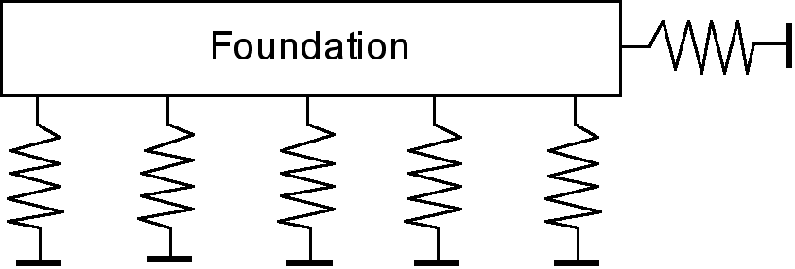
Winkler’s Model:
This is the oldest, simplest and most well known model used for SSI analysis by structural engineers.
It consists of an infinite number of springs on a rigid base.

Slide 67
Analysis of Beam Supported by Springs
The figure below shows the 1D model for the mat:

Slide 68
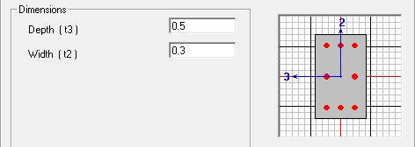
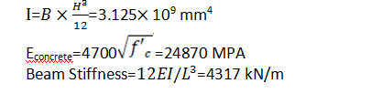
Analysis of Beam Supported by Springs
The beam has a height of 0.5m and a width of 0.3m as shown

Slide 69
k spring/K Beam | k beam | k spring | R 1 | R2 | R2/R1 | R1/W
0.00001 | 4317 | 0.04317 | 40 | 40 | 1 | 0.333
0.023 | 4317 | 99.291 | 41.04 | 39.48 | 0.96 | 0.342
0.05 | 4317 | 215.85 | 42.19 | 38.91 | 0.92 | 0.352
0.1 | 4317 | 431.7 | 44.13 | 37.94 | 0.86 | 0.368
0.2 | 4317 | 863.4 | 47.39 | 36.31 | 0.77 | 0.395
0.3 | 4317 | 1295.1 | 50.02 | 34.99 | 0.7 | 0.417
0.4 | 4317 | 1726.8 | 52.19 | 33.91 | 0.65 | 0.435
0.5 | 4317 | 2158.5 | 54.02 | 32.99 | 0.61 | 0.45
0.6 | 4317 | 2590.2 | 55.57 | 32.22 | 0.58 | 0.463
0.7 | 4317 | 3021.9 | 56.91 | 31.55 | 0.55 | 0.474
0.8 | 4317 | 3453.6 | 58.07 | 30.97 | 0.53 | 0.484
0.9 | 4317 | 3885.3 | 59.01 | 30.5 | 0.52 | 0.492
1 | 4317 | 4317 | 60 | 30 | 0.5 | 0.5
1.1 | 4317 | 4748.7 | 61.18 | 29.41 | 0.48 | 0.51
1.3 | 4317 | 5612.1 | 62.19 | 28.91 | 0.46 | 0.518
2 | 4317 | 8634 | 65.44 | 27.28 | 0.42 | 0.545
3 | 4317 | 12951 | 67.97 | 26.02 | 0.38 | 0.566
5 | 4317 | 21585 | 70.39 | 24.81 | 0.35 | 0.587
6 | 4317 | 25902 | 71.06 | 24.47 | 0.34 | 0.592
8 | 4317 | 34536 | 71.95 | 24.03 | 0.33 | 0.6
9 | 4317 | 38853 | 72.25 | 23.88 | 0.33 | 0.602
10 | 4317 | 43170 | 72.5 | 23.75 | 0.33 | 0.604
1000000 | 4317 | 4.317E+09 | 74.12 | 22.94 | 0.31 | 0.618

Slide 70
Analysis of Beam Supported by Springs
Drawing the relationship between the internal/external beam reactions and the spring/beam stiffness we get the following graph:

Slide 71
Analysis of Beam Supported by Springs
From the graph we can conclude the following:
1- The reactions (displacements) are equal when the ratio of spring over beam stiffness approaches zero.
2- When the ratio of spring over beam stiffness approaches infinity springs behaves as pin supports (with no vertical displacement).
3- When the ratio of spring over beam stiffness approaches infinity, R2/R1 approaches 0.3 which we can get from the analysis of a beam of two equal spans with uniformly distributed load formulas as shown in Figure 5.8 on the next page.
4-The ratio (R2/R1) decreases as Ks/Kb increases .
5- The internal spring takes a load that equals 60% of the total load on the beam (tributary area) when Ks/Kb equals around 10.
6- Using K_{eq}= K_{st}/(1 + (K_{st}/ K_{s})) where K_{s} is soil stiffness and K_{st} is structural stiffness, when K_{s} is very large then equals 0, thus K_{eq=}K_{st.}.

Slide 72
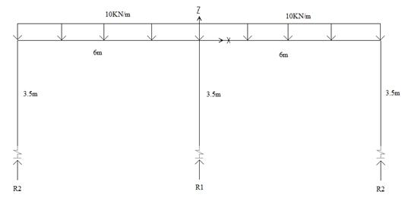
Analysis of frame supported by springs:
The same beam and the same methodology in section 5.5 is used for frame analysis. The only difference is we now have columns of 3.5m height between the beams and springs as shown below:
The table on the next slide shows the effect of spring stiffness on reactions and Moment in external column for column of dimension 0.5*0.3m

Slide 73
K_{s}/K_{b} ratio | K beam | K spring | R1 | R2 | M(external ) | R2/R1 | R1/W | M/(WL²/8)
0.023 | 4317 | 99.291 | 40.35 | 39.83 | 46.46 | 0.99 | 0.336 | 1.03
0.05 | 4317 | 215.85 | 40.76 | 39.62 | 45.99 | 0.97 | 0.34 | 1.02
0.1 | 4317 | 431.7 | 41.47 | 39.27 | 45.15 | 0.95 | 0.346 | 1
0.2 | 4317 | 863.4 | 42.79 | 38.61 | 43.6 | 0.9 | 0.357 | 0.97
0.3 | 4317 | 1295.1 | 43.99 | 38.01 | 42.2 | 0.86 | 0.367 | 0.94
0.4 | 4317 | 1726.8 | 45.07 | 37.47 | 40.9 | 0.83 | 0.376 | 0.91
0.5 | 4317 | 2158.5 | 46.06 | 36.97 | 39.7 | 0.8 | 0.384 | 0.88
0.6 | 4317 | 2590.2 | 46.97 | 36.52 | 38.7 | 0.78 | 0.391 | 0.86
0.7 | 4317 | 3021.9 | 47.08 | 36.46 | 37.7 | 0.77 | 0.392 | 0.84
0.8 | 4317 | 3453.6 | 48.57 | 35.72 | 36.8 | 0.74 | 0.405 | 0.82
0.9 | 4317 | 3885.3 | 49.28 | 35.36 | 36 | 0.72 | 0.411 | 0.8
1 | 4317 | 4317 | 49.94 | 35.03 | 35.23 | 0.7 | 0.416 | 0.78
1.1 | 4317 | 4748.7 | 50.55 | 34.73 | 34.5 | 0.69 | 0.421 | 0.77
1.3 | 4317 | 5612.1 | 51.66 | 34.17 | 33 | 0.66 | 0.431 | 0.73
2 | 4317 | 8634 | 54.61 | 32.7 | 29.7 | 0.6 | 0.455 | 0.66
3 | 4317 | 12951 | 57.32 | 31.34 | 26.6 | 0.55 | 0.478 | 0.59
5 | 4317 | 21585 | 60.34 | 29.83 | 23.01 | 0.49 | 0.503 | 0.51
6 | 4317 | 25902 | 61.26 | 29.37 | 21.59 | 0.48 | 0.511 | 0.48
8 | 4317 | 34536 | 62.55 | 28.73 | 20.4 | 0.46 | 0.521 | 0.45
9 | 4317 | 38853 | 63.01 | 28.5 | 19.23 | 0.45 | 0.525 | 0.43
10 | 4317 | 43170 | 63.4 | 28.3 | 19.04 | 0.45 | 0.528 | 0.42
20 | 4317 | 86340 | 65.3 | 27.35 | 17.4 | 0.42 | 0.544 | 0.39
40 | 4317 | 172680 | 66.37 | 26.82 | 15.9 | 0.4 | 0.553 | 0.35
1000000 | 4317 | 4317000000 | 67.33 | 26.34 | 14.8 | 0.39 | 0.561 | 0.33

Slide 74
Analysis of frame supported by springs:
We do the same for columns of dimension 0.7*0.4m.
By drawing the relationship between the ratio of spring to beam stiffness and R2/R1 for (0.5*0.3)m and (0.7*0.4)m columns, we get the following graph:

Slide 75
Analysis of frame supported by springs:
By drawing the relationship between the ratio of the spring to beam stiffness and M/(WL²/8) for both (0.5*0.3)m and (0.7*0.4)m columns, we get the following graph:

Slide 76
Analysis of frame supported by springs:
From the graphs we conclude the following:
1- The reactions (displacements) are equal when the ratio of spring over beam stiffness approaches zero .The same behavior as the beam in 1--D analysis.
2- When the ratio of spring over beam stiffness approaches infinity springs behaves as Pin supports (with no vertical displacement). The same behavior as the beam in 1-D analysis.
4-The ratio (R2/R1) decreases as Ks/Kb increases .
5- Larger cross section of the columns the ratio increases .
6- As the ratio of spring over beam stiffness increases ,the moment on the external columns decreases .
7- As the cross section of the columns increases ,the moment on the external columns increases.

Slide 77
Results and Conclusions:
1- We can use K_{eq} = K_{st}/(1 + (K_{st}/ K_{s})) on the assumption that the soil and the structure are two springs connected in series, where K_{st} is the structure stiffness and K_{s}is the soil stiffness.
2- If K_{s} is larger than K_{st}, then the equivalent stiffness K_{eq} is equal to K_{st}, thus it is acceptable in this case to assume infinite rigidity for supports when analyzing and designing the elements of super-structure (Slab, beams and columns).
3- If we have weak soil, K_{eq} will be affected by the soil, thus to assume infinite rigidity for supports when analyzing and designing the elements of super-structure (Slab, beams and columns) would not be accurate molding.
4- Assuming that the structure is divided into sub-structure and super-structure the same analogy can be used in analysis if having a conferrable mat such as what we have in our project.

Slide 78
Thank you for Listening!

Slide 79
Dedication
To our beloved parents who devote their lives for us,
To our friends who supported us,
To our colleagues who did not hesitate to provide their assistance, To our dedicated teachers whom we are grateful for,
To the AN-NAjah National University, the foster of advancement and knowledge,
We would like to thank our dedicated supervisor
Dr. Abd Al-Razaq Touqan
who guided us and with his help we were able to update and enrich our knowledge and study.

