Slide 1
Auto-Control street lights
supervised by :
Dr. Kamel Saleh
Prepared by :
Lama Jehad
Doha Darawsheh
Areej Batta

Slide 2
Outline
Over view
introduction
Types of lamps used in streetlights
Dimming topolgies.
Result
Economical Advantage
Conclusion

Slide 3
Over view
This project will control Illumination Intensity of street lighting(high pressure sodium lamps and light Emitting Diod) by using different method in each type.
Illumination Intensity changes according to the time in the night. For example the illumination intensity decreases because there is no need to the same amount of lightening in the street at certain hours of the night.

Slide 4
Types of lamps used in streetlights
Low Pressure Sodium
High Pressure Mercury
Metal Halide
High Pressure Sodium
led street lights
For all light type the dimming voltage can be up to 50%

Slide 5
First part:
Control illumination for high pressure sodium.

Slide 6
Circuit analysise
The controller circuit job is to change the illumination of the street lights according to a time we set, this can be done by changing the conduction angle of the triac (α)as the time changes which changes the power supplied to the light.

Slide 7
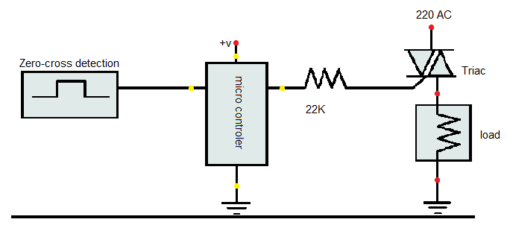
Circuit analyze
This circuit consist of three basic parts :
Dimming circuit
zero crossing circuit
Load

Slide 8
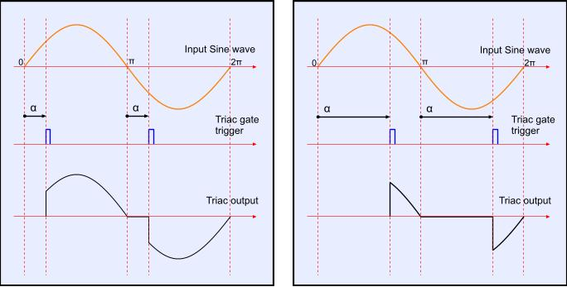
Dimming Circuit
The basic operation of this circuit is during a full cycle of an AC waveform, the thyristor will only allow a part of the waveform to be delivered to the load (lamp).

Slide 9
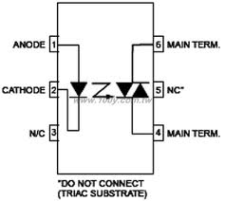
What we use for Dimming circuit?
1- Moc3021
2-Triac
3-Aurdino

Slide 10
Zero Crossing Detector
electrical circuit that detects the instant when a sine wave, or the natural format of alternating current (AC), is at zero volts in amplitude and sends a signal to its controlled circuit.
Zero crossing point is accrues tow times during the cycle .
Notes:
accures to

Slide 11
Zero Crossing Detector

Slide 12
Flow Chart
Zero crossing detectors sent pulse at every zero crossing point.
The Arduino tests if any signal is sent by the zero crossing detector
No
YES
The Arduino is programmed to calculate the angel offset when a zero voltage is detected.
An Arduino output pin is connected to the triac gate, it sends a pulses to the gates ( those pulses determine the value of conduction angle α )
The triac delay to conduct depends on the value of α. For example; when α becomes bigger the triac delays more then the lamb will be less brighter.

Slide 13
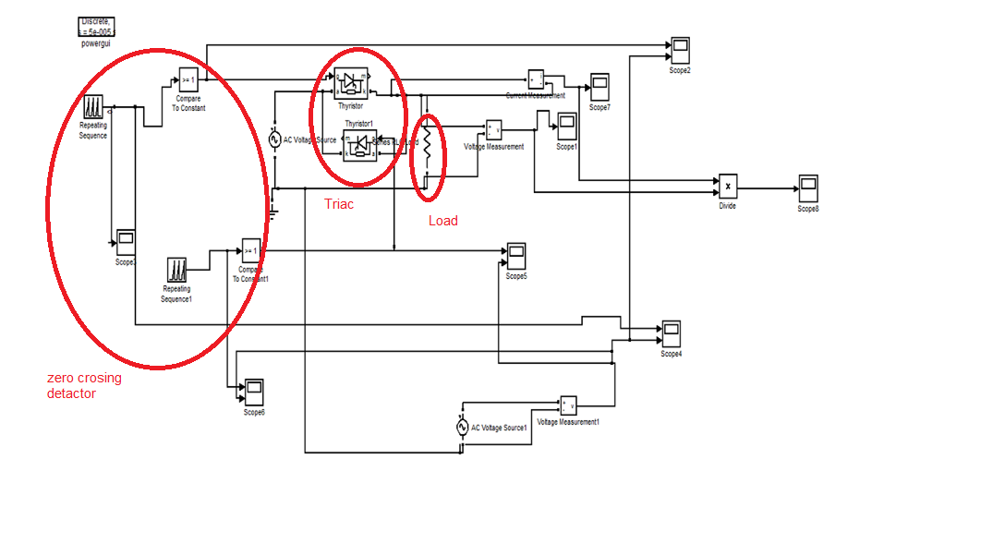
Circuit Simulation

Slide 14
Result: the out put of zero crossing and rectifier:

Slide 15
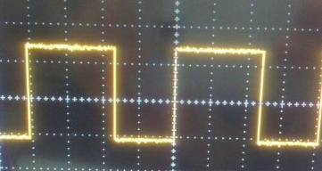
Out put of aurdino at different α : :

Slide 16
The out put of triac:

Slide 17
Economical Advantage
Power consumtion | Percentage of dimming | Time of the day
250 watt | No dimming | 6-10
175 watt | 30% | 10-12
125 watt | 50% | 12-3
150 watt | 40% | 3-6

Slide 18
Economical Advantage
If there is a 1000 lamps in the city then the cost of street light in one night:
1-without dimming:1800 NIS
2-with dimming=1305 NIS
The saving money=500 NIS

Slide 19
Second part:
In this part we are going to achieve an
auto intensity control of white Light
Emitting Diode (LED) using pulse width modulation technique

Slide 20
Circuit analysis:
In pulse-width modulation (PWM) dimming the LEDs are driven with full amplitude pulses of current and the width of the pulses is varied to control the apparent brightness.
.

Slide 21
Circuit analysis:
The average value of voltage (and current) fed to the load is controlled by turning the switch between supply and load on and off at fast pace, the longer the switch is on compared to the off periods which called the duty cycle, the higher the power supplied to the load is. So changing the duty cycle will change the power supplied to the load.

Slide 22
the effect of duty cycle at the average value.

Slide 23
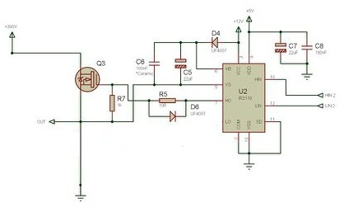
Circuit analysis:
The dc dimmer using IGBT contain three parts:

Slide 24
IGBT: Insulated-gate bipolar transistor
Is a three-terminal power semiconductor device primarily used as an electronic switch and in a newer devices is noted for combining high efficiency and fast switching. It switches electric power in many modern appliances.

Slide 25
IR2110:
Is an IGBT driver, used to isolate the lower and higher side of the transistor, it provides the high peak current necessary to open and close the gate rapidly.

Slide 26
Arduino
We used Arduino to control the duty cycle
Of the out pulse which after that enter the IR
We choose the duty cycle according to the time of the day

Slide 27
(Loads (LED
LED ( Light emitting diod ) : Its an high efficiency light uses DC voltage , consume low power .

Slide 28
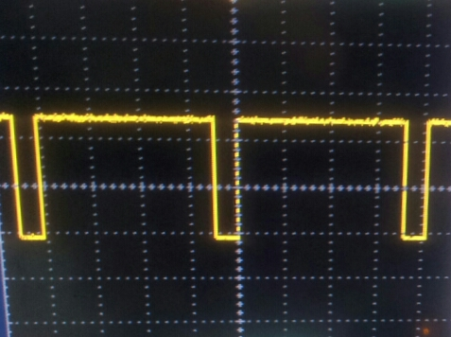
Result:
The duty cycle of the out put pulse from IGBT change .
when the duty cycle equals to 90%

Slide 29
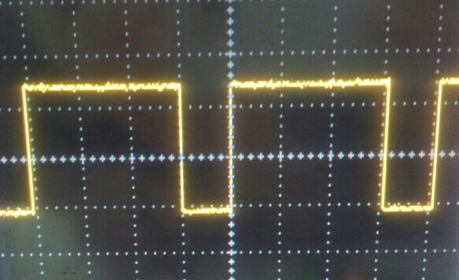
Result
When the duty cycle equals 75% :

Slide 30
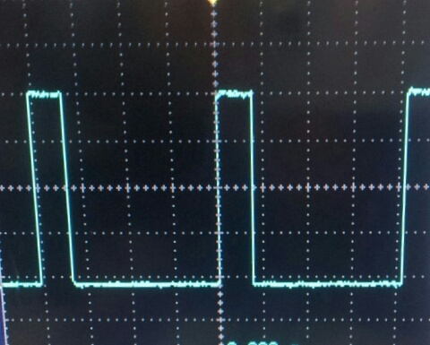
Result
When the duty cycle equals 20%:

Slide 31
Result
According to the previous result when we change the duty of the input pulse of the I
GBT the average voltage delivered to load .
(vedio).

Slide 32
Conclusion:
As the world is running out of fuel getting this stepper dimmer will save and help in the reduction of energy consumption
According to the results we can get the proper
illumination with suitable amount of energy supplied.
change depends on the time of day, we set a timer and according to
Its value the illumination will be changed.

