Slide 1
Analysis And Design Of Rawabi Girls’ School Graduation Project
Prepared by:
Faisal Qadri
Fehmi Taher
Mahmoud Abueideh
Supervised by: Eng. Ibrahim Arman
Wednesday, 18/5/2016

Slide 2
Introduction
CHAPTER 1: INTRODUCTION
Location

Slide 3
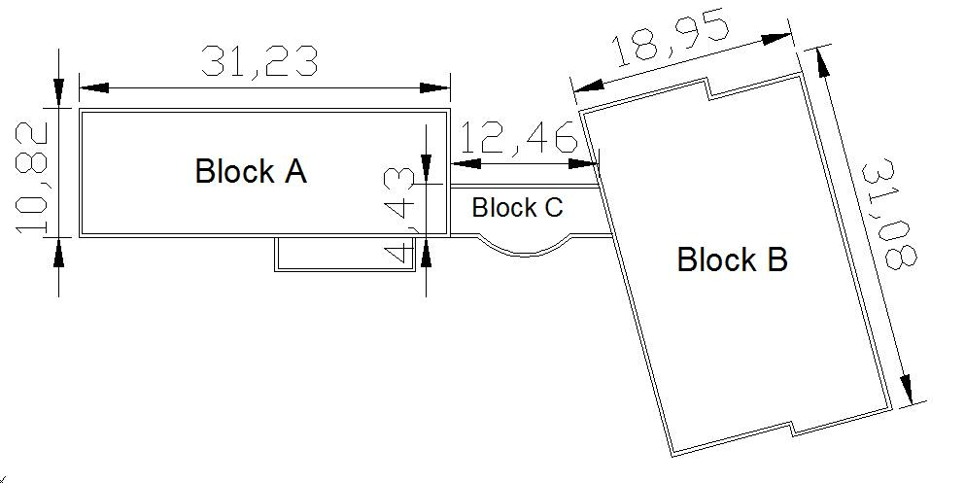
Introduction
CHAPTER 1: INTRODUCTION
General description

Slide 4
Codes and standards
CHAPTER 1: INTRODUCTION
Uniform building code (UBC) 1997.
American concrete institute ACI 318M-14.
Jordanian Code 2006.

Slide 5
Principles of analysis and design
CHAPTER 1: INTRODUCTION
Load and resistance factor design (LRFD)
- Increase the applied load
- Reduce the capacity of structural members
Used program: SAP2000 program

Slide 6
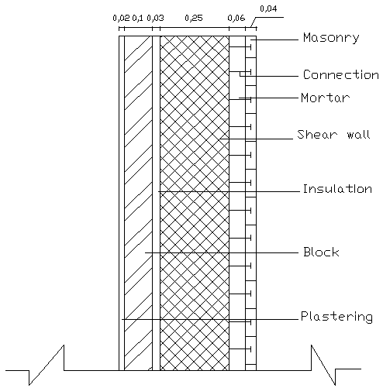
Structural System
CHAPTER 1: INTRODUCTION
Building frame system
Space frames
Shear walls
Exterior walls
Reinforced concrete
Interior walls
Reinforced concrete blocks

Slide 7
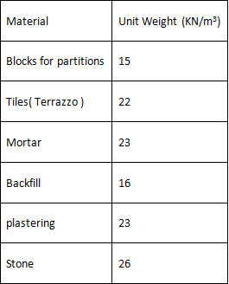
Materials
CHAPTER 1: INTRODUCTION
Structural materials:
1- Reinforced concrete
Compression strength= 28 MPA
2- Reinforcing steel:Grade 60
Yielding strength = 420 MPA
Non-structural materials:

Slide 8
Loads
CHAPTER 1: INTRODUCTION
Gravity loads:
1- Dead load: includes the weights of structural elements
2- Superimposed dead load: includes the weights of non- structural elements and divided into:
SDL on slabs
SDL on shear walls

Slide 9
Sample calculation
CHAPTER 1: INTRODUCTION
SDL on slabs = tiles+mortar+backfilling+partitions
= (0.03*22)+(0.03*23)+(0.1*16)+1
= 4 KN/m²
SDL on shear walls = stones+blocks+plastering
=(0.04*26)+(0.1*15)+(0.02*23)
= 3 KN/m²

Slide 10
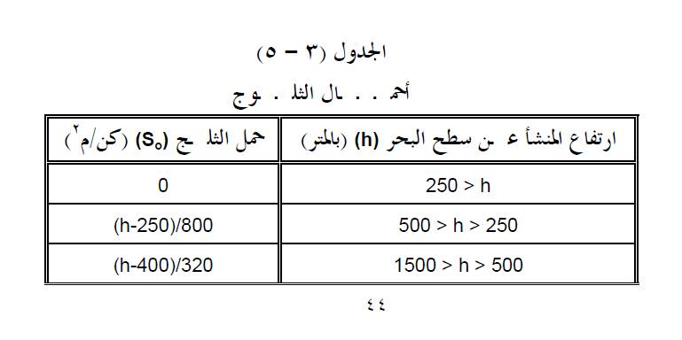
Loads
CHAPTER 1: INTRODUCTION
3- Snow load: formula provided in Jordanian code

Slide 11
Sample calculation
CHAPTER 1: INTRODUCTION
Structure elevation (h) = 702 m
S = (h-400)/320
= (702-400)/320
= 0.94 KN/m²
Snow load is taken 1 KN/m²

Slide 12
Loads
CHAPTER 1: INTRODUCTION
4- Live load
Minimum value of live load based on UBC97:
Live load = 2 KN/m² For schools
Live load = 4.8 KN/m² For corridors
Live load is taken 5 KN/m²

Slide 13
Loads
CHAPTER 1: INTRODUCTION
Lateral loads:
1-Wind load
2-Earthquake load

Slide 14
Wind load
CHAPTER 1: INTRODUCTION
General formula:
P = C_{e} C_{q} q_{s} I_{w}
Normal area method
C_{e} : Height, exposure, gust factor ( exposure B).
C_{q} : Pressure coefficient, 0.8 for windward, 0.5 for leeward.
q_{s} : Wind stagnation pressure at 10 m elevation, taken 0.7 for wind speed of 120 Km/hr.
I_{w} : Wind importance factor, taken 1

Slide 15
Sample calculation
CHAPTER 1: INTRODUCTION
The wind pressure for block B first floor:
C_{e} for 3.64 elevation = 0.62
P(windward) = (0.62)*(0.8)*(0.7)*(1)
= 0.35
P(leeward) = (0.62)*(0.5)*(0.7)*(1)
= 0.22
Wind force = (P)*(tributary area)

Slide 16
Earthquake load
CHAPTER 1: INTRODUCTION
Period (method A)
T = C_{t} (h)^{3/4}
T= 0.33 second (Block A and C)
T= 0.41 second (Block B)
Seismic zone (2B)
Seismic factor (Z) = 0.2
Importance factor (I) = 1, taken 1.5

Slide 17
Earthquake load
CHAPTER 1: INTRODUCTION
Seismic coefficients : (C_{a,} C_{v})
C_{a}= 0.24 C_{v}= 0.32
Response factor
R= 5.5
Amplification factor
Ωo= 2.8

Slide 18
Earthquake analysis approach
CHAPTER 1: INTRODUCTION
Equivalent static method: valid
V= (C_{v}* I /R * T)W
= 0.26 W (blocks A and C)
= 0.21 W (block B)
However, maximum design base shear = 0.163 W
which governs.
Dynamic Analysis: valid

Slide 19
Load transfer system
CHAPTER 2: Preliminary design
Gravity loads transfer mechanism
Lateral loads transfer mechanism

Slide 20
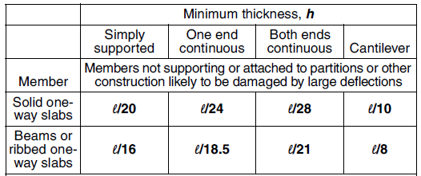
Preliminary slab thickness and loads
CHAPTER 2: Preliminary design
One way solid slab
Thickness:
based on ACI deflection requirements as shown:

Slide 21
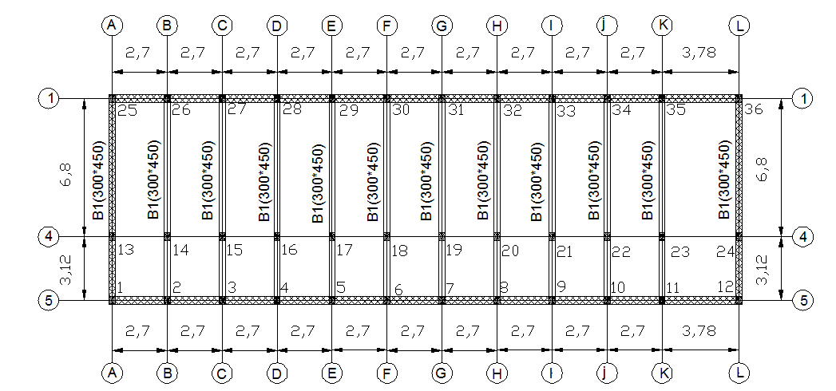
Sample calculations
CHAPTER 2: Preliminary design
For one end continuous slab, taking the critical span
t = L/24 = 380 cm/24 = 16 cm

Slide 22
Sample calculations
CHAPTER 2: Preliminary design
Load combination used
1- 1.2DL + 1.6LL
2- 1.4DL
Loads
Maximum load (Wu)= 1.2 (4 + 25*.18) +1.6*5 = 18.2 KN/m² for 1-D slab model

Slide 23
Preliminary dimensions of beams
CHAPTER 2: Preliminary design
Principle of analysis:
- One dimensional modeling on SAP2000
- load transfer from slab to beam

Slide 24
Preliminary dimensions of beams
CHAPTER 2: Preliminary design
Depth and width of the beams
- Depth is based on ACI
- Critical beam span, one end continuous
- Sample calculation for block B:
Depth (h)= L/18.5 = 680/18.5 = 37 cm
The dimension of block A beams:
300*450 mm

Slide 25
Dimensions of columns and walls
CHAPTER 2: Preliminary design
Analysis of the columns
- load transfer from beam to columns
General formula:
ØP_{n} = Ø ƛ (0.85 f'c A_{c} + A_{s} f_{y})
Ø: 0.65 (tied column)
Ø: 0.75 (spiral ties)
ƛ: 0.8 (tied column)
ƛ: 0.85 (spiral ties)

Slide 26
Sample calculations
CHAPTER 2: Preliminary design
The maximum reaction from the beam model is the load applied on the column as shown in this example:
Maximum reaction = (331.23)*(3 stories) = 993 KN
Area of steel is neglected for simplicity and the dimensions of column are found on this basis

Slide 27
Dimensions of columns and walls
CHAPTER 2: Preliminary design
Shear wall 250 mm
Shear wall 300 mm

Slide 28
Three dimensional analysis and design
CHAPTER 3: Three dimensional analysis and design
Three dimensional modeling of blocks A,B and C
Verification of loads
Checks for irregularities and deflections

Slide 29
Structural modeling of blocks
CHAPTER 3: Three dimensional analysis and design
Materials:
Materials properties were mentioned previously
Section modifiers
- Beams = 0.35
- Columns = 0.7
- Slab = 0.25
- Shear wall = 0.35

Slide 30
Structural modeling of blocks
CHAPTER 3: Three dimensional analysis and design
Masses
The total seismic dead load (W) included:
W= dead load + superimposed dead load + 25% live load.
Functions
Response spectrum function is defined
based on UBC97

Slide 31
Structural elements dimensions
CHAPTER 3: Three dimensional analysis and design
Slabs
Slab thickness = 160 mm
Shear walls
- shear walls 250 mm thickness
- shear walls 300 mm thickness

Slide 32
Structural modeling of blocks
CHAPTER 3: Three dimensional analysis and design
Columns
- Dimensions 300*400 mm ( blocks A,B,C)
- Circular columns of 300 mm in block C
Beams
- Dimensions 300*400 ( block A,B)
- Dimensions 250 * 250 ( block C)
Tie beams
- Dimensions 350*400

Slide 33
Story forces
CHAPTER 3: Three dimensional analysis and design
Fx = (V - Ft ) wx hx / Ʃhi wi
- Ft = 0.0 since T< 0.7 second
-height and weight at each level are shown
- Manual calculation

Slide 34
Irregularity
CHAPTER 3: Three dimensional analysis and design
Vertical irregularity
Weight (mass) irregularity in block B
Horizontal irregularity
All irregularities are checked and detailed in the report

Slide 35
Verification of internal forces
CHAPTER 3: Three dimensional analysis and design
Shear force
Slab
General formula:
ØVC = 0.167 (f'c)^0.5 *b*d
For a strip 1 m
ØVC = 0.167 (28)^0.5 *1000*120
ØVC = 106.04 KN

Slide 36
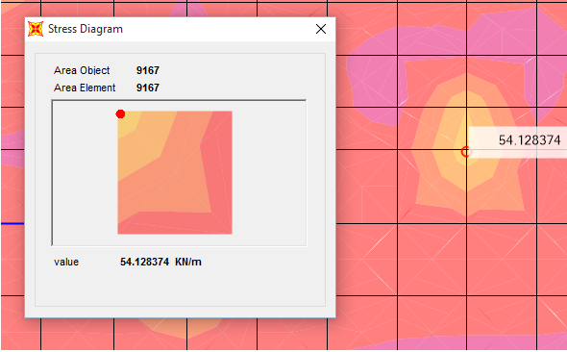
Verification of internal forces
CHAPTER 3: Three dimensional analysis and design
The figure shows the values at slab by SAP:

Slide 37
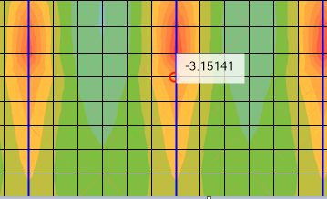
Verification of internal forces
CHAPTER 3: Three dimensional analysis and design
Moment (live load)
- Representing slab like simply supported beam
- By SAP (three values)
- Right moment

Slide 38
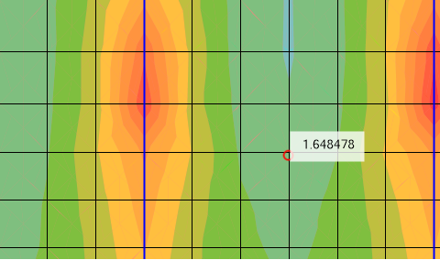
Verification of internal forces
CHAPTER 3: Three dimensional analysis and design
- Middle moment

Slide 39
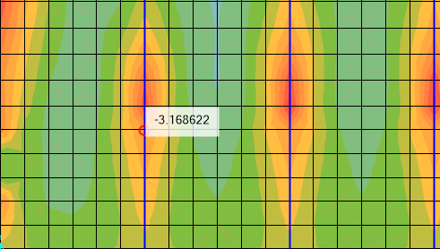
Verification of internal forces
CHAPTER 3: Three dimensional analysis and design
- Left moment

Slide 40
Verification of internal forces
CHAPTER 3: Three dimensional analysis and design
- Moment = (M_{left} + M_{right}) / 2 + M_{middle}
= (3.16 + 3.15) / 2 + 1.64
= 4.79 KN.m.
- Manual moment= W*L²/8
= 5*2.7²/8
= 4.55 KN.m.
- Difference (%) = 5

Slide 41
Verification of internal forces
CHAPTER 3: Three dimensional analysis and design
Axial Force
- Block A, middle column, tributary area, live load
- Manual calculation (Three stories)
- Axial load = (live load)*(tributary area)
= (3)*(5)*(4.96*2.7)
= 200.88 KN
- SAP
- Difference(%)= 5.33

Slide 42
Deflection
CHAPTER 3: Three dimensional analysis and design
Long-term deflection
- Given by the following formula
ʋ_{LT} = ʋ_{L} + ƛ∞ ʋ_{D} + ƛ_{t} ʋ_{st}
- ƛ∞ = ƛ_{t} = 2, according to equation (more than two years)
- ʋ_{LT =} long term deflection

Slide 43
Deflection
CHAPTER 3: Three dimensional analysis and design
The limitations as following in the table
- L/240

Slide 44
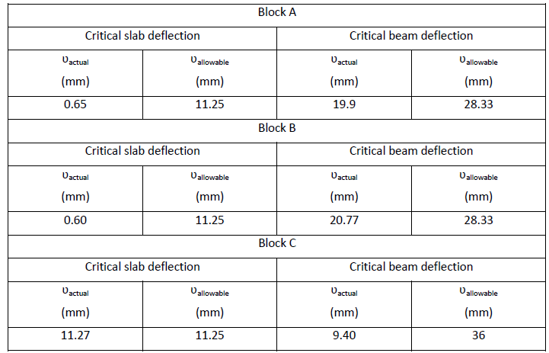
Deflection
CHAPTER 3: Three dimensional analysis and design
The following table shows the critical values and the allowable ones

Slide 45
Story drift
CHAPTER 3: Three dimensional analysis and design
Definition
Limitation
0.025H = 0.025*3.64
= 91 mm
Equation
ΔM = 0.7R ΔS
ΔM: maximum inelastic response displacement
ΔS: maximum elastic displacement

Slide 46
Story drift
CHAPTER 3: Three dimensional analysis and design
The table shows the values of story drifts for block A as an example:
Maximum story drift = 91 mm

Slide 47
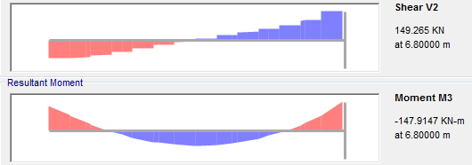
DESIGN OF STRUCUTURAL ELEMENTS
CHAPTER 4: Verification and design of structural elements
Beams
-Verification of program outputs (Vu, Mu, Tu)
Shear output (Vu = 149.26 KN)
-steel reinforcement
- Shear ratio = 0.78 mm^2/mm

Slide 48
DESIGN OF STRUCUTURAL ELEMENTS
CHAPTER 4: Verification and design of structural elements
Beams
Verification of program outputs (Mu, Vu, Tu)
Moment output (147.9 KN.m)
Steel ratio (ρ) = 0.0126
Area of steel 1323 mm²
All outputs are OK

Slide 49
DESIGN OF STRUCUTURAL ELEMENTS
CHAPTER 4: Verification and design of structural elements
Beams
Verification of program outputs (Mu, Vu, Tu)
Torsion output (Tu = 0.88 KN.m)
Threshold torsion (Tth)
= 4.76 KN.m
No need for torsion reinforcement (At/s = 0.0)
All outputs are OK

Slide 50
DESIGN OF STRUCUTURAL ELEMENTS
CHAPTER 4: Verification and design of structural elements
Shear strength check
ØV_{c} should be at least larger than the lesser of
1- Vu resulting from the gravitational load combination:
Vu
2- Vu resulting from the design load combination:
1.2D + 2.0E + 1.0L + 0.2S
- Since ØVc> Vu
69.45KN > 66.25 KN , check is ok

Slide 51
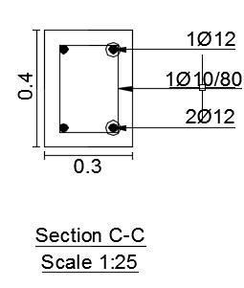
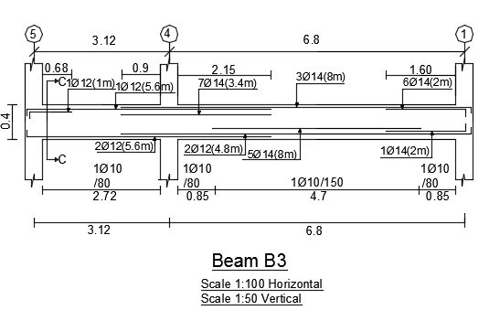
DESIGN OF STRUCUTURAL ELEMENTS
CHAPTER 4: Verification and design of structural elements
-Beam’s reinforcement
Stirrups of 1Ø10/80 mm

Slide 52
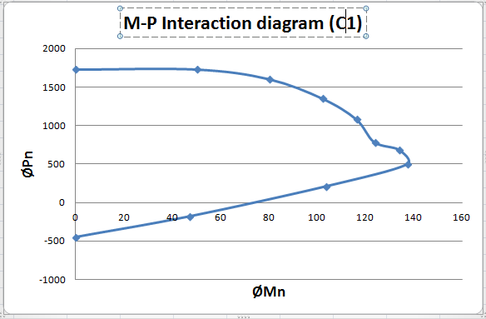
DESIGN OF STRUCUTURAL ELEMENTS
CHAPTER 4: Verification and design of structural elements
Columns
Verification of column design:
- Projection of maximum axial and moment of column (C1) on P-M interaction diagram for 1% steel ratio
Dimensions:
= 0.3*0.4 m²
Pu = 218.5 KN
Mu = 47.9 KN.m

Slide 53
DESIGN OF STRUCUTURAL ELEMENTS
CHAPTER 4: Verification and design of structural elements
Shear check for column
ØV_{c} should be at least larger than the lesser of:
ØV_{c} = 69.45 KN
1- Vu resulting from the gravitational load combination:
V_{u} = (M_{nT} + M_{nB})/L_{n}
2- Vu resulting from the design load combination:
1.2D + 2.8E + 1.0L + 0.2S
ØV_{c} > Vu
69.45 KN > 18.25 KN, ok.

Slide 54
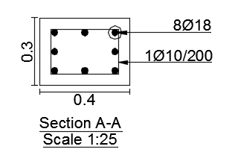
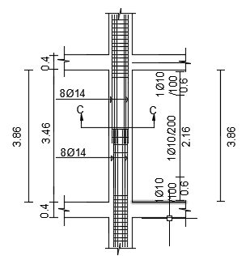
DESIGN OF STRUCUTURAL ELEMENTS
CHAPTER 4: Verification and design of structural elements
Column’s Reinforcement
Ties 1Ø10/200 mm

Slide 55
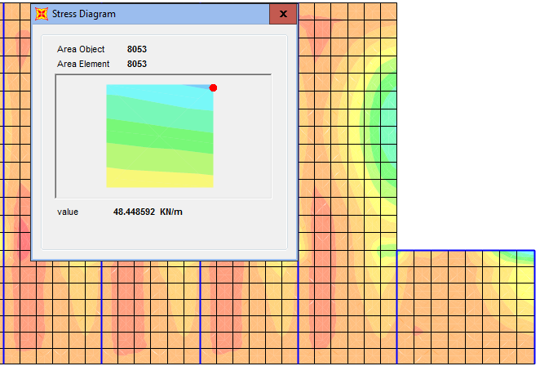
DESIGN OF STRUCUTURAL ELEMENTS
CHAPTER 4: Verification and design of structural elements
Slabs
Shear check for slabs
ØV_{C} = 79.37KN
Vu = 48.44 KN

Slide 56
DESIGN OF STRUCUTURAL ELEMENTS
CHAPTER 4: Verification and design of structural elements
Slabs’ reinforcement
Minimum steel ratio (ρ = 0.0018)
ØM_{n} =14.15 KN.m , compared to
maximum value = 15.07 KN.m
Designed for minimum area of steel
As = 288 mm² , 4Ø10/m in both directions.

Slide 57
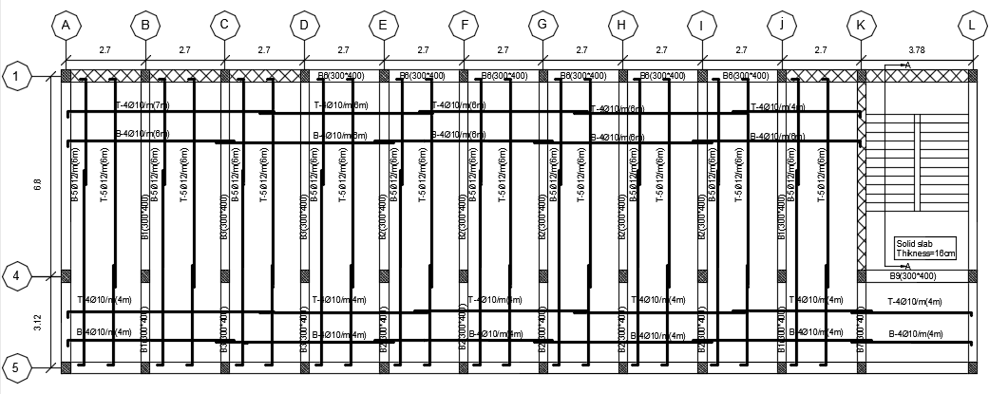
CHAPTER 4: Verification and design of structural elements
DESIGN OF STRUCUTURAL ELEMENTS
Slab’s reinforcement

Slide 58
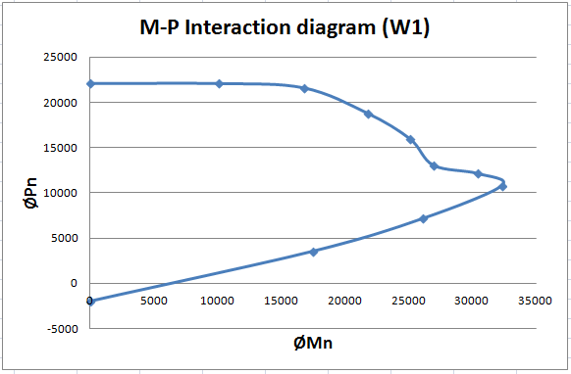
CHAPTER 4: Verification and design of structural elements
DESIGN OF STRUCUTURAL ELEMENTS
Walls
Verification of walls dimensions
Maximum moment and axial forces acting on the wall (W1) to be in the range of the P-M diagram:
-length = 6.8 m
Pu = 2132 KN
Mu = 4073 KN.m
As_{min} = 0.0025*b*h
= 625 mm²

Slide 59
CHAPTER 4: Verification and design of structural elements
DESIGN OF STRUCUTURAL ELEMENTS
In plane shear check
As beam
= 0.116
Minimum horizontal reinforcement is required

Slide 60
CHAPTER 4: Verification and design of structural elements
DESIGN OF STRUCUTURAL ELEMENTS
Out of plane shear
As slab
ØV_{c} > V_{u}
944.53 kN >47 KN
- No reinforcement is required

Slide 61
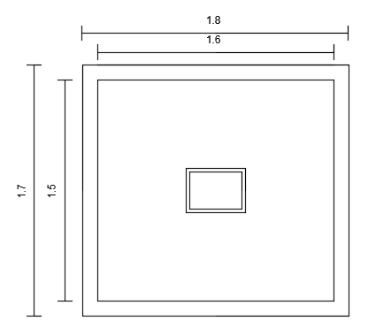
CHAPTER 4: Verification and design of structural elements
DESIGN OF STRUCUTURAL ELEMENTS
Footings
Isolated footings
Area
From service loads
Area = 1.5*1.6 m²

Slide 62
CHAPTER 4: Verification and design of structural elements
DESIGN OF STRUCUTURAL ELEMENTS
Depth of footing:
Based on ultimate loads
Wide beam shear
Punching shear
Depth = 40 cm

Slide 63
CHAPTER 4: Verification and design of structural elements
DESIGN OF STRUCUTURAL ELEMENTS
Isolated footing reinforcement
Moment = 106.69 KN.m for a width b = 1.6 m
ρ = 0.00164 less than minimum ρ
A_{s} = 0.0018 * b * h
= 0.0018 * 1600 * 400 = 1152 mm²
= 1Ø12/150 mm, in both directions

Slide 64
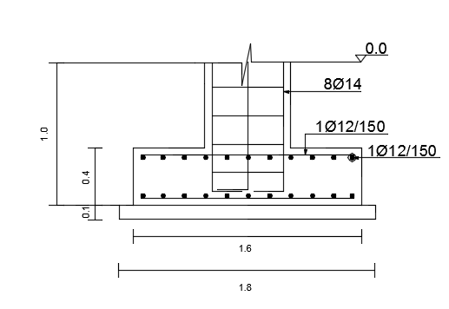
CHAPTER 4: Verification and design of structural elements
DESIGN OF STRUCUTURAL ELEMENTS
Reinforcement Details:

Slide 65
CHAPTER 4: Verification and design of structural elements
DESIGN OF STRUCUTURAL ELEMENTS
B. Wall Footings
Area
From maximum service loads on the critical wall(L = 6.8m)
Area = 1.25*6.8 m²

Slide 66
CHAPTER 4: Verification and design of structural elements
DESIGN OF STRUCUTURAL ELEMENTS
Depth of footing:
Wide beam shear
Where Pu = 2937 KN is shown:
h = 30 cm

Slide 67
CHAPTER 4: Verification and design of structural elements
DESIGN OF STRUCUTURAL ELEMENTS
Wall footing reinforcement
Moment = 321.08 KN.m for a width b = 6.8 m
ρ = 0.00203
A_{s} = 0.00203 * b * d
= 0.00203 * 6800 * 250 =3454 mm²
= 1Ø14/300 mm.

Slide 68
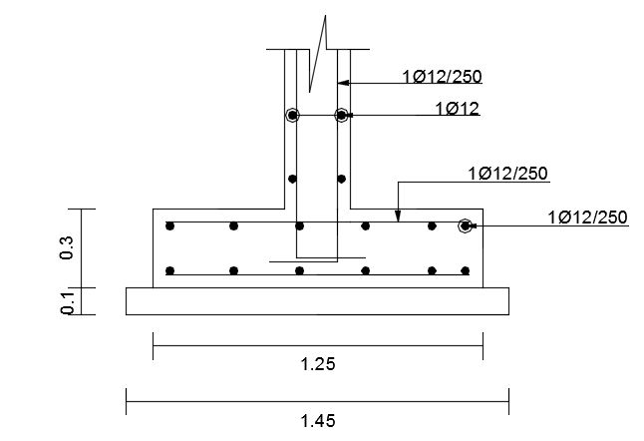
CHAPTER 4: Verification and design of structural elements
DESIGN OF STRUCUTURAL ELEMENTS
Reinforcement details:

Slide 69
Additional elements
CHAPTER 5: Additional elements design
Diaphragm
Collector
Tie building elements/ provide three dimensional system
Transfer lateral loads to vertical elements

Slide 70
CHAPTER 5: Additional elements design
Additional elements
Diaphragm
Analysis/ 1D model
Supports’ stiffnesses (walls)
Like springs
Values

Slide 71
CHAPTER 5: Additional elements design
Additional elements
-Force distributions (cumulative)

Slide 72
CHAPTER 5: Additional elements design
Additional elements
Shear force/ bending moment
Steel reinforcement
Moment
As = 2854 mm² , 25Ø12/2 m (large region)
As = 501 mm² , 5Ø12/0.8m (small region)

Slide 73
CHAPTER 5: Additional elements design
Additional elements
Shear check
ØVc = 944 KN
ΩVu > Vc
1360.29 KN > 944 KN
Vs = 555 KN
= 0.148 mm^2/m
3Ø10/m

Slide 74
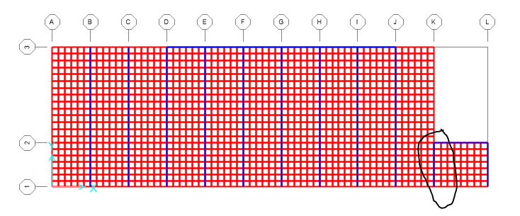
CHAPTER 5: Additional elements design
Additional elements
Collector
Connection between the diaphragm and vertical elements
Axial forces
Two main sections/ discontinuity

Slide 75
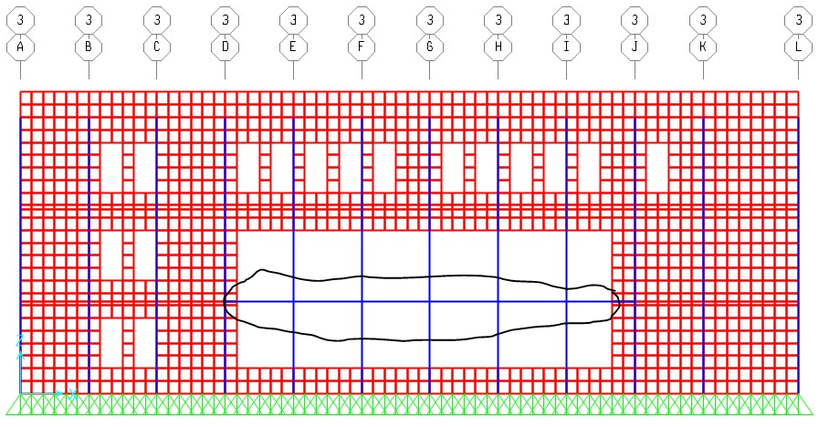
CHAPTER 5: Additional elements design
Additional elements
Collector
Complete the path of loads for lateral ones

Slide 76
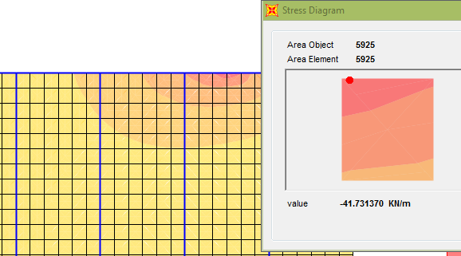
CHAPTER 5: Additional elements design
Additional elements
Design calculations
First floor/ X-direction
Fx = 71.73 KN

Slide 77
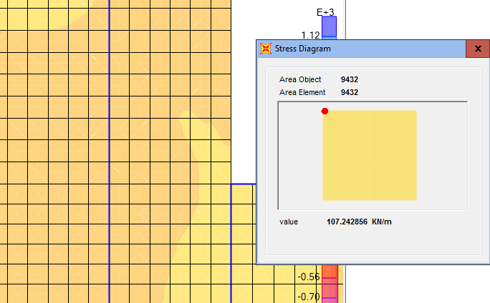
CHAPTER 5: Additional elements design
Additional elements
Design calculations
All floors/ Y-direction
Fy = 107.24 KN

Slide 78
CHAPTER 5: Additional elements design
Additional elements
Steel reinforcement
Equation
Asx= 309 mm^2, (3Ø12)
Asy = 794 mm^2, (7Ø12)

Slide 79
Thank you for your attention

