Slide 1
بسم الله الرحمن الرحيم
An-Najah National University
Faculty of Engineering and Information Technology
Department of Mechanical and Mechatronics Engineering

Slide 2
FAMO A 3-Axis Multi Tool CNC Machine
Supervised by :
Dr. Salameh Abdul Fattah
Fahid Yaseen
Omar Moumar
Mahmoud Diab

Slide 3
Contents
Introduction
Mechanical Design
Motors
Control
Results & Analysis
Discussion
Conclusions and Recommendations

Slide 4
Introduction
Overview of CNC machine
What do we mean by CNC ? CNC stands for Computer Numerically Controlled machine
Basic Components
Machine
Control System
Open loop
Close loop

Slide 5
Objectives & Motivations
To achieve very high accuracy
To reduce time and effort needed.
To design a more flexible production system
Reducing error probabilities in a way devolves to zero error.
Able to perform many shapes.

Slide 6
Mechanical Design
The Mechanical design consists of two main parts:
The Frame
The Transmission System

Slide 7
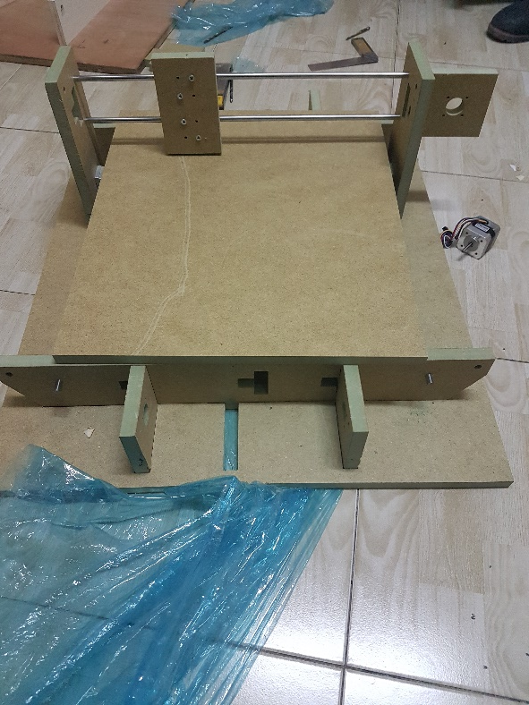
Frame
The frame of the machine is made of HDF wood.
We designed the frame using AutoCAD.
We cut the frame pieces using a CNC milling machine.
We assembled the pieces together.

Slide 8
3D Drawing by AutoCAD

Slide 9
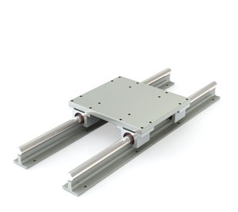
Transmission System
We will talk about :
Sliders and bearings
Rails
Pulley and Belt

Slide 10
Sliders and Bearings
Sliders and Bearings
Constrain motion to one degree of freedom motion only
Greatly reduces friction between moving parts
We used linear ball bearing sliders

Slide 11
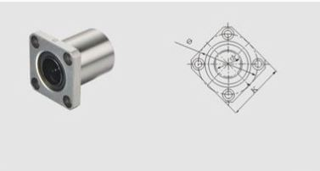
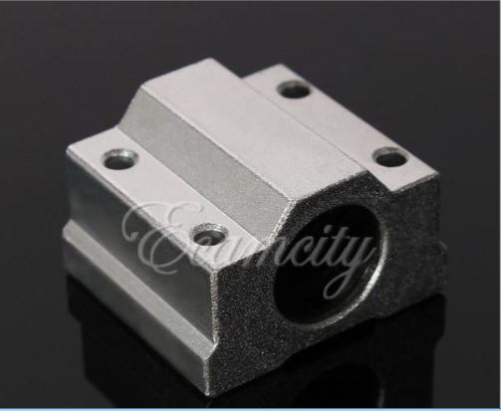
Sliders
In our project we used the following ball bearing sliders.
LMK8 flange ball bearing slider
SC8UU ball bearing slider.

Slide 12
Rails
Rails are the part that the slider moves along.
Rails provide free linear motion in one direction
Frictionless to make motion very smooth
Chrome-plated steel shaft

Slide 13
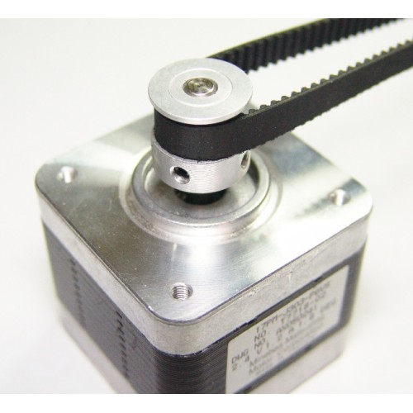
Pulley and Belt
Belts
Transmit motion from motor pulley to the counter pulley.
Provide constant tension

Slide 14
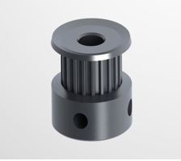
Pulley and Belt
GT2 20 teeth timing pulley
GT2 timing belt

Slide 15
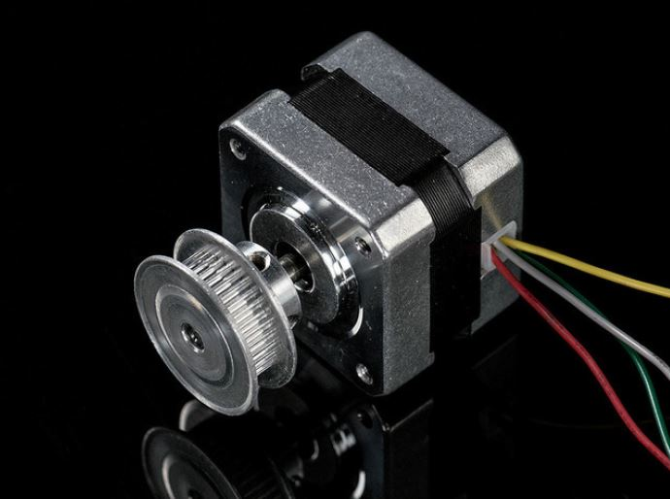
Motors
What is a Stepper Motor ?
DC motors that move in discrete steps
Multiple coils (phases)
By energizing each phase in sequence, the motor will rotate, one step at a time

Slide 16
Motors
What are stepper motors good for ?
Precise positioning
Speed Control
Low speed – High torque

Slide 17
Motors
Advantages
High torque at startup
Easy to control
Easy to implement
Can be used for both open-loop and closed-loop systems
High precision and Reliability
Excellent response time

Slide 18
Motors
Disadvantages
Requires a dedicated control circuit
High current consumption
Torque reduced at high speed
Hard to control at high speeds

Slide 19
Control
Hardware
Arduino Uno
GRBL Shield
Stepper motor drivers ( A4988)
Computer
Software
GRBL and XLoader
Universal Gcode Sender
MakerCAM

Slide 20
Control
What is GRBL ?
Open source software
Runs on Arduino
Takes Gcode and turns it to motor signals
What is Gcode ?
The most widely used numerical control (NC) programming language.
It is a way for you to tell the machine to move to various points at a desired speed.

Slide 21
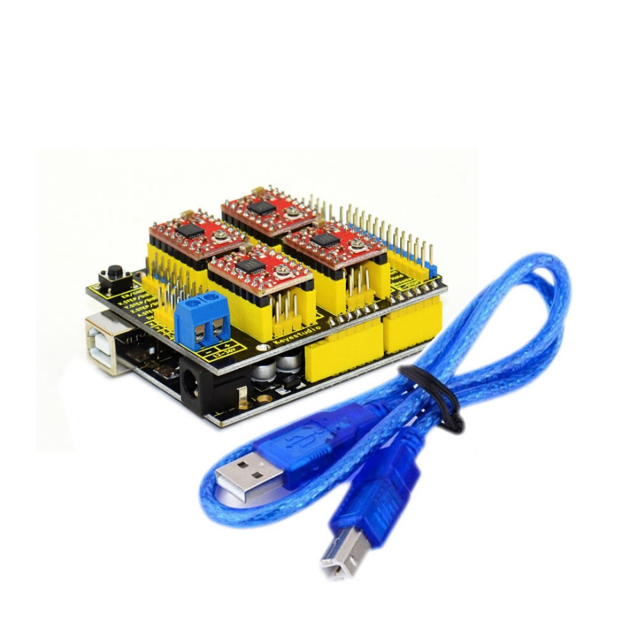
The Arduino and the shield.
The Arduino, the shield and the drivers

Slide 22
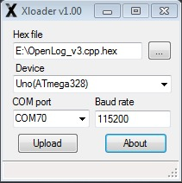
Control
How get this to work ?
Upload GRBL software to Arduino Using XLoader

Slide 23
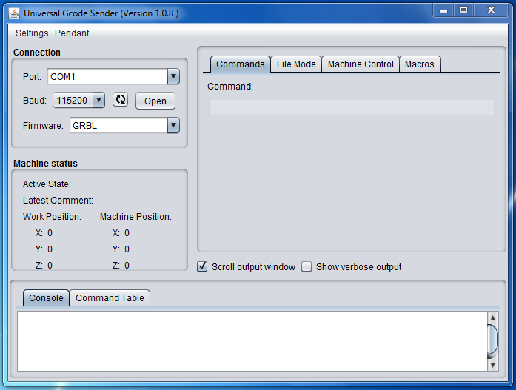
Streaming G-Code
There are many programs that can be used one of which is Universal G-Code sender.

Slide 24
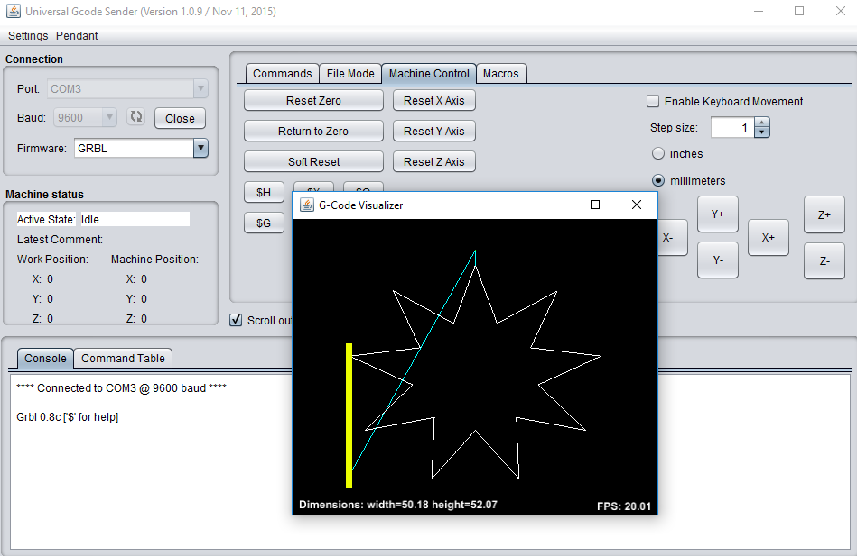
Advantages
Universal Gcode Sender
User friendly interface
Sending Gcode Commands
Sending Gcode Files
Visualizing
Micro Steps Control
Speed Control

Slide 25
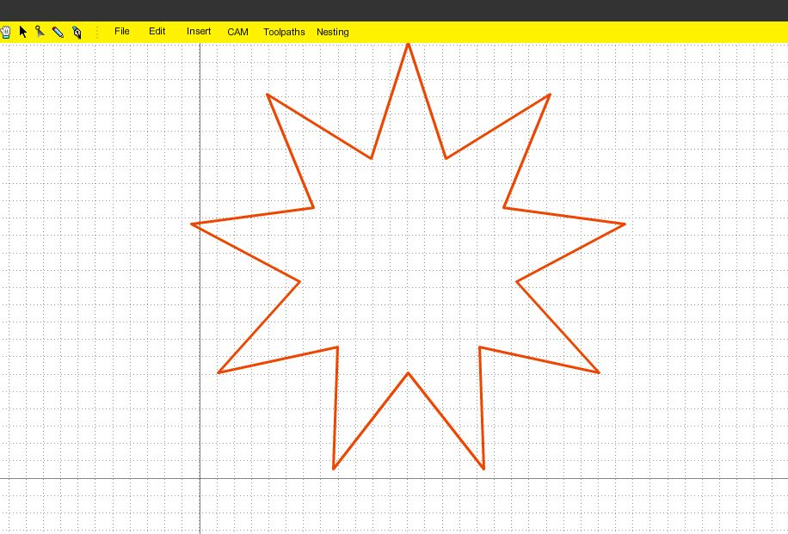
G-Code
CAD to Gcode
CAD models can be created using many programs. These drawings can later be turned to G-Codes.

Slide 26
Discussion
Problems
Changing the primary idea of the project
Material of the frame of the machine.
Final processing of wood
Cutting the wood into the frame
Wrong dimensions
The Corners
Accuracy of the Y-axis

Slide 27
Changing the primary idea of the project
The first idea was to create a 2-axis hot wire
the idea was changed to make a 3-axis multi tool CNC machine

Slide 28
Material of the frame of the machine
Stainless steel, Aluminum, Acrylic plastic and wood
We chose processed wood

Slide 29
Final processing of wood
Although the wood used is already processed but after being subjected to humidity or liquids for extended periods of time
painting the wood with car paint that works as an insulator

Slide 30
Cutting the wood into the frame
cuting the wood with primitive tools
Afterwards, we redesigned the project for better balance and cut the parts of the frame at a CNC workshop to get maximum accuracy

Slide 31
Wrong dimensions
After cutting the wood into shape, we realized that the thickness of the wood was not as ordered (16mm) but it was (17mm). This lead to some problems in fitting the pieces together.
To solve the problem we had to use a file to smoothen the edges and curves of the pieces

Slide 32
Accuracy of the Y-axis
At first we had one motor running each axis
We solved this problem by adding another motor to the other side of the y-axis

Slide 33
How to Improve In the future
To make the machine as industrial as possible we are going to replace the wood frame with a stainless steel or Aluminum frame. The z-axis links will be higher so that there will be more space for the z-axis to travel.
Better motors and control system will be used for a larger scale machine.
The transmission system will be replaced with screw and gears mechanism.

Slide 34
Conclusion
The round cross-sectional rails are not the best choice to go with accurate industrial machines, but we had to go with what was available and affordable. But on the other hand, the linear rails aren’t too bad to be used because they linear smooth and frictionless motion.
A better alternative would be to use the rack and pinion mechanism or the gear and screw type of mechanisms.
The stepper motor is the best choice for automated and computerized motion due to its ease of use and high accuracy and reliability. It’s very easy to control and install into automated systems.

Slide 35
Conclusion
The Arduino is the best attractive choice of a controller, because it’s very cheap and easy to deal with. Sensors can be connected to Arduino directly and also it’s very basic programs and simple algorithms.
We found out for the first time that the Arduino can host a CNC GRBL shield to receive G-Codes and send pulses to control steppers very accurately using micro-stepping motor driver.

Slide 36
Recommendations
For industrial purposes a better controller must be used, because the Arduino isn’t designed to be put in an industrial environment. Mach3 Interface board or PLC are recommended.
An industrial machine should be made of better materials than wood such as Aluminum and Stainless steel.
A screw and gear mechanism is the best choice for both accuracy and endurance.
Larger and stronger motors must be used to handle the high torques and bending forces.
A set of industrial motor drivers must be used to handle the high currents the motors will draw.

Slide 37
Thank you

