Slide 1
Design and Fabricate Windmill water pump
Group names:
Akram Yasin
Anas Abu Radi
Hani Qawariq
Motaz Modallal
Supervised to Dr :Ahmad Alramahi

Slide 3
Contents
problem statement
Definition of Windmill Water Pump
Design of Windmill Water Pump
Fabrication
Conclusion and Recommendations

Slide 4
Description of problem statement
The aim of the project is to provide the places that far from electricity resources with product which can be use instead of electrical pump in order to lift water from water harvesting to tanks which can use in farming sector . we can achieve this by using windmill water pump which use renewable wind energy , moreover product preserve the green environment of any additional pollution ,by avoid residual harmful to the environment .

Slide 5
Definition of Windmill Water Pump

Slide 6
Definition of Windmill Water Pump
Windmill water pump is advice use wind energy to lift water by using translation motion of wind to rotate the blades which connect by rotor with gear that transfer the rotation motion of windmill to reciprocating motion on crank shaft that act on reciprocating pump to lift water by its motion.

Slide 7
Design of Windmill Water Pump
Windmill water pump consist of:
Tower
Blades
Gear box and bearing system
Shafts
Crank and connecting rod
Piston (reciprocating pump )
Valves and tubes

Slide 8
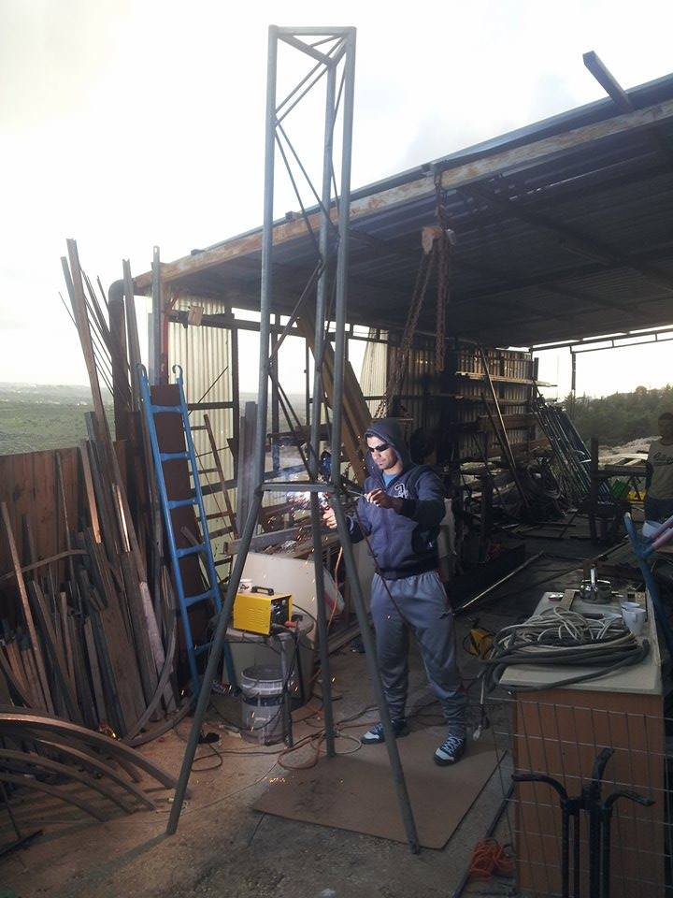
Design of Windmill Water Pump
Tower
Tower used to carry the rotor and gear box at
a height of 3.5 meter to get more effective wind
speed and to protect humans from the danger
of the rotating blades, the structure of the tower is
a truss built of circular steel rods and tubes, the top
of the tower has a plane of triangular shape .

Slide 9
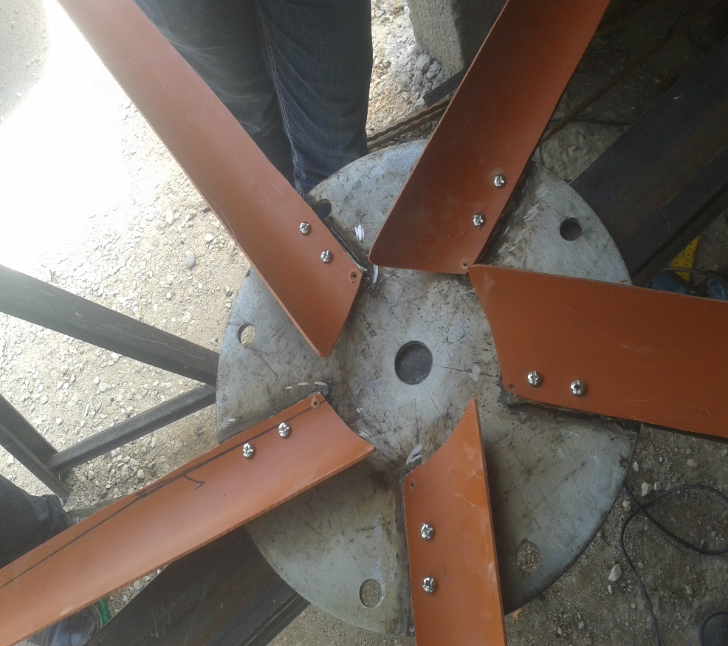
Design of Windmill Water Pump
Blades :
The number of blade is 5 to get more
amount of blade surface that impact with
wind , this increase the rotation speed of
blade , material used in blade is 4 inch
plastic Pipe .

Slide 10
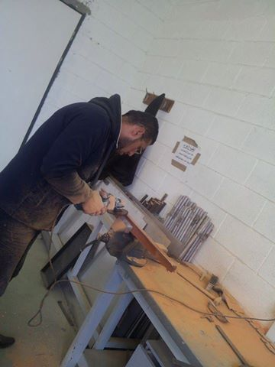
Design of Windmill Water Pump
Blades :
tip speed ratio = 6
Velocity of wind = 3.4 km/h
Angular velocity = 50 rpm
The length of the blade is 90 cm

Slide 11
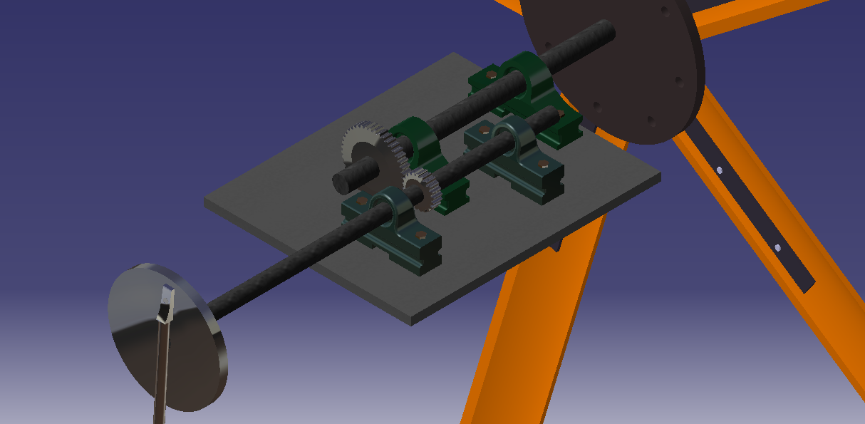
Design of Windmill Water Pump
Gear box , bearing system and shafts
Gear box contain a Gear system used to increase the rotational speed from rotor to crank , bearing system used to reduce the friction losses and vibration.

Slide 12
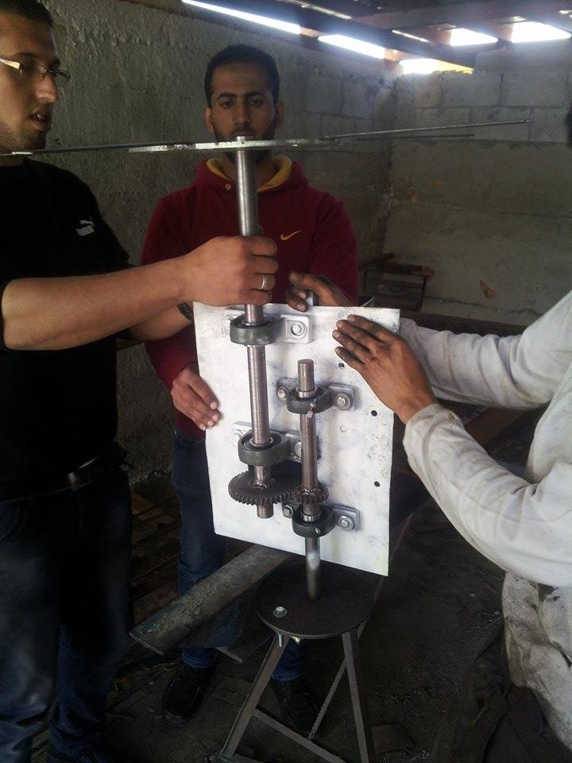
Design of Windmill Water Pump
shafts
Two steel shafts were used , one connect the rotor and the gear and it has length of 50 cm and diameter of 30 mm, and another shaft connects between pinion and the disk which acts as a crank; this shaft has a diameter of 25 mm and a length of 50 cm as

Slide 13
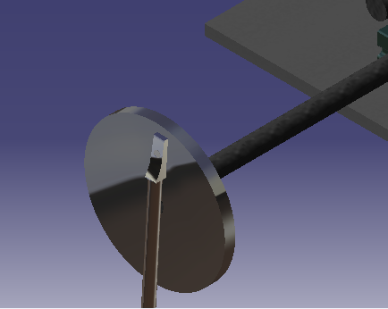
Design of Windmill Water Pump
Disk and connecting rod (crank slider mechanism)
Steel disk used to transform the rotational motion of the pinion to sliding motion in the piston pump; the crank and piston linked together through the connecting rod.

Slide 14
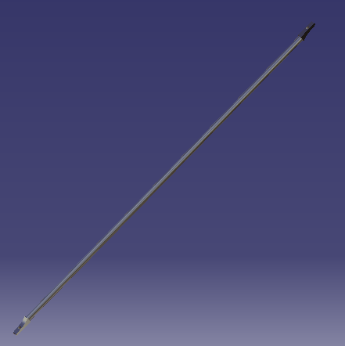
Design of Windmill Water Pump
Disk and connecting rod (crank slider mechanism)
Steel rod connects between disk and piston, it has length of 1 m The disk has diameter = 25 cm, but the connecting rod is Pined at radius of 7.5 cm.

Slide 15
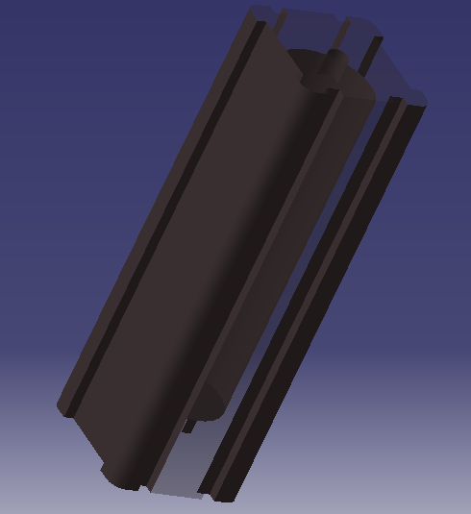
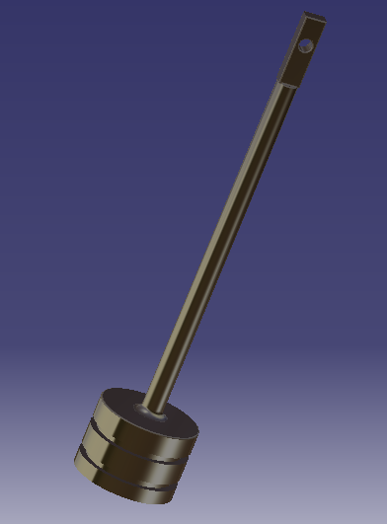
Design of Windmill Water Pump
Piston pump
Piston has a stroke length of 15cm, suction and delivery valves work in opposite of each others . other.
At the time which first two valves in suction stroke the second two valves in delivery stroke, that mean piston pump has two suction and two delivery stokes

Slide 16
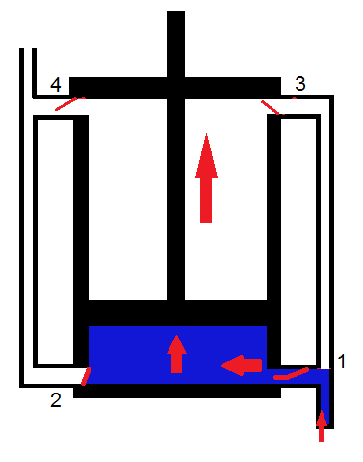
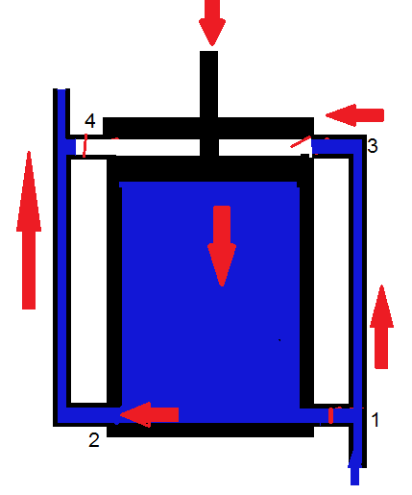
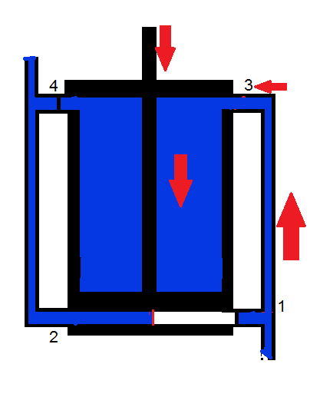
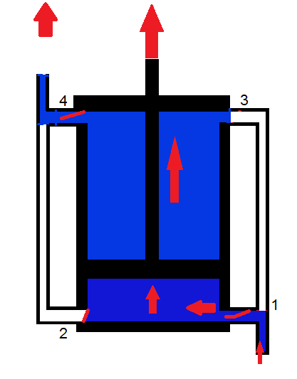
Design of Windmill Water Pump
Valves and tubes
Pump has 4 valves to get suction stroke at the same time of delivery stroke tubes to flow water from well to tank this make it continues .

Slide 17
Fabrication
Building the Tower
Using arc welding to connect between 3 tubes with steel connecting pieces in order to have symmetric triangle shape to avoid failure of structure .

Slide 18
Fabrication
Blades Cutting a
Using cutting technique demonstrated on YouTube, five identical blades were cut ,and fixed with angular spacing (72º).

Slide 19
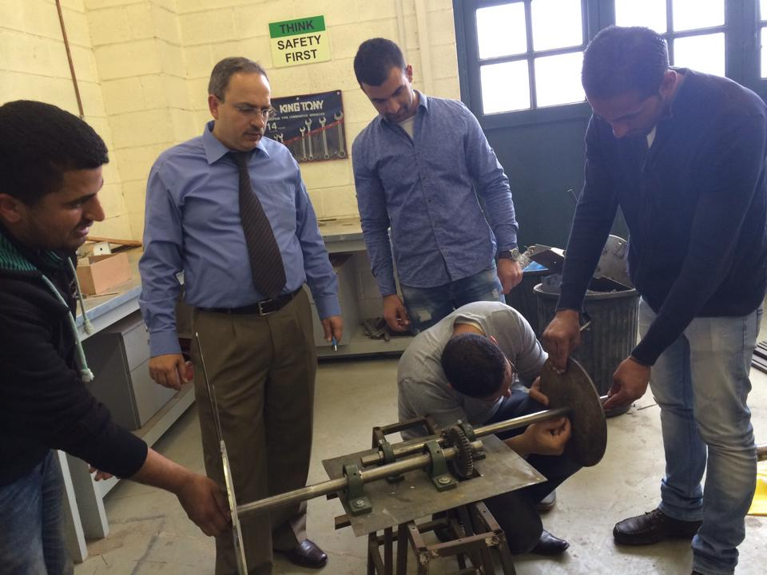
Fabrication
Gear box
The gears and shafts are lift by the bearing system that fixed in a steel box above the tower.

Slide 20
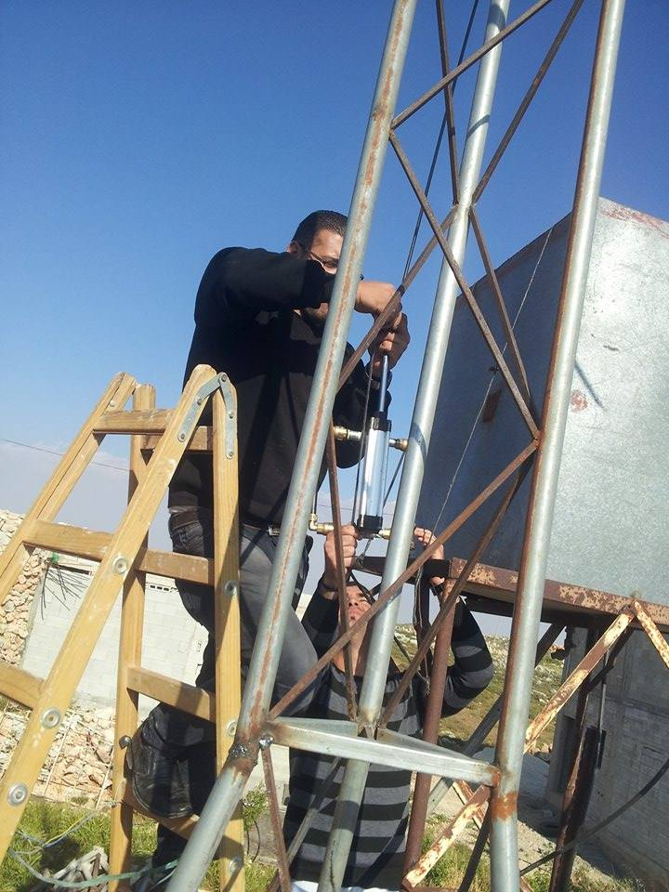
Fabrication
Piston
The piston fixed on the side the tower under 1 m from the gear box.

Slide 21
Conclusion and Recommendations
in this project we reached that wind energy can use to lift water , this project prove this aim , we faced some problem relating with equipment ,firstly finding proper pump (reciprocating pump) .
We recommend the presence of a donor for this project to be run carefully through obtaining the required tools properly,

Slide 22
Thank you

