Slide 1

An-Najah National University
Faculty of Engineering
Civil Engineering Department
Graduation Project
Foundation Design for Western Amphitheater of Nablus Municipality Stadium .
Supervisor: Dr. Sami Hijjawi
Prepared by:
Dana Amer
Reema Alhaj Ahmad
2010 -2011

Slide 2
project definition
The project is concerned about the design of foundation for The Western Amphitheater at Nablus Municipality Stadium for football.
The project site lies to the west of the playing area of Nablus stadium.
The stadium has a capacity around 5,000 persons, and expands on a distance about 120m, its area is about 2110m², and the amphitheater consists of 18 seating's area.

Slide 3
Project definition
Below the amphitheater, there are sport halls in the southern part and some commercial shops with a cafeteria above in the northern part.

Slide 4
Geotechnical investigation report
The geotechnical conditions at the project were studied and a site investigation report was prepared.
The results of the investigation revealed that the subsurface conditions at the construction locations are erratic (non-homogeneous).

Slide 5
Geotechnical investigation report
At the northern part of the site, brown and plastic silty clay was encountered to an average depth of boreholes about 10m.
Where ;
At the southern part the soil was encountered containing boulders and has greater bearing capacity.

Slide 6
Types of foundation used:
There are four types of foundations used depending on soil type, bearing capacity and the suitability of the type recommended with the site condition:
Single footings.
Combined footings.
Mat foundation.
Piles foundation.

Slide 7
Single footing design :
Isolated footing are used to support single columns , Its function is to spread the column load to the soil , so that the stress intensity is reduced .
This is one of the most economical types of footings and is used when columns are spaced at relatively long distances.

Slide 8
Single footing design
Single footings are designed using hand calculations, SAP and PROKON.
Single footings are proposed to be constructed on the southern part, the allowable bearing capacity is 250 kN/m² .
Loads on columns are calculated using tributary area method and classified into four groups according to its ultimate load .

Slide 9
Single footing design
Design of single footing :
Representative column | Horizontal load KN |  | Vertical load KN |  | Group
 | Live load | Dead load | Live load | Dead load
F4 | -7.5 | -6 | 107.5 | 181.5 | 0-400
A17 | -5.5 | -5.03 | 271 | 285 | 400-800
C19 | 7.04 | 5.6 | 460.4 | 386 | 800- 1200
F17 | 7.22 | 5.73 | 577.2 | 494.4 | > 1200

Slide 10
Single footing design
Manual Design steps :
Area of footing = Total service loads on column / net soil pressure.
Determine footing dimensions B & H.
Assume depth for footing .
Check soil pressure .
Check wide beam shear : ΦV_{c} > V_{ult}
Check punching shear : ΦV_{cp} > P_{ult, punching}
Design for flexure (reinforcement needed ).

Slide 11
Single footing design :
Summary of result :

Slide 12
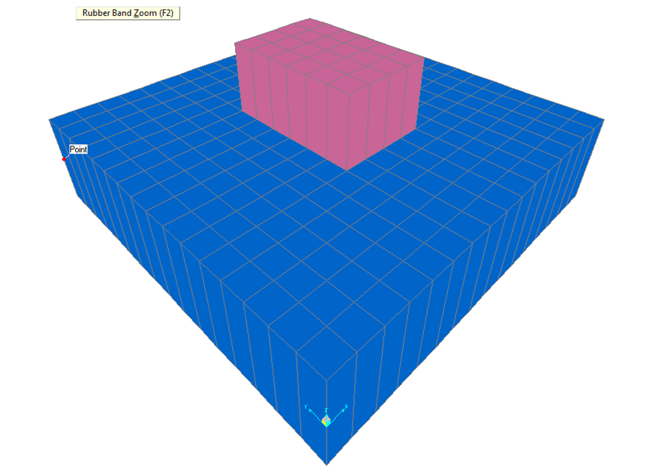
Single footing design
Design using sap

Slide 13
Single footing design
Check Deformation :
From service combination deformation of single footing must be less than 10mm .
From deformed shape the max deformation results = 5.3 mm which is less than 10mm …. OK.

Slide 14
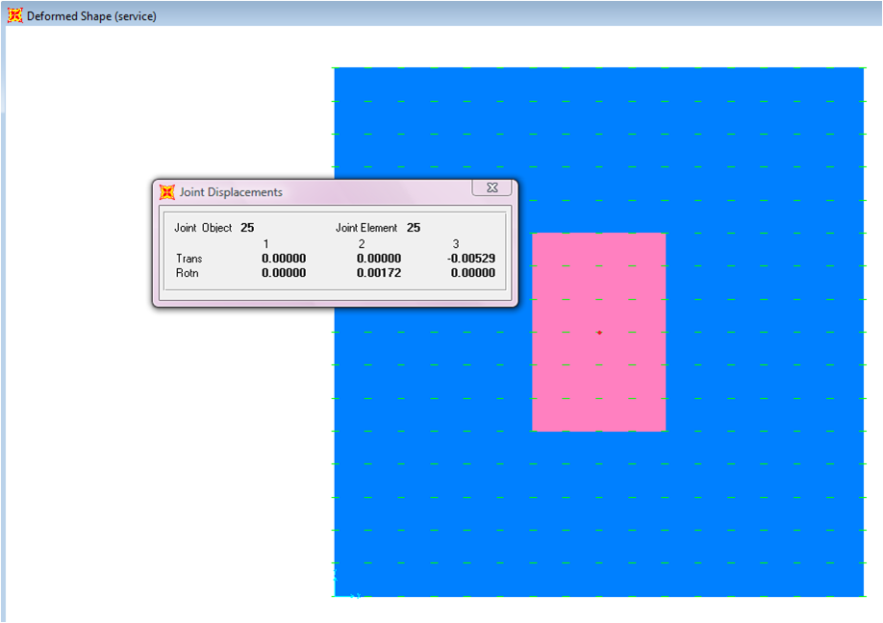
Single footing design

Slide 15
Single footing design
Check soil pressure
Joint reaction from service combination = 1.138 KN .
Soil pressure = 113.8 KN/ m²
Which is less than 215 KN/ m² ....OK

Slide 16
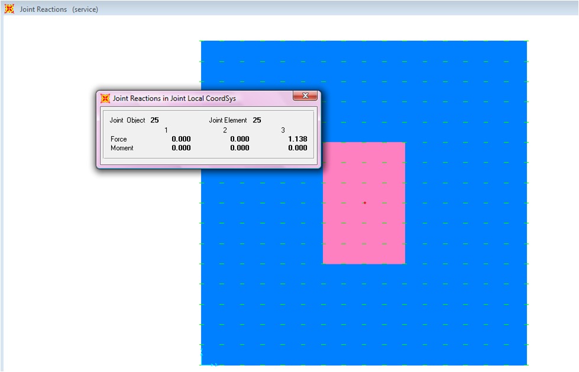
Single footing design

Slide 17
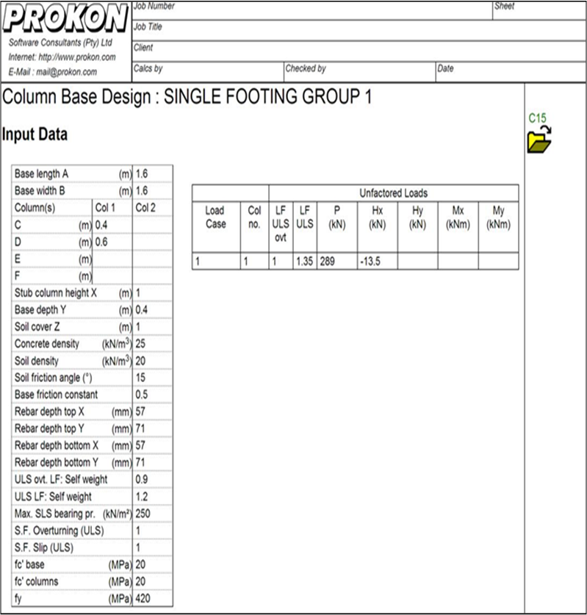
Single footing ( prokon)

Slide 18
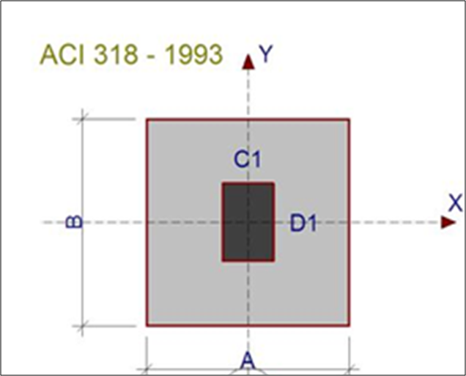
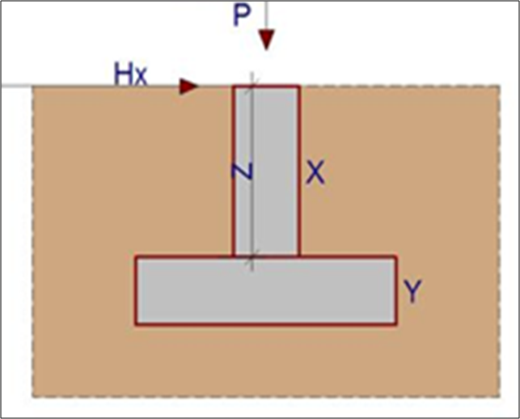
Single footing (prokon)

Slide 19
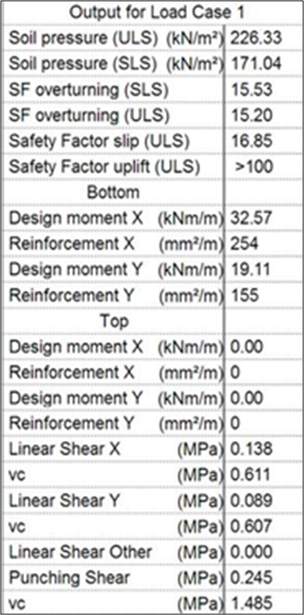
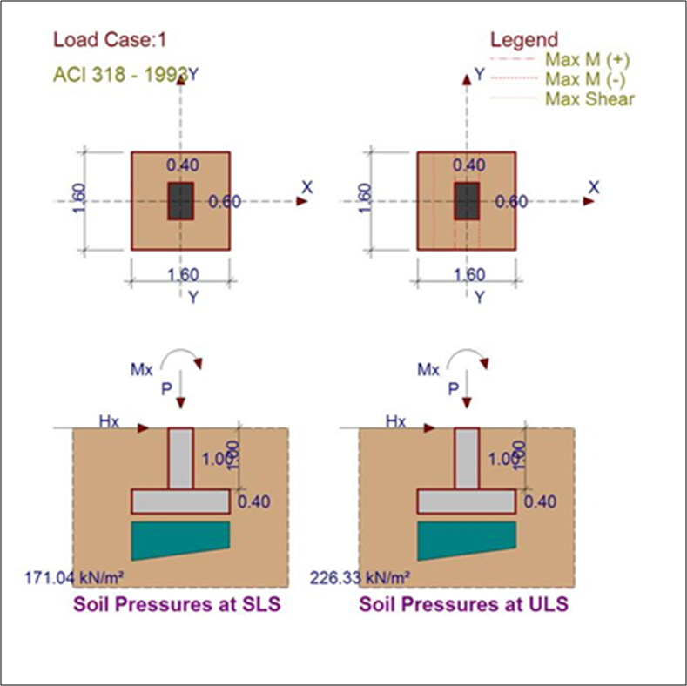
Single footing (prokon )

Slide 20
Combined Footing.
Combined footings are designed using PROKON.
Combined footings are proposed to be constructed on the southern part, the allowable bearing capacity is 250 KN/m².

Slide 21
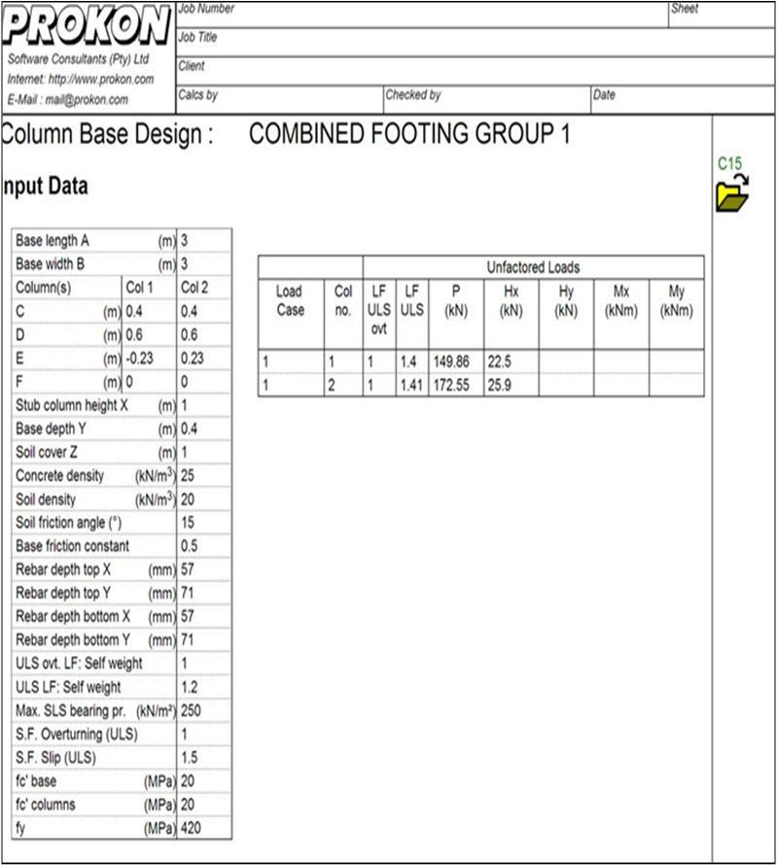
Combined footing :

Slide 22
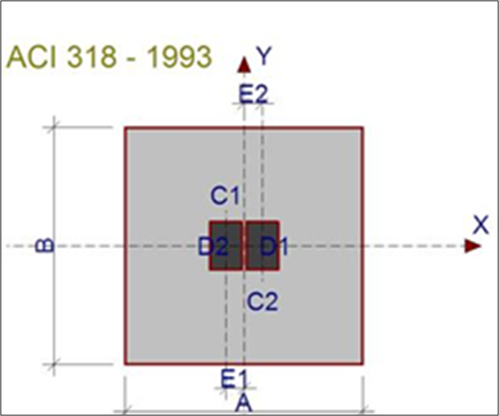
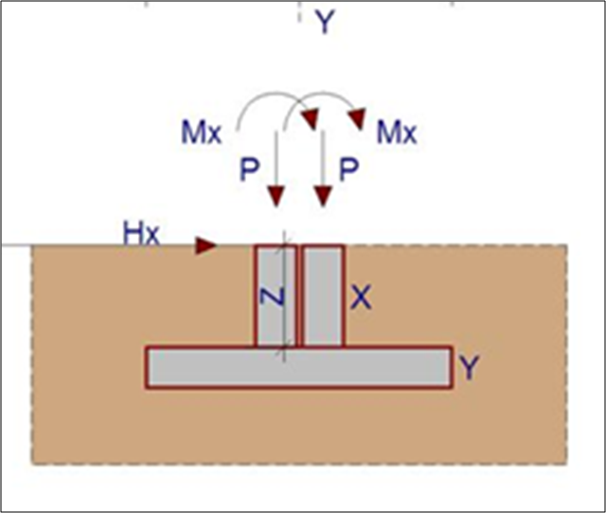
Combined Footing : Sketch Of Base

Slide 23
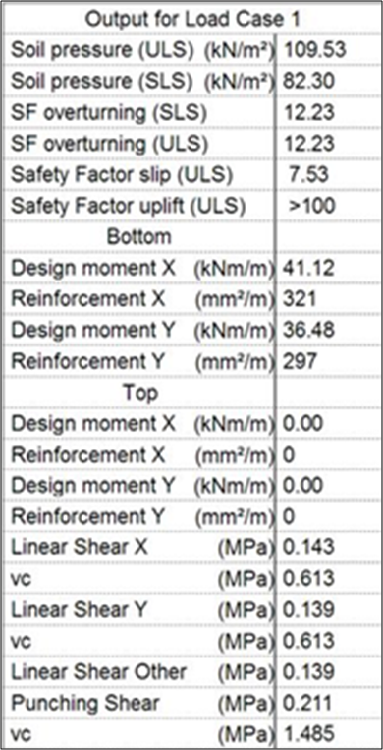
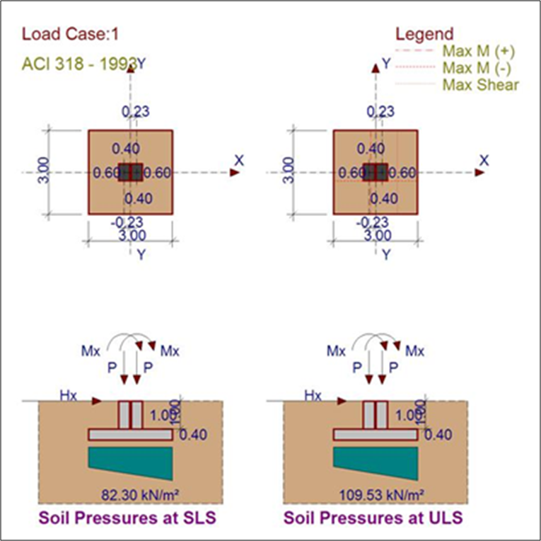
Combined footing: Output For Load Case:

Slide 24
Combined footing: Reinforcement
For this group reinforcement = 5Ф14/m top and bottom in each directions X and Y.
This value of reinforcement is obtained from the minimum value, because both reinforcement values obtained from Prokon are less than the minimum value which = 720mm² per 1m.

Slide 25
Mat Foundation :
Mat foundation is designed using SAP .
Mat foundation is proposed to be constructed on the northern part, the allowable bearing capacity is 160 KN/m².
Columns are 60*60 and 40*60cm.
It’s dimensions are : 24.4m * 15.05m * 0.8m

Slide 26
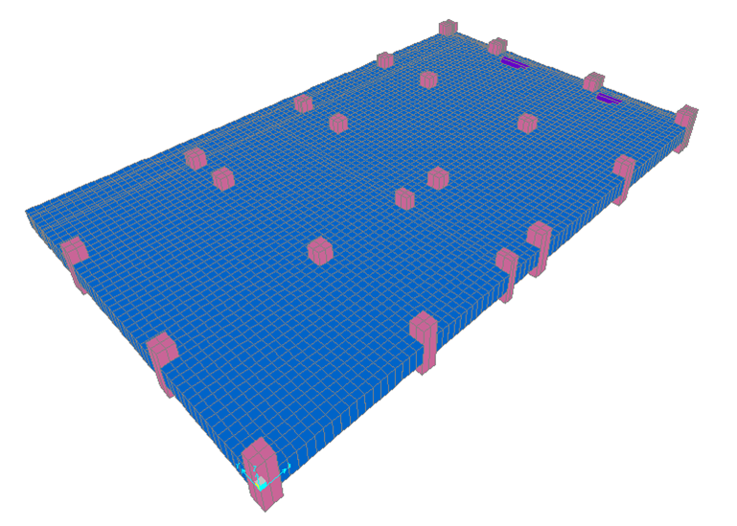
Mat foundation

Slide 27
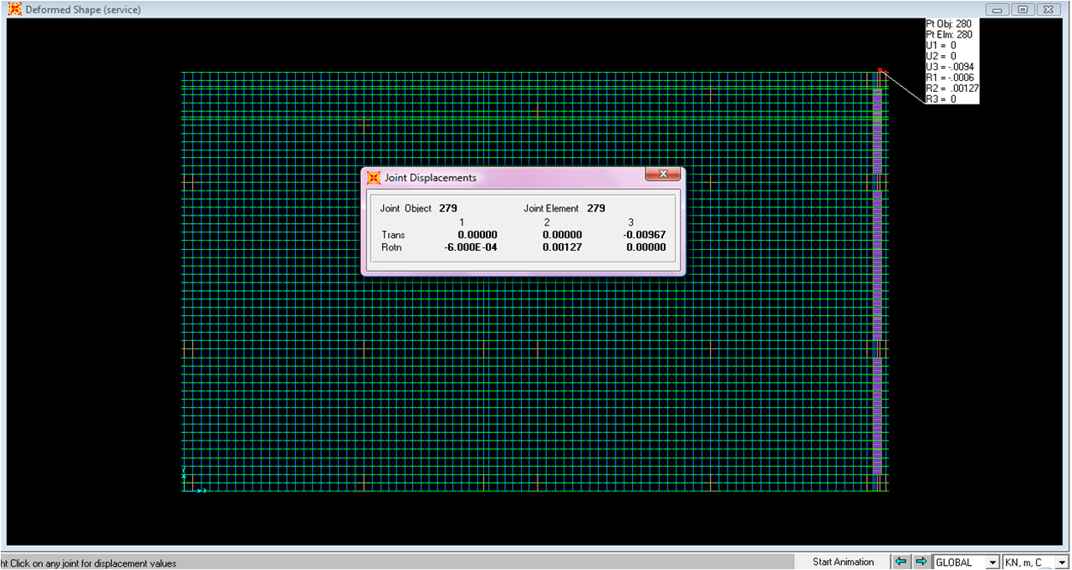
Mat foundation
Check deformation of mat foundation :
Maximum value of deformation= 0.009 < 0.01 Ok.

Slide 28
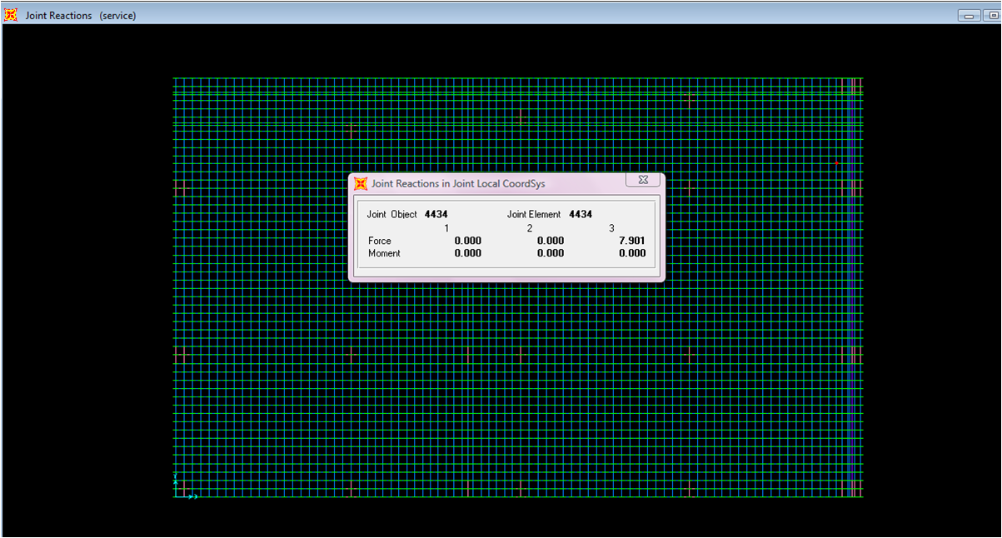
Mat foundation
Check soil pressure :
Soil pressure = 87.78 KN/m² < 160 KN/m² OK

Slide 29
Mat foundation reinforcement
Top reinforcement : 5Ф20/1m.
Bottom reinforcement : 5Ф20/1m when the moment is less than the minimum value and 5Ф25/1m when the moment is larger than the minimum value

Slide 30
Settlement of mat foundation :
Sc =9.12 cm
This value is not acceptable, to reduce it soil improvement techniques must be done before the construction process such that:
Dynamic Compaction of soil.
Pre-compression (mainly for soft saturated Clayey Soil ) using surcharge load for reducing consolidation settlement .

Slide 31
Pile foundation
Pile foundations are designed hand calculations and SAP, where capacity of pile is evaluated using ALL PILE program .
Its assumed to be design as another alternative for mat foundation .

Slide 32
Pile foundation
Manual design steps :
The minimum distance between two piles is 3D
Pile caps should extend at least 15 cm beyond the outside face of exterior face of exterior piles.
The minimum thickness of pile cap above pile heads is 30 cm.
The cover in pile caps commonly ranges between 20 & 25 cm .

Slide 33

Pile foundation
Design Steps:
Number of pile required .
Cap dimension
Assume depth (d)
Check shear .
Reinforcement design

Slide 34
Pile foundation
Cap of 2 piles( D = 60 cm , length 10 m) are used for all columns at structural break .
Cap for column R17 is designed using sap where 4 piles of ( D = 60 cm , length 10 m) are required .
Cap for columns R19 and S 19 is designed using sap where 4 piles are required .
Two piles have D = 60 cm , length 10 m .
The other pile D = 70 cm , length 12 m .
Cap and piles are designed under retaining wall

Slide 35
THANK YOU

