Slide 1
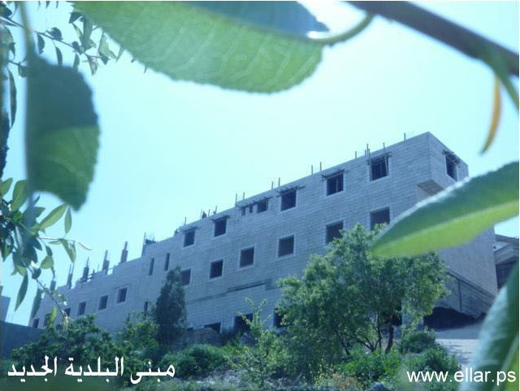
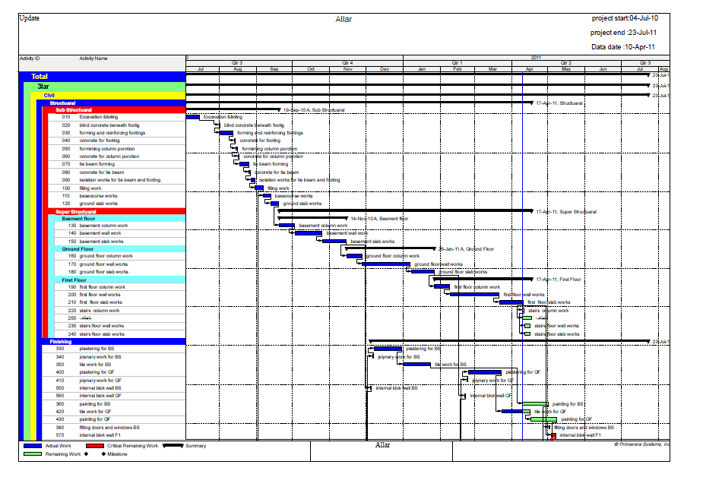
Construction Project management
Prepared by:
Muath Saadeh
Saadeh Abu-Sa’da
Kamel Beshara

Slide 2
Allar Municipality building
Graduating project consist two parts :
*The first part include preparing a theoretical research.
* The second part includes the application of the principle in construction project management.

Slide 3
Contents
Introduction
Project Time Management
Project Scope Management
Project Cost Management
Project Quality Management

Slide 4
Contents
6
Project Communications Management
7
Project Human Resource Management
8
Project Integration Management
9
Project Risk Management
10
Project Procurement Management

Slide 5

What is Project?
* Project is the collection of activities, that are related or connected, for developing a product or a service,
* Projects have always start and end times.
* Projects have always a customer who uses the results.

Slide 6
Cycle define project
timescale
budget
unique
Projects
Limited resources

Slide 7
Define
Project
Management
What is Project Management?
Project Management is the skills, tools and management processes required to undertake a project successfully.
It is a set of principles, practices, and techniques applied to lead project teams and control project schedule, cost, and performance risks to result in delighted customers.
What is the Project Management Body of Knowledge (PMBOK)?
The Project Management Institute has identified nine topic areas to define the scope of project management knowledge as follows: scope, integration, time, cost, quality, human resources, communications, risk, and procurement.

Slide 8
Brief Description Part Two
The building located in Allar village near Tulkarem city in the western strip of village
Allar municipality building is a 3 floor building consist of basement floor and 2 floors above the ground surface the basement contain a sport Jim and storage hall the ground floor (first floor ) contain a twelve storage rooms the second floor contain the employees offices and meeting and lecture hall
The area of the basement is 581.15m² and the first floor area is 616.57m² same as the second floor and the area the stairs and elevator section is 43.20m² of the area of the land which the building is constructed in is 1290.00m²

Slide 9
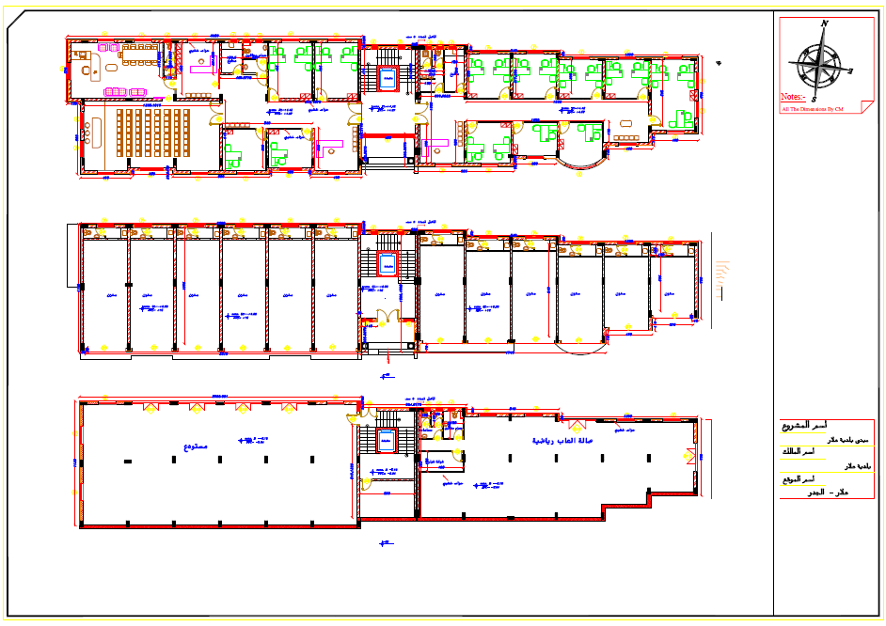
Drawings of Project:

Slide 10

Allar Municipality Building
First will be planned for the project normally
and calculating the duration of the project and the total cost of project
The purpose of our study is to obtain the final cost, and duration for it.
In order to obtain these values we followed the following steps:

Slide 11
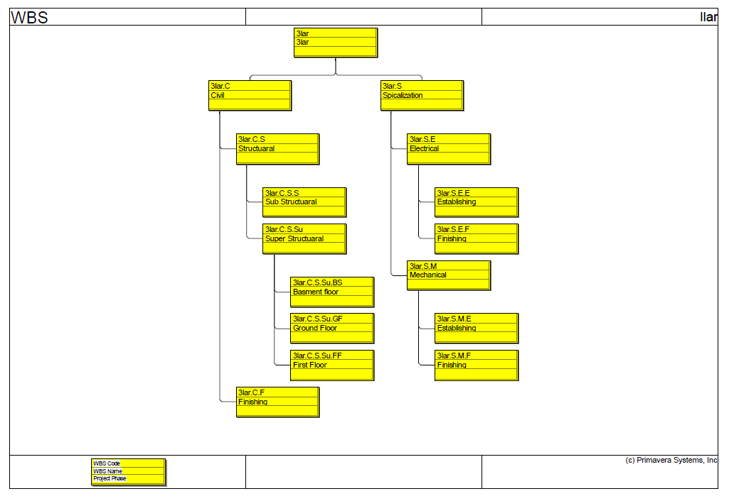
Allar Municipality Building
1- Work breakdown structure:
The project is divided into activities in a process called work breakdown structure. In this project we breakdown in the following:

Slide 12
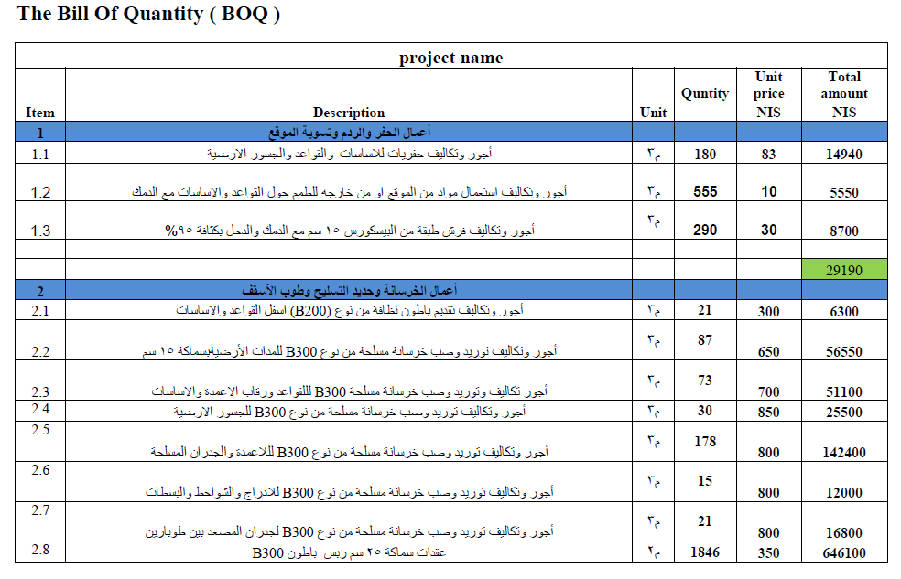
Allar Municipality Building
2- Calculate the cost

Slide 13
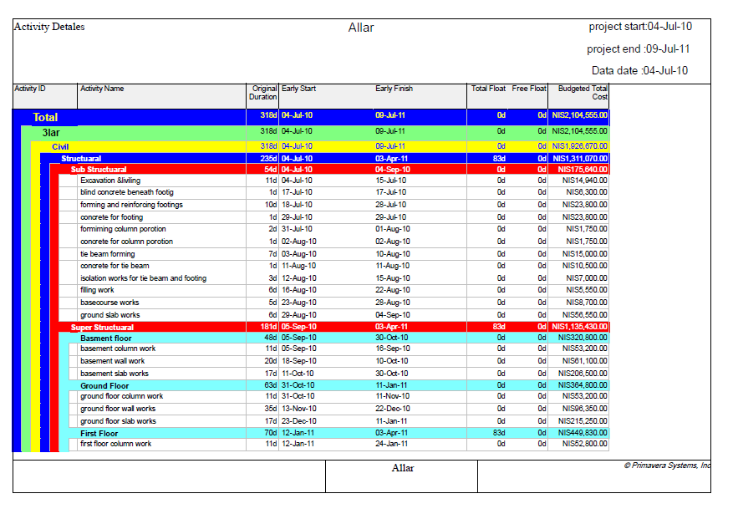
Allar Municipality Building
3-Schedual planning by primavera 6.0

Slide 14
Allar Municipality Building
Results
Total project cost = 2104555 NIS
Profit & Overhead 20% from total cost
The cost of structural work is = 1311071 NIS
The cost of mechanical work is = 95835 NIS
The cost of electrical work is = 82050 NIS
The cost of finishing work is =615600 NIS
Project start 04-Jul-2010 and end in 09-Jul-2011
Project duration 318 work day
Calendar 6day work in week

Slide 15
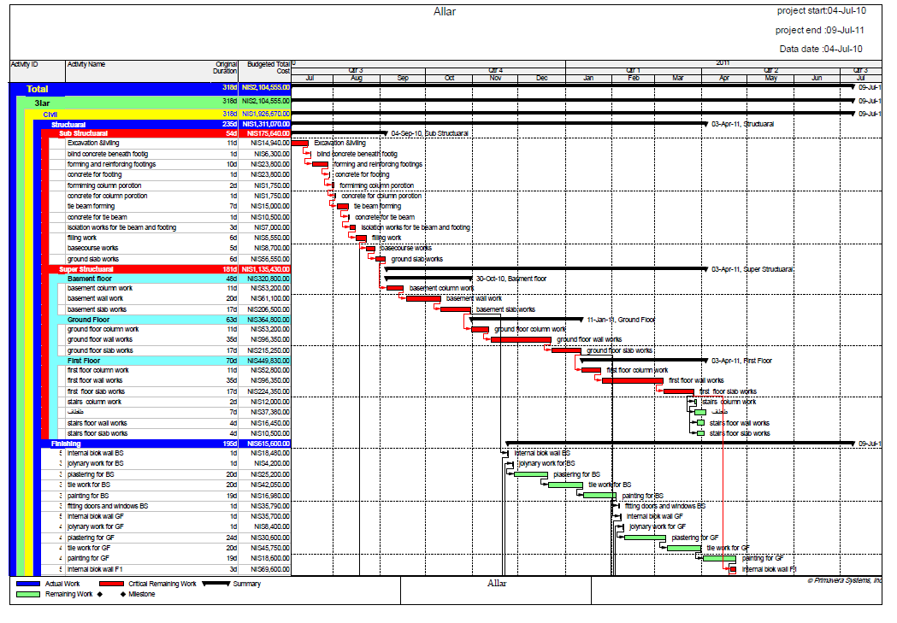

Slide 16
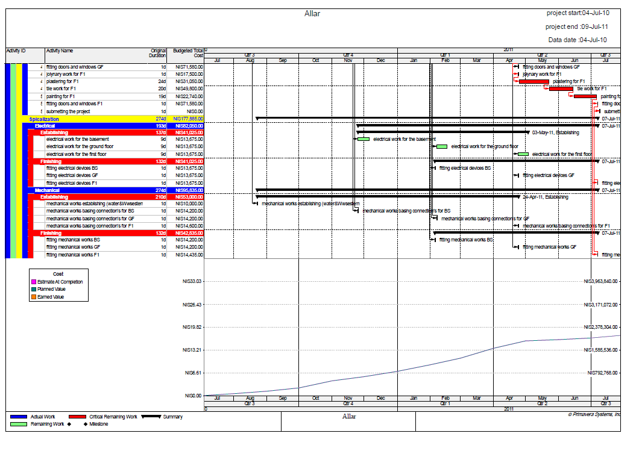

Slide 17

Update project
After the work schedule and start the implementation, we need to update the project data into compare the project actually and the planned project and the impact on the schedule.
Update date 10-4-2011

Slide 18
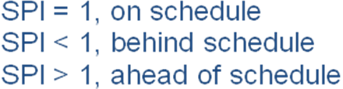
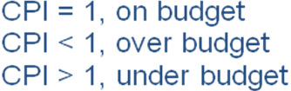
Earned Value
Earned value Reporting-Costs:
Earned value
Earned value Reporting-Schedule:
CPI
EVA
SPI
Update project

Slide 19
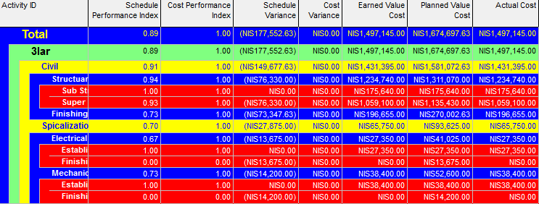
Earned Value
From this table we calculate the following:
Schedule Performance Index (SPI) =0.89
or
SPI=BCWP/BCWS=1497145/1674697=0..89 <1
SPI<1 behind Schedule (Project delayed)

Slide 20
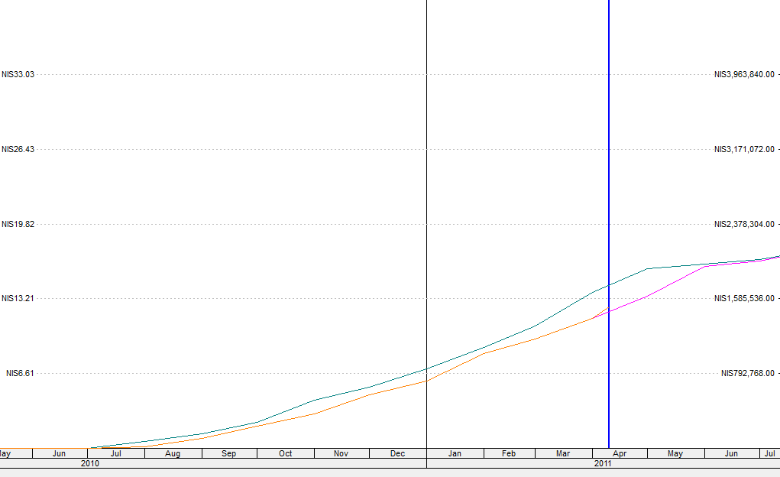
S-Curve
Update line 10-4-2011
PCWS (PV)
EAC
PCWP (EV)

Slide 21

Muath , Saadeh , Kamel

