Slide 1
Lean six sigma on Mega Bricks Factory
Prepared by
Reem Awad
Mostafa Ghanim
Yasmn Nser
Moath Barameh
Mamon Skafi
Supervisor : Eng Ahmed Zaid

Slide 2
Dedication
To the eyes that watched us day and night for protection...To the affectionate hearts and generous hands…. To the main reason of our success and the first creativity motivation... To whom raised us up in our education journey when we were down... To who will shed happy tears the moment when we are throwing our graduation caps up.
Our beloved parents…
y.

Slide 3
Introduction About our project

Slide 4
Lean Six Sigma
is a combination of two powerful methods: Lean and Six Sigma complement each other. Lean accelerates Six Sigma, delivering greater results than what would typically be achieved by Lean or Six Sigma individually. Combining these two methods gives the improvement team a comprehensive tool set to increase the speed and effectiveness of any process within the organization – resulting in increased revenue, reduced costs and improved collaboration .

Slide 5
Lean
Lean is popular for its methodical approach to streamlining both manufacturing and service processes by eliminating waste while continuing to deliver value to customers. Although Lean is widely known for these benefits, it’s not just a set of tools.
Six Sigma
Six Sigma is simply a method of efficiently solving a problem. Using Six Sigma reduces the amount of defective products manufactured or services provided, resulting in increased revenue and greater customer satisfaction.
Six Sigma identifies the cause(s) of your problem to efficiently develop effective solution(s).

Slide 6
Benefits of Using Lean Six Sigma
Lean Six Sigma Increases Revenue.
Lean Six Sigma Decreases Costs
Lean Six Sigma Improves Efficiency & Effectiveness
Lean Six Sigma improves the efficiency and effectiveness of your organization
Lean Six Sigma develops effective people/employees within your organization.
Introductions to Mega Co.
Mega bricks and material construction Co. Established in 2010 , it has a factory at Tulkerem (kofer sour ) with an area of almost 5donmes it has one production line that manufactures bricks with different kind the company work 6 days a week from 6 am -4pm , for each day the factory production quantity 1000 ballet and pallets have different capacity depend on the type of bricks.
Raw Material and Finished Product :
Raw Material :
Water
Concrete
ناعمة راجعة
سمسم

Slide 7
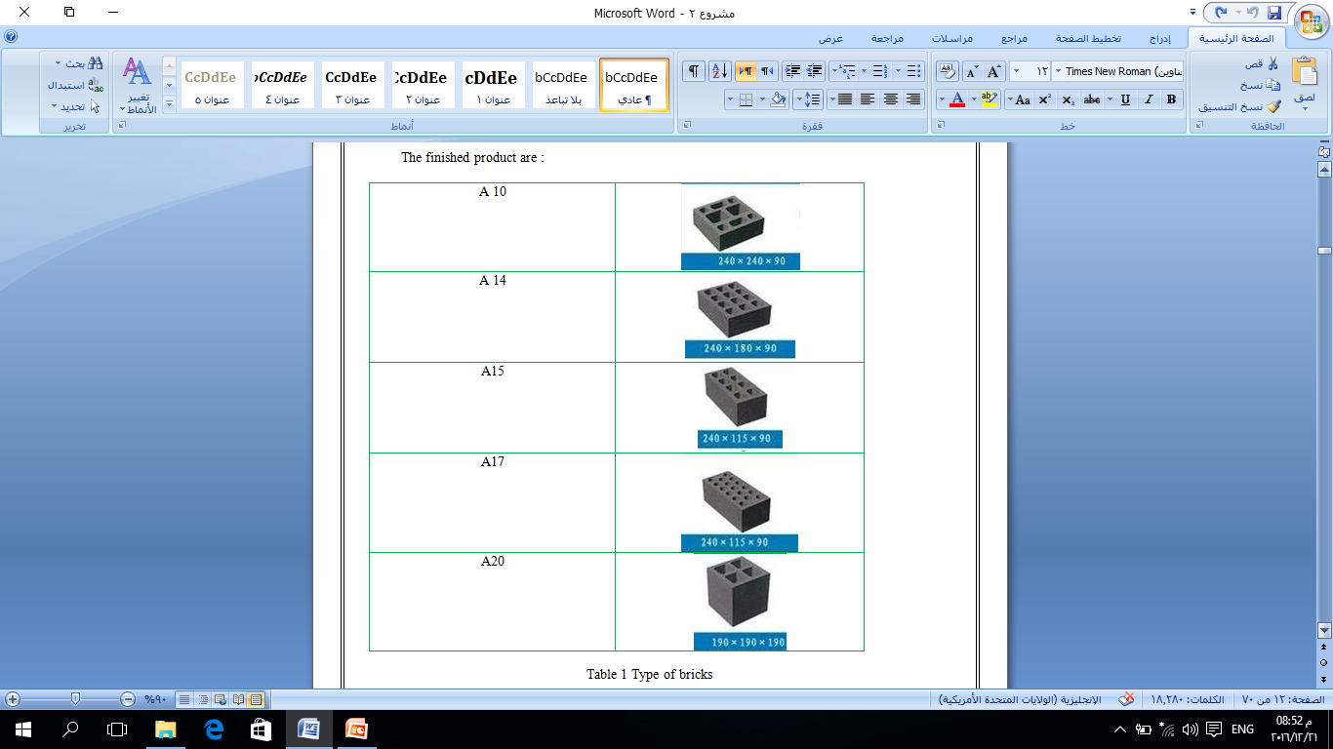

Slide 8
  Statement of the problem.
The factory has issues that delay the whole work by hours and sometime the whole work day ,lack of documentation and the documentation of failure that caused time and delay , finally lake of supervision on the employee
We include in graduation project (4)case study :
1. Lean Six Sigma in a call centre (Laureani et al, 2010a)
2. Lean Six Sigma in health-care delivery
3. An aircraft manufacturer: Reducing inventory to improve cash flow
4. Electronics market leader: Accelerating innovation

Slide 9
The metrology that we use
DMAIC
DMAIC is the Six Sigma acronym for the five steps used to improve an existing process or product. These are:
•Define the Project — This is usually a problem to be solved. What are the goals, resources and limits of the project?
•Measure – Collect data about the current system or process.
•Analyze the Data — To find the root cause of the error.
•Improve – Design and implement changes that will eliminate the error. Some techniques that are used include design of experiments, poka-yoke and standard work.
•Control – Provide a system that allows monitoring and adjustments to maintain and improve on what was accomplished.

Slide 10
Some of the lean six sigma tool that we use
1. Cause-and-effects diagrams (fishbone diagram)
2.Histograms
3.Run Chart
4.Pareto charts
5.Stratification (flow charts)
6.Control charts
Scatter diagram
Takt time
DPMO
SCAMPER

Slide 11
Measure and analysis

Slide 12
Measure and Analysis
Measure Phase
"You can manage what you can measure; you can measure, what you can define; you can define, what you can understand".
Measure is the second phase of a team’s work with the Lean Six Sigma process improvement strategy. In this phase the focus of the team shifts from qualitative to quantitative components of the Lean Six Sigma methodology.
The goal of the Measure phase of a Six Sigma DMAIC project is to get as much information as possible on the current process so as to fully understand both how it works and how well it works. This entails three key tasks:
creating a detailed process map
gathering baseline data and summarizing
analyzing the data.

Slide 13
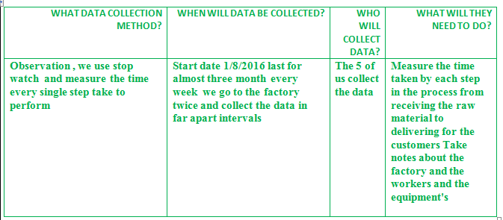
The lean tools and procedures that we will use in these phase are :
Outline performance standard's
Data collection plan
Fish bone diagram
Process map
FMEA
Outline performance standards
1. Operational definition

Slide 14
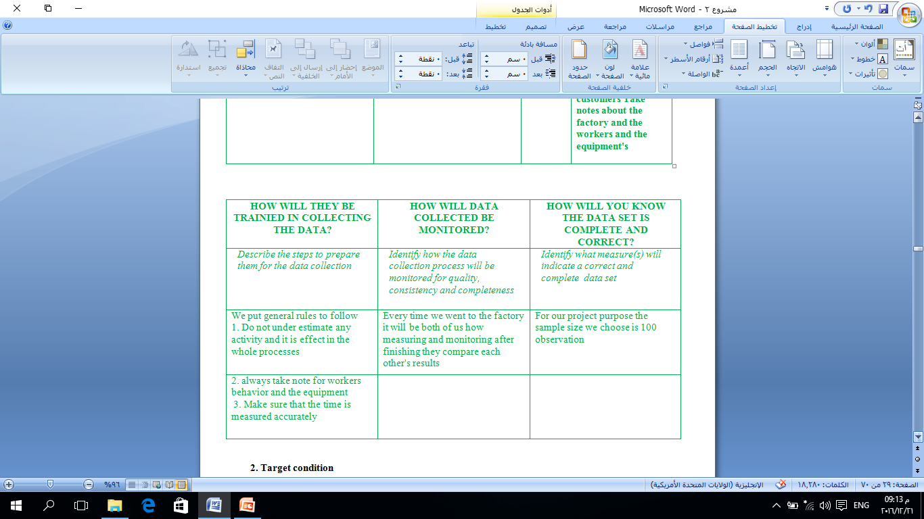

Slide 15
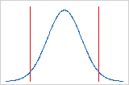
2. Target condition
It is what we want to achieve. It is a tangible image; something that we can describe. This is not just the result that we want, but how we want things to be or work.
our target from the whole project is to achieve customer satisfaction by decreasing the manufacturing and delivering time and deliver the final product on time and also to increase manufacturing productivity and with number the target is to deliver for each customer within 1.5 day or minimum.
3. Specification limits
We choose the specification as follow :
Upper specification limits is 3.
Lower specification limits is 7 . (it is not that important in these kind of problem because the lower we get the better, the more customer satisfied )

Slide 16
4. Defect definition
Defect is any point that located out the specification limit that we assigned.
Data collection plan
Data Collection Strategy – Sampling
Sampling can be done by following methods Probability Sampling :
Simple Random Sampling.
Stratified Random Sampling.
Systematic Sampling.
Cluster Sampling.
Our collection plan
We use the simple Random sampling for measuring time for each process from receiving the raw material to deliver the bricks to the customers.
We choose A20 this product is the best seller these year and the year before and has the highest demand, till these moment.

Slide 17
the measuring phase last for 3 months ,we collect data for 100 trial the collecting data sheet will be attached in the Appendix , the category(process) that we measure the time for:
preparing and ordered the raw material.
mixing the raw material.
preparing the mold.
change the mold.
machining .
transfer to another place.
transfer to the drying area.
move for shipment .
delivering for the customer.

Slide 18
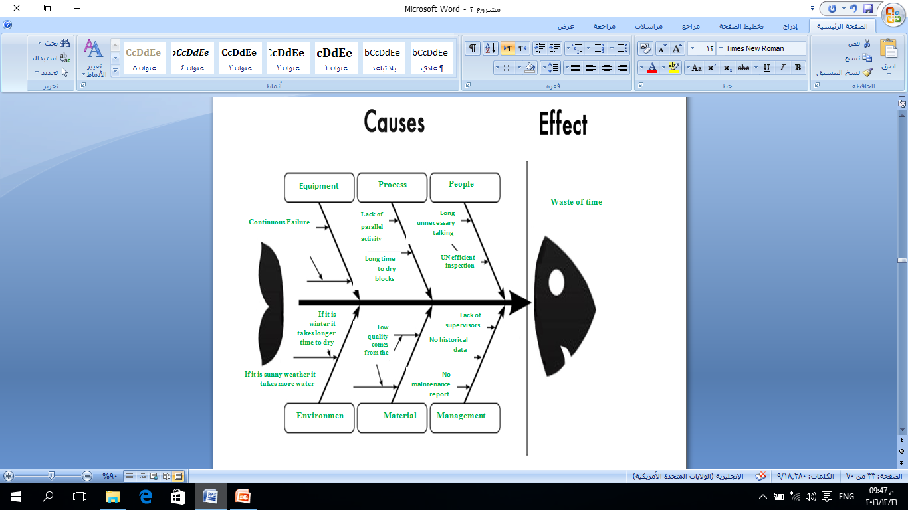
Fish bone diagram

Slide 19
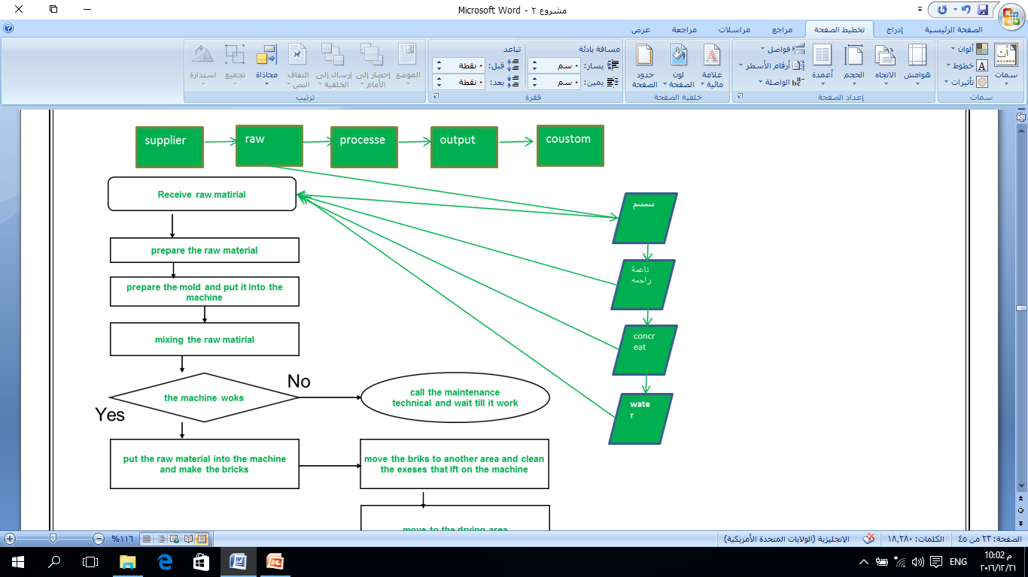
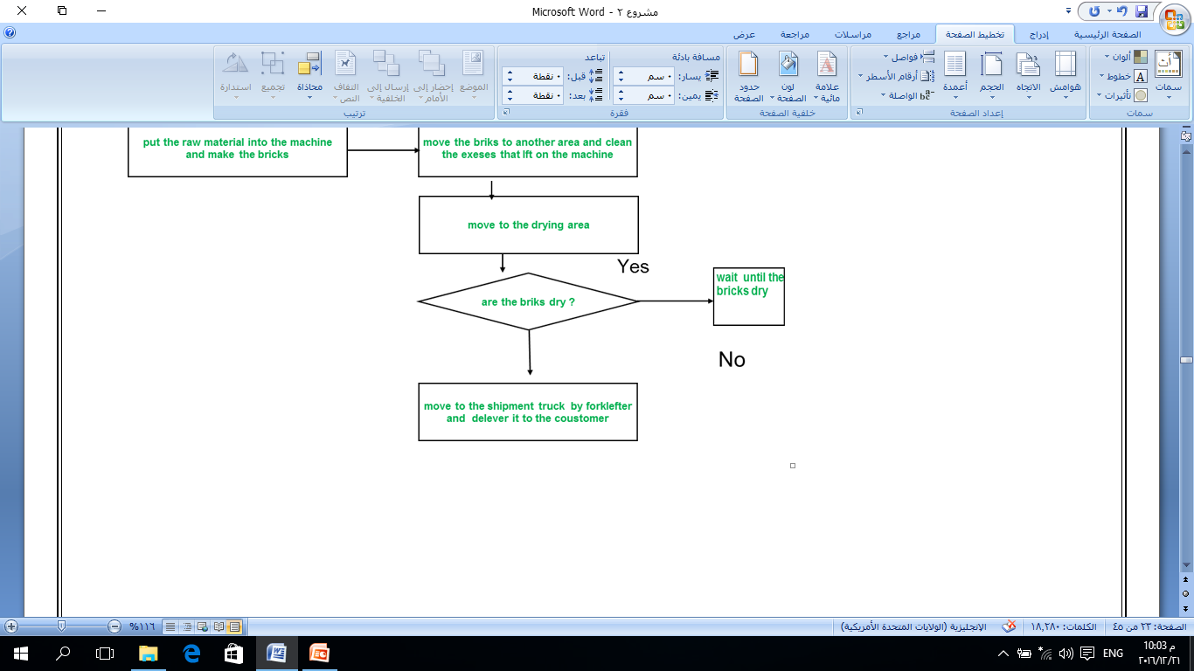
process map (flow chart )

Slide 20
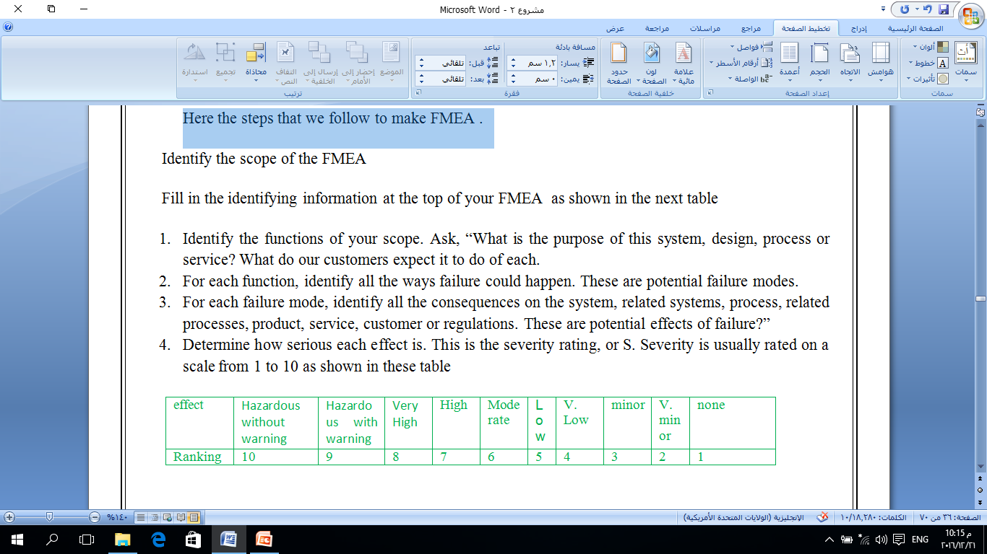
FMEA
FMEA is a qualitative and systematic tool, usually created within a spreadsheet, to help practitioners anticipate what might go wrong with a product or process.
Finding Failure Modes
Here the steps that we follow to make FMEA .
Identify the functions of your scope.
For each function, identify all the ways failure could happen.
For each failure mode, identify all the consequences on the system.
Determine how serious each effect is. This is the severity rating, or S. Severity is usually rated on a scale from 1 to 10 as shown in these table .

Slide 21
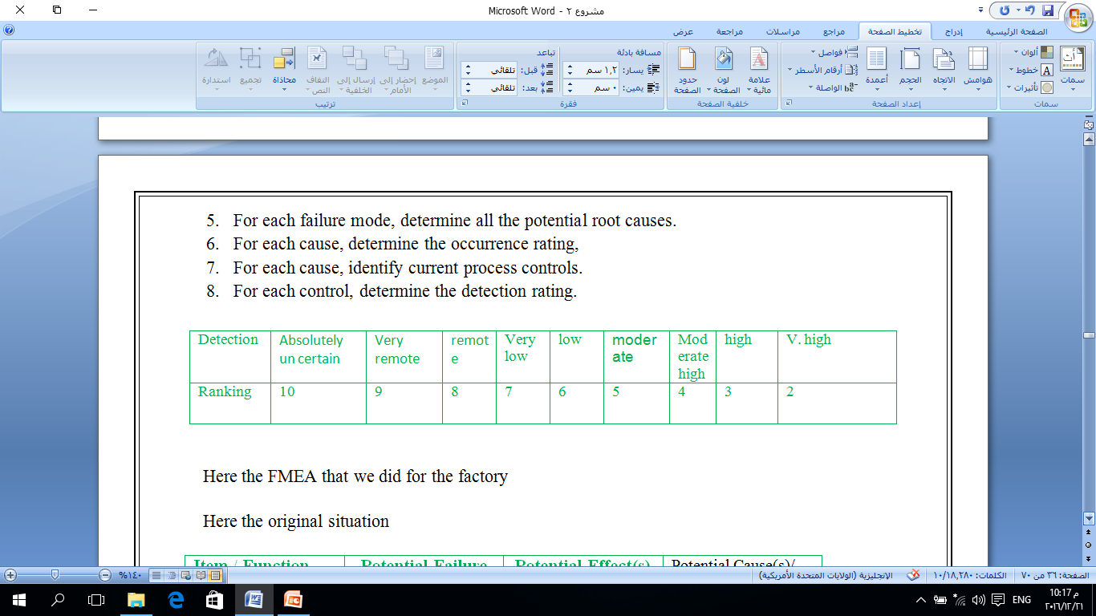
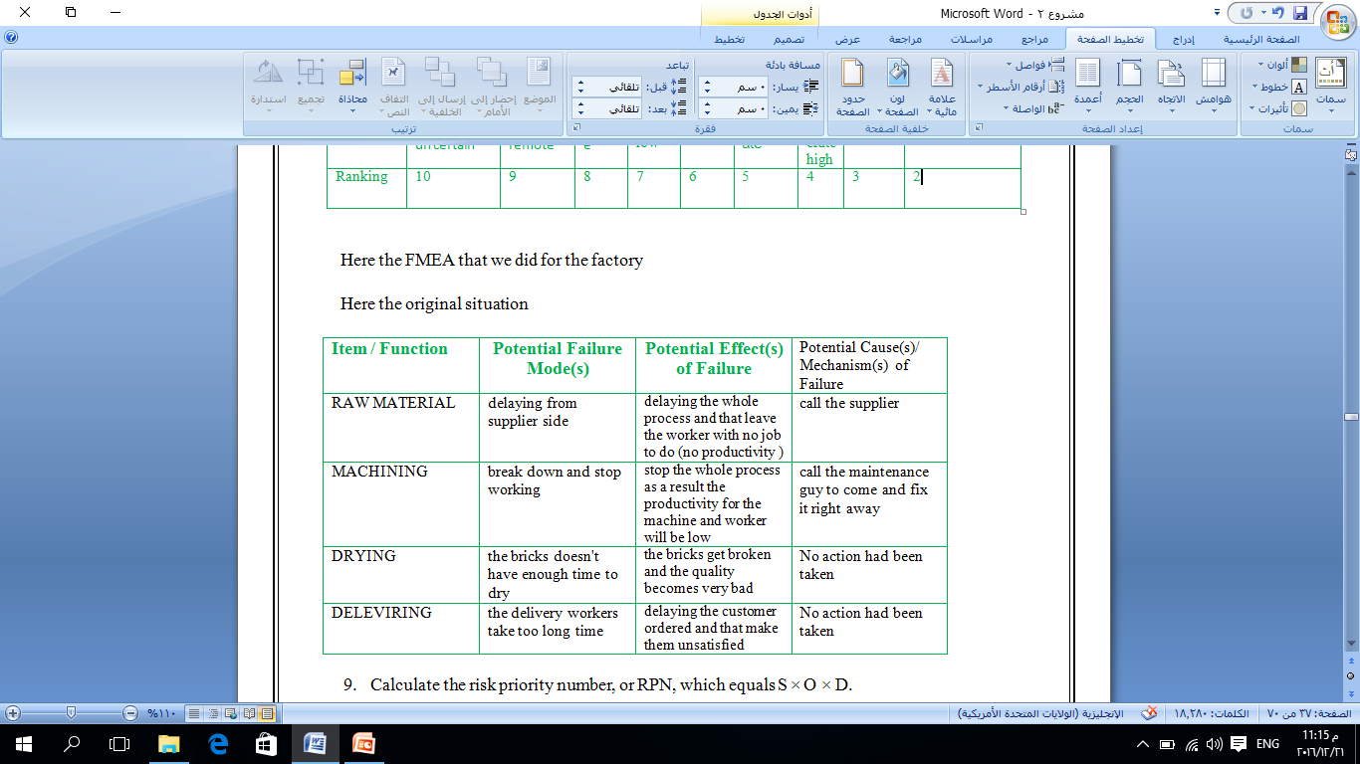
For each failure mode, determine all the potential root causes.
For each cause, determine the occurrence rating,
For each cause, identify current process controls.
For each control, determine the detection rating.
Here the original situation

Slide 22
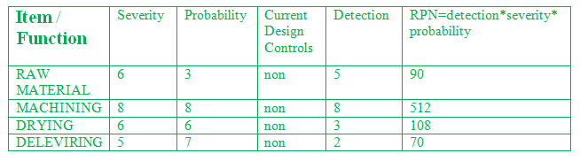
Calculate the risk priority number, or RPN, which equals S × O × D.
From the observation we can see that the major critical, risk item is machining with RPN=512 and by ordered them from the highest RPN
  Machining with RPN =512
  Drying with RPN =108
  Raw material with RPN=90
  Delivering with RPN = 70

Slide 23
After we finish the measure phase the result from these phase are
  We did a sampling process for sample size =100 over 3 month for every single process in the production line we choose the product A20 because it is the product with the highest demand and with the highest sales in these year
  After we finish sampling and talking notes we did a fish bone diagram with the factory problem (waste of time) and we define every reason for these problem
  After we did a process map we see where the bottleneck are which is machining and drying processes
  After we finish the FMEA process we narrow down the reason for our problem to 4 and rank them from the most risk priority number to the least one and evaluate them with number

Slide 24
Phase two: Analyze
Analyze in lean six sigma is: analyze the data to investigate and verify cause-and-effect relationships. Determine what the relationships are, and attempt to ensure that all factors have been considered. Seek out root cause of the defect under investigation.
The analyze phase divided into three steps:
Step 1: Baseline the process’s current capability.
Step2: Define the performance objectives for the process
Step3: Identify sources of variation
The steps and lean tools that we will in Baseline the process’s current capability.:
  Histogram
  Run chart
  Pareto Analysis
  Value steam mapping
  Scatter diagram

Slide 25
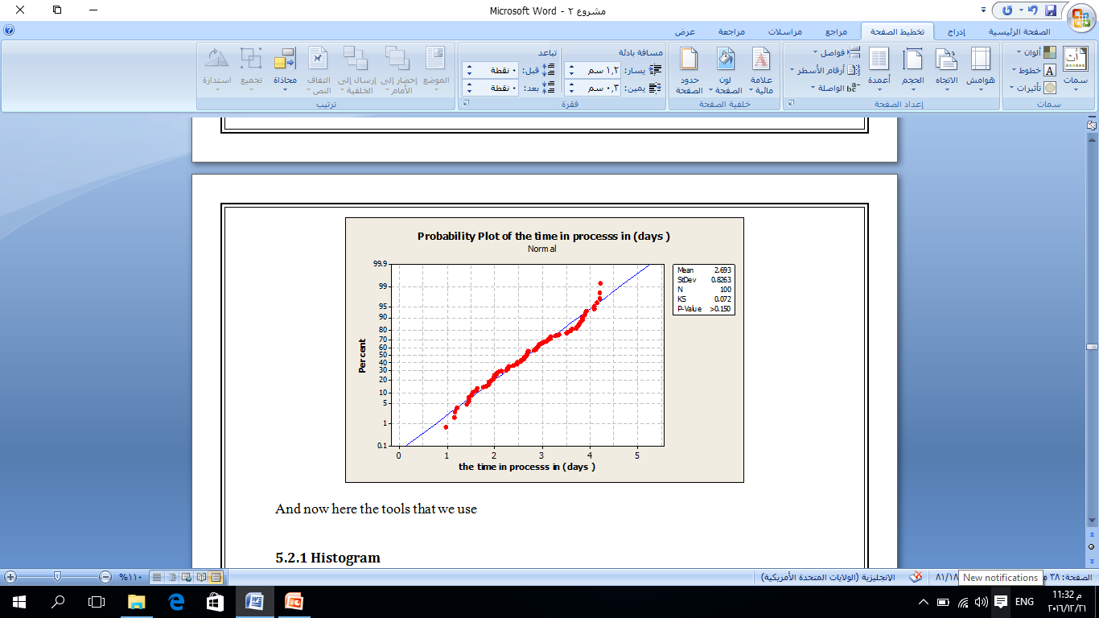
We analyze the data by Minitab to know what distribution to use and what it is the lower and upper Specification limit and the mean and the slandered deviation without any change in it so we can evaluate the current stat for the factory so the result was it is normally distributed(by the normality test as shown ) with mean =2.689 and LSL =.85 USL=4.55 and standard deviation=.827 , the result shows us that the process it is very wide .

Slide 26
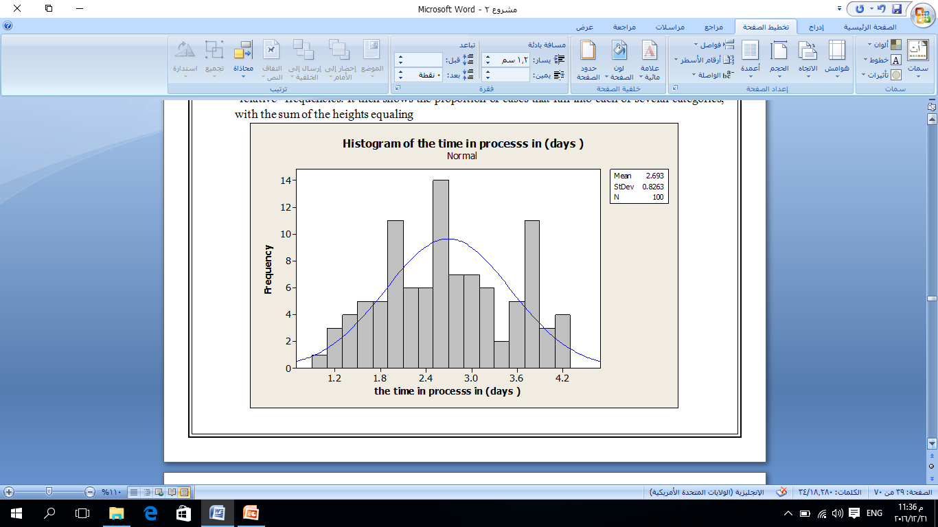
Histogram
A histogram is a graphical representation of the distribution of numerical data. It is an estimate of the probability distribution of a continuous variable (quantitative variable) and was first introduced by Karl Pearson.
As we can see from these figure the data is normally distributed, as we can see the data have more tendency towering the right it is has more frequent , however it is not that big tendency it is just normal .

Slide 27
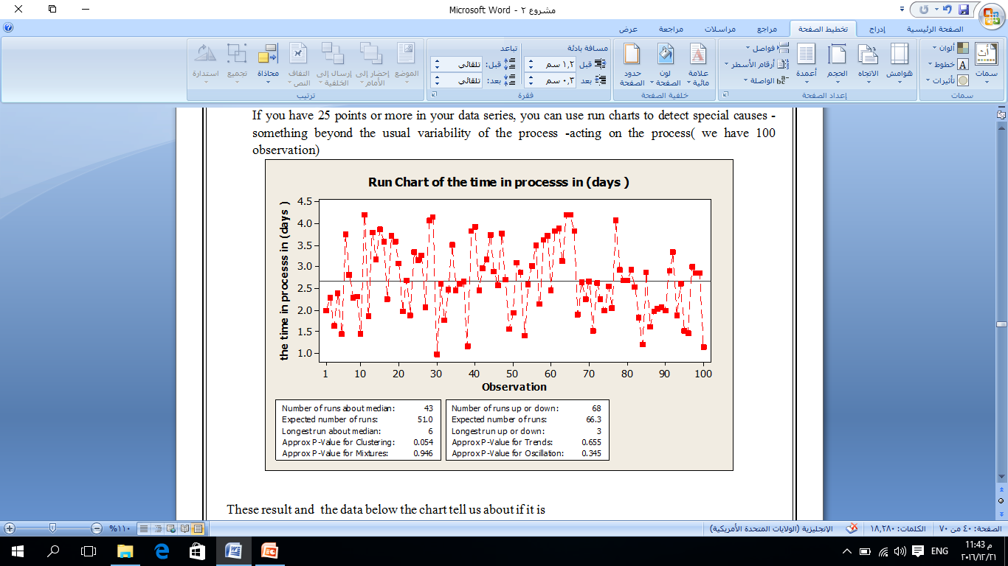
The Run chart:
Run charts (often known as line graphs outside the quality management field) display process performance over time. Upward and downward trends, cycles, and large aberrations may be spotted and investigated further.
If you have 25 points or more in your data series, you can use run charts to detect special causes - something beyond the usual variability of the process -acting on the process( we have 100 observation)

Slide 28
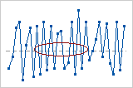
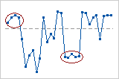
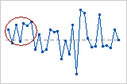
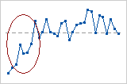
These result and the data below the chart tell us about if it is
  Mixture patterns
our p value for mixtures=.946 >.05 that's mean there is no mixtures happened.
  Cluster patterns
for our data the p value for clustering is .0546>.05 that is mean probably there is no cluster patterns .
  Oscillating patterns
our P- value for oscillation is.345 >.05 which means there is no oscillation.
  Trend patterns
for our data the P-value for trend is .665 >.05 which means there is no trends From the run chat we see that the mean 2.6 day and that’s high number of day and it cause unsatisfaction for the customer.

Slide 30
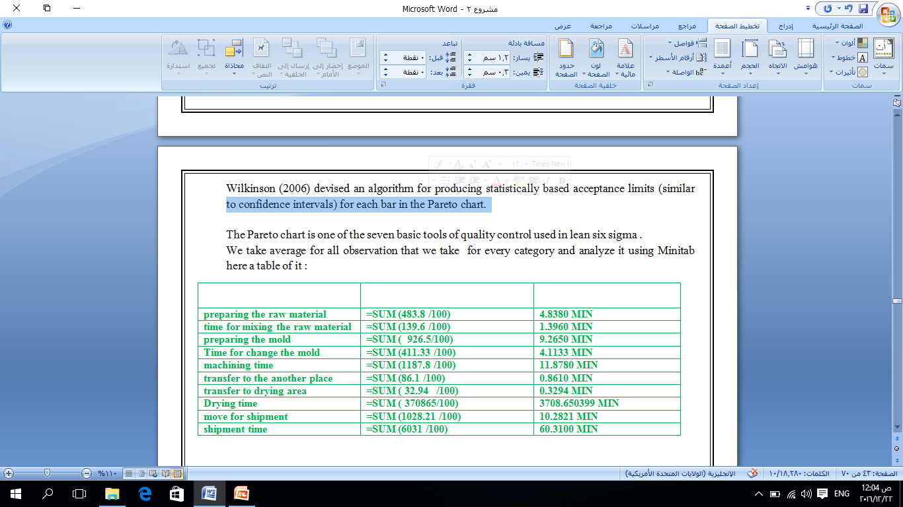
Pareto chart analysis
Pareto chart is one of the most important tools used by the six sigma consultants during the implementation of the projects. It was described by Vilfredo Pareto who was a renowned Italian economist.
We take average for all observation that we take for every category and analyze it using Minitab here a table of it :

Slide 31
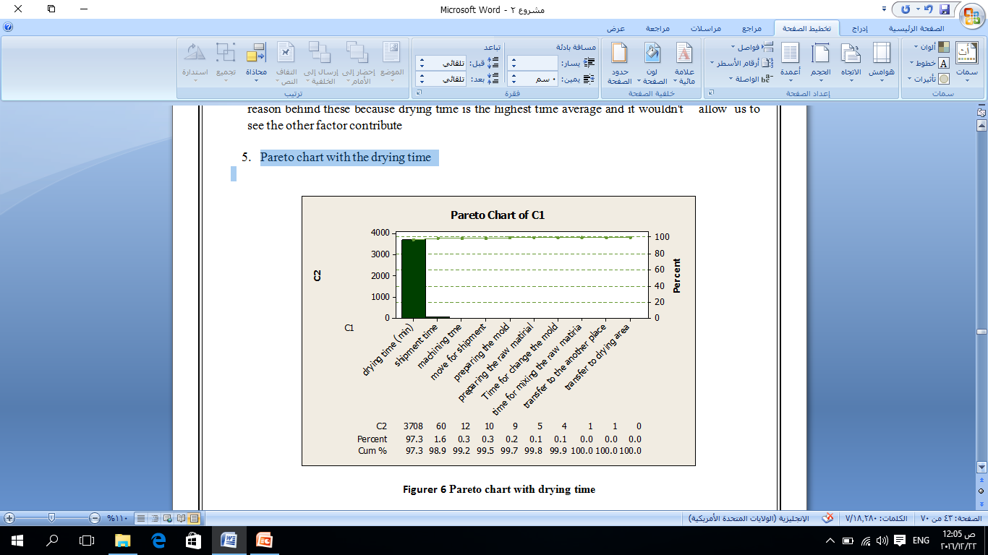
  Pareto chart with the drying time
As the chart show us the drying time alone is 97.3 of the whole time so it is the main factor of delaying with customers ordered.

Slide 32
  Pareto chart without drying time
As for the other factor beside the drying time we see that ( 79.9) percent for whole process (without drying time ) is for
Shipment time (58.4)%
Machining time (11.5)%
Move for shipment (10) %
So as a result we see that drying time is the major time consuming process in the whole production line By (97.3)% ,as for other activity the shipment and the moving for shipment and the machining time is the most consuming factor by (79.9) with percentage (3/9) .

Slide 33
After we did a Pareto chart we define the major three element that cause the delaying and unsatisfied customers
Drying Time
Machining Time
Shipping Time
And now we will did a run chart for every one of them
Run chart for shipment time

Slide 34
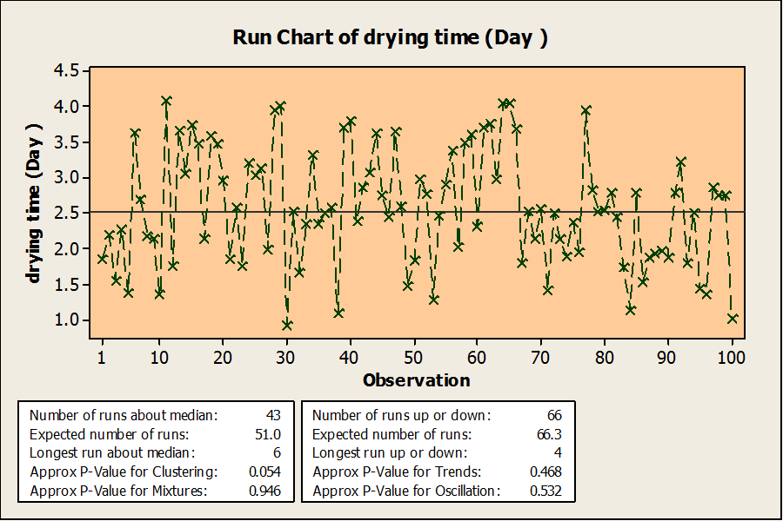
Run chart for Drying time per day
as we can see from these chart the drying time mean 2.5 day and it can reach 4 day and 1.9 or least our goal is to make it less than 1.5 for the whole process , since the Drying time takes very long time

Slide 35
Base lining process capability – Numerical method( DPMO)
Calculating Z-score
Z-Score, or z-value, is used to determine the probability of defect for a random variable critical characteristic which is measured in continuous data.

Slide 36

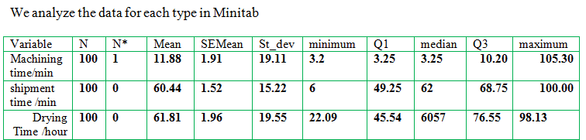
DPMO=(total count of defects /number of units number of opportunities *1000,000.
The shape of distribution of the current process is appeared as normal distribution
Z – Score =( process average – specification limit ) / process standard deviation
We have to calculate z_ value for drying time and shipment time, machining time doesn't follow normal distribution

Slide 37
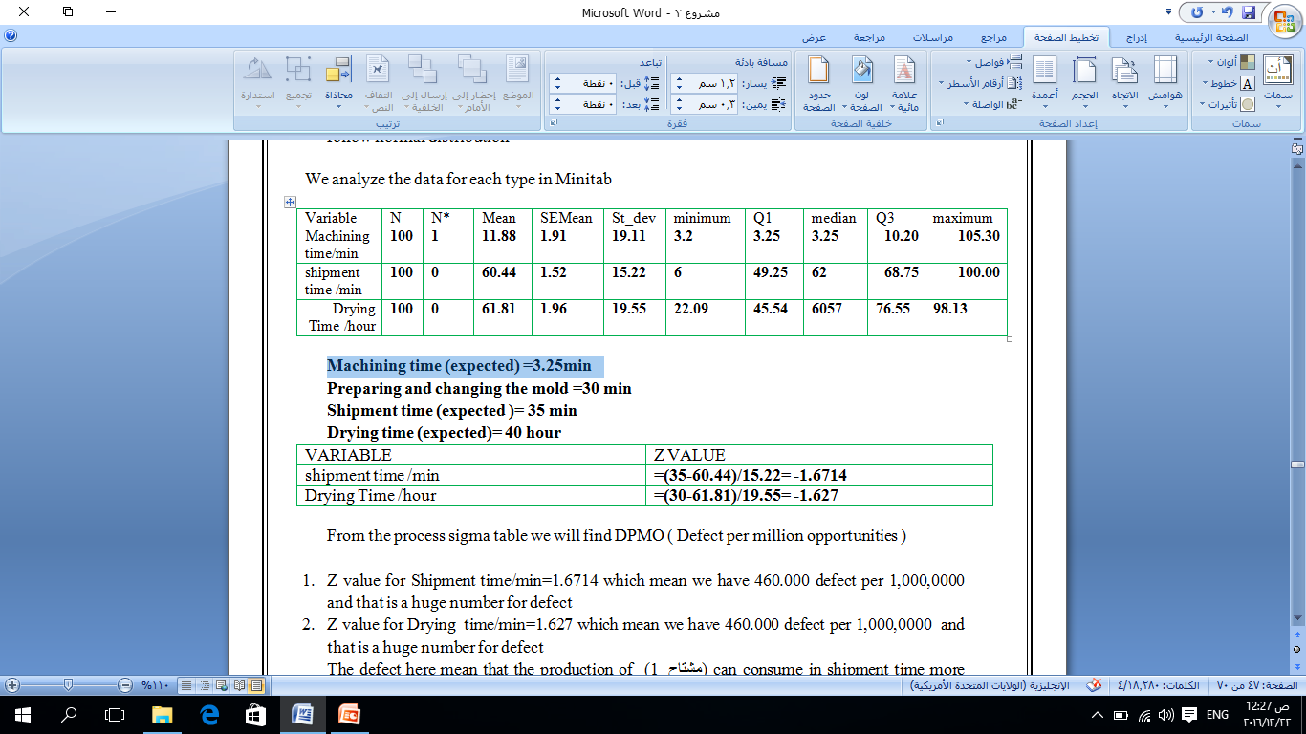
Machining time (expected) =3.25min
Preparing and changing the mold =30 min
Shipment time (expected )= 35 min
Drying time (expected)= 40 hour
From the process sigma table we will find DPMO ( Defect per million opportunities )
Z value for Shipment time/min=1.6714 which mean we have 460.000 defect per 1,000,0000 and that is a huge number for defect
Z value for Drying time/min=1.627 which mean we have 460.000 defect per 1,000,0000 and that is a huge number for defect
The defect here mean that the production of (1 مشتاح ) can consume in shipment time more than 35 MIN in 46 %
And the same for drying , The defect mean that the production of (1 مشتاح ) can consume in drying time more than 40 hour in 46 %

Slide 38
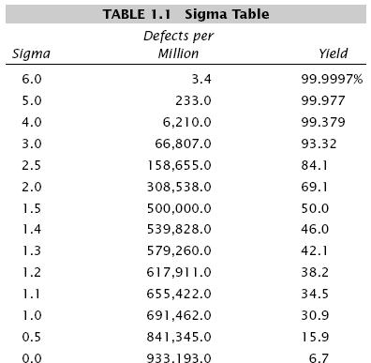
Now for the machining time we will use the formula above
DPMO=(total count of defects /number of units number of opportunities *1000,000.
Defect here is any break down happened to the machine
The opportunity the requirement that been inspected which is machine normally working without any stop or break down
=26/74 *1,000,000= 351351.35 Defects per million as we can see from the Excel sheet we count the time that the machine break down which is 26 time

Slide 39
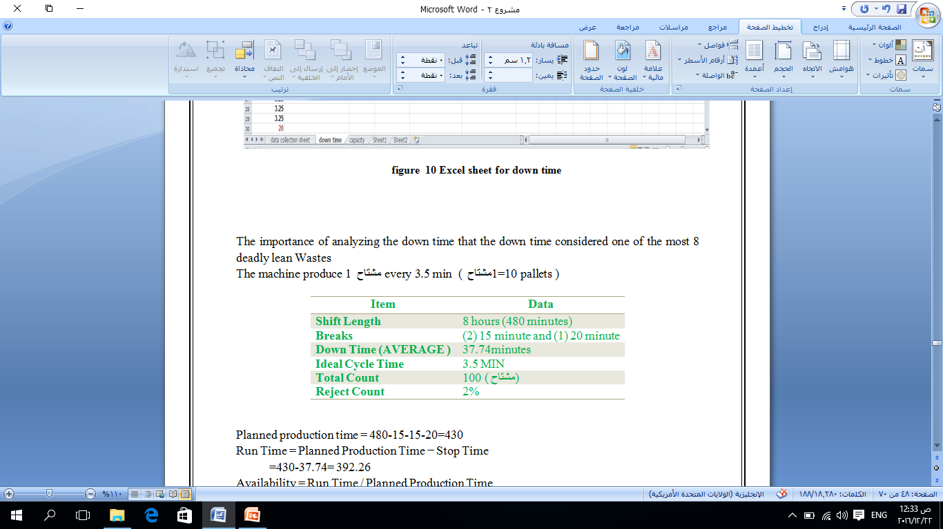
Planned production time = 480-15-15-20=430
Run Time = Planned Production Time − Stop Time
=430-37.74= 392.26
Availability = Run Time / Planned Production Time
=392.26/430 =91%
Performance = (Ideal Cycle Time × Total Count) / Run Time
=(3.25*100)/392.26= 82%
Quality = Good Count / Total Count = .98*100 /100= 98%
OEE = Availability × Performance × Quality = 91%* 82% *98%=73.12%
Down Time = (sum of down time – sum of maintenance time )/ the whole monitoring time = (943.5-440 )/1119.5= 44.97%
Up time = 100% - 44.97% = 55.03 %

Slide 40
DPMO for preparing and change the mold
DPMO=(total count of defects /number of units number of opportunities *1000,000.
Defect here is any time larger than 25 min
DPMO =(12/100-12)*1,000,000=150,000 DEFECT PER MILLION
Minimize the whole production time sum of :
time for preparing and ordered the raw material
time for mixing the raw material
change and preparing the mold
machining time
transfer to the another place
transfer to drying area)
try to minimize the down time for the machine
try to minimize the shipment time
try to minimize the drying time
Define the performance objectives for the process

Slide 41

Identify sources of variation.
Takt time analysis
Takt Time is the rate at which products or services should be produced to meet the rate of customer demand.
The value, in conjunction with the current loading (production) rates, is used to analyze process loads, bottlenecks, and excess capacity.
available time = 480-15-15-20- .45*430)/150=1.57 /مشتاحmin we notice that the takt time is Very low comparing to the machine speed 3.25 /مشتاحmin

Slide 42
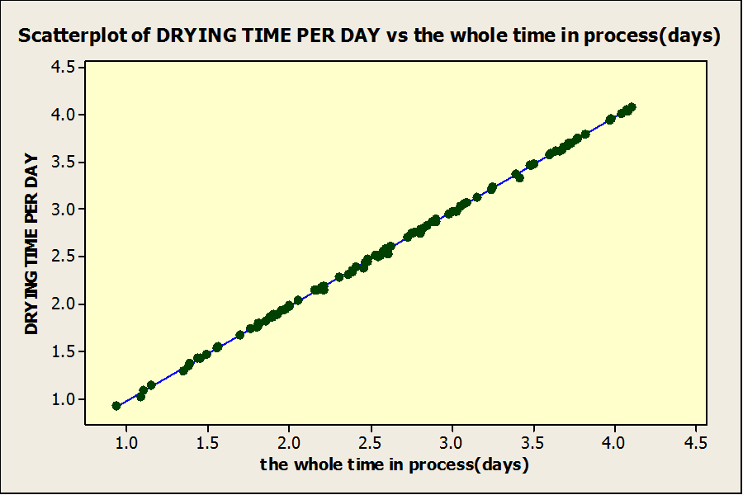
Steps to do correlation
  Scatter plot is the graph which is used while studying correlation.
  If the plotted points come closer to form a straight line, the higher is the correlation between the two variables.There can be no correlation if the plotted points do not form a line. The number +1 or -1 is in perfect correlation and if the number is closer to either extreme, the relationship is stronger.
Pearson correlation of DRYING TIME PER DAY and the whole time in process(days( = 1.000
Figure 20 correlation time in procsee drying time
Pearson correlation of DRYING TIME PER DAY and the whole time in process(days( = 1.000

Slide 43
Pearson correlation of machining time and sum time in process without dry
= 0.797 so as we can see is there is a strong positive relationship between processing time without drying or shipment and machining time , the correlation shows a matching result with our previous

Slide 44
Improve
phase

Slide 45
Improve phase
Improve is the step where creative solutions to existing problems can be developed and tested, using various experiment or piloting techniques.
The best ideas for improvement, based on what was learned in Measure and Analyze, are tested and implemented on a limited basis to determine if there is statistical evidence of sustained improvement.
Improve Roadmap
Remove as much waste as possible, accept no alternative! Solid education and analysis has identified these areas of opportunity in earlier phases.
INPUTS
Six Sigma Specific Project – A list of validated causes
Lean Specific Project – Knowledge of what needs to be treated in order to minimize or eliminate waste from the process.

Slide 46
PROCESS
Six Sigma Specific Project
Selection of the improvement strategy
Generate potential solutions through a variety of means
Select most appropriate solutions
Develop an implementation plan
Implement solutions through application of project management and change leadership skills
Lean Specific Project
Utilize the most appropriate lean tools to treat identified sources of waste Implement solutions through application of project management and change leadership skills
OUTPUTS
Solutions are implemented and the new process is operational

Slide 47
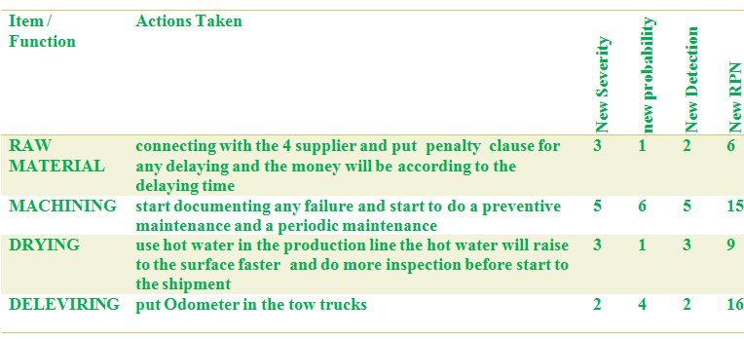
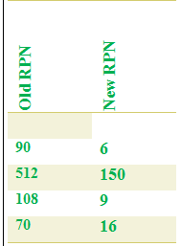
FMEA (part 2)
And here a comparison between the values of RPN

Slide 48
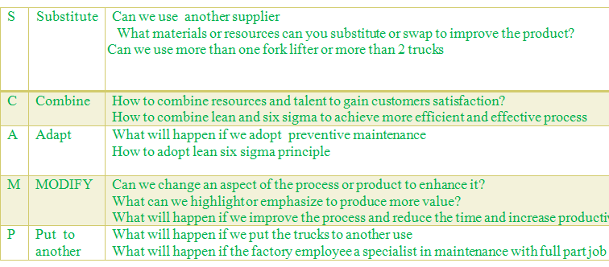
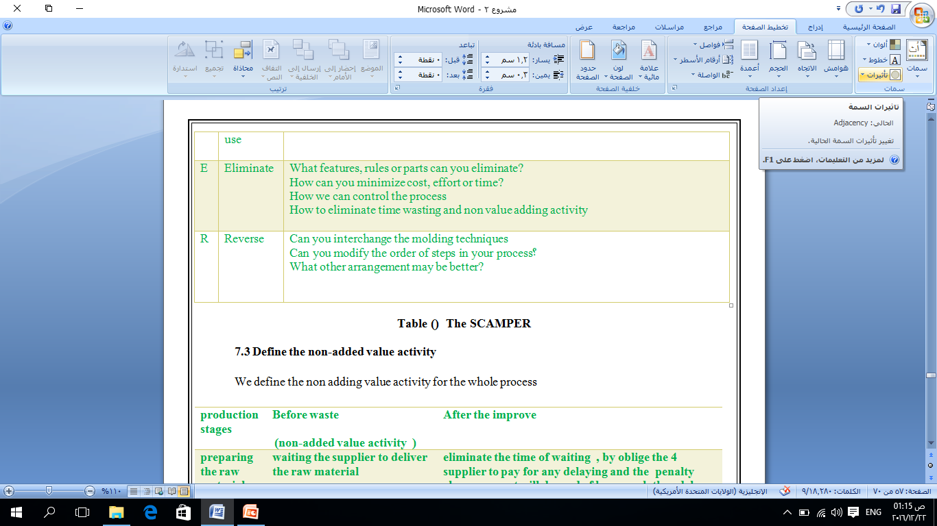
SCAMPER
Tool description
tool can be used by a team to explore the issues and question everything to formulate new, fresh ideas. Problem-solving teams often produce many solution ideas when responding to the SCAMPER questions asked.

Slide 49
Define the non-added value activity
production stages | Before waste (non-added value activity ) | After the improve
preparing the raw material | waiting the supplier to deliver the raw material | eliminate the time of waiting , by oblige the 4 supplier to pay for any delaying and the penalty clause amount will depend of how much they delay
preparing and change the mold | not following any instruction for preparing and changing the mold | Follow the instruction that mentioned better and effective process
machining time | ignored any maintenance documentation any calculation and any preventive maintenance | Periodic maintenance every 2 days Document any failures happened Make sure that changing the mold process is not effecting the machine performance
shipment time | lake of supervision over the drivers of the trucks | Use odometer to track the two drivers and monitor the delivering time
drying time | not following or using any way or tool to fasten the dying process | Use scientific instruction to fasten up the drying time

Slide 50
* Reducing changing molding time instruction :
TIP No. 1
Avoid Unnecessary Idling
TIP No. 2
Organize Mold Storage
TIP No. 3
Follow a Checklist
TIP No. 4
Commit to Training
TIP No. 5
Communicate Effectively
TIP No. 6
Don’t Neglect Maintenance
* Drying time instruction
1. The presence of too much sand will decrease the amount of drying.
2. The brick may have been squashed while still wet.
3. undersized mod problem happened when using too much water during the mixing stage

Slide 51
measuring the process improve
Now for measuring the process improve we take observation for timing for the improve phase for 20 days and the results will be shown in the Appendix table and here a part of it we take 30 observation and we did improved actions in the process as mentioned before now we will analyze the improved data using
Histogram chart
For the whole processing time
For the manufacturing and transferring to drying place
Run chart
For the machining time
For the whole process
Normality test

Slide 52
1.Histogram
For the whole time in day

Slide 53
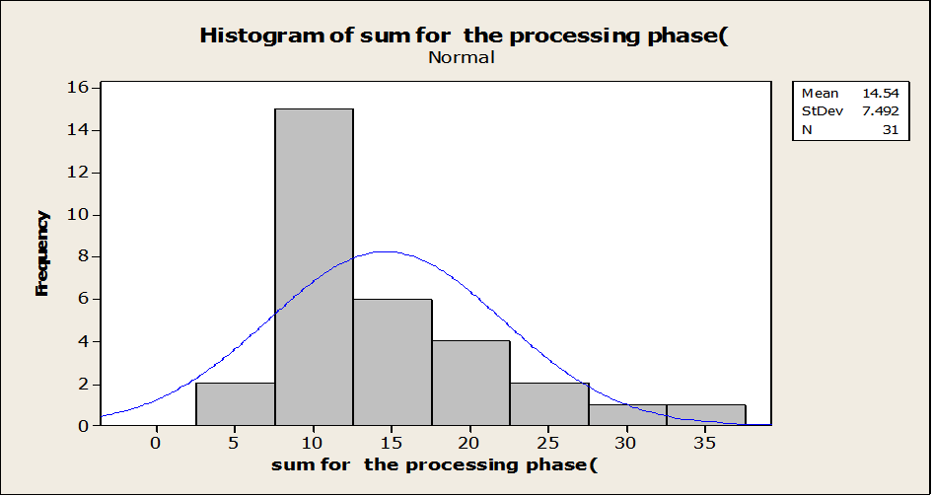
Histogram for the manufacturing phase

Slide 54
We notice that the mean for the manufacturing phase after the improving is 14.45 min and that is a very good number comparing to the previous one in the manufacturing phase we improve three processes :
  preparing and ordering raw material
  preparing and changing the mold
  machining time
Run chart
For machining time

Slide 55
For the whole process time
Normality test

Slide 56
DPMO
We will find the DPMO for
Machining time (no normal distributed )
Preparing and changing the mold (not normal distributed (
Machining time (expected) =3.25min
Preparing and changing the mold =30 min
Shipment time (expected )= 35 min
Drying time (expected)= 40 hour
Processes | DPMO before Improve | DPMO after improve
1. Machining time | 351351 | 2/28 *1000000=71428.57
2. Preparing and changing the mold | 150,000 | 1/30 *1000000= 33333.33333 ( no value reaches to 30 )

Slide 57
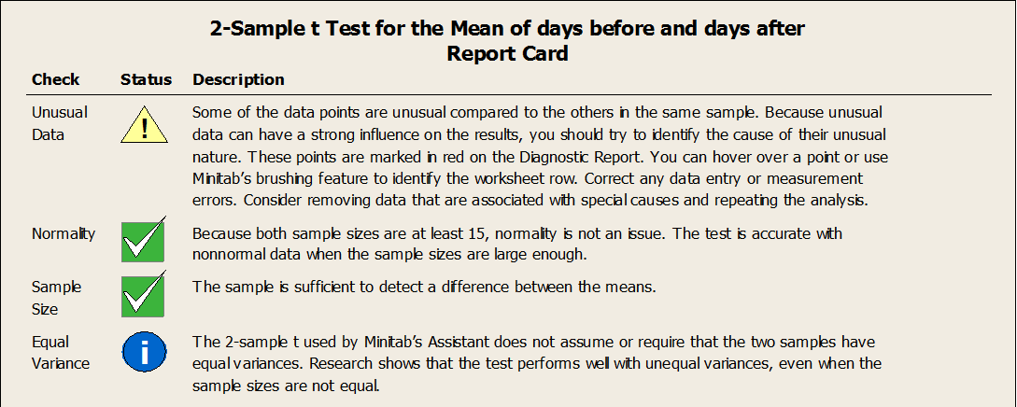
Hypotheses test
It means determine whether the difference between two proportions is significant., is appropriate when the following conditions are met:
The sampling method for each population is simple random sampling.
The samples are independent.
Each sample includes at least 10 successes and 10 failures.
Each population is at least 20 times as big as its sample.
In order to run an independent t-test, you need the following:
1. One independent, categorical variable that has two levels/groups.
2. One continuous dependent variable.
H0: mean before = mean after
H1: mean before > mean after

Slide 58
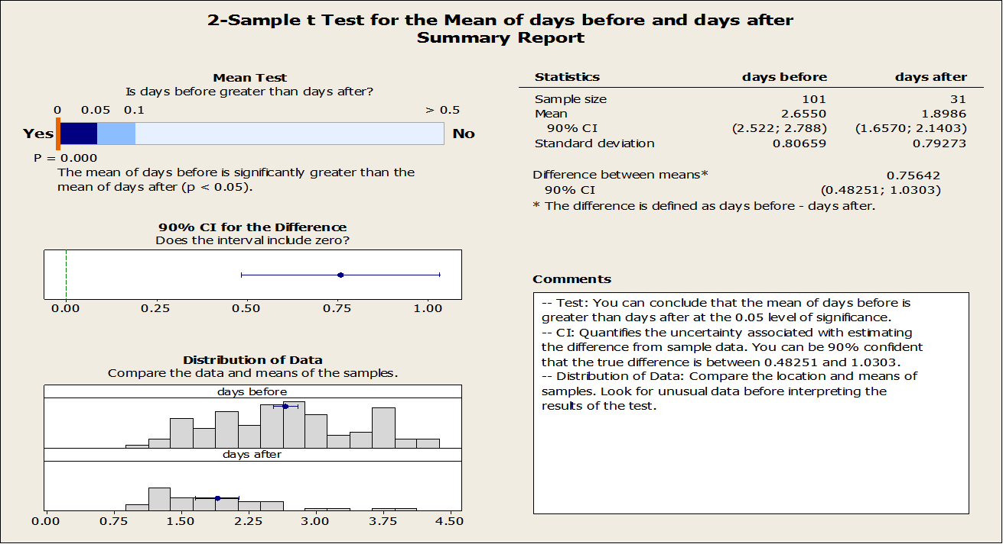

Slide 59
Hypotheses test for the manufacturing time
comparison between before and after manufacturing

Slide 60
Box Blot
box blot for manufacturing and processing before and after

Slide 61
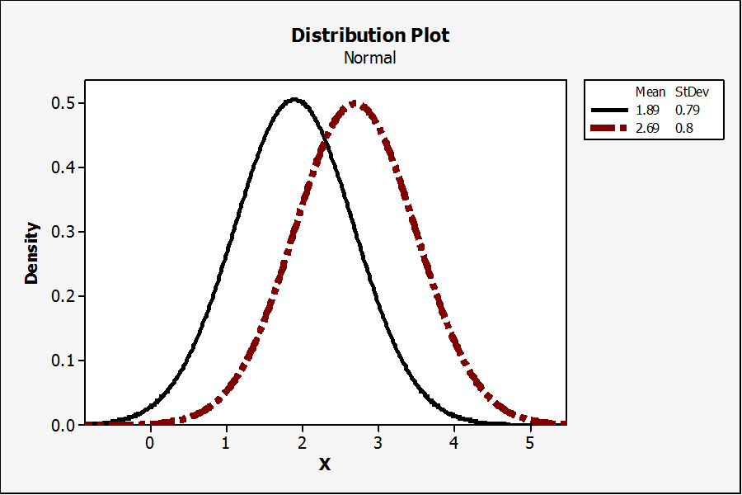
Differences in the before and after improve
Takt time
After improve available time = 480-15-15-20- (.18*430)=2.35 we notice that the takt time is higher now because the available time is higher

Slide 62
Control

Slide 63
Control
The CONTROL phase
is the conclusion of the team's journey. The team responsible for a solid hand-off to the Process Owner to maintain the gains.
The final capability is determined and the closing performance and all related changes are documented on the closing contract. This phase is not as statistically intensive as the MEASURE, ANALYZE, and IMPROVE phases.
The steps we follow to make the control phase are
Standardizing and Documenting the Improvements
creating a Process Monitoring Plan
Wrapping Up the Control Phase
Closing Out the Project

Slide 64
1. Standardizing and Documenting the Improvements
Step 1: Announcement of the new maintenance procedures. Without the support of management, skepticism and resistance will kill the initiative.
Step 2: Launch a formal education program. This program will inform and educate everyone in the organization about new maintenance activities, benefits, and the importance of contribution from everyone.
Step 3: Create an organizational support structure. This group needs to include members from every level of the organization from management to the shop floor .
Step 4: Establish basic policies and quantifiable goals which is to decrease the down time as we did in the improve stage
Step 5: kick-off. Implementation will begin at this stage.
Step 6: Improve effectiveness of each piece of equipment.

Slide 65
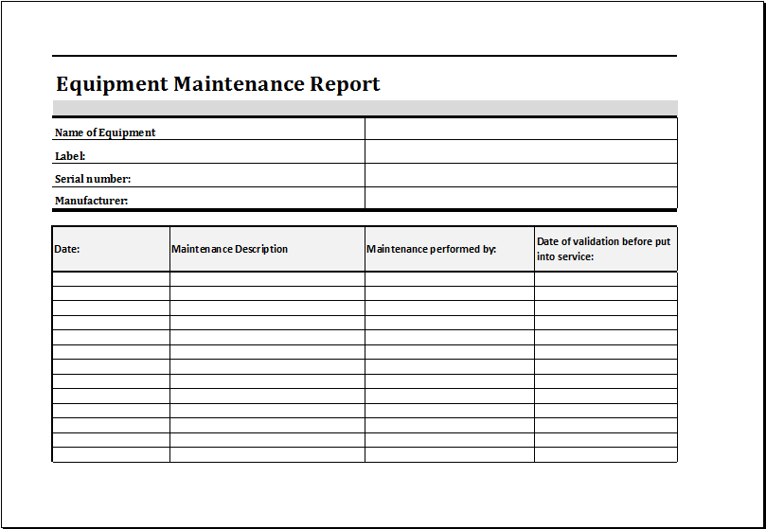
Step 7: Develop a planned or preventive maintenance program.
Step 8: Conduct training to improve operation and maintenance skills and to prevent the action that causes the machine down time like shutdown the whole system for changing the molds.
Step 9: Develop a maintenance report that will fill by the worker every 2 days
Figure 34equipment maintenance report
Step 10: Continuous Improvement - As in any Lean initiative the organization needs to develop a continuous improvement mindset.

Slide 66
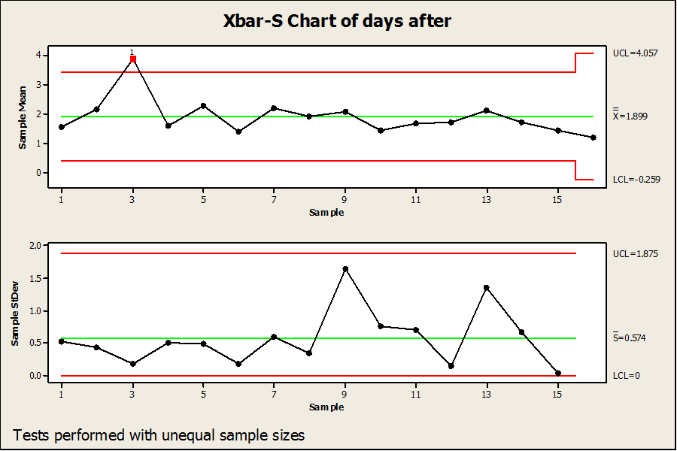
2. Creating a Process Monitoring Plan
The monitoring way that we use is control chart
Control Chart is a graphical tool that helps determine if a process is “in control or not”. A control chart has three zones and is graphically represented
As we can see the group has mean of 1.899 and has one out value and that is normal because drying time un controllable

Slide 67
Our Recommendations:
Hire tow persons in the factory one is a maintenance technical and the other is engineering who is responsible for the whole maintenance operation and the documentation
Consider a new ways for drying like ovens , new machine line that consist of faster machine and drying device
Scheduling customers ordered and put a new policy that the ordered quantity should be one day notice or more
Try to make tow person in charge of changing the die because these operation if it is will planed it will save a lot of time as we saw in the improve stage
The drivers and the workers should be more strict to the time and more serious
Consider buying new fork lifter so the move to truck, the time will decrease to half
Start a documentation process for everything in the factory specially for related
maintenance information
Continue with the periodic maintenance every 2-4 day
Start doing maintenance reports

Slide 68
10.Consider doing a night shift and if so follow these procedure
1.Avoid shiftwork for workers older than 50.
2.Use rapid rotations as opposed to weekly or monthly cycles.
3.Schedule as few night shifts (three or less) in succession as possible.
4. Use forward rotation of shifts if possible Limit the total number of working shifts in succession to seven or less. 6.
5.Include some free weekends, with at least two successive full days off.
6.Schedule rest days after night shifts.
7. Keep the plans simple, predictable, and equitable for all workers.
11.Consider buying safety equipment because the one in the factory are poor and ineffective
Always encourage workers and motivate them
13.Train the worker who is responsible for die changing with more expert trainers
14.Eliminate or control the works noises
15.Provide both general and task lighting—avoid glare.
Adjust work surface height based on the task being performed

Slide 69
17. The operators should be provided with resilient anti-fatigue mats, because standing for extended periods on a cement floor are fatiguing.
providing fixed locations for all tools and materials at the workstation eliminates, or at least minimizes, the short hesitations required to search for and select the objects needed to do the work
The most important, or most frequently used components, should be placed in the most convenient locations
A trade-off between increased safety and decreased performance with gloves must be considered
Using material more economically
22.Materials can often be salvaged, rather than sold as scrap.
reducing setup time:
1. Work that can be done while the equipment is running should be done at that time.
2. .Eliminate machine base adjustment

Slide 70
The end
Thank you

