Slide 1
Automated slicing machine
An-najah National University
Faculty of Engineering
Mechatronics Engineering Department
under the supervision of : Dr.Nidal Farhat
Done by :
Abd Alwahad Hindi
Banan Mehdawi
Hanan Hamdan
Lujain Alfares
Maymoona Dagles

Slide 2
Content
over view
main idea & objectives.
Literature review
Constrains.
controller
Sequence of operation
order
Pushing operation
Slicing operation
Measurement system
problems

Slide 3
General view Main idea

Slide 4
General view
The objective of the project is designing a full automated slicing machine which depends on measurement system, control and electrical circuits.
Reduce labor cost
Increase accuracy
Decrease operation time

Slide 5
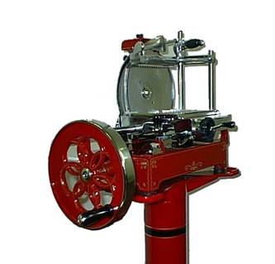
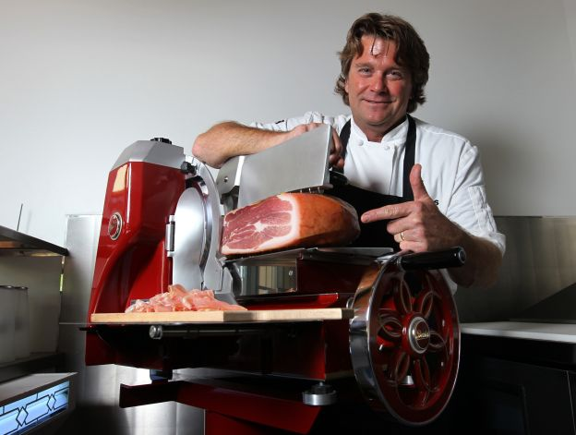
General view Literature review
* The first meat slicing machine was invented by an American in 1873. The machine made use of an oblique knife in a vertical sliding frame.
Manual slicing machines.
Semi automated slicing machines.
No measurement system .
Fig : Manual slicing machine
(old type)

Slide 6
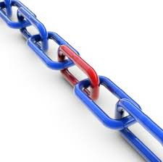
General view Constraints
Project constraints are anything that restricts the project. They should be considered during design, so limitation would not exceed.

Slide 7
Safety: The cutting region & covered material
Quality: the precise during cutting and weighing , vibration & the slot bath
Speed: The motors, slider mechanism and cutting knife must be synchronized.
Order: The order should not exceed 1 kg and the thickness from ( 2mm-9mm)
Machine’s dimension: r(meat) <= r (cutting disc) & suitable dimensions
Cost: components were chosen according to its function firstly and then the cost.
At the end our machine costs 230 $ while the similar machines in the market cost about 500 $.

Slide 8
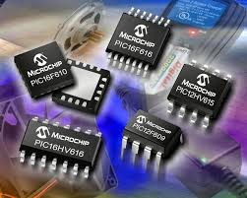
General view
Controller
Arduino:
It is a microcontroller board based on the ATmega2560.
It has 54 digital input/output pins
simply connect it to a computer with a USB cable or power it with an AC-to-DC adapter or battery to get started.

Slide 9
General view
Controller
advantages of Aurduino over pic16f877 :
Arduino more reliable than pic16f877.
It doesn’t need a basic circuit as pic16f877.
Easy to use, easier than pic16f877.
It has a lot of analog and digital pins.
Built in protection

Slide 10
Sequence of operation 1) Order
The user should enter the weight and the thickness by keypad.
The aurduino calculates the number of turns to get the required thickness
Aurduino will send signals to relay to turn on the dc motor of the screw.

Slide 11
2) Pushing operation
We replaced the stepper motor with dc motor to actuate the screw.
The Dc motor is connected to gears which will transfer the motion from the motor to the nut.
the nut is fixed to the center of the gear to transfer motion from rotation to translation in order to move screw back and forward.

Slide 12
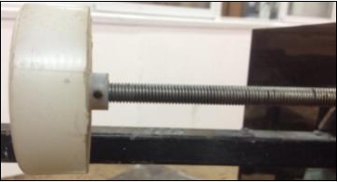
2) Pushing operation
The screw will push the product to the cutting area.
When the product finish, the screw will back to its initial position
This would be done by inverting the polarities of the dc motor by Aurduino.

Slide 13
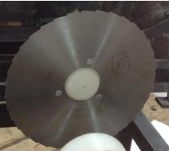
3) Cutting operation
Cutting area ( product detection )
Slicing mechanism

Slide 14
Cutting operation a) Cutting area ( product detection )
Dc motor that pushes the screw will stay on so the product reaches the cutting area.
Which will detected by infrared sensor.
infrared sensor also will detect if the product finished.
The Aurduio received the signal from the sensor so the slicing mechanism could start working.

Slide 15
b) Slicing mechanism
Aurduino will send a signal to 2 relays.
The first one is connected to a dc motor which will actuate the blade to be rotated around its axis .
The second one is connected to another dc motor to actuate the slider crank mechanism.

Slide 16
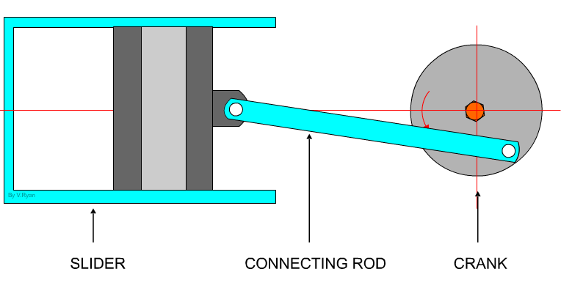
Cutting operation b) Slider crank mechanism
The slider mechanism is mainly used to get a reciprocating motion from rotary motion .
it is composed of three important parts:
1) Rotating disk fixed to the dc motor
2) The slider which is slides inside the tube
3) Connecting rod which joins the parts together and hold the blade

Slide 17
Cutting operation b) Slicing mechanism
We used a mechanical limit switch to detect the position of the cutting blade
When the cutting blade reaches to the switch, the Aurduino will turn the slider dc motor off.
It will stay off till the screw push the product to the distance as ordered. (thickness)

Slide 18
3) Measurement system
After cutting, the slices will fall down to a plate over the balance device.
The balance will measure the weight continuously and send a signal to the Aurdiuno.
If { W (measured) >= W (ordered) } the Aurdiuno will stop the machine

Slide 19
Problems
Torque of stepper motor → Dc motor
Twisting force on the product from the screw→ two objects as holder
Vibrations in the Cutting blade → rubber
Fatigue in the slider crank → welding
Bridge output → amplifier

Slide 20
Thank you

