Slide 1
Sensor Controlled Animatronic Hand
Graduation project presentation

Slide 2
Overview
Introduction
Constraints
Methodology
Sensor reading
Calculations
Communication
Movement
Results
Conclusion
Questions

Slide 3
Overview
Introduction
Constraints
Methodology
Sensor reading
Calculations
Optimization and filtering
Movement
Results
Conclusion
Questions

Slide 4
Introduction
LEAP motion controller; what is it?
Problem: Cheap and Accurate animatronic hands aren’t very common
Possible Solution: using a sensor to control the hand.
A LEAP motion sensor can be used to read hand movements.

Slide 5
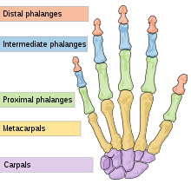
Introduction
The structure of the human hand:

Slide 6
Overview
Introduction
Constraints
Methodology
Sensor reading
Calculations
Communication
Movement
Results
Conclusion
Questions

Slide 7
Constraints
Mechanical constraints:
Hard to acquire springs of specific size and elasticity.
3D printing a hand model was unavailable to us.
Sensor constraints:
Hard to acquire
Readings not always correct
Software constraints:
LEAP Android SDK is still in Alpha mode

Slide 8
Overview
Introduction
Constraints
Methodology
Sensor reading
Calculations
Communication
Movement
Results
Conclusion
Questions

Slide 9
Sensor Reading
3 IR Transmitters sends out Infrared red light
Two IR Cameras are used to read the picture.
The raw data is sent to the PC.
The API processes the raw data, and produces output.
Output is in the form of 3-Dimensional vectors.

Slide 10
Overview
Introduction
Constraints
Methodology
Sensor reading
Calculations
Communication
movement
Results
Conclusion
Questions

Slide 11
Calculations
The distance between the connections points is calculated
The distance is then scaled, reduce the effect of different hand sizes
$$L_{i}=S_{i}∗\frac{d\left(V_{i},V_{j}\right)}{d\left(V­_{i} , V_{i.5}\right)+d\left(V_{i.5},V_{j}\right)}$$
The distances are then summed to calculate the needed pull for the wire.
This is done for each finger, producing a 2-dimensional integer array.

Slide 12
Overview
Introduction
Constraints
Methodology
Sensor reading
Calculations
Communication
movement
Results
Conclusion
Questions

Slide 13
Communication
Calculated wire lengths are sent to the microcontroller from the PC.
The data is sent in big endian, each reading as a 2-byte integer.
The length of the array in bytes, as well as the dimensions of the 2-dimensional array are appended to the beginning of the sent data.
The Microcontroller reconstructs the 2-dimensional array from the input bytes.

Slide 14
Overview
Introduction
Constraints
Methodology
Sensor reading
Calculations
Communication
Movement
Results
Conclusion
Questions

Slide 15
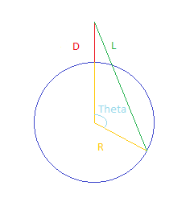
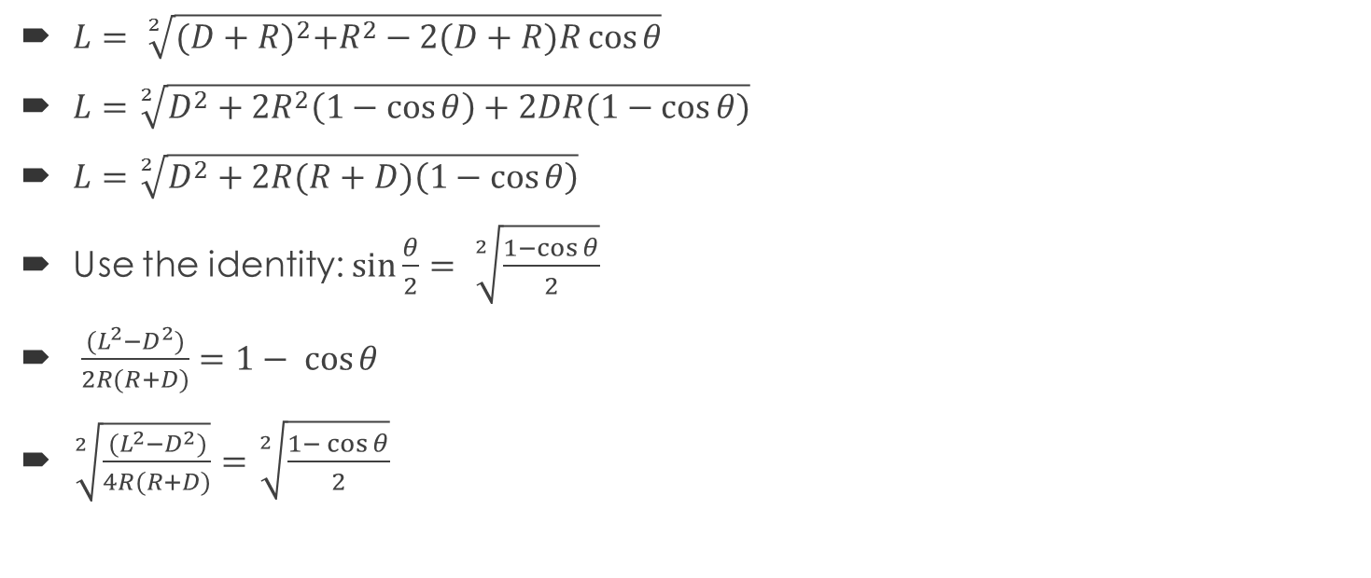
Movement Calculations
$L= \sqrt[2]{{(D+R)}^{2}+R^{2}−2(D+R)R\cos{θ}}$
$L=\sqrt[2]{D^{2}+2R^{2}\left(1−\cos{θ}\right)+2DR(1−\cos{θ)}}$
$L=\sqrt[2]{D^{2}+2R(R+D)\left(1−\cos{θ}\right)}$
Use the identity: $\sin{\frac{θ}{2}}= \sqrt[2]{\frac{1−\cos{θ}}{2}}$
$\frac{{(L}^{2}−D^{2})}{2R(R+D)}=1− \cos{θ}$
$\sqrt[2]{\frac{{(L}^{2}−D^{2})}{4R(R+D)}}=\sqrt[2]{\frac{1− \cos{θ}}{2}}$
$$θ= 2\sin^{−1}{\sqrt[2]{\frac{\left.{\left(L\right.}^{2}−D^{2}\right)}{\left.4R(R+D\right)}}}$$

Slide 16
Movement
Move servo motors to pull fingers
Calculate angle from wire length
This requires physical information about the models hand
Use the following equation:
$$θ= 2\sin^{−1}{\sqrt[2]{\frac{{(L}^{2}−D^{2})}{4R(R+D)}}}$$

Slide 17
Overview
Introduction
Constraints
Methodology
Sensor reading
Calculations
Communication
Movement
Results
Conclusion
Questions

Slide 18
Results
Sensing Process:
Once the system is up and running, you place your right hand above the sensor
The LEAP will read the right hand position and transmit the data
Similar movements will be reflected onto the Animatronic Hand

Slide 19
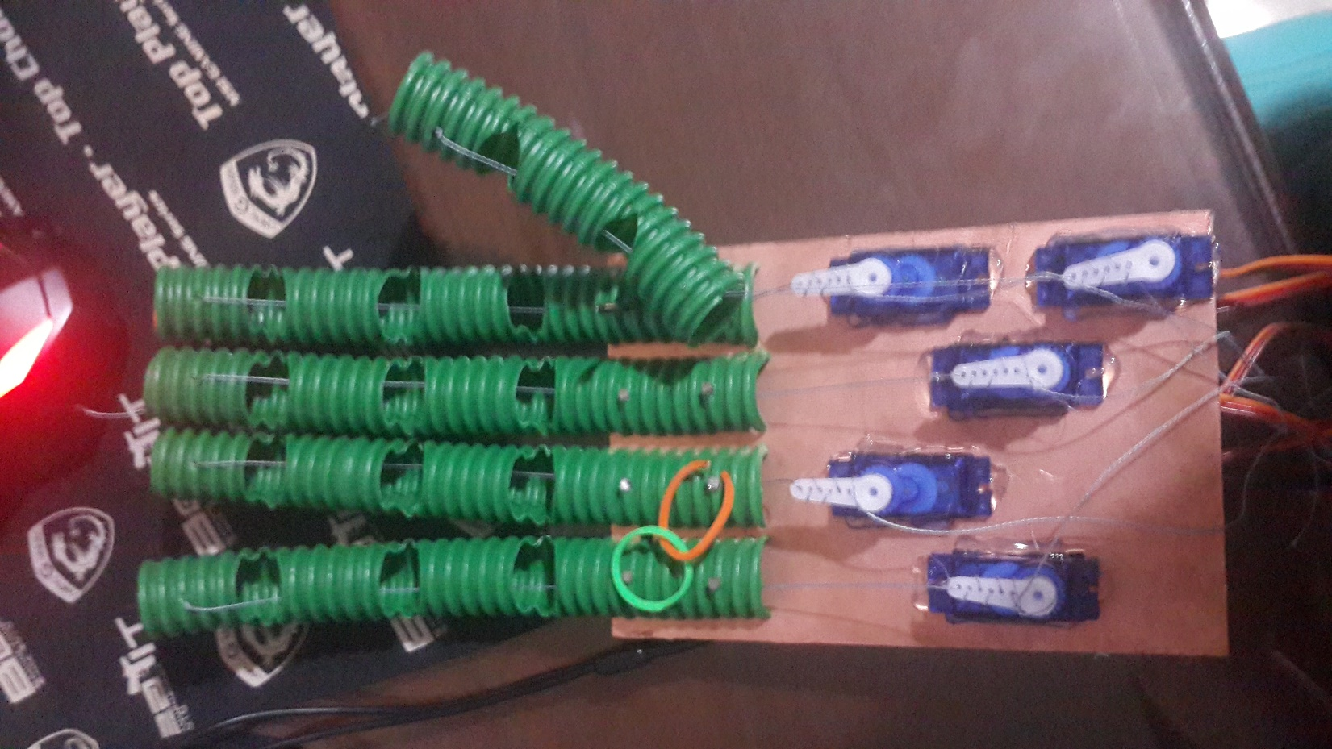
Results
Final Product:

Slide 20
Overview
Introduction
Constraints
Methodology
Sensor reading
Calculations
Communication
Movement
Results
Conclusion
Questions

Slide 21
Conclusion
LEAP motion sensor provides ease of use to the operator.
The current design only mimics the movement of fingers, the movements of the wrist are not implemented.
The physical design of the hand can be greatly improved to better mimic the movements of human hand

Slide 22
Any Questions?

Slide 23
Appendix: Calculations
Assuming that we have and scaling array S1, S2, S3, (an array that contains values that we want to scale our readings to), and that d(p,q) is Euclidean distance between vectors p and q, defined as:
$d(p,q)=\sqrt[2]{\left(Xp−Xq\right)+\left(Yp−Yq\right)+\left(Zp−Zq\right)}$
The equation for the wire length would be:
$L=L_{1}+L_{2}+L_{3}$

Slide 24

Appendix: Calculations
Where:
$L_{1}=S_{1}∗\frac{d\left(V_{1},V_{2}\right)}{d\left(V­_{1} , V_{1.5}\right)+d\left(V_{1.5},V_{2}\right)}$
$L_{2}=S_{2}∗\frac{d\left(V_{2},V_{3}\right)}{d\left(V­_{2} , V_{2.5}\right)+d\left(V_{2.5},V_{3}\right)}$
$L_{3}=S_{3}∗\frac{d\left(V_{3},V_{4}\right)}{d\left(V­_{3} , V_{3.5}\right)+d\left(V_{3.5},V_{4}\right)}$

