Slide 1
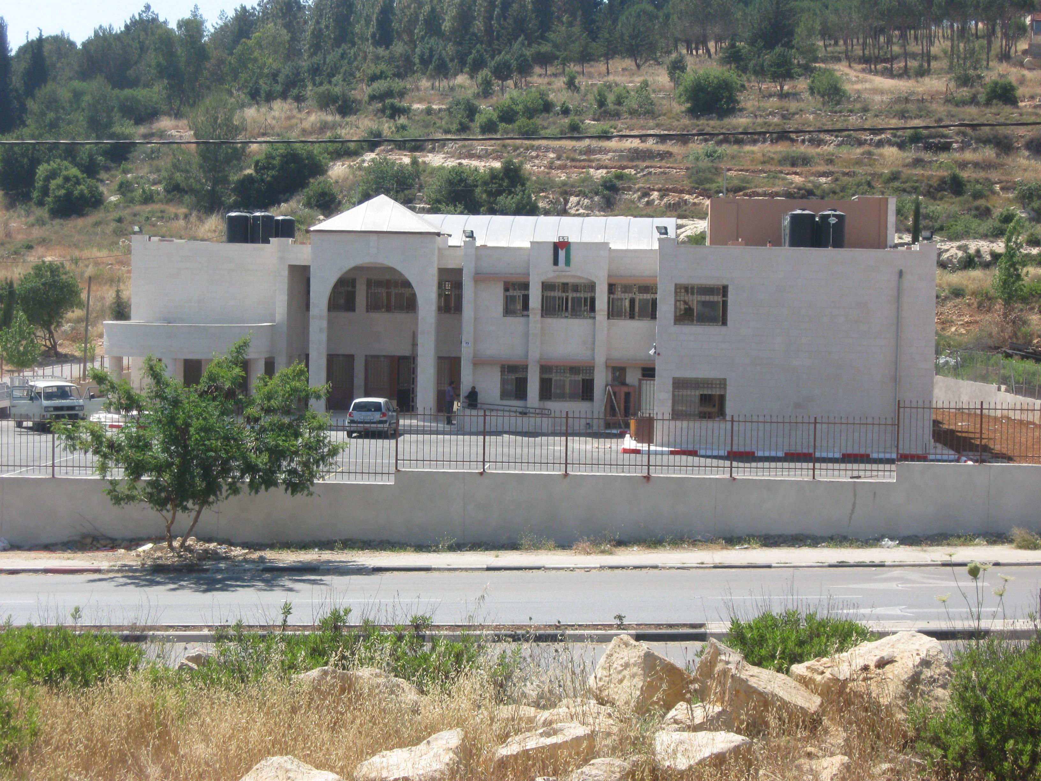
An Najah National University
Engineering College
Civil Engineering Department
Construction Project Management
{Beir Ziet Secondary Boys School }
Prepared by:
Abd Alraheem Ali Ameen Zedan
Musa Mahmmod
Supevisor:
Ins: Baraq Joma’a
Submitted in partial fulfillment of construction project management for the bachelor degree in civil engineering

Slide 2
Project consist of two part
Part 1: Preparing a theoretical research
Part 2: The application of the principles in construction project management

Slide 3
Project Management
Project management is the application of Knowledge, skills, tools and techniques to project activities to meet project requirements.

Slide 4
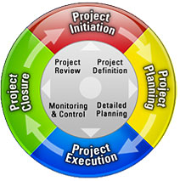
Project Life Cycle

Slide 5
The components of Project Management
Project Scope Management
Project Time Management
Project Cost Management
Project Risk Management
Project Quality Management
Project Human resource Management
Project Communication Management
Project Procurement Management
Project Integration Management

Slide 6
Objective of Project :
Apply these theories at a real project to gain a better understanding of many issues and to get some experience in construction management
Know how to use management to deal with Project constrains { Time , Cost & Performance}

Slide 7
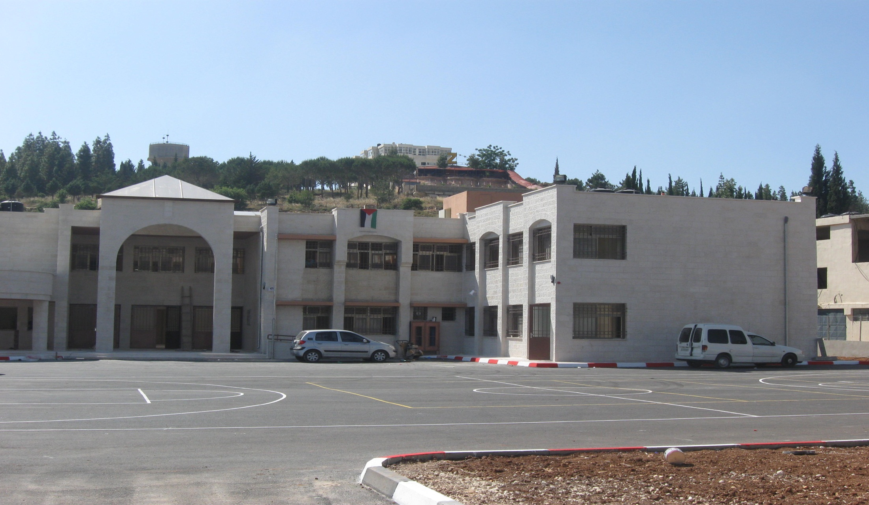
Beir Ziet Secondary Boys School

Slide 8
Project Description
Beir Ziet Secondary Boys School
Location : Beir Ziet Village( Main Street )
Purpose : achieves students service villages Beir Ziet, Abu Qash . and Abu Shkhedem.
General Information :
It consist of Two Floors each floor is 960 m2

Slide 9
Quantity Survey, Cost Analysis and BOQ
Assumptions in work :
All Cost Analysis consider the currency is shekels
The Exchange Rate (1$ = 3.5 NIS)
Electrical and Mechanical Work we take it as a lump sum.
Profit = 10% of total cost.
Overhead cost = 5% of total cost.

Slide 10
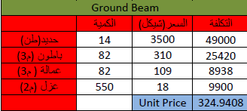
Cost Analysis

Slide 11
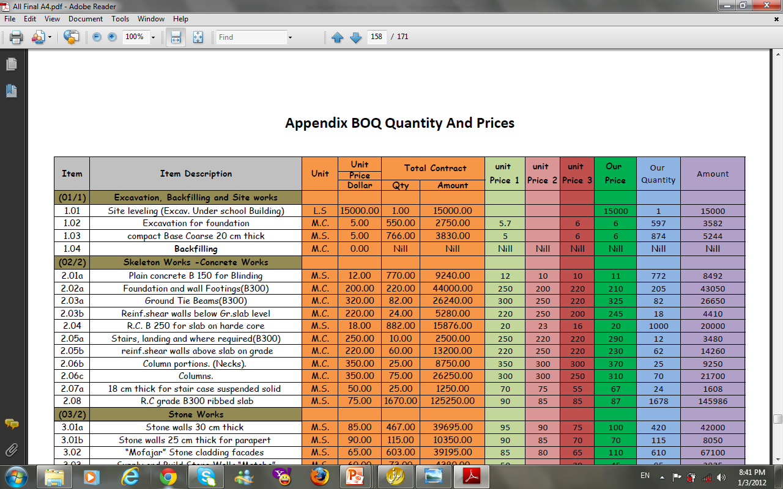
BOQ

Slide 12
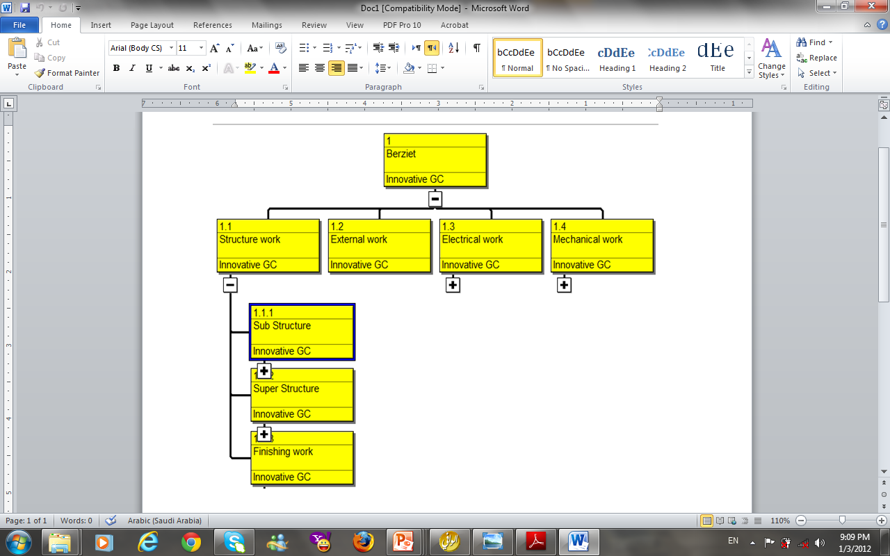
WBS

Slide 13
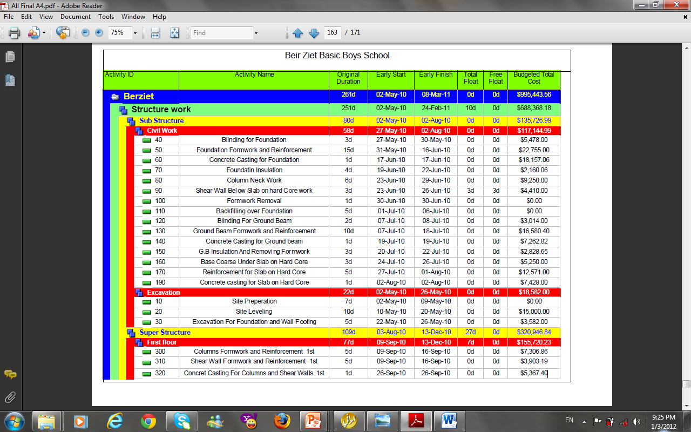
Activity List

Slide 14
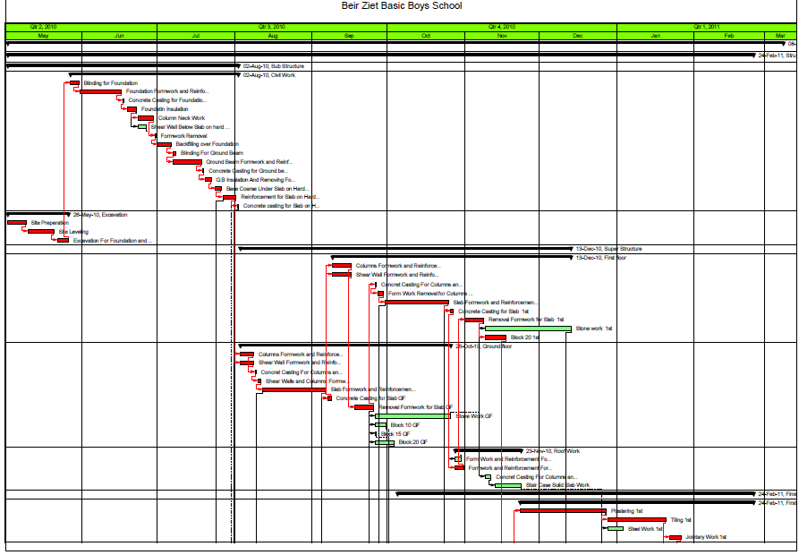
Time Schedule

Slide 15
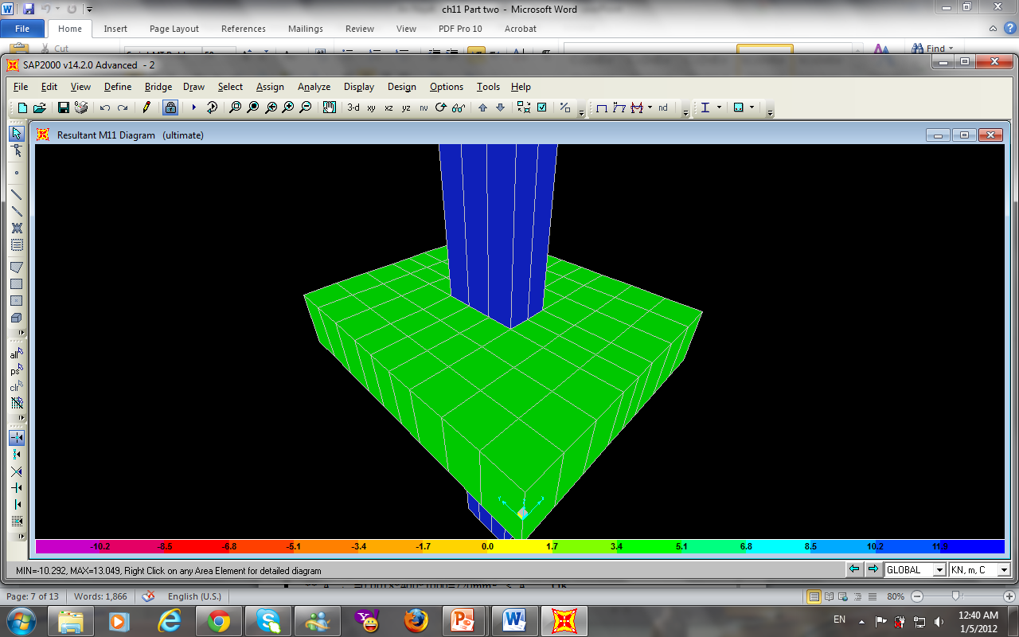
Problem Case
The design bearing capacity = 2.2 kg/cm2
After make the soil test bearing capacity
of soil found 4.4kg/cm²
And as a consultant make a
Redesign for The Foundation

Slide 16
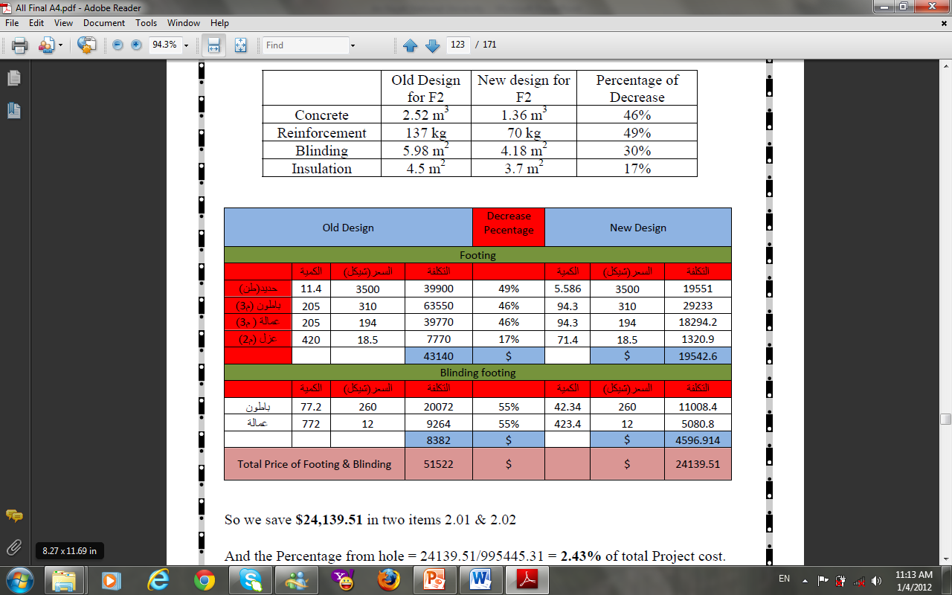
Comparison between old and New design

Slide 17
Results from Redesign
So we save $24,139.51 in two items 2.01 & 2.02
And the Percentage from hole = 24139.51/995445.31 = 2.43% of total Project cost.
And the Percentage from this two items = 24139.51/51522= 47%
Total cost of New Design = 27382.2 $
Recommendation

Slide 18
Earned Value Analysis
Calculated Values for Earned Value Reports Costs
CPI = 1
Calculated Values for Earned Value Reports Schedule
From Primavera Project Planner (P6.1), we find that value of
SPI =0.9 < 1 behind scheduled (Project delayed)
Hand calculations

Slide 19
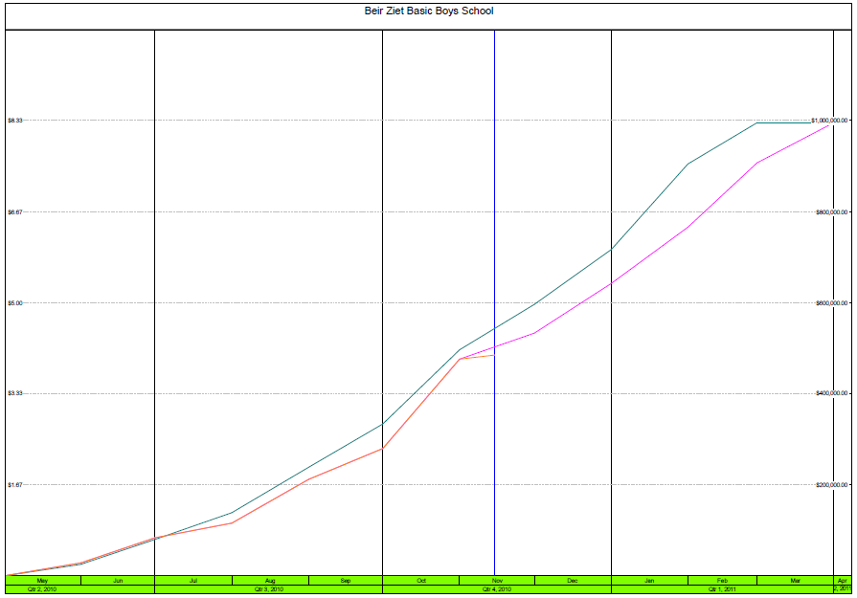
S- Curve
Current Date 15-Nov-2010
BCWS
EAC
BCWP

Slide 20
Results and Conclusion
The total cost = $ 995445.31
Start Date 1st May, 2010,
Finish Date 8th March, 2011
Total duration =261 working days = 312 calendar days

Slide 21
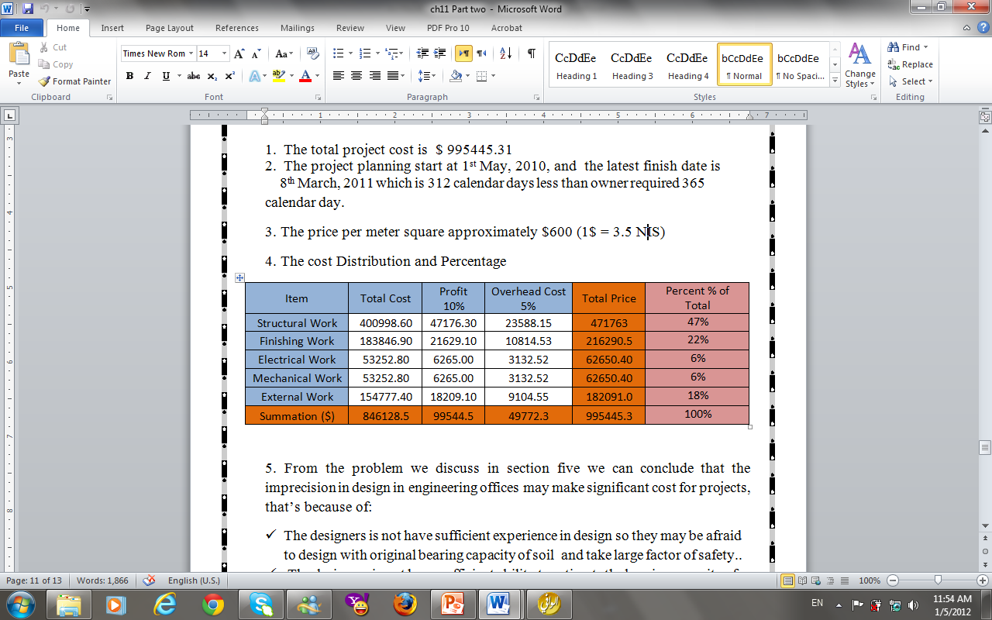
The cost Distribution and Percentage

Slide 22
Risk Analysis
Exchange rate fluctuation
Economic instability
Design assumptions
Management procedures

Slide 23
SWOT Analysis
Strengths S
Good Technical Skills
Good Supervision
Weaknesses W
Bad Contractor Management
Bad Design
Opportunities O
Good Financial Support
No Taxes on Work
Threats T
Exchange rate fluctuation
Political conditions

Slide 24

Project Management
To Success

Slide 25
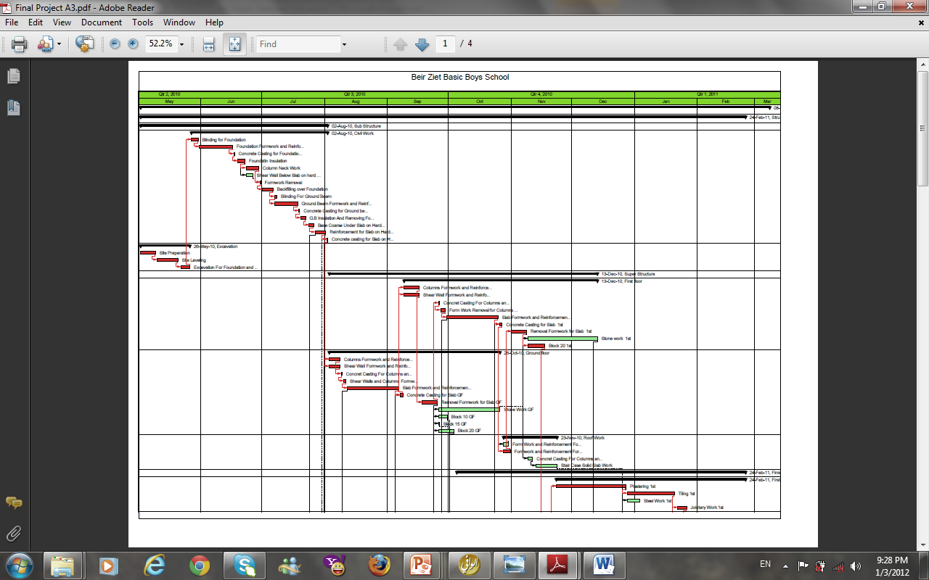
Thank You

