Slide 1

An Najah National University Collage Of Engineering Civil Engineering Department
Construction Project Management
“Aljadera School ”
Submitted in partial fulfillment of construction project management for the bachelor degree in civil engineering
Prepared by:
Mohammad Shehab Motaz Abduldaim
Khalid Mahmoud Ahmad Mahajneh
Presented to:
Ins: Luay Dwaikat

Slide 2
Graduating project consist two parts :
The first part include preparing a theoretical research.
The second part includes the application of the principle in construction project management.

Slide 3
Introduction
What is a Project?
A project is a temporary endeavor undertaken to accomplish a unique product or service with a defined start and end point and specific objectives that, when attained, signify completion.

Slide 4
What is Project Management?
Project management is the application of knowledge, skills, tools, and techniques to project activities in order to meet or exceed stakeholder needs and expectations from a project.

Slide 5
What can go wrong in a Project?
The major cause of project failure is not the specifics of what went wrong, but rather the lack of procedures, methodology and standards for managing the project

Slide 6

The Triple Constraint

Slide 7
OUR PROJECT

Slide 8
Project overview
Al-jadera basic school is allocated in Al-jadera village near Ramallah , it accommodated large number of students
It achieves all student services and structural needs , it consists of 4 floors, ground floor, first floor , second floor and third floor.
Total area of the building is 2178.18 m^2.
High of each story is 3.38 m.

Slide 9
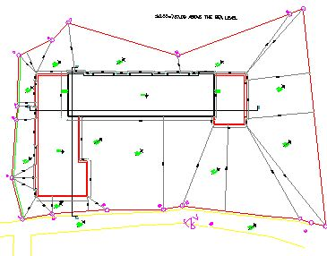
Site Plan

Slide 10
Sequence of work
According to the drawings and specifications, a specific method is used in managing this project, by following these steps:
WBS Preparation.
Quantity Surveying.
Activity list & activity coding.
Bill of quantity (BOQ) preparation; quantities, cost, resources, and man hours.
Activity durations & productivity.
Project price.
Project network.
Project budgeting.
Project duration.

Slide 11
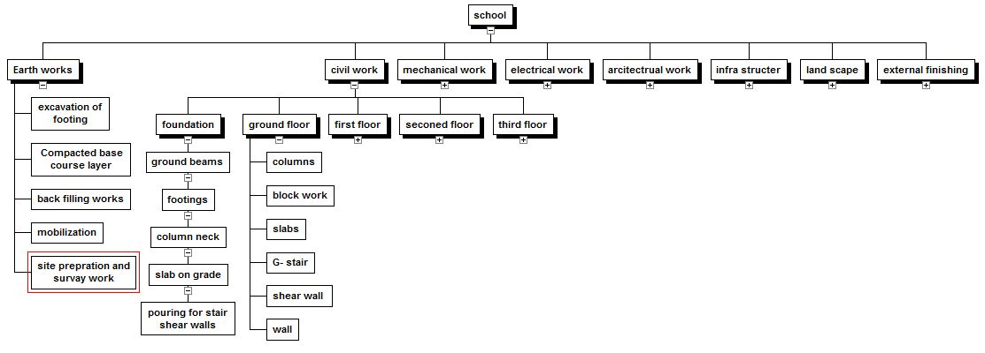
Work Breakdown Structure (WBS)

Slide 12
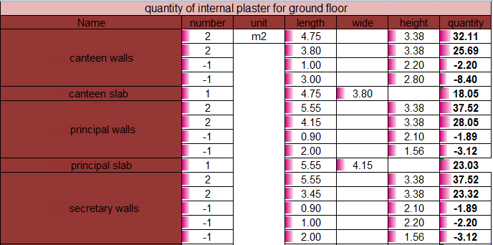
Quantity Surveying:
We have calculated the quantities in our project. We used the most accurate way in calculating the quantities .
Example of calculating Plaster.

Slide 13
:Activity Coding
The activity code used at this project can be illustrated as follows:
The first letter: represents the 1st letter at level three in the WBS, like;
0: Ground floor
1: First floor
And so…
The second letter: represents the 1st letter at level two in the WBS, like;
E: Earth work
C: civil work
And so…
The third letter: represents the 1st letter at level four in the WBS, like;
W: walls & columns.
RS: roof slab &stairs.
And so…
For example; activity (F1CW) is located at 1st floor, civil works, walls & columns

Slide 14
:Activity Duration
After determining the productivity rates for each labor from statistical studies we determine the duration according to this equation
Duration = (Quantity /(NO of crew*productivity ))
For example : the activity of Tile for Ground floor
Quantity =503.92 m2
Productivity = 20 m2 /day /crew , crew (1 Skilled + 1 Unskilled )
NO of crew = 3
Duration = (503.92 /(20*3)) = 9 days

Slide 15
:Activity Cost
After doing the activity list and quantity works , we did a study to determine the resources of each activity and the cost of these resources in order to determine the cost of activities
As in the previous example:
Cost of 1m2 of tile = 60 NIS
Total man hours = 9 *3 *16 = 432 hr
Cost of one crew = 260 NIS/day
Total cost of labor = 260 *9 *3 = 7020 NIS
Total cost of material = 503.92 *60 =30235.2 NIS
Total cost of activity = 7020 + 30235.2 = 37255.2 NIS

Slide 16
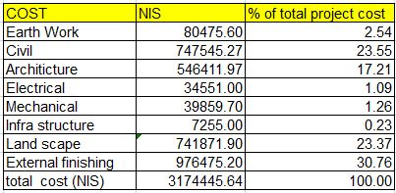
Results:
The following table shows the percent of work for each part of WBS to the total work:

Slide 17
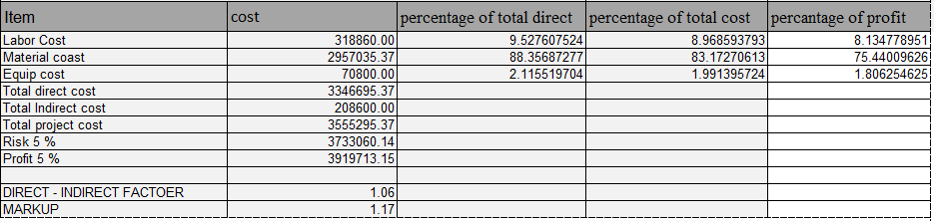
Cost-Price Analysis

Slide 18
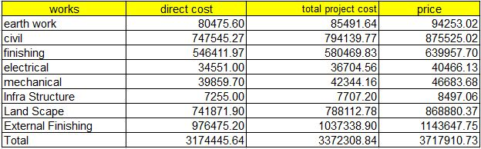
The following table shows the direct and total project cost with the price the factor used is :
Direct – indirect = 1.062
Mark up = 1.17

Slide 19
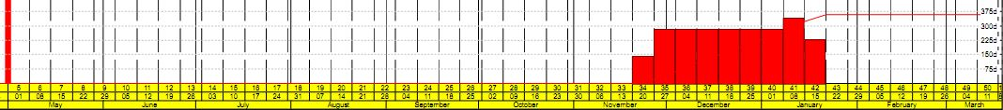
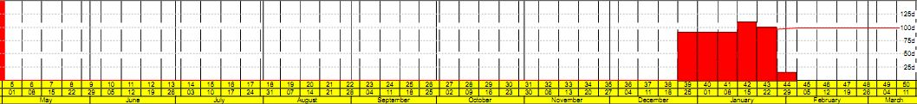
Resource Profile
In our project ,we took into consideration the sequence of labor s for the same activities with no day off for example
Plaster & Tile Profile :

Slide 20
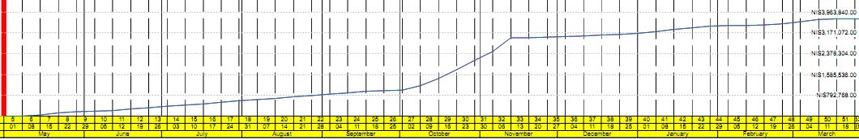
S – Curve

Slide 21
Discussion and conclusions:
After we made the analysis in this sample project we reach to some approximate values for unit man hours which can be used for other similar project so saves time in cost estimation .
From the percent of cost for each part of WBS we note that external finishing has the major affect in the cost of the project then civil work , land scape and architecture work so its prefer to do the external finishing "stone cladding "at the end of project to allow for some flexibility an activities sequences and do not affect in the project cost from the beginning .

Slide 22
Thanks For Your Attention

