Slide 1
An-Najah National University Faculty of Engineering and Information Technology Department of Industrial Engineering
Graduation Project (II): Operations Improvement at Mhanna Factory
Submitted to : Eng. Sulieman Daifi
Prepared by :Morshed Mhanna

Slide 2
Outline
Introduction
Current Factory Profile
Possible Fields of Improvement
Suggested Improvements and Interventions
Measuring The Effects of Improvements

Slide 3
Project Overview
In this research, a comprehensive improvement of operations will be undertaken to enhance the performance and the profitability of Mhanna Factory in Tulkarm.

Slide 4
The improvement will not be limited to the “shop floor” , it will include the other aspects of the business which are collectively called the Manufacturing Support Systems.

Slide 5
Methodology
Acquire information about the current situation of the factory.
Select a number of fields to introduce improvements.
Suggest possible improvements and intervention to enhance the performance of the factory.
Define Key Performance Indicators (KPI's) to enable the management to measure the positive impact of the improvements.

Slide 6
Objectives
Provide evidence for the management of the factory on the importance of implementing the proposed improvements.
Give an example for the industrial sector: family business is the most common in the Palestinian economy, therefore it is very important to demonstrate the possibility of applying scientific approaches of operations improvement to this type of business.

Slide 7
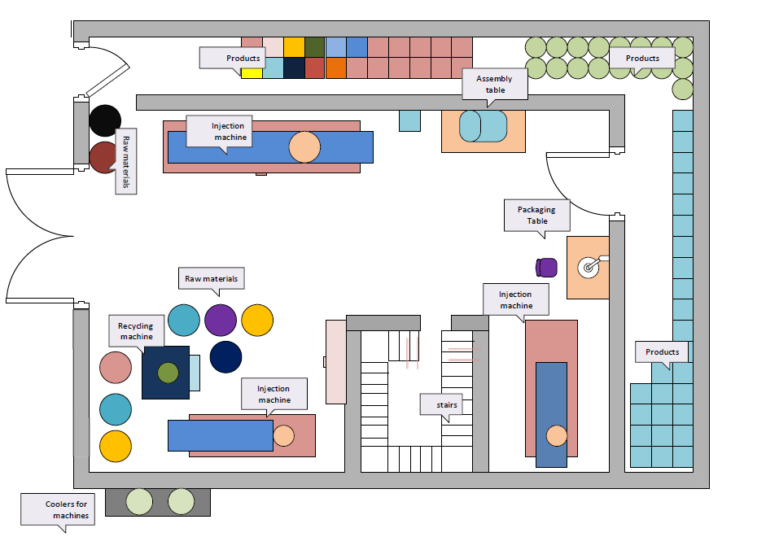
Current Factory Profile
Production, Quality , Safety and Maintenance
Production Planning and Inventory Management
Facility Layout

Slide 8
Improvements and Interventions
Quality Management
Production Management
Inventory & Stores
Facility Layout
Maintenance & Safety Management

Slide 9
Quality Management:
Obtaining quality certifications for the factory.
Introduce the Quality Control Charts.
Improve the overall quality of the products.

Slide 10
Quality Certification
Quality Control Charts
Improving the Qulity of the Products

Slide 12
Production Management:
Implement systematic demand forecasting techniques to determine potential required quantities and plan the production accordingly.
Analyze the current capacity of the factory and study the available options to increase it.
Develop a methodology to process orders effectively and schedule production runs in the optimal order (Sequencing and Scheduling).

Slide 13
Inventory & Stores
Creating a Materials Management System
It is that function of business that is responsible for the coordination of planning, sourcing, purchasing, moving, storing and controlling materials in an optimum manner so as to provide service to the customer, at a pre-decided level at a minimum cost.

Slide 14
Inventory & Stores
Increasing Storage Area: by utilizing the high ceiling of the factory and adding an extra floor to store light items.

Slide 15
Facility Layout
The current layout was not determined based on scientific considerations, it was the result of the space and construction limitations.

Slide 16
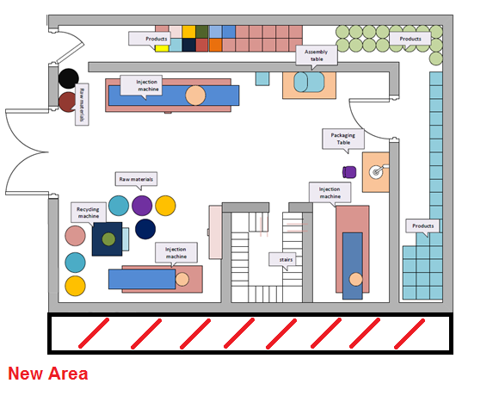
Possible Modifications to the Current Layout:
Move the cooling unit to the rooftop and add the narrow space where it is now to the factory area.

Slide 17
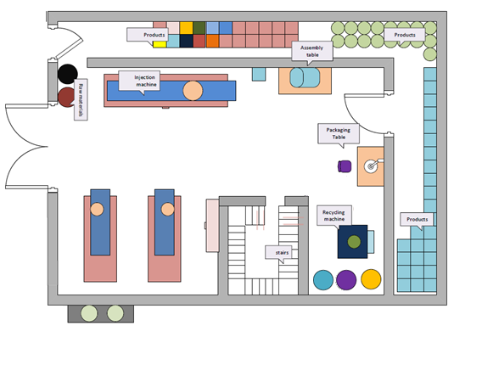
Move the two machines together and create a processing area.

Slide 18
Safety Management:
This term needs to be introduced to the factory and this does not necessarily mean hiring a safety manager, alternatively it can be added to the responsibilities of the production supervisor or the factory manager.

Slide 19
The main responsibilities of safety management:
Provide a workplace that is free from serious safety and health hazards.
Monitor the workplace to ensure employees follow safety in manufacturing
Create a culture in the factory that recognizes the importance of safety

Slide 20
Maintenance Management
There is a technician in the factory, he needs to be trained to do more maintenance tasks, and he can also be guided to perform regular preventive maintenance for the machine based on a set schedule. There is also a possibility to contract an external company to do complicated maintenance activities if this was proven to be more cost-effective.

Slide 21
Measuring the Effects of the Interventions
After discussing the possible improvements to the operation of the factory, there is a need to measure the impact of these improvements. This impact can be measured using a set of specific indicators called Key Performance Indicators.

Slide 22
Overall Sales
The most tangible and straightforward measure of success for any business is the volume of sales. It reflects the competitiveness of the product or service provided by a given business and its ability to capture market share.
Improved quality
lower cost,
the ability to fulfill orders on time

Slide 23
Asset Utilization
Most businesses are unable to achieve full utilization of their assets due to some complicated factors such as demand fluctuations and workforce availability.
This can be avoided by scheduling production and managing the inventories in a scientific way.

Slide 24
Production Rate / Cycle time
The number of products made in the time unit is the simplest definition of the production rate. It is directly related to the cycle time which is the total time required to make a certain item.
Better material handling
shorter setup time

Slide 25
Time from order to shipment
Most factories struggle to meet the delivery deadlines and shipment dates due to unexpected lags and delays.
increasing the production rate
keeping a reserve stock of products to tackle shortages
systematic scheduling of production

Slide 26
Defective Rates
Lower defective rates mean less waste and cost, better overall quality and consistency, higher production rate and ability to plan production.

Slide 27
Conclusions
This factory lacks many business functions and departments such as Quality, Production, Maintenance, Human Resources, Sales and Marketing and Inventory Management.
The absence of these functions as separate departments doesn’t mean that the core tasks associated with them are not implemented at the factory.

Slide 28
Conclusions ….
The size of the business and the nature of its work can explain its ability to operate without these functions as separate departments.
This type of businesses (family-business) can operate without separate departments in some areas.
There are great opportunities for improvement in the operation of the factory in several areas.

Slide 29
Recommendations
The suggested improvements and interventions have to be carefully studied to investigate the feasibility and possibility of each one.
This needs fact-based work to determine the benefits and costs of each intervention.

Slide 30
Recommendations
This factory is a good model of the Small and Medium Enterprises which account for the majority of businesses in Palestine.
It can also be used as an example for other factories that are managed by the owner which is the most common type of ownership in the industrial sector in Palestine.

Slide 31
Recommendations
The changing realities in the local market mean that the factory must adapt to the change and adopt a new mindset to keep up with the competition and avoid losing market share.
Operating with higher efficiency and lower cost enables the factory to sell at lower prices which is a great advantage for competitiveness.

Slide 32
Thanks

