Slide 1


AN-NAJAH NATIONAL UNIVERSITY
BUILDING ENGINEERING DEPARTMENT
Recreation Centre
PREPARED BY:
Bayan Hudhud
Shayma’ Aljurf
Thekra Shehada
Supervisor :
Dr.Mo’ayad Salhab

Slide 2
Contents
1
2
3
4
5
6
Project Background
Architectural Plan.
Mechanical Plan.
Structural Plan.
Environmental Analysis.
Electrical Plan.

Slide 3
Project Background
The project is designing of Recreation Centre in Nablus, The building contains of three floors, basement, ground floor, anf first floor.

Slide 4
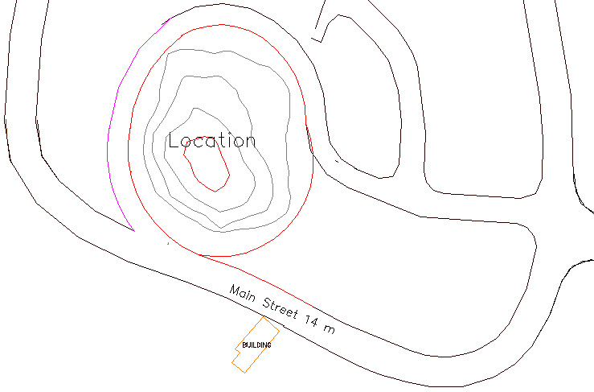
Location

Slide 5
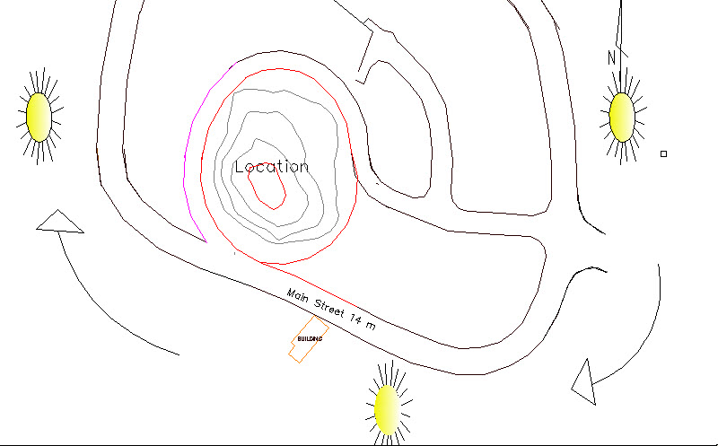
Site Analysis

Slide 6
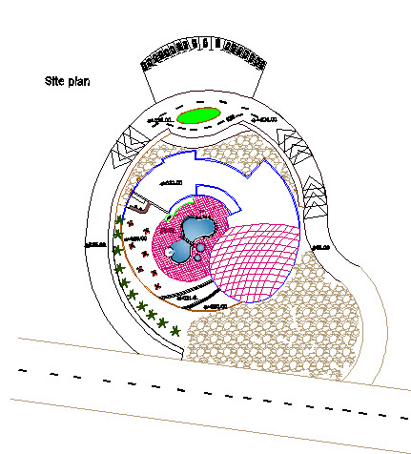
Site Plan

Slide 7
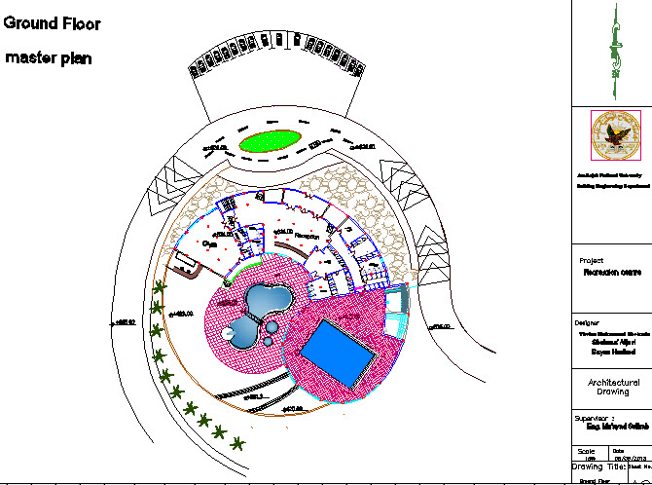
Ground Floor Master Plan

Slide 8
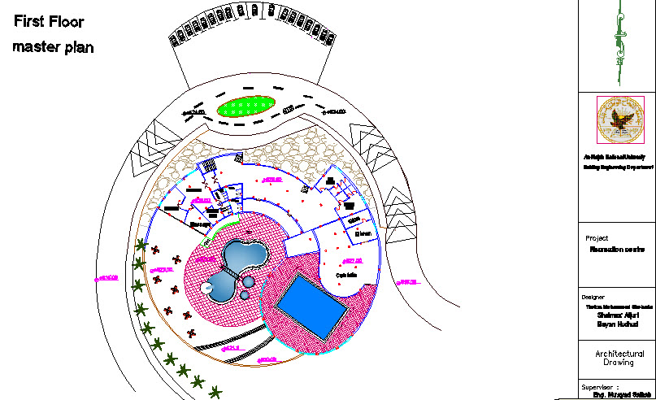
First Floor Master Plan

Slide 9
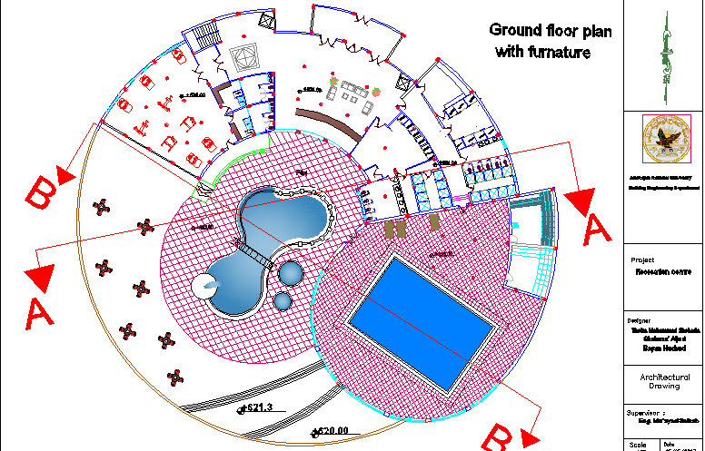
Grnd Floor Master Plan
Ground Floor furniture Plan

Slide 10
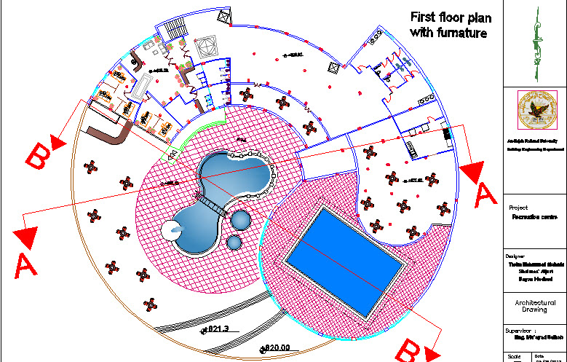
First Floor furniture Plan

Slide 11
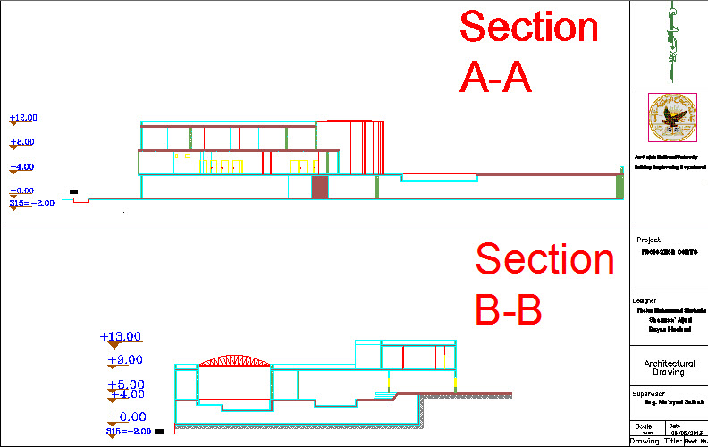
Sections

Slide 12
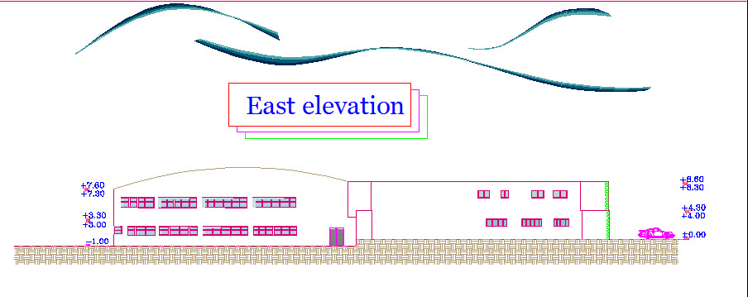
Elevations

Slide 13
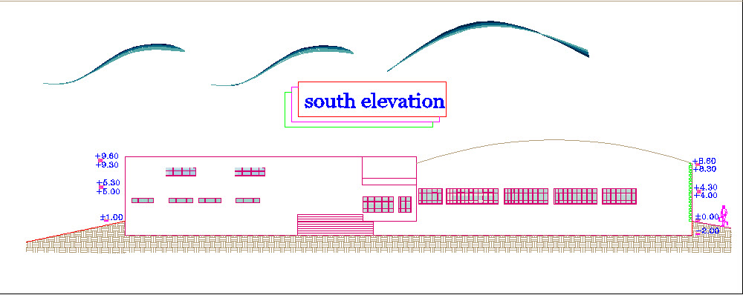
Elevations

Slide 14
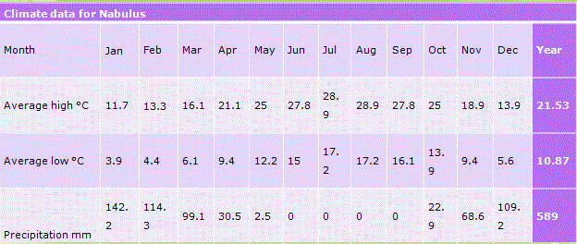
Climate Data In Nablus

Slide 15
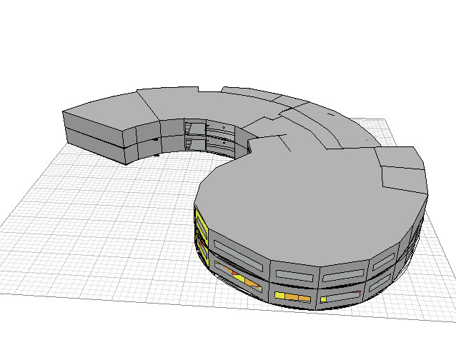
Environmental Analysis
The Environmental Analysis has been mad by using the Autodesk Building Analysis Program (ECOTECT)

Slide 16
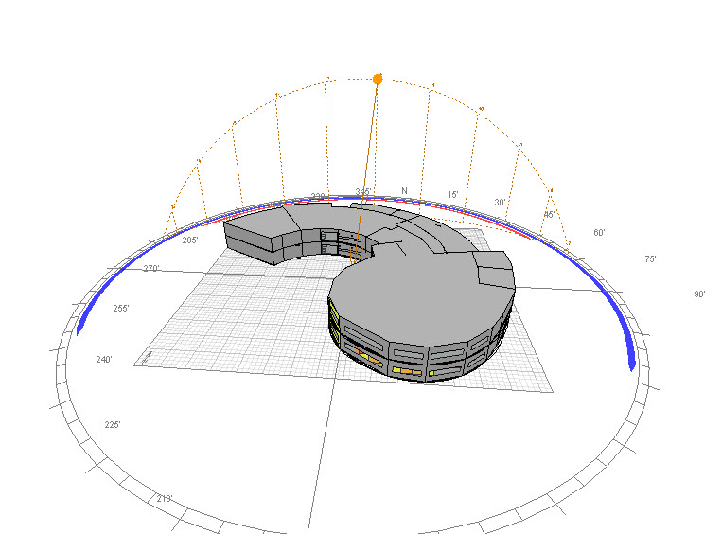
Sun Path
Sun Path In Sumner Solstice (21 June)

Slide 17
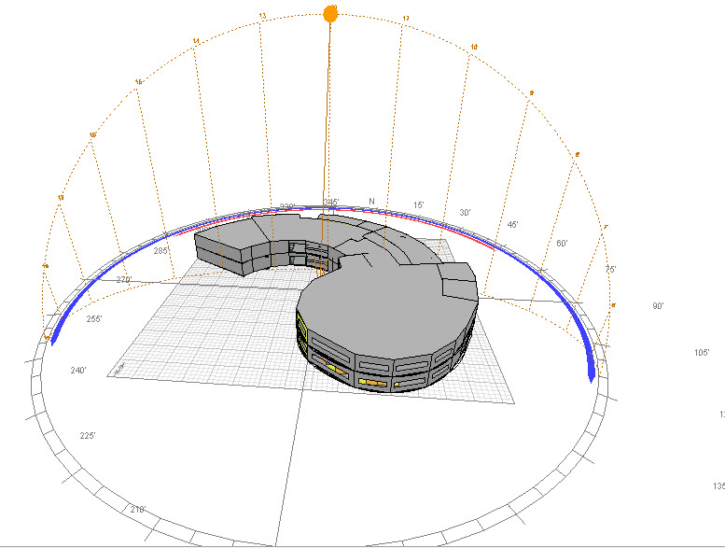
Sun Path
Sun Path In Winter Solstice (22 December )

Slide 18
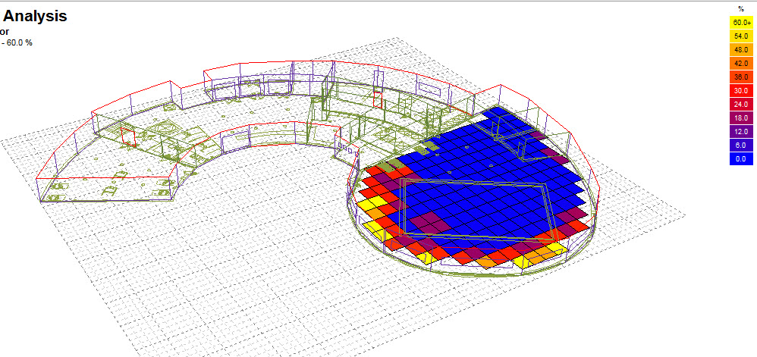
Natural Lighting for Swimming Pool

Slide 19
Curtin Walls of the Swimming pool :
1
Dark colored .
2
Reflection factor of about 75% of the wall area.
3
Thickness more than 4 mm

Slide 20
Electrical Design
1
Lighting.
2
Power.
3
Low current and Fire resisting

Slide 21
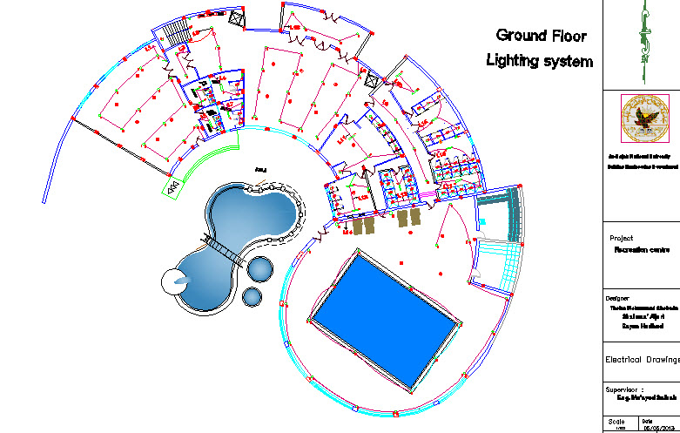
Ground Floor Lighting System

Slide 22
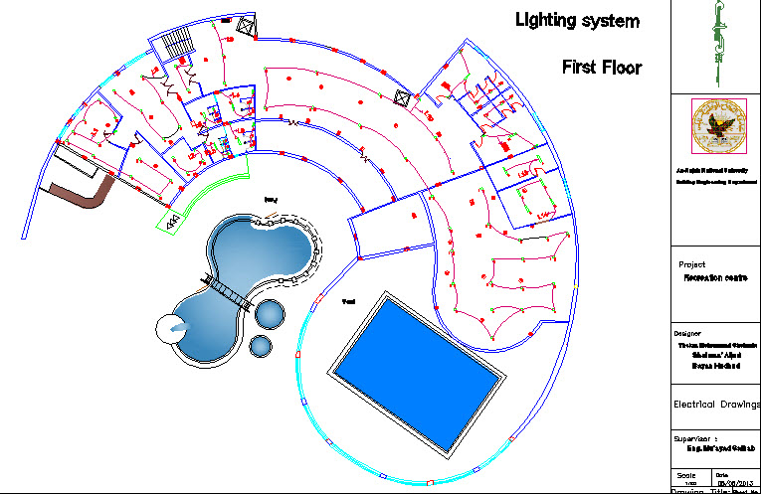
First Floor Lighting System

Slide 23
Lamp Type
Partition | Lamp Type
Gym | HID
Swimming Pool | Metal Halide Lamp
Parking | HID
Cafeteria | CFL

Slide 24
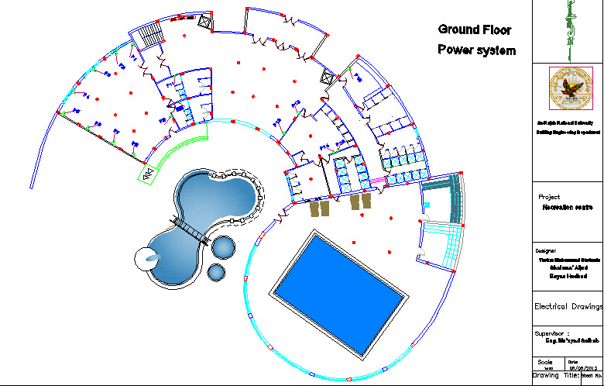
Ground Floor Power System

Slide 25
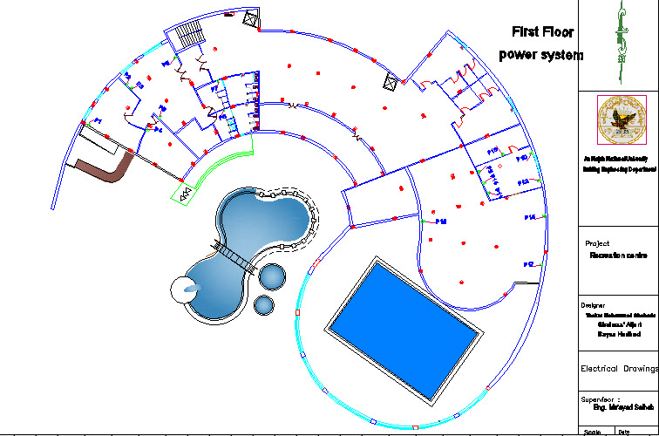
First Floor Power System

Slide 26
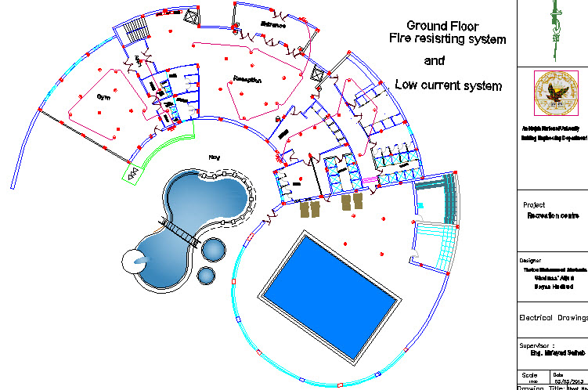
Ground Floor Low Current and Fire Resisting System

Slide 27
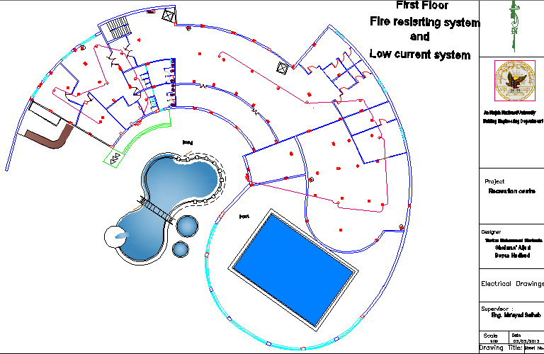
First Floor Low Current and Fire Resisting System

Slide 28
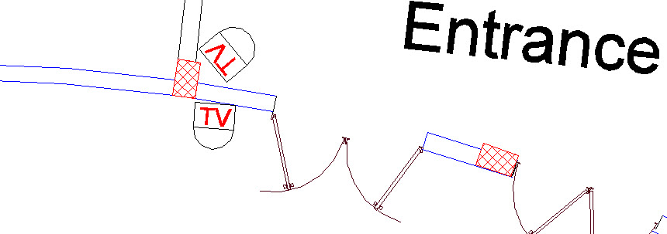
Low Current System

Slide 29
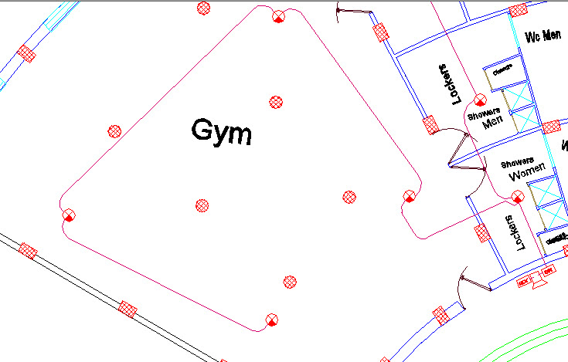
Fire Resisting System

Slide 30
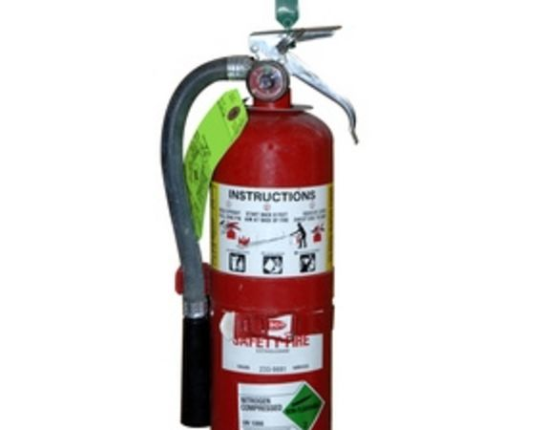
Fire Resisting System
Extinguisher

Slide 31
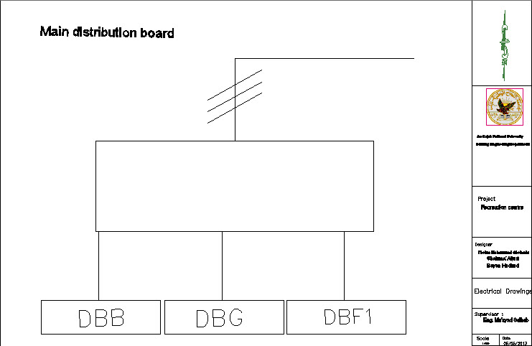
Main Board

Slide 32
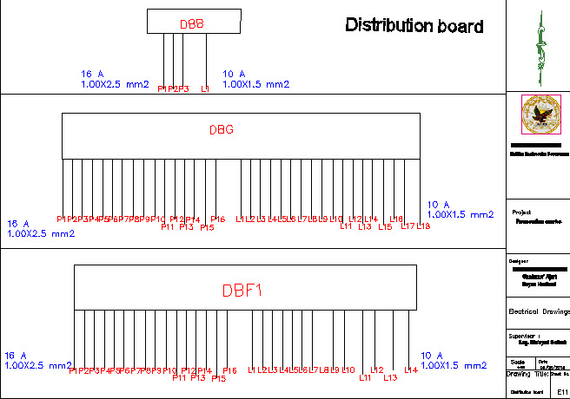
Main Board

Slide 33
Thanks For Listening

