Slide 1
Graduation Project:
Analysis & Redesign of
Balaa Water Distribution Network
By:
Mohammed Noufal Mohammed Mohsen

Slide 2
Objective of the Project :
1- Study the current water supply network of Balaa town
2- Take in to consideration the topography and study water flow in network
3- Explore defects in the network and try to find best design
4- Calculate if there is a need to other resources of water

Slide 3
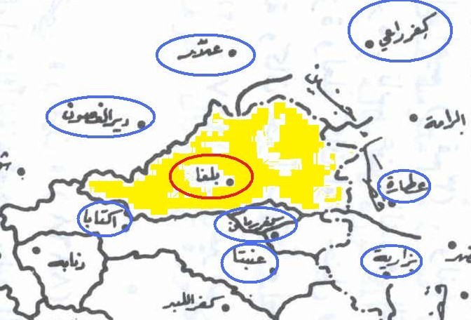
Study Area

Slide 4
Objective of the Project :
Population = 8000 c
Area = 21121 dounm
Last update of the WDN = 1980’s

Slide 5
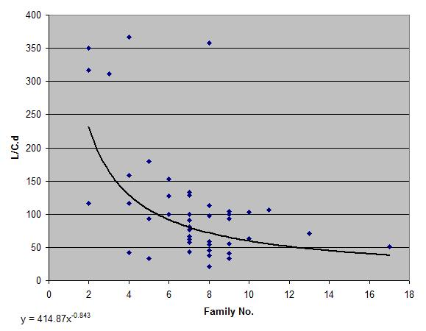
Data Collection and Questionnaire Analysis

Slide 6
Data Collection and Questionnaire Analysis

Slide 7
Data Collection and Questionnaire Analysis

Slide 8
EPANET Program
Running hydraulic and water quality simulations.
Viewing the result in variety of formats which include colour-coded network maps, data tables, time series and contour plots.
Compute friction head loss using the Hazen-Williams, Darcy-Weisbach or Chezy-Manninig formulas.
Model various types of valves including shutoff, check, pressure, regulating and flow control valves.

Slide 9
EPANET Program
Input ∙ Pipes
1- ID
2- Diameter
3- Length
4- Roughness

Slide 10
EPANET Program
Input ∙ Node
1- ID
2- Elevation
3- Demand

Slide 11
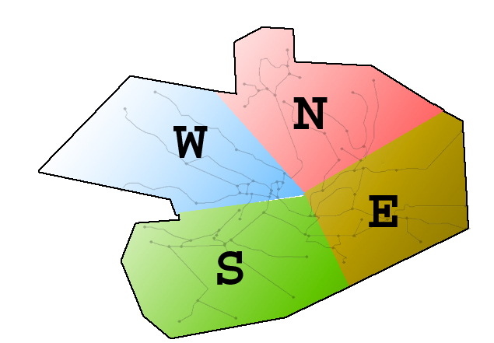
EPANET Program
Input ∙ Node

Slide 12
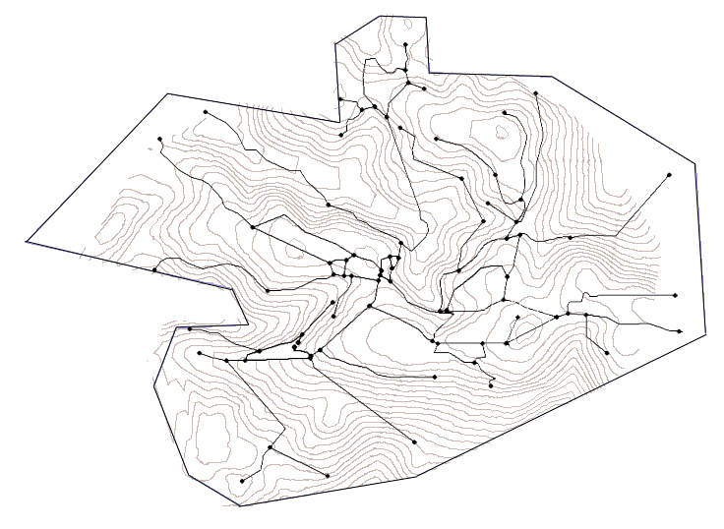
EPANET Program
Input ∙ Node

Slide 13
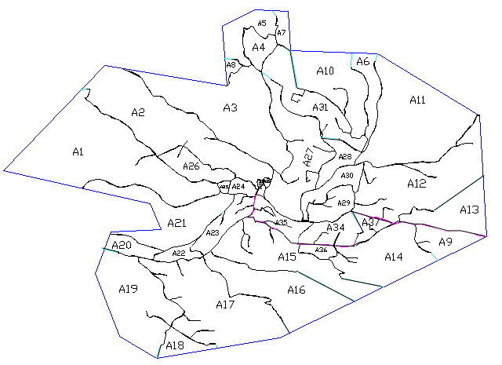
EPANET Program
Input ∙ Node

Slide 14
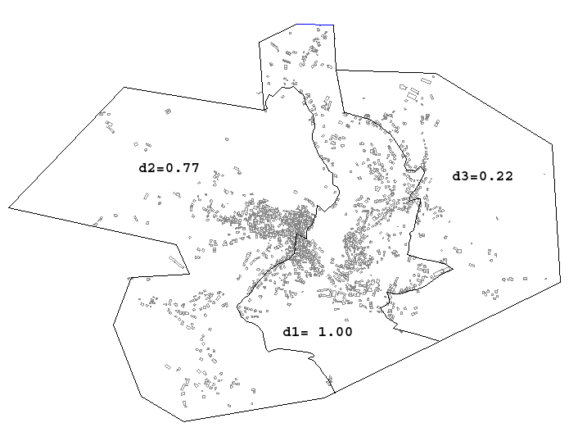
EPANET Program
Input ∙ Node

Slide 15
Time Pattern

Slide 16
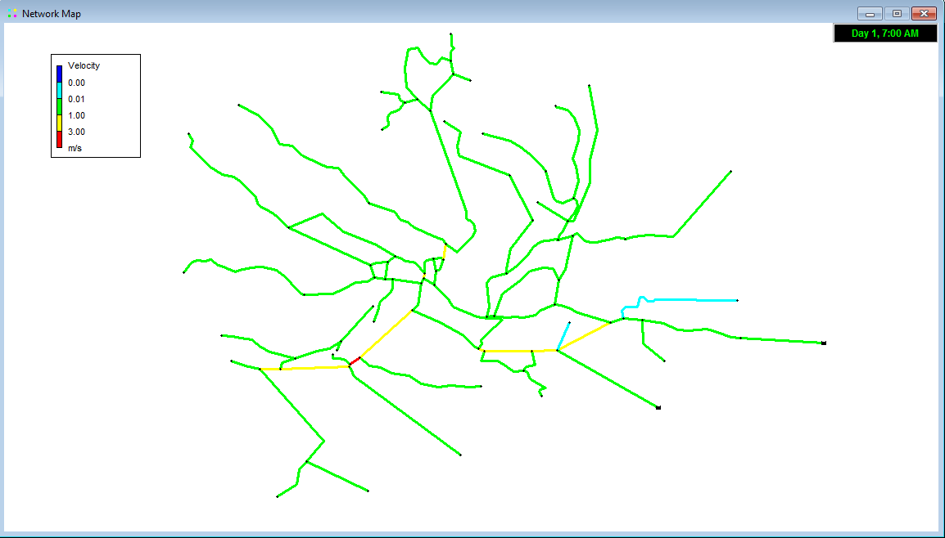
Analysis and Design of Future Water Supply Network
Out put ∙ Pipes Velocity

Slide 17
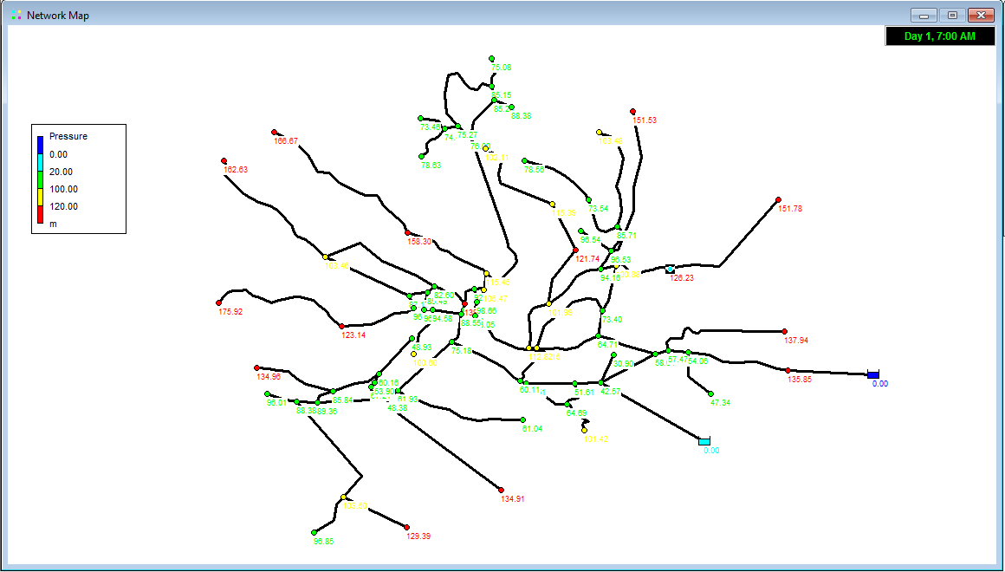
Analysis and Design of Future Water Supply Network
Out put ∙ Node pressure

Slide 18
Analysis and Design of Future Water Supply Network
Design Period = 30 years
P_{F} = P_{o}(1+i)^{n}
Pf = 16785 c

Slide 19
Analysis and Design of Future Water Supply Network
Design Period = 30 years
P_{F} = P_{o}(1+i)^{n}
Pf = 16785 c

Slide 20
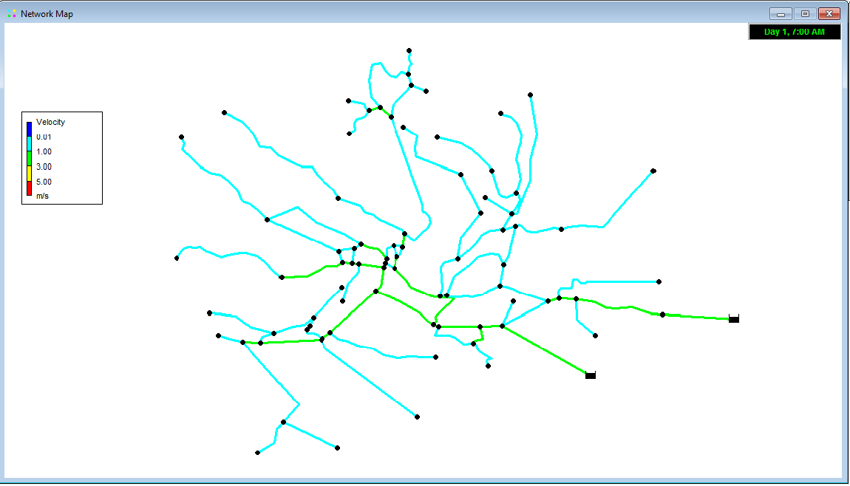
Analysis and Design of Future Water Supply Network
Future Output >> Velocity

Slide 21
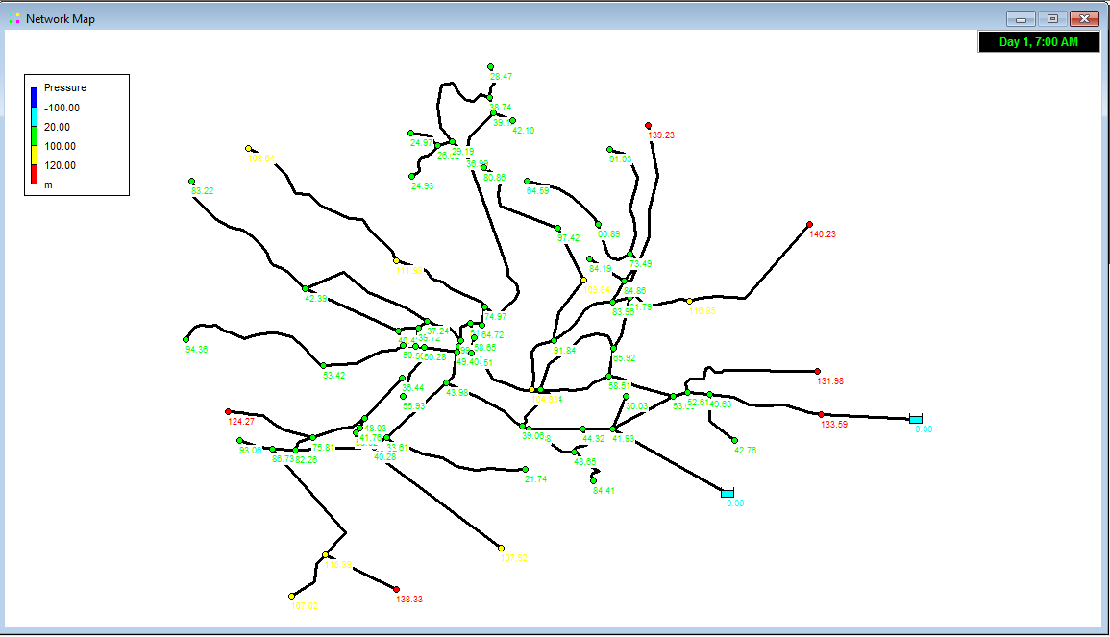
Analysis and Design of Future Water Supply Network
Future Output >> Pressure

Slide 22
Analysis and Design of Future Water Supply Network
Changed Pipes :
Pipe ID | Old Diameter (in.) | Future Diameter (in.)
9 | 2 | 3
11 | 2 | 3
17 | 3 | 4
18 | 2 | 4
20 | 3 | 4
51 | 3 | 4
52 | 3 | 4
53 | 3 | 4
56 | 3 | 4
57 | 3 | 4
58 | 3 | 4
76 | 6 | 4
83 | 6 | 2
88 | 2 | 2
89 | 6 | 2

Slide 23
Analysis and Design of Future Water Supply Network
Cost :
Pipe Diameter | Total Length (m) | Cost per Meter Length (NIS/m) | Total Cost (NIS)
2’’ | 16535.2 | 80 | 1,322,816
3’’ | 3267.7 | 103 | 336,573
4’’ | 3867.2 | 126 | 487,267
6’’ | 2385.2 | 130 | 310,076
 |  | Total Cost | 2,456,732

