Slide 1
Hydraulic Analysis of the Water
Distribution Network of Anabta Town
&
Research about Wadi Al-Zaimar
Prepared by: Abeer Barakat Thanaa Daoor Leena Salameh

Slide 2
Objectives
1. To estimate and analyze water consumption and water losses in the Town of Anabta.
2. To hydraulically analyze the water distribution network of Anabta Town using EPANET.

Slide 3
Description of Anabta Town
Location
Anabta (عنبتا‎) is a Palestinian town located 20 Kilometres east of Tulkarm Governorate in the northern West Bank. It is 15 Km apart from the Mediterranean coast.
It has an area of 1,300 Dunams
The Population of Anabta is approximately 8000

Slide 4
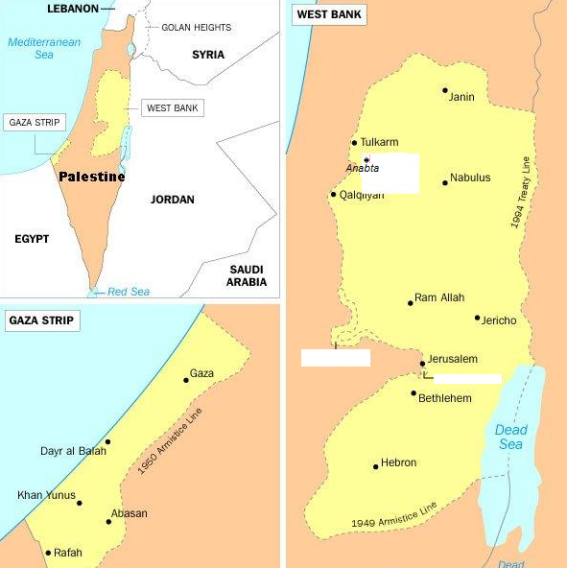

Slide 5
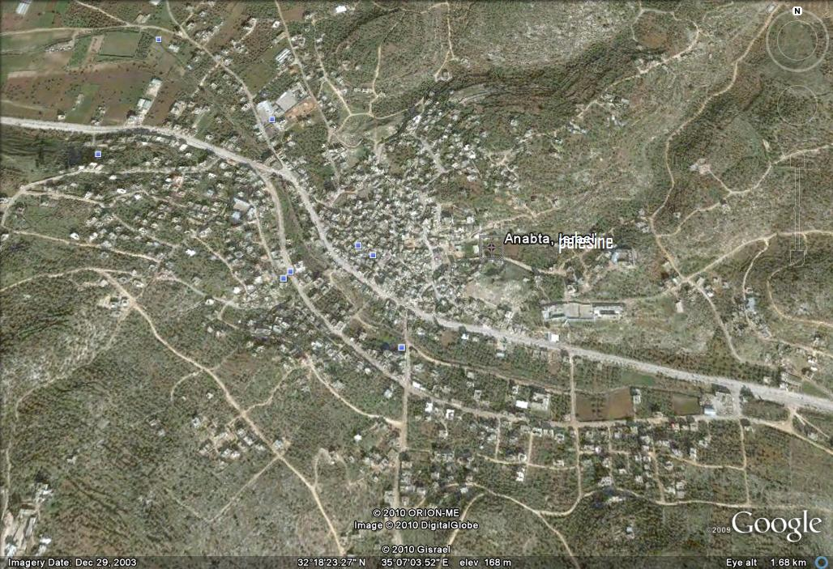
Topography

Slide 6
Climate and Rainfall
Anabta has a Mediterranean climate, warm rainy winter and hot dry summer.
8 to 16 °C 17 to 30 °
Anabta receives in excess of 550 millimetres (21.7 in) of rain yearly.

Slide 7
Collected Data
Questionnaire on a sample of 100 houses.
results:
Daily consumption = 70 L/c-d
Quality problems that the residents of Anabta face

Slide 8
1.Questionaire

Slide 9
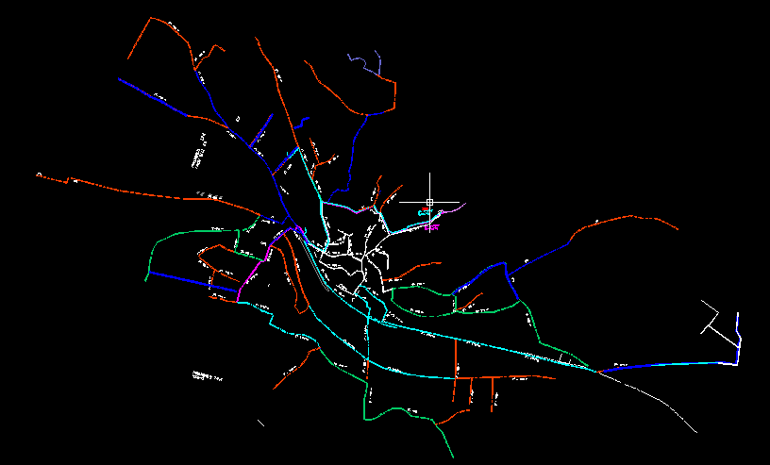
2. AutoCAD drawing

Slide 10
2. AutoCAD drawing
AutoCAD drawing includes:
1. Pipes diameters
2. nodes elevations

Slide 11
Hydraulic Analysis
Input Data
1.Pipes diameters and HWC
Hazen – Williams formula:
H_{f} = 162.5* (Q/C_{HW} )^{1.852} *D ^{-4.87} *L
2.Demand at each node =population * individual need
Numbers of nodes
3.Nodes elevations

Slide 12
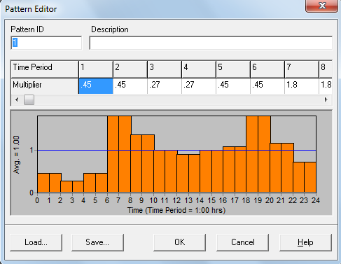
Demand pattern

Slide 13
Reservoirs locations and elevations
The first reservoir locates in the southern part of the Town has a total head of 360 and includes 3.5 m water elevation and 356.5m elevation above the sea level
The second one locates in the southern part of the Town.This reservoir has total head of 300m including 3.5 m water level and 296.5 m above the sea level.

Slide 14
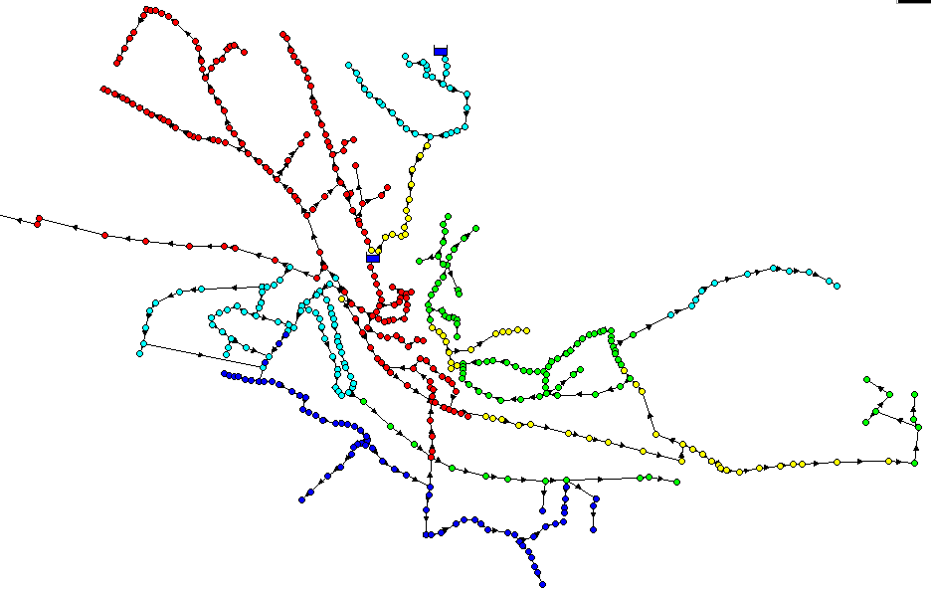
Output Data (pressure values)

Slide 15
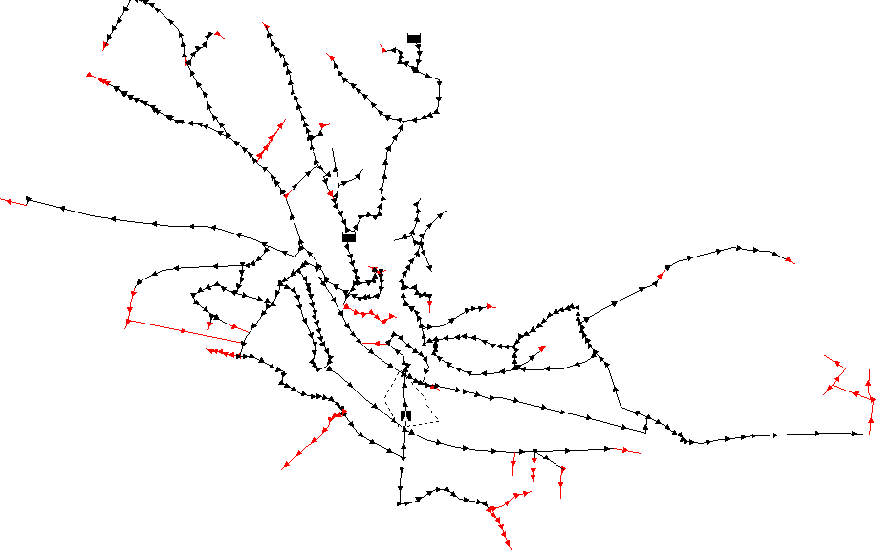
Output Data ( velocity values)

Slide 16
Recommendations
Pressure reducing valves at high pressure
areas
Decrease the diameters in low velocity pipes

Slide 17
Hydraulic analysis under
future scenario
20 years from now the population is expected to be 12,370 depending on a growth rate of 1.92%
Future demand at each node including 30% losses = 1.6 CMH

Slide 18
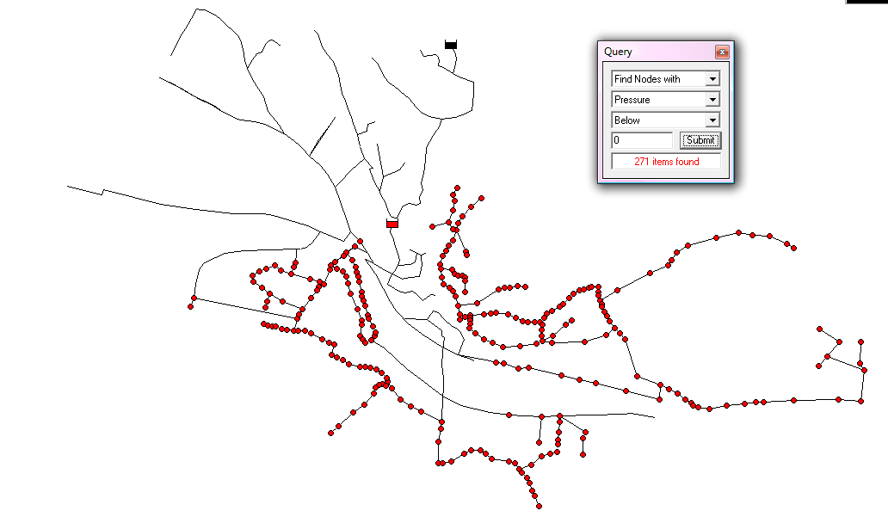
Future Negative Pressure

Slide 19
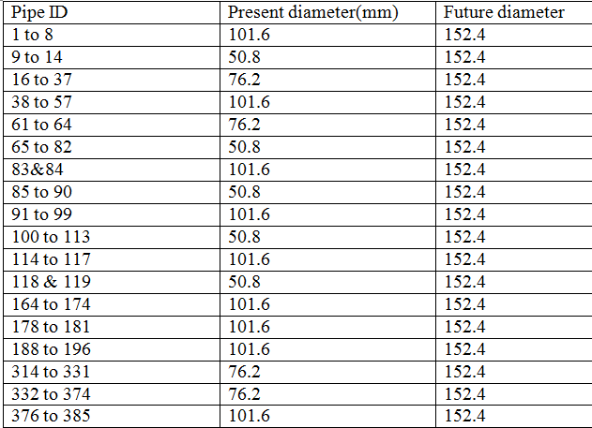
Changed Diameters

Slide 20
Solution
We changed the diameters
Add a pump with power of = δ*H*Q =1937.96 KN.M/HR
The resultant pressure ranges between 25 and 160m.
Velocity .01 – 2.8 m/s

Slide 21
Wadi Al-Zaimar
Wadi Al- Zeimar passes through many villages between the western portion of Nablus City and beyond the Town of Anabta.
The wadi is infamous in its negative impact surrounding environment
influence on the groundwater quality.

Slide 22
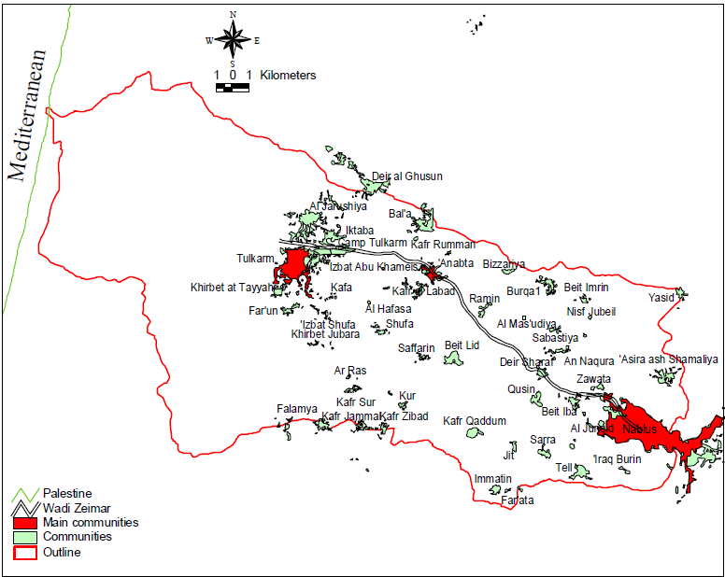

Slide 23
Objectives
Assign all the major polluting factories and industrial facilities and the corresponding loadings before entering the wadi.
Identify the types of pollution in the wadi

Slide 24
Sources
Industrial factories present along the banks
Wastewater being disposed of in the wadi
Solid waste is being dumped in the wadi

Slide 25
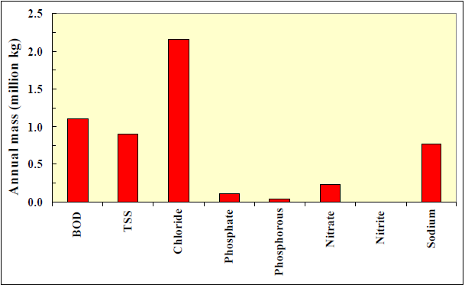
Total annual mass loading to the Wadi Zeimar from the western portion of the City of Nablus.

Slide 26
Effects
1-bad odours
2- contamination of the groundwater well
3-the increase in soil salinity
4- the elevated heavy metal occurrences in soil and groundwater
5-and the promotion of the intensive existence of insects by the wadi.
6-Recent statistics discover that 16 cancer cases in Anabta
7- aesthetic eyesores and ugly blemish.

Slide 27
Toxic Metals
The two main toxic parameters that are used by the leather factory are sulphide and chromium.
Chemical analysis shows high nitrate concentrations exceeding the maximum contaminant level of 10 mg/L NO3-N

Slide 28
Groundwater wells
Pump (m3/yr) | Basin | Use | Depth | Ground water location
44,094 | W | Agricultural | 200 | Anabta
- | NE | Abandoned | - | Dair Sharaf
- | NE | Abandoned | - | Dair Sharaf
- | NE | Domestic | 670 | Dair Sharaf
758,622 | NE | Agricultural | 318 | Bait Iba
982,000 | NE | Domestic | 595 | Bait Iba
42,245 | W | Domestic | 150 | Anabta
136,722 | W | Agricultural | 200 | Anabta
- | W | Agricultural | 160 | Anabta

Slide 29
General recommendations
Shelter the wadi through piping.
Wastewater will be treated before being discharged of into the wadi.
Stop dumping of solid wastes in the wadi
industries monitored and inspected (standard limits)

