Slide 1
Graduation Project
3D Dynamic and Soil Structure Interaction Design for Al-Huda Building

Slide 2
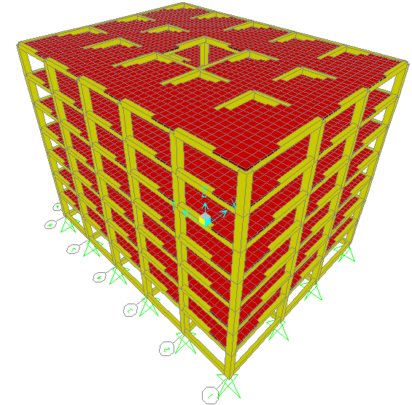


Slide 3
This project is formed of six basic chapters:-
Chapter 1: Introduction, that describes the structure location, loads, materials, codes and standards and the basic structural system of the structure.
Chapter 2: Preliminary design, which introduces the selection of slab, beams and columns dimensions according to ACI code.
Chapter 3: Structural verification, which introduces checks for the structure as one story to compatibility, equilibrium and stress strain relationship then replicate the structure to seven stories and the same checks well be done.
Chapter 4: Static design, which introduces design of different structural elements using SAP program which are slab, beams, columns, footings and tie beams.
Chapter 5: Dynamic analysis, which introduces analysis of the building using manual solution and SAP program.
Chapter 6: Soil -structure interaction, here we compare the results of different soil cases in static and dynamic conditions on the building.

Slide 4
Chapter One
Introduction

Slide 5
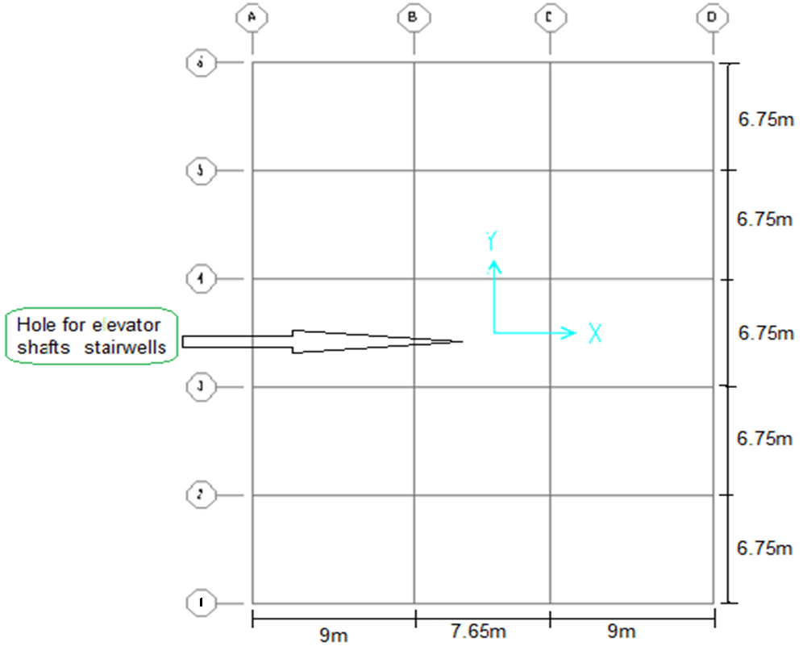
Plane view

Slide 6
1.1 Description of Project
-Type of building: Office Building
-Area of the building (865 m²)
-Number of stories ( 7 stories )
-Ground floor contains Garages and Stories with elevation (4.5 m)
-Remaining floors contain offices
with elevation (3.75 m)

Slide 7
1.2 Location
The site of the building is located in Ramallah on a rocky soil with bearing capacity(3.5kg/cm ²)
1.3 Analysis philosophy
We will represent the results of the design and analysis of the building through various methods of analysis in order to reach the best. Comparisons between different results, first static then dynamic analysis will be done.
1.4 Program analysis (SAP2000 v.14.2)

Slide 8
1.5 CODE
(ACI318M-08)
1.6 Material
𝒇'c=250kg/cm²
ℱy=4200kg/cm²
1.7 Loads
Ultimate load =1.2 (DL+SID) +1.6 LL
DL: dead load
SID: super imposed load (0.3 ton/m²)
LL: live load (0.4 ton/m²)

Slide 9
Chapter Two
Preliminary Design

Slide 10
-Beams dimension: h=L /18.5=900/18.5=50 cm use 50 x 60 cm
-Columns dimension: use 70x70 cm
-Slab thickness: use t= 20 cm

Slide 11
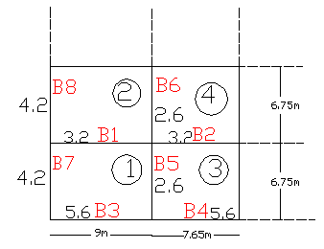
Check slab thickness
-Calculate α for all beams :- α:ratio of beam stiffness to slab stiffness

Slide 12
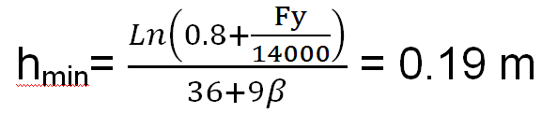
The average ratio α_{m} for panels 1,2,3,4 α_{m} for panels 1= =3.9 α_{m} for panels 2=3.3 α_{m} for panels 3=3.5 α_{m} for panels 4=2.9 since α_{m} >2.0 apply equation 9.13ACI code so; select thickness of slab is 20 cm.

Slide 13
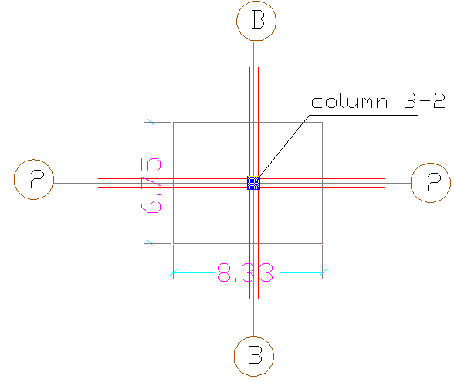
Check column dimension
-critical column is B-2
Tributary area = 56.125 m²

Slide 14
P_{u}= 7246.5 KN
P_{column}=ϕ (0.8) [ 0.85 f/_{c}( A_{g}- A_{s} ) + f_{y} A_{s}]
7246.5x100=0.65x0.8[ 0.85x250 ( A_{g}- 0.02A_{g} ) + 4200x 0.02A_{g}]
Ag=4768.4 cm² 69x69 cm
70x70 cm OK

Slide 15
Chapter Three
Structural Analysis Laws and its verification

Slide 16
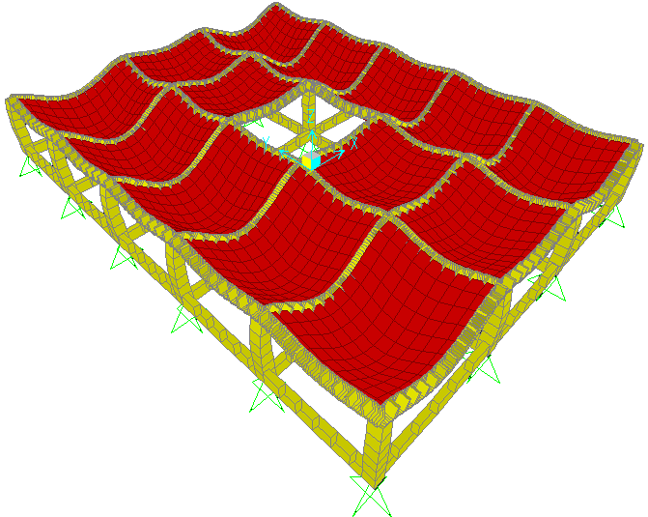
3-1 For one storey
3-1.1 Compatibility:
Compatibility is ok……………….

Slide 17
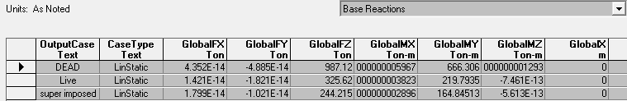
3-1.2 Equilibrium:
Dead load (manual) = 965.08 ton.
Live load (manual) = 325.62 ton.
Super imposed(manual)=244.215 ton.

Slide 18



% of error ( Dead Load )
% of error ( Live Load )
% of error ( Super Imposed Load )
…………….Equilibrium is ok

Slide 19

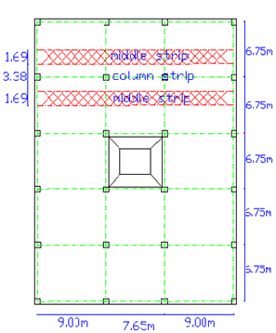
3-1.3 Stress-strain relationship:
-Direct design method is applicable .
M –ve = 0.65 Mo = 44.74 ton.m
M +ve = 0.35 Mo = 24.1 ton.m
M -ve (beam)=(0.825)(0.85)(44.74) = 31.37 ton.m
M +ve (beam)=(0.825)(0.85)(24.1) = 16.9 ton.m

Slide 20
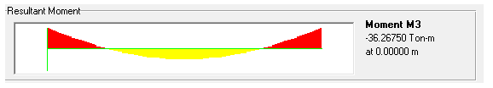


Results from SAP
Moment on the interior negative beam in X-direction
Moment on the interior positive beam in X-direction
< 10% ok

Slide 21
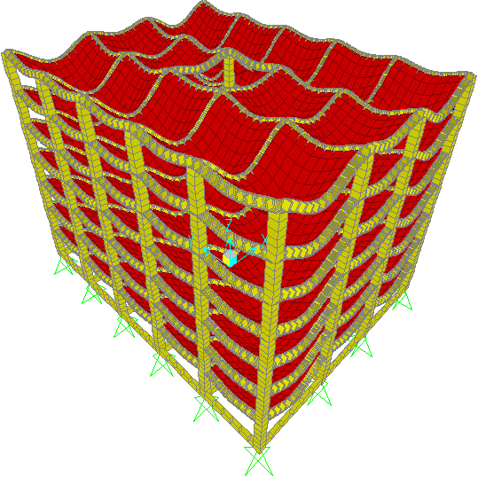
3-2 For seven stories
3-2.1 Compatibility:
Compatibility is ok……………….

Slide 22
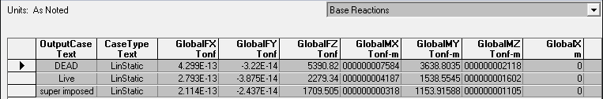
3-2.2 Equilibrium:
Dead load (manual) = 5390.83 ton.
Live load (manual) = 2279.34 ton.
Super imposed(manual)=1709.51 ton.

Slide 23

% of error ( Dead Load )
% of error ( Live Load )
% of error ( Super Imposed Load )
…………….Equilibrium is ok

Slide 24
3-2.3 Stress-strain relationship:
-Direct design method is applicable .
M –ve = 0.65 Mo = 44.74 ton.m
M +ve = 0.35 Mo = 24.1 ton.m
M -ve (beam)=(0.825)(0.85)(44.74) = 31.37 ton.m
M +ve (beam)=(0.825)(0.85)(24.1) = 16.9 ton.m

Slide 25


Results from SAP
Moment on the interior negative beam in X-direction
Moment on the interior positive beam in X-direction

Slide 26
Chapter Four
Static Design
of
the Building

Slide 27
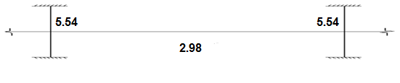
4.1-Design of slab:-
4-1.1 Manual design
In this section we take frame 5-5 in the first storey in X-direction
→moment on column strip for interior span (ton.m)
M-ve =5.54 ton.m →As= 2.6cm² (Use 3 Φ12mm\m)
M+ve =2.98 ton.m →As= 1.14cm² (Use 2 Φ12mm\m)

Slide 28
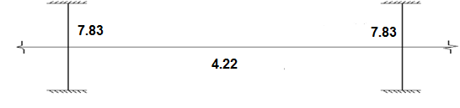
→moment on middle strip for interior span (ton.m)
M-ve =7.83 ton.m →As= 7.48cm² (Use 7 Φ12mm\m)
M+ve =4.22 ton.m →As= 4cm² (Use 4 Φ12mm\m)

Slide 29
Comparison between manual and SAP result for frame 5-5
Moment (ton.m) | SAP result | Manual result | # of bars(sap) | # of bars(manual)
M_{+v for column strip} | 0.93 | 0.88 | 3 Ф12mm/m | 2 Φ12mm\m
M_{+v for middle strip} | 0.86 | 2.5 | 3 Ф12mm/m | 4 Φ12mm\m
M_{-v for column strip} | 3.52 | 1.64 | 6 Ф12mm/m. | 3 Φ12mm\m
M_{-v for middle strip} | 2.91 | 4.64 | 5 Ф12mm/1m | 7Φ12mm\m

Slide 30
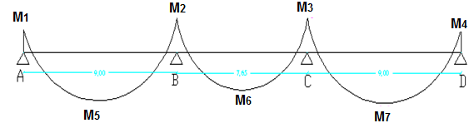
SAP results :
SAP result in X-direction :
Note: M1 = M4
M2 = M3
M5 = M7

Slide 31
Floor | Moment | Col. Strip -ve | moment |  | Col. Strip +ve | Moment | Mid. Strip -ve | Moment | Mid. Strip +ve
1 | M1,M4 | 9.22 |  | M5,M7 | 7.39 | M1,M4 | 3.02 | M5,M7 | 6.12
 | M2,M3 | 11.89 |  | M6 | 3.15 | M2,M3 | 4.95 | M6 | 1.45
2 | M1,M4 | 8.09 |  | M5,M7 | 7.31 | M1,M4 | 3.07 | M5,M7 | 6.05
 | M2,M3 | 11.74 |  | M6 | 3.19 | M2,M3 | 5.62 | M6 | 1.47
3 | M1,M4 | 9.43 |  | M5,M7 | 7.34 | M1,M4 | 3.0 | M5,M7 | 6.06
 | M2,M3 | 11.67 |  | M6 | 3.18 | M2,M3 | 5.6 | M6 | 1.47
4 | M1,M4 | 9.47 |  | M5,M7 | 7.34 | M1,M4 | 3.1 | M5,M7 | 6.06
 | M2,M3 | 11.6 |  | M6 | 3.20 | M2,M3 | 4.9 | M6 | 1.47
5 | M1,M4 | 9.48 |  | M5,M7 | 7.35 | M1,M4 | 3.1 | M5,M7 | 6.07
 | M2,M3 | 11.56 |  | M6 | 3.19 | M2,M3 | 4.9 | M6 | 1.47
6 | M1,M4 | 9.61 |  | M5,M7 | 7.28 | M1,M4 | 3.1 | M5,M7 | 6.03
 | M2,M3 | 11.49 |  | M6 | 3.23 | M2,M3 | 4.87 | M6 | 1.47
7 | M1,M4 | 9.08 |  | M5,M7 | 7.6 | M1,M4 | 3.0 | M5,M7 | 6.23
 | M2,M3 | 11.7 |  | M6 | 3.09 | M2,M3 | 4.95 | M6 | 1.43

Slide 32
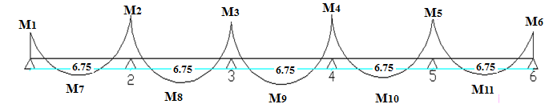
SAP result in Y-direction :
Note : M1= M6
M2 = M5
M3 = M4
M7 = M11
M8 = M10

Slide 33
Floor | Col. Strip –ve. |  |  | Col. Strip +ve |  |  | Mid. Strip -ve |  |  | Mid. Strip +ve
 | M1,6 | M2,5 | M3,4 | M7,11 | M9 | M8,10 | M1,6 | M2,5 | M3,4 | M7,11 | M9 | M8,10
1 | 4.17 | 7.84 | 4.48 | 2.56 | 2.41 | 0.85 | 4.22 | 4.47 | 6.9 | 3.46 | 3.28 | 3.21
2 | 4.4 | 6.12 | 5.4 | 2.52 | 2.41 | 0.85 | 4.32 | 4.41 | 7.33 | 3.44 | 3.28 | 3.17
3 | 4.48 | 5.36 | 6.27 | 2.52 | 2.41 | 0.85 | 4.35 | 4.4 | 9.0 | 3.46 | 3.28 | 3.17
4 | 4.55 | 4.32 | 5.4 | 2.52 | 2.41 | 0.85 | 4.37 | 4.72 | 7.37 | 3.46 | 3.28 | 3.17
5 | 4.6 | 5.2 | 6.31 | 2.56 | 2.41 | 0.85 | 4.39 | 4.35 | 9.05 | 3.46 | 3.28 | 3.17
6 | 4.74 | 5.1 | 4.48 | 2.52 | 2.41 | 0.85 | 4.43 | 8.46 | 7.43 | 3.44 | 3.28 | 3.17
7 | 4.21 | 5.4 | 6.23 | 2.68 | 2.45 | 0.80 | 4.26 | 5.75 | 8.86 | 3.51 | 3.28 | 3.15

Slide 34
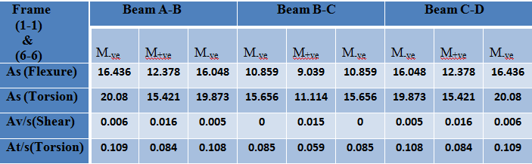
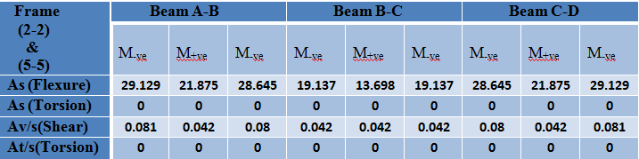
4.2-Design of beams :-
SAP results in X-direction

Slide 35
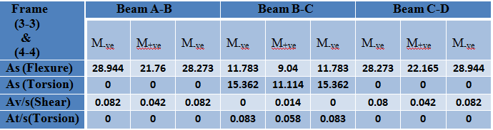
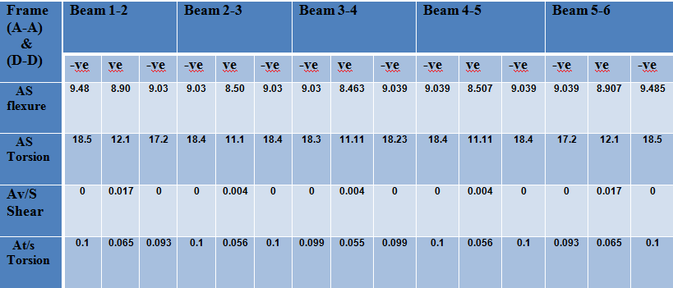
SAP results in Y-direction

Slide 36
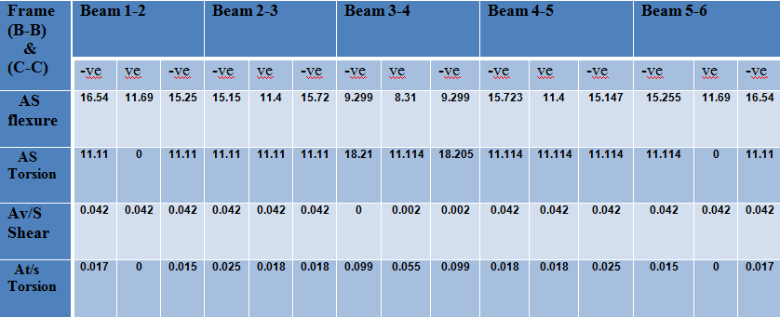

Slide 37
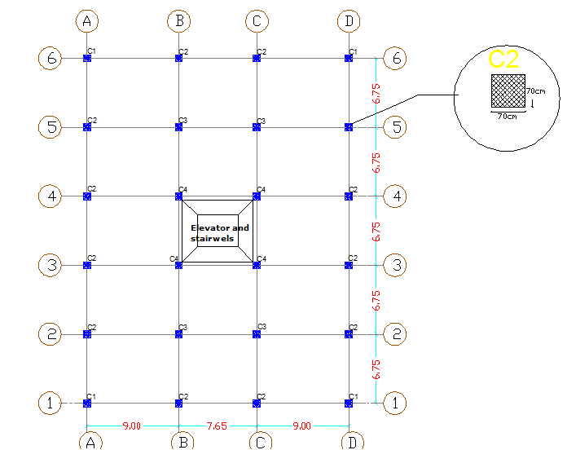
4.3-Design of columns :-

Slide 38
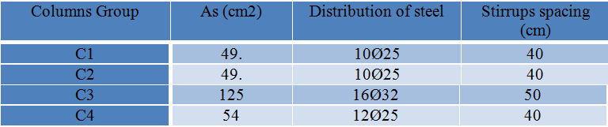
4.3.1- SAP results for one storey:-

Slide 39
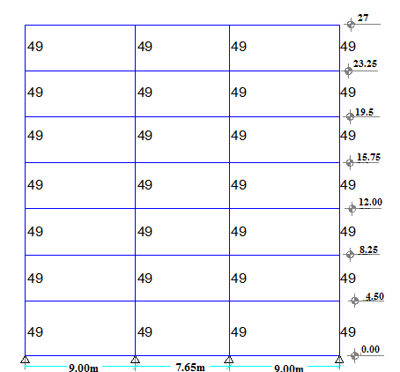
4.3.2- SAP results for seven storey:-
Frame 1-1&6-6 (cm²)

Slide 40
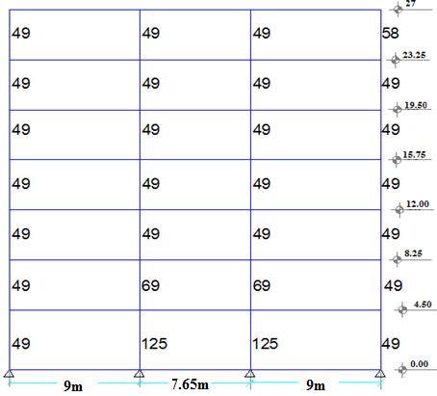
Frame 2-2&5-5(cm²)

Slide 41
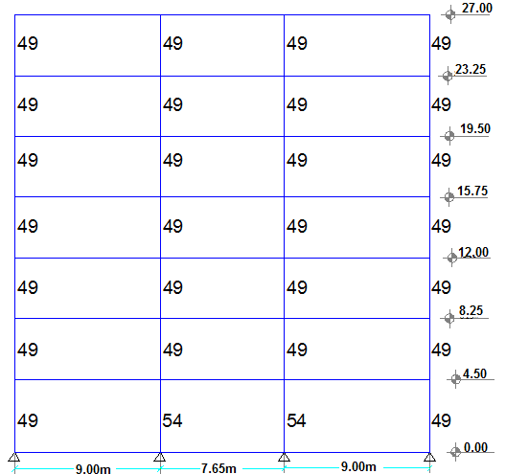
Frame 3-3&4-4 (cm²)

Slide 42
Summary:
From previous figures area of steel for all column in the building which names C₁ equal 49cm² except:-
In the first storey
C.B-2, C.B-5, C.C-2, C.C-5 → refers to C₃ = 125cm².
C.B-3, C.B-4, C.C-3, C.C4 → refers to C₂ = 54cm² .
In the second storey
C.B-2, C.B-5, C.C-2, C.C-5 → refers to C₅ = 69cm² use 14Ø25
In the last storey
C.D-2, C.D-5 → refers to C₆ = 58cm² use 12Ø25

Slide 43
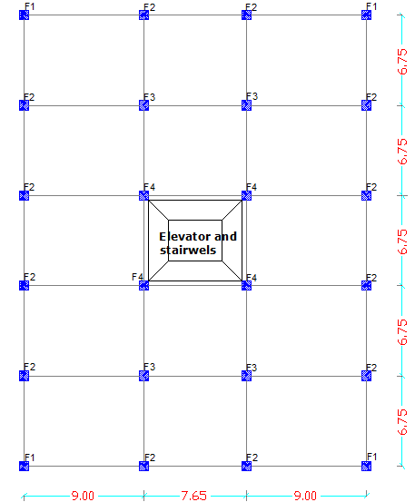
4.4-Design of footing :-

Slide 44
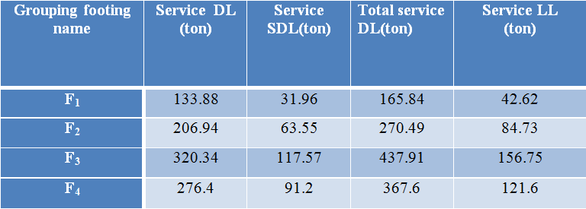
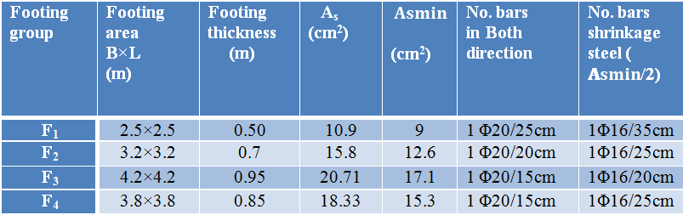
Service load on footing from SAP
summary footing dimension and flexural design:

Slide 45
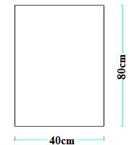
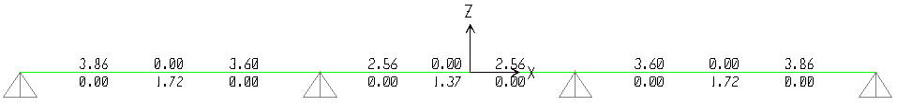
4.5-Design of tie beams :-
Dimension of tie beam : 40 * 80 cm
ρ _{min} = 0.0033
A_{s} = ρ * b * d = 0.0033* 40 * 74 = 9.8 cm²
Results from sap :

Slide 46
Chapter Five
Dynamic design
of
the building

Slide 47
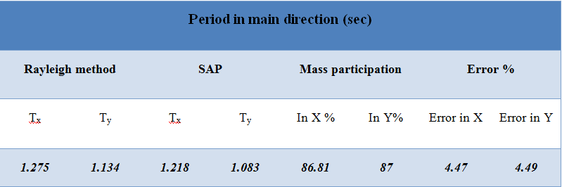
5.1- Dynamic analysis
5.1-A SAP and manual results

Slide 48
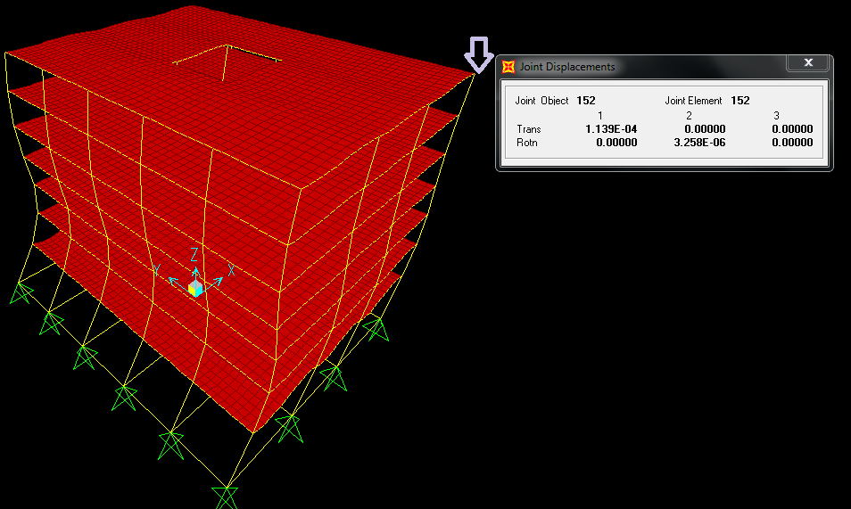
5.1-B sin earthquake subjected in the building (sin 0.002)

Slide 49
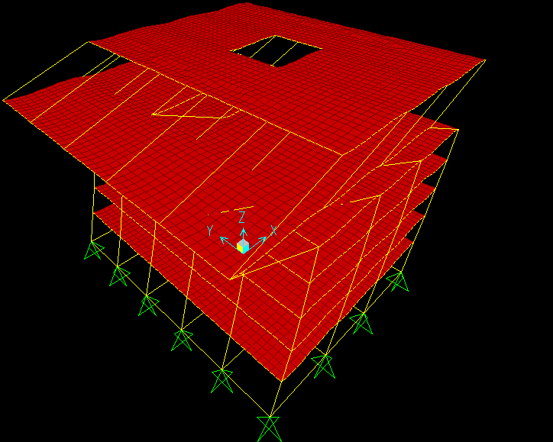
5.1-C El-Centro earthquake subjected in the building

Slide 50
5.2- Dynamic Design
5.2-A Response spectrum method:
Input data :
Ss: mapped spectral acceleration for short periods (0.5)
S₁: mapped spectral acceleration for 1.0 sec. periods (0.2)
site class ( C )
Important factor I=1.25 (refer to IBC2006)
Response modification coefficient R= 3 (refer to IBC2006)
Scale factor = g*I/R = 4.0875

Slide 51
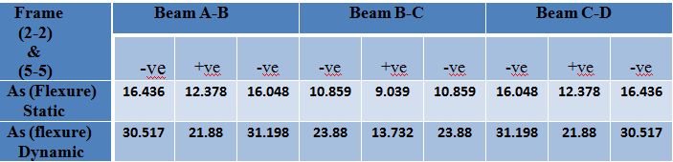
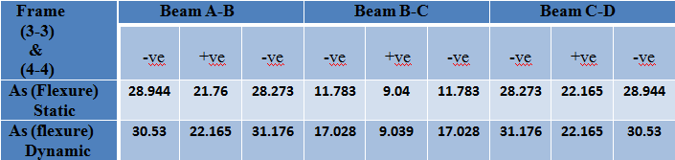
5.2- B Result of beams
5.2-B1 Result in X-direction:
The following table show the difference in area of steel from static design to dynamic design in X– direction :

Slide 52
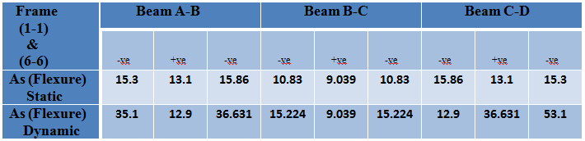
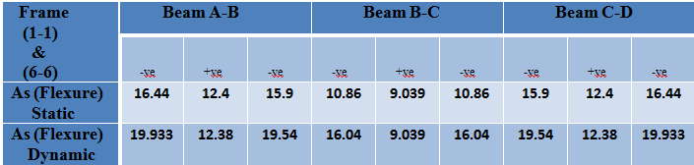
For the first three stories
For the last four stories :

Slide 53
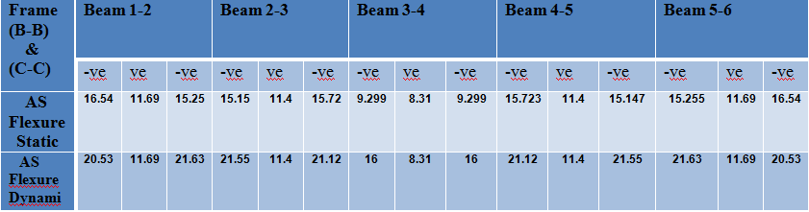
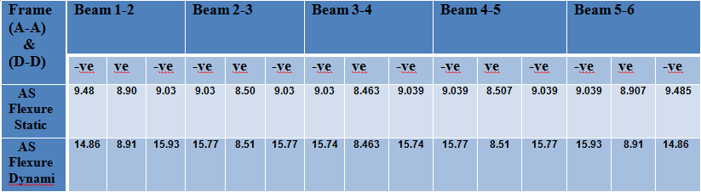
5.2-B2 Result in Y-direction:

Slide 54
Chapter Six
Soil-Structure Interaction

Slide 55
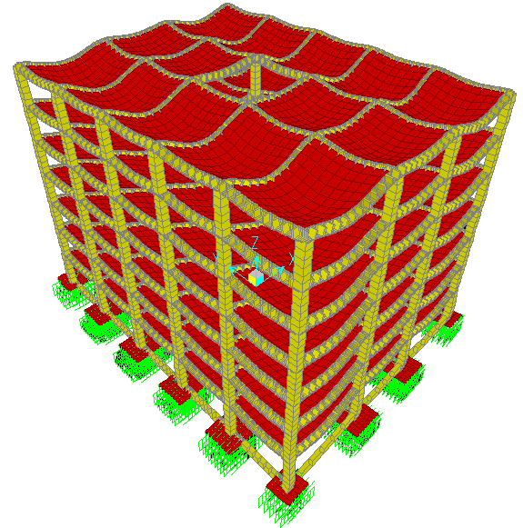

Slide 56
6-1 Applying soil cases
B.C (kg/cm²) | SOIL DESCRIPTION
13.1 | Hardpan overlaying rock
11.0 | Very compact sandy gravel
6.6 | Loose gravel and sandy gravel, compact sand and gravelly sand, very compact sand-inorganic silt soils
5.5 | Hard, dry, consolidated clay
4.4 | Loose coarse to medium sand, medium compact fine sand
3.3 | Compact sand clay
2.2 | Loose, fine sand, medium compact sand-inorganic silt soils
1.6 | Firm or stiff clay
1.1 | Loose, saturated sand-clay soils, medium soft clay

Slide 57
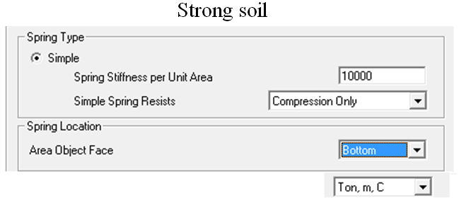
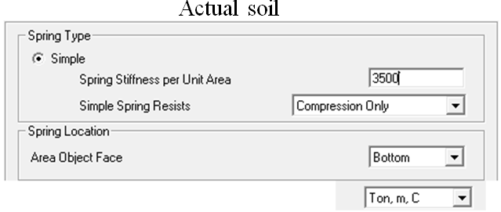
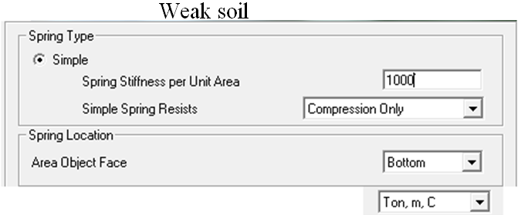

Slide 58
6-2 Comparison under static conditions:
The moment values in columns and the beams in strong soil case through actual soil case to weak soil case is decreasing, which appears in flexure steel, for example in first floor frame 2-2:
Fixation | Strong soil | Actual soil | Weak soil
Beam (A-B) exterior positive moment
27.33 cm² | 27.49 cm² | 27.44 cm² | 27.22 cm²
Column B-1
129.55 cm² | 131.01 cm² | 129.97 cm² | 127.87 cm²
This is due to decreasing in settlement differences
Except fixation case
 | Corner (cm) | Interior (cm) | Corner / Interior
Fixation case | 0.34 | 1.02 | 0.333
Strong soil case10kg | 0.53 | 0.64 | 0.83
Actual soil case3.5kg | 0.94 | 1.03 | 0.913
Weak soil case1.0kg | 2.49 | 2.54 | 0.98

Slide 59
6-3 Comparison under dynamic conditions:
The moment values in fixation case to strong soil case through actual soil case to weak soil case is decreasing, which appears in flexure steel, for example in first floor frame 2-2:
Fixation | Strong soil | Actual soil | Weak soil
Beam (A-B) exterior positive moment
31.63 cm² | 30.92 cm² | 30.9 cm² | 30.71 cm²
Column B-1
128.58 cm² | 126.34 cm² | 125.37 cm² | 123.3 cm²
Tie beam (B-A) exterior positive moment
9.91 cm² | 5.02 cm² | 6.37 cm² | 8.43 cm²
Except the tie beams

Slide 60
Settlement values & settlement ratios from earthquake response spectrum
 | Corner (cm) | Interior (cm) | Corner / Interior
Fixation case | 0.02 | 0.006 | 3.33
Strong soil case10kg | 0.065 | 0.011 | 5.91
Actual soil case3.5kg | 0.115 | 0.019 | 6.05
Weak soil case1.0kg | 0.294 | 0.054 | 5.4
Interior columns are tied from four sides
Corner columns are tied from two sides
So more tied less bending less settlement

Slide 61
Thank you
all
For listening

