Slide 1

An-Najah National University
Faculty of Engineering
Civil Engineering Department
Graduation Project
Prepared by :
1- Areej Melhem
2- Jawad Ateyani
3-Rasha Ghanem
4- Tareq Zeyad
Supervised by :
Dr. Abdul Razzaq Touqan

Slide 2
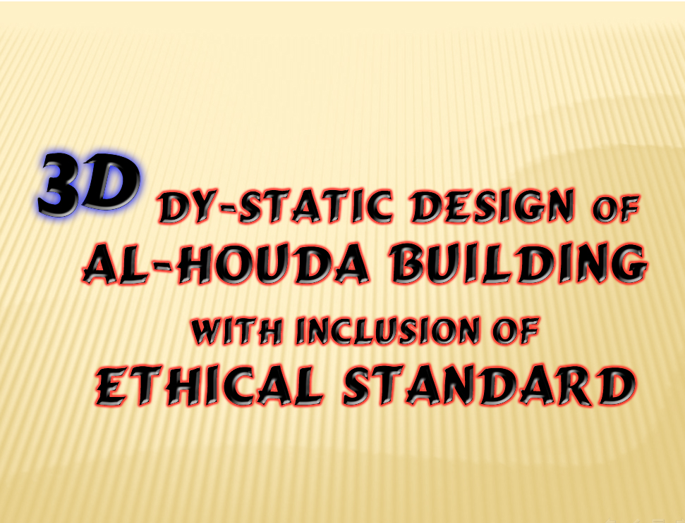

Slide 3
3D Dy- Static Design of Al- HOUDA Building with inclusion of Ethical standard
CHAPTER ONE : General Description
CHAPTER TWO : Preliminary Design
CHAPTER THREE : Structural Analysis Laws and
Verifications of Slabs and Beams
CHAPTER FOUR : Static Design
CHAPTER FIVE : Dynamic Design
CHAPTER SIX : Ethical Issues and Earthquake Risk
Reduction

Slide 4
Abstract
This project is a structural analysis and design of a residential building in Nablus
that will resist earthquake and consists of
a garage at the ground floor and other seven stories.

Slide 5
Introduction
Design codes :
The codes used in the project are:
1- The American Concrete Institute
(ACI) code 2008
2- The International Building Code (IBC-2009)

Slide 6
Materials
Introduction
Concrete:
Concrete strength for columns is B400→fc=32MPa.
Concrete strength for others is
B300→fc=24 MPa.
Steel:
Steel yield strength = f_{y} = 420 MPa.

Slide 7
Introduction
Loads:
S.I.D.L = 4.5 KN/m²
Live load = 2.5 KN/m²

Slide 8
Selection of the System :
Separate the structure into two parts with
asufficient gap.
The selected structural systems to be used in the project is One way ribbed slab with main beam in x _ axis, using hidden interior beams and drop exterior beams

Slide 9
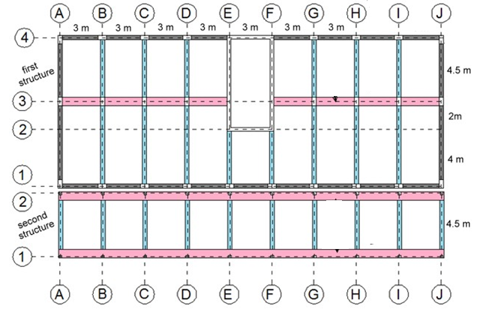
In Y directions :

Slide 10
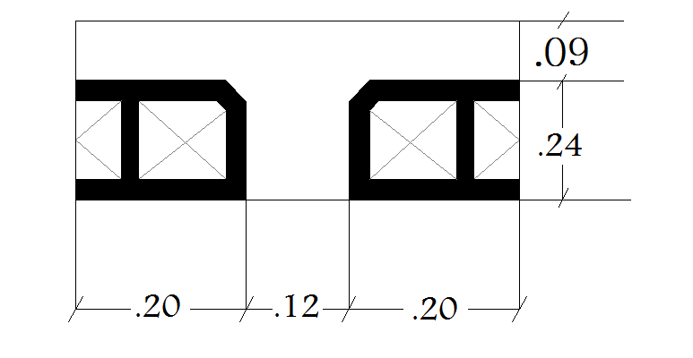
Selected dimensions :
beams: main beam 0.6*0.33
interior beam 0.3*0.33
perimeter beam 0.3*0.5
Slab :

Slide 11
Selected dimensions :
Columns :
For first structure : 0.3*0.6
For second structure : 0.2*0.2
Tie beams :
For first structure : 0.3*0.5
For second structure : 0.2*0.4

Slide 12
3D MODEL Verifications :
For one story :
1- Compatibility … Ok
2- equilibrium max. error 5% … Ok
(manual calculations match SAP results )
3- stress strain verification max. error 10%
for beams & slabs … Ok

Slide 13
STATIC DESIGN

Slide 14
Design of Footing :
1- Isolated footing (single )
2- Combined footing
3- Wall footing
Taking service and ultimate loads from SAP

Slide 15
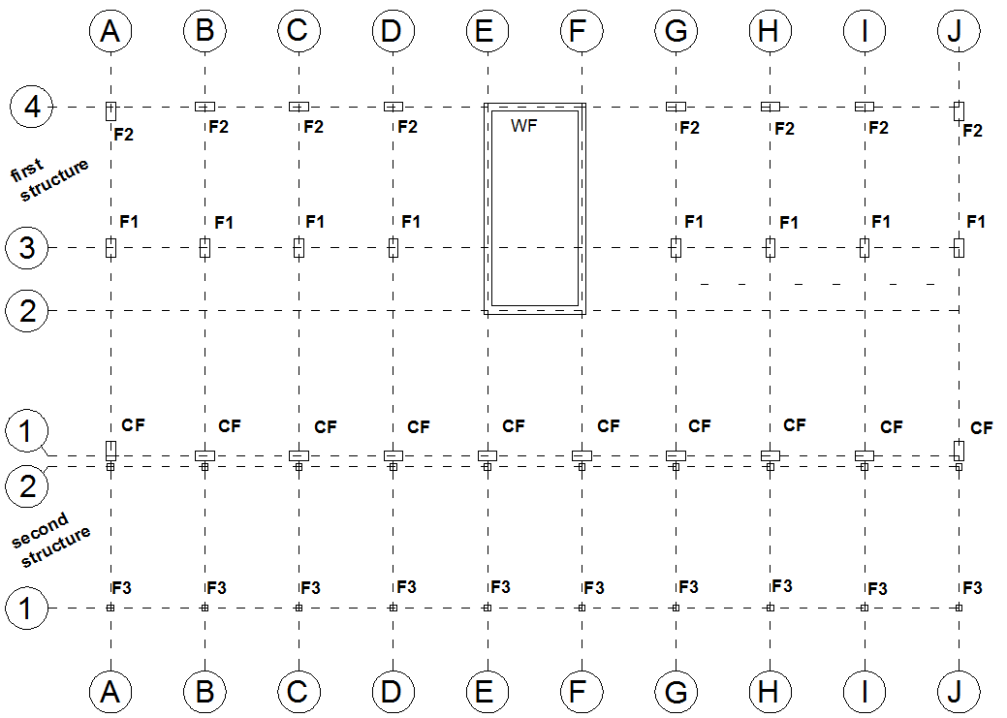

Slide 16
Design of Footing :
* Isolated (single ) & wall footing Design done by excel sheet
longitudinal steel (bottom steel)
group | L (m) | B (m) | H | for long side | for short side
F1 | 2.7 | 2.1 | 0.55 | 1 Ø 18 / 150 mm | 1 Ø 16 / 150 mm
F2 | 2.1 | 1.7 | 0.45 | 1 Ø 14 / 150mm | 1 Ø 14 / 150mm
F3 | 0.7 | 0.7 | 0.3 | 1 Ø 12 / 200mm | 1 Ø 12 / 200mm
shrinkage steel (top steel)
group | in both direction
F1 | 1 Ø 12 / 200 mm
F2 | 1 Ø 12 / 250 mm
F3 | 1 Ø 12 / 300 mm
 | Width (m) | H (m) | For short side (bottom ) | Shrinkage (top in both side) (bottom in long side )
Wall footing (WF) | 1.4 | 0.35 | 1 Ø 16 / 150 mm | 1 Ø 12 / 300 mm

Slide 17
Design of Footing
* Combined footing analysis done by SAP
for long direction : 1 ø 18 /90 mm (bottom)
for short direction : 1 ø 18 /90 mm (bottom)
1 ø 16 /200 mm (top)
Shrinkage steel : use 1 Ø 16 / 250 mm (top)

Slide 18
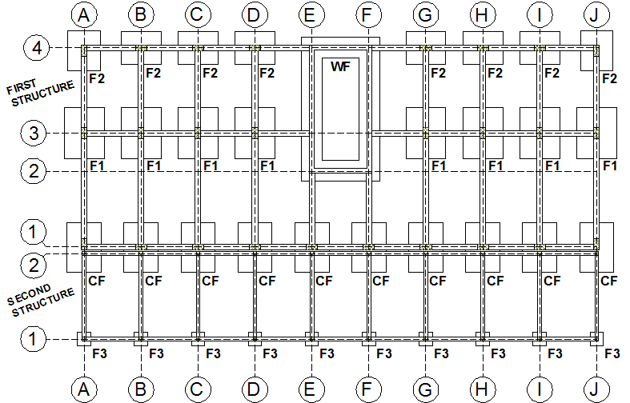
Plan view

Slide 19
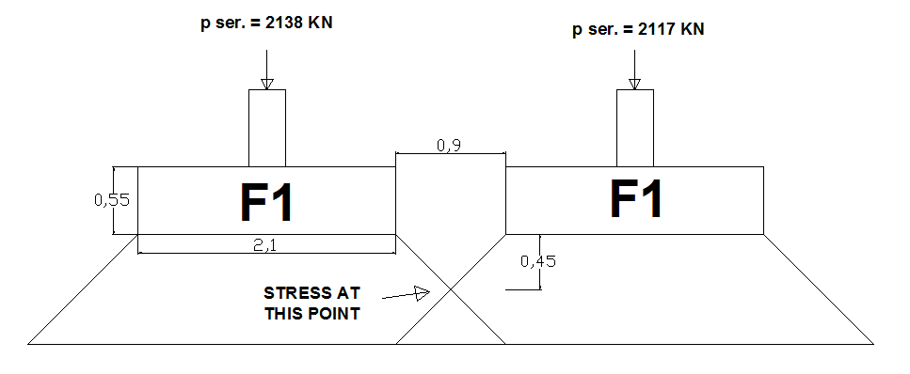
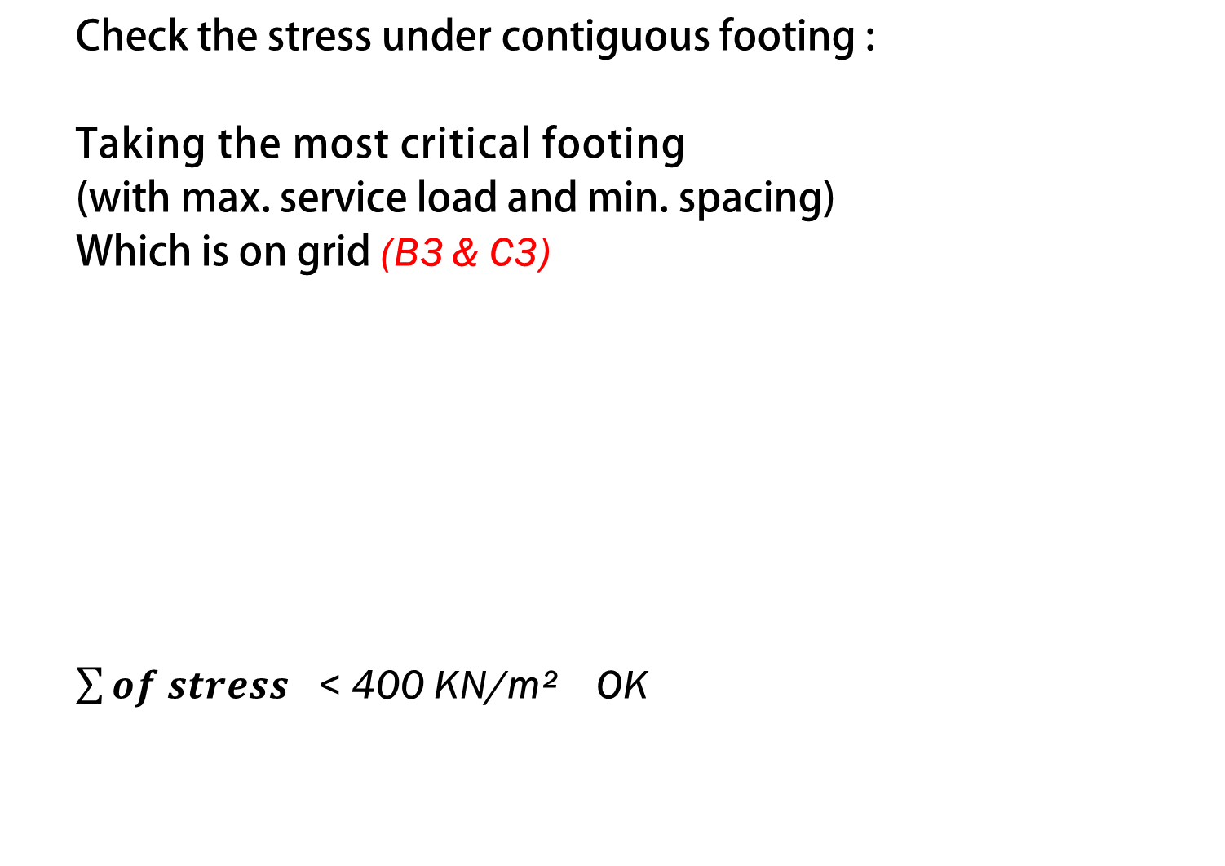
Design of Footing
Check the stress under contiguous footing :
Taking the most critical footing
(with max. service load and min. spacing)
Which is on grid (B3 & C3)
$\sum{of stress }$ < 400 KN/m² OK

Slide 20
Design of columns :
Columns are designed as short columns
And based on SAP results for first structure the max. area of steel required 1972 mm²
So use 8ø 18
for second structure the max. area of steel required 400 mm²
So use 4ø 16

Slide 21
Design of Beams:
Design for flexure , shear and torsion based on SAP result after verify it manually.
Take frame A-A in first structure as an example :

Slide 22
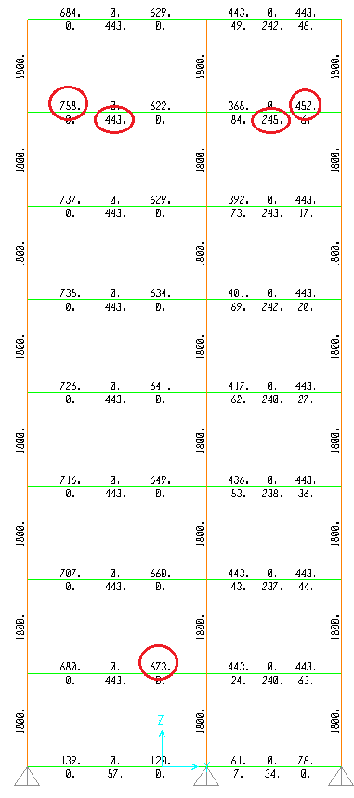
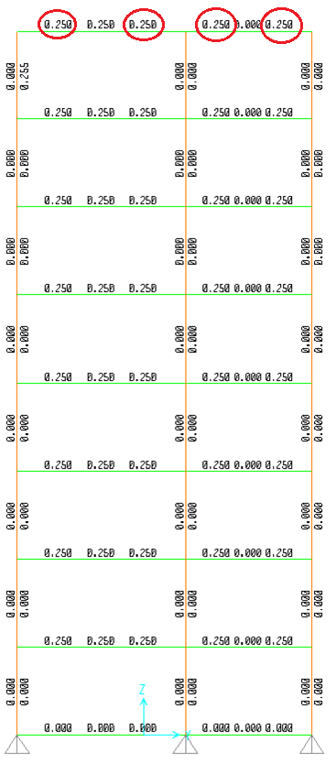
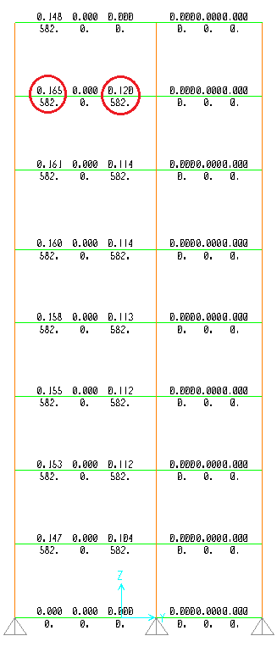
flexure
shear
torsion

Slide 23
Design of Beams:
right | middle | right /Left | middle | left
452 | 245 | 673 | 443 | 758 | flexure
0 | 0 | 582 | 0 | 582 | Torsion / long
0 | 0 | 0.12 | 0 | 0.165 | Torsion / trans.
0 | 0 | 0.25 | 0 | 0.25 | Shear
 | frame A-A /first structure
 | left | middle of span | right / left | middle of span | right / left
top | 4Ø18 | 2Ø18 | 4Ø18 | 2Ø18 | 2Ø18
middle | 2Ø12 | no need | 2Ø12 | no need | no need
bottom |  | 4Ø12 |  | 3Ø12
transverse |  | 1Ø10 / 250 |  | 1Ø10 / 300

Slide 24
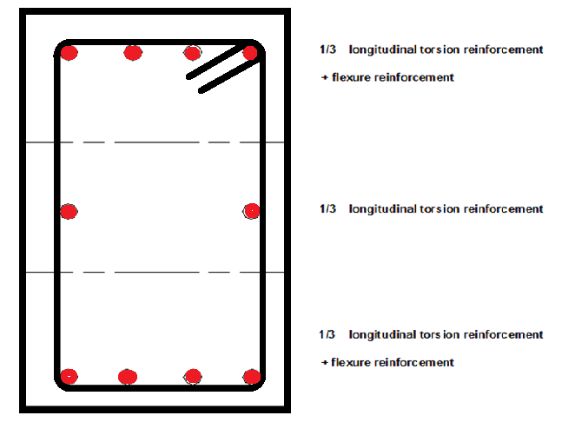
Design of Beams:

Slide 25
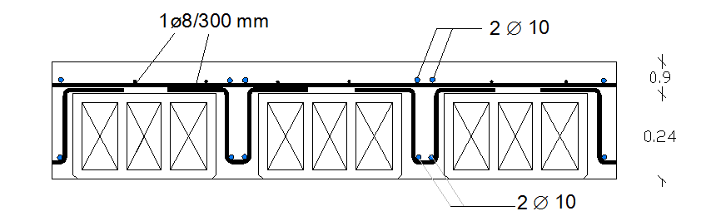
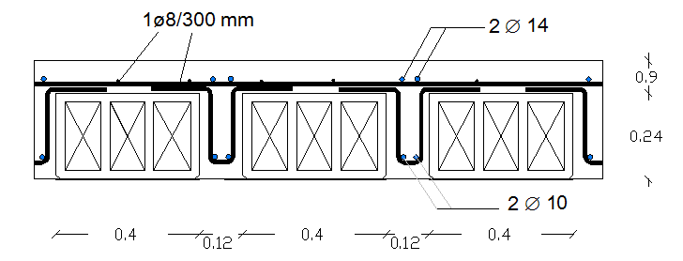
Design of slab :
Taking the maximum negative and positive moment in the stories and designing for it .
we get two cross section
In the middle of the span:
above the support:

Slide 26
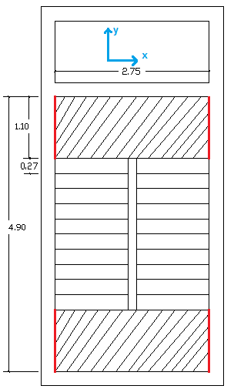
Design of Stair:
Analysis of stair based on SAP .
In x direction:
1 Ø 12 / 20 cm as top steel
In y direction :
Negative :
1 Ø 12 / 20 cm
Positive :
1 Ø 12 / 30 cm

Slide 27
DYNAMIC DESIGN

Slide 28
Dynamic Design
There are three methods to perform analysis and design of earthquake:
1-Time history.
2-Response spectrum.
3-Equivalent static.
In this project dynamic analysis and design will be done using the second method (response spectrum in x & y directions).

Slide 29

Dynamic Design
Before using SAP hand calculation should be done to verify SAP results with max errors 25 % :
Using this equation :
Where :
M : mass (ton)
K : stiffness (KN/m)

Slide 30
Period Calculations
For first structure :
Period in x : T = 0.087s
Period in x from SAP : T = 0.088s
Error = 1.14 % < 25 % which is acceptable.
With 89.1 % modal participation mass ratio
Period in Y : T = 0.028s
Period in Y from SAP : T = 0.088s
Error = 68.1 % < 25 % which is unacceptable.
With 73.8 % modal participation mass ratio

Slide 31
Period Calculations
For second structure :
Period in x : T = 0.98 s
Period in x from SAP : T = 0.62 s
Error = 36.1 % > 25 % which is unacceptable.
With 99.9 % modal participation mass ratio
Period in Y : T = 0.98 s
Period in Y from SAP : T = 0.66 s
Error = 31.1 % > 25 % which is unacceptable.
With 99.9 % modal participation mass ratio

Slide 32
Response Spectrum (IBC 2006) :
Input data :
I: seismic factor (importance factor) = 1
R: response modification factor
R = 4.5 // for first structure
R = 3 // for second structure
(PGA: peak ground acceleration = 0.25 g according to seismic map for Palestine (Nablus).
Soil type: B (Rock)
Ss: spectral curve at short period = 0.5
S1: spectral curve at 1second period = 0.2

Slide 33
Dynamic Design
design of beams :
comparing the value of moment on beams
( static & dynamic load combinations )
the results are :
for main beams (on frame 1-1/3-3/4-4) the critical combination is the dynamic.
and for secondary beams on frame (A-A/B-B/…/J-J) The critical is the static (the Difference in moments are small).

Slide 34
Dynamic Design
Design of columns :
Comparing axial force in dynamic and static
For first structure :
the critical combination is the static. the area of steel does not change expect one column (B3 / I3) use 8 Ø 20
For second structure :
the critical combination is the dynamic
use 4 Ø 20 instead of 4 Ø 16

Slide 35
Dynamic Design
Design of slab :
The static combination is critical , so the static design does not change.

Slide 36
Ethical Issues and Earthquake Risk Reduction
This search aim to show the relationship between ethics and earthquake.
Ethics
Earthquake

