Slide 1
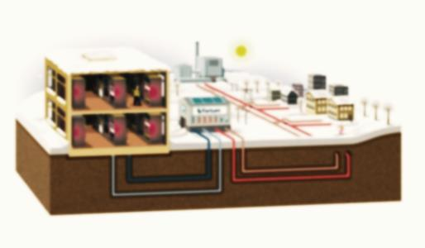
An-Najah National University
Faculty of Engineering
Mechanical Engineering Department
District Heating Network
Prepared by:
Mahmoud Salem
Mahmoud Ghanem
Basem Daghlas
Mohammad Daragmeh
Supervisor:
Eng. Luqman Hirzallah

Slide 2
Contents :
Introduction
System Components
Network design
Calculations
Conclusion

Slide 3
Introduction :
Definition
District Heating Network : is a system for distributing heat generated in a centralized location for residential and commercial for heating and production of domestic hot water.

Slide 4
Benefit of DH:
Organize the heat production
Reduce the risk and maintenance
Easy to use and control
Make cities more pleasant places

Slide 5
Components :
The System consist of
Boiler
Pipe Network isolated
Pumps
Heat Exchanger for each building
Valve and accessories

Slide 6
: Boiler
We select model Rex 450 for the center Boiler.
We select vertical centrifugal pump with 6 bar and capacity 20 l/s
: Pumps
: Pipes
We select stainless steel pipe with Insulation
u= 0.14-0.41 w/m.c

Slide 7
How Its Work

Slide 8
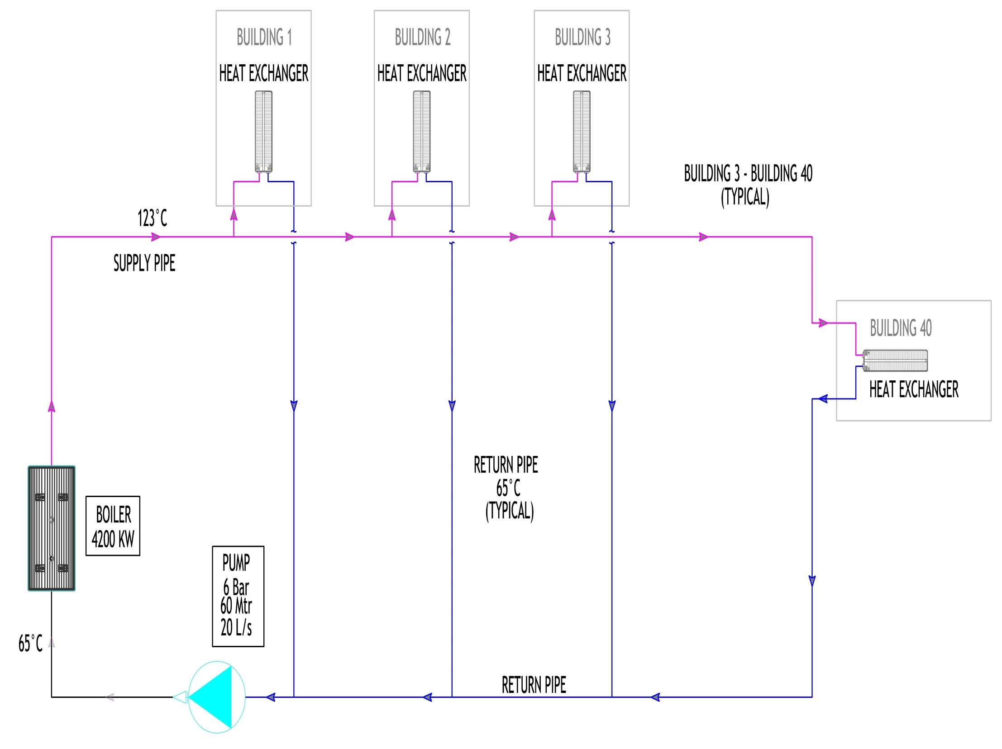

Slide 9
Literature Review in Palestine
This project will be the first in Palestine is not implemented yet in Palestine even though there is need for such a project.

Slide 10
Model :
Representation of reality
It is required to perform the calculation
In DH networks the following assumption :
One dimensional geometry
Junctions between components occurs in points

Slide 11
Network design
Topological representation
we use graph theory to determine nodes and branch's
Physical representation
we use fluid dynamic equations and thermal equation

Slide 12
Topological representation
A graph is a representation of a set of connected objects.
This representation is based on two concepts: the node and the branch
Nodes are used to describe a section at which two or more components are connected. the nodes of fluid network usually correspond to junctions
A branch is a line that is bounded by two nodes

Slide 13

Physical representation
Momentum equation and Continuity equation
$\left(P_{i}−P_{i−1}\right)= − {ΔP}_{FRICT}−{ΔP}_{LOCAL}−{ΔP}_{PUMP}$
${ A}^{T }.P$=$ΔP$
Energy equation

Slide 14
Incidence matrix
The interconnection between the nodes and branches is expresses by the incidence matrix

Slide 15
Calculations :
We have assumed heating load is 120(watt) per area and we have 38 building

Slide 16
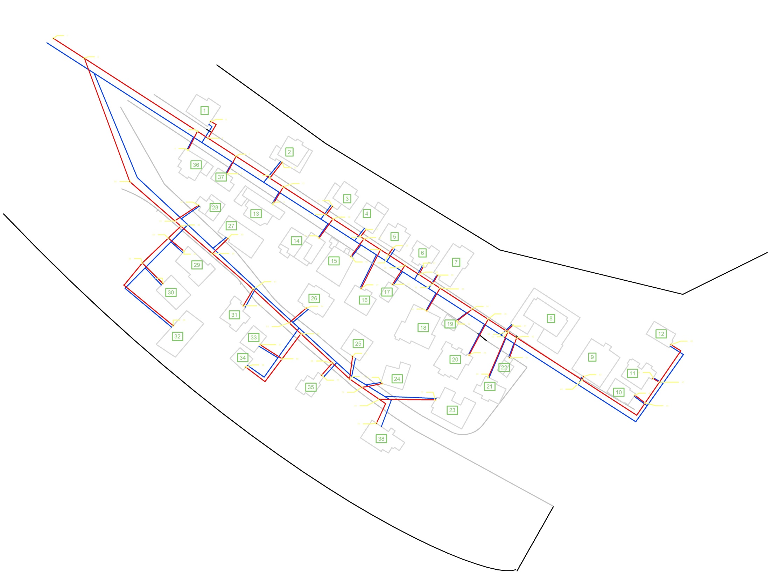

Slide 17
Pressure loss

Slide 18
Mass flow rate

Slide 19
Temperature

Slide 20
Compressed fluid check
From compressed thermodynamics table flow the pressure found 5 bar at 120°C ,so using a pump greater than 5 bar to take over friction to be fluid compressed liquid .

Slide 21
Pump Cavitation check
By net positive suction head(NPSH )
NPSH = 48.5 >${Npsh}_{min}$
➔Will not occur cavitation to the pump

Slide 22
Comparison between traditional and central district heating systems

Slide 23
Propane and Electricity
Price of KWH produced by Propane$→$0.7 NIS
Price of KWH produced by E$lectricity→$.58 NIS

Slide 24
Conclusion:
This system in our country is not feasible due to the high cost of oil derivatives.
This system can be applied in our country through the waste to energy furnace or utilize gas located on Gaza Strip.

Slide 25
Before the end we have small videos for DSH

